Slide 1

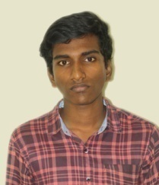




YOGESH D (VH12895)
1 Year/ 1 Sem
B.E. Computer Science and Engineering
Register No. | :
Father’s Name | : | Mr.K. DHAKSHINA MOORTHY
Mother’s Name | : | Mrs. D.INDIRA
Branch | : | B.E. Computer Science Engineering
Batch | : | 2023-2027
Student Mobile No. | : | 8667221703
Students email id | : | dyogesh.official@gmail.com
Parent Mobile No. | : | 7845847305
Mentor Details | : | Dr. G. SURESH, 9443958871
Mentor email id | : | g.suresh@velhightech.com
HoD Details | : | Mr. Pradeep Katta, 9940227242
Department email id | : | firstyearhod@velhightech.com
Dean/S&H | : | Dr. Nagasankar P, 9840699762
Email: | : | deanfirstyear@velhightech.com
WhatsApp Group link | :
CGPA | : | NA
No. of Arrears (if any) | : | NA
Date:

