Slide 1
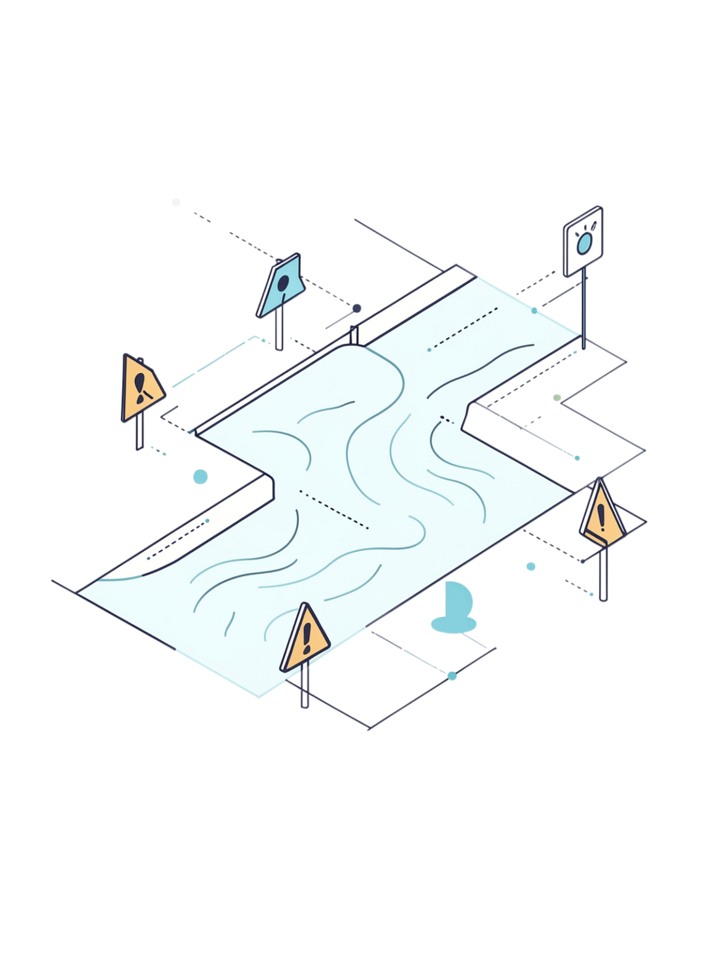
IoT-Based Flood Detection and Early Warning System
Using Real-Time Water Level Monitoring Sensors
A continuous IoT-based solution for flood monitoring, early warning, and disaster preparedness — monitoring environmental conditions through a centralized platform to protect lives, property, and infrastructure.
DODDI YOGESH SAI TEJA
323129520048

Slide 2
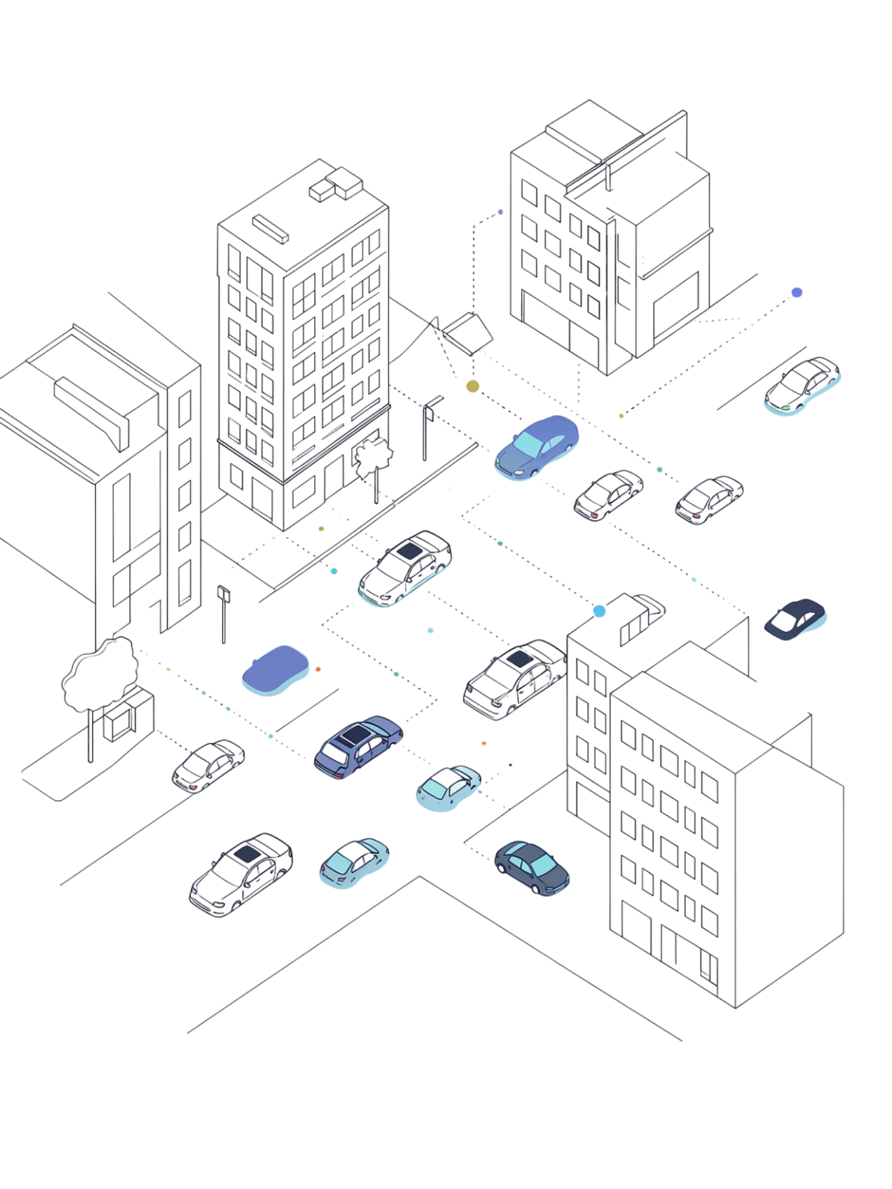
Problem Statement
The Threat of Floods
Limitations of Traditional Methods
Floods are among the most devastating natural disasters, causing significant damage to human lives, property, and critical infrastructure.
Rely on manual observations and periodic measurements
Introduce delays in emergency response and evacuation
Lack continuous, real-time situational awareness
What Is Needed
Government agencies and disaster management authorities require intelligent systems that continuously monitor water levels and provide early warnings before dangerous flooding conditions occur.

Slide 3
Proposed Solution
An IoT-Based Flood Detection and Early Warning System that continuously monitors environmental conditions and automatically alerts authorities and residents when safety thresholds are exceeded.
Continuous Sensing
IoT & Cloud Connectivity
Monitors river and reservoir water levels alongside rainfall conditions in real time.
Transmits environmental data through IoT communication modules to a centralized cloud platform.
Real-Time Analysis
Automated Alerts
Analyzes incoming data to identify potentially dangerous conditions as they develop.
Generates warning notifications and sends alerts to authorities and nearby residents when thresholds are exceeded.

Slide 4
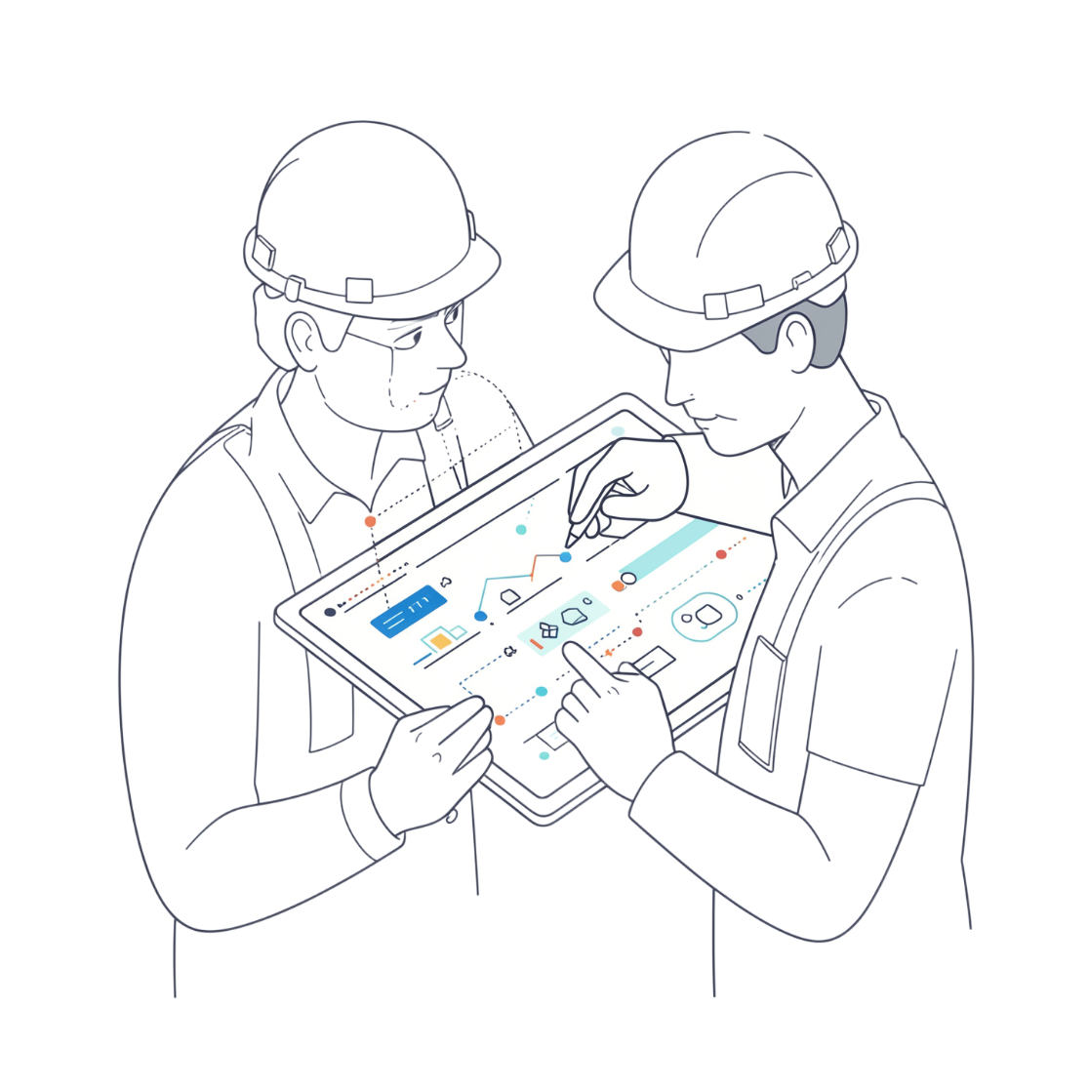
Objectives
Monitoring Goals
Continuously monitor river and reservoir water levels
Monitor rainfall conditions in real time
Detect increasing water levels and identify threshold breaches
Warning & Response Goals
Generate automated early warning notifications
Provide alerts to authorities and nearby residents
Support timely disaster preparedness and emergency response
Safety & Management Goals
Enhance public safety and reduce flood-related disaster risks
Support effective emergency management

Slide 5
Sensors and System Components
Seven integrated components work together to deliver continuous flood monitoring and early warning.
Water Level Sensors
Rainfall Sensors
IoT Communication Modules
Continuously measure water levels in rivers and reservoirs.
Monitor rainfall conditions to provide additional environmental context.
Transmit sensor data to the centralized monitoring platform.
Cloud Connectivity
Real-Time Analytics
Monitoring Platform
Enables centralized, remote access to all environmental monitoring data.
Processes water-level and rainfall information to detect dangerous conditions.
Centralized, secure, and user-friendly interface for continuous environmental oversight.
Automated Alert System
Generates warning notifications when predefined safety thresholds are exceeded.

Slide 6
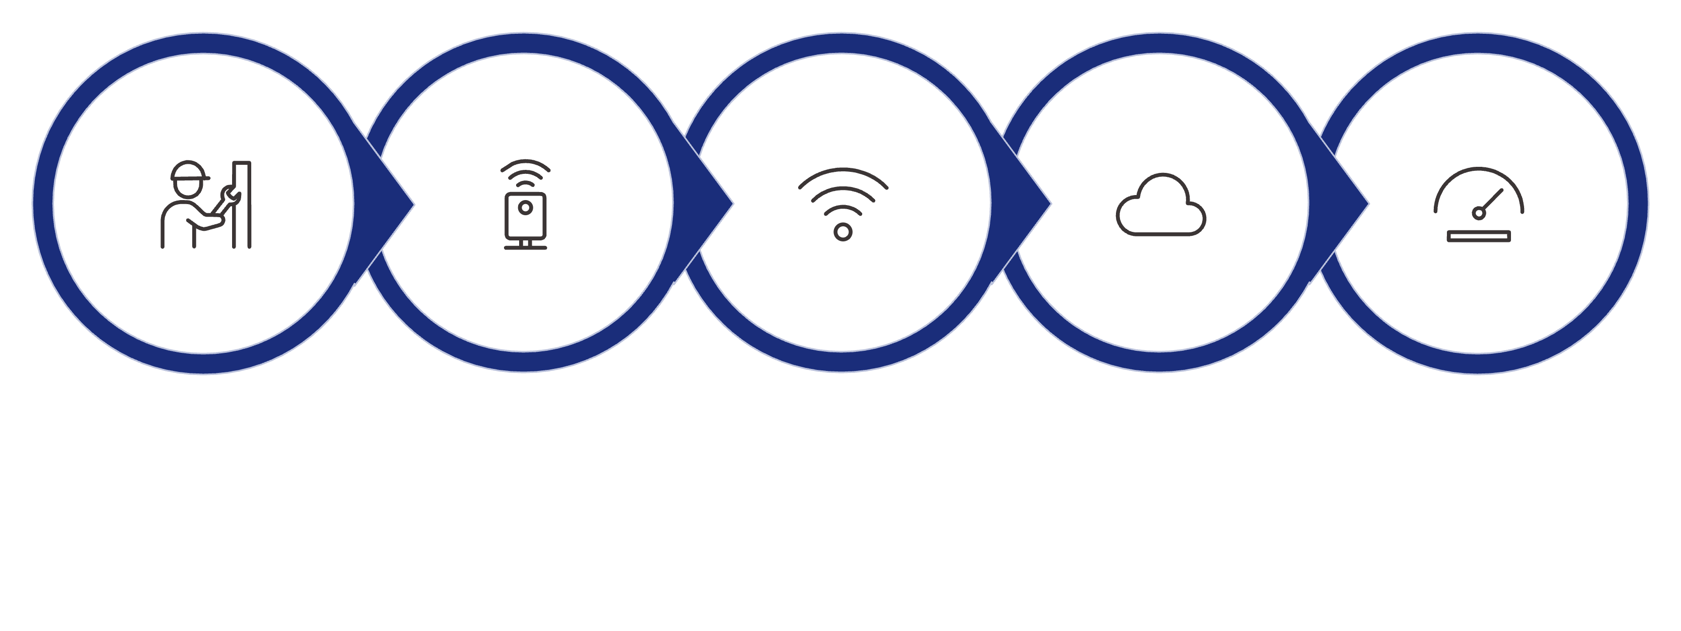
System Working Process
The end-to-end workflow from sensor installation to alert delivery follows a precise, ordered sequence.
Install Sensors
Continuous Sensing
Transmit Data
Cloud Analysis
Threshold Check
Each step in this pipeline is automated — from continuous sensing through cloud transmission, real-time analysis, threshold comparison, and instant alert delivery — ensuring no manual intervention is required for early warning generation.

Slide 7
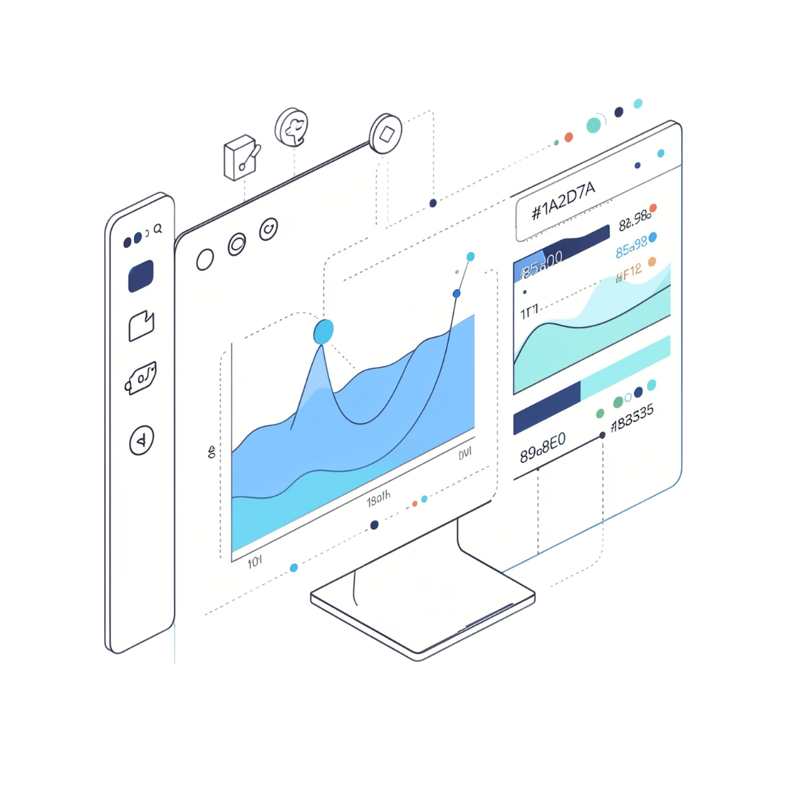
Real-Time Monitoring Dashboard
Information Displayed
Live water levels and rainfall statistics
Historical water-level and rainfall trends
Alert history and current sensor status
Current environmental monitoring information
How It Helps Authorities
Monitor water conditions continuously
Identify changes in water levels as they occur
Review historical trends for informed decision-making
Track warning notifications and sensor health
Support timely disaster preparedness and emergency response

Slide 8
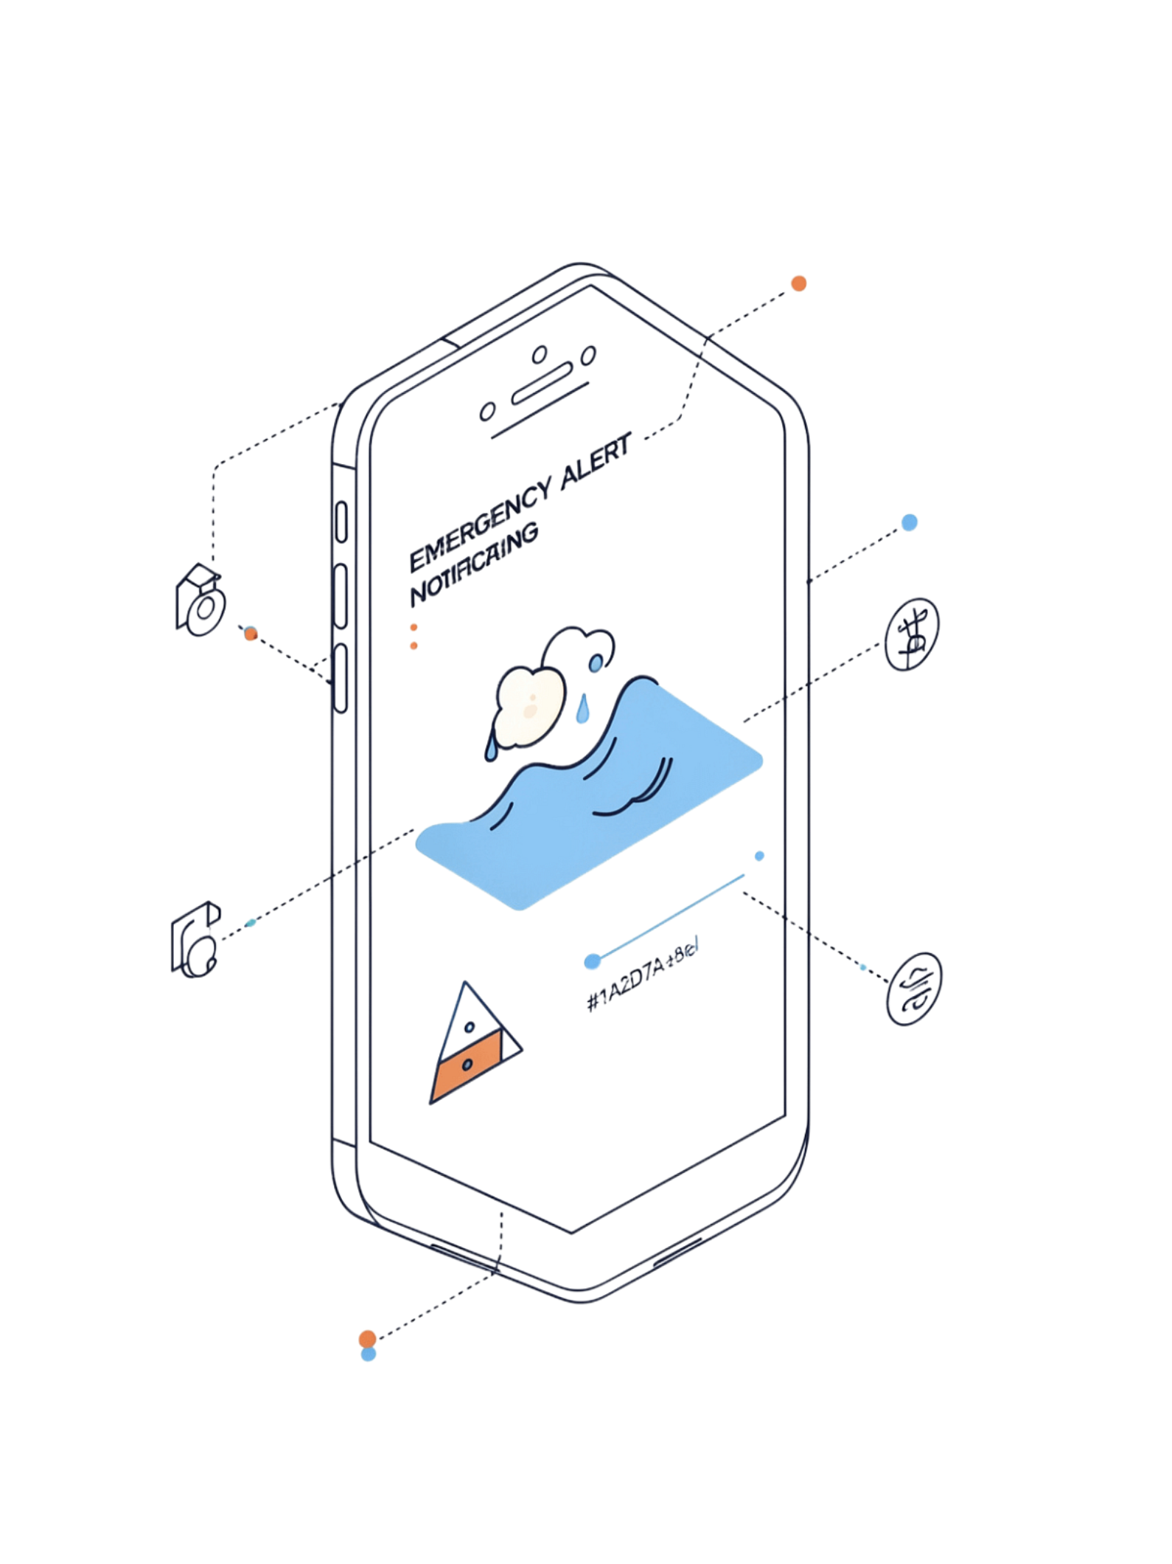
Early Warning and Alerts
Warning Mechanism
Key Benefits
Continuously monitor water levels against predefined safety thresholds
Identify potentially dangerous water-level conditions automatically
Generate automated warning notifications when thresholds are exceeded
Send alerts to authorities and nearby residents immediately
Enable faster awareness of potential flooding
Improved Early Warning
Faster detection of dangerous conditions before flooding occurs.
Enhanced Public Safety
Timely alerts help residents and authorities act before disaster strikes.
Reduced Disaster Risk
Continuous monitoring and faster response minimize flood-related losses.
Better Emergency Management
Supports coordinated, data-driven disaster management operations.

Slide 9
Applications and Scope
Who Can Use This System
System Scope
The system supports continuous monitoring of water levels and rainfall conditions across different flood-prone environments.
System Characteristics
Disaster Management Agencies
Municipalities
Secure — protected data transmission and access control
Scalable — deployable across multiple sites and sensor networks
Centralized — unified environmental monitoring platform
Real-Time — supports live disaster preparedness decisions
Effective — designed to support emergency management operations
Rural Communities
Dams & Reservoirs
Smart City Infrastructure

Slide 10
Conclusion
The IoT-Based Flood Detection and Early Warning System delivers a modern, automated approach to flood monitoring and disaster preparedness.
01
02
Continuous Sensing
Cloud-Connected Analytics
Water level and rainfall sensors continuously monitor rivers, reservoirs, and environmental conditions.
IoT modules and cloud connectivity enable centralized real-time monitoring and threshold analysis.
03
04
Automated Early Warning
Interactive Dashboard
Automated notifications alert authorities and residents when safety thresholds are exceeded.
Displays live water levels, rainfall statistics, historical trends, alert history, and sensor status.
"Real-time IoT-based flood monitoring and early warnings enable faster preparedness, improved public safety, and more effective emergency response."

