Slide 1


TripSync
Collaborative Travel Planner & Trust Platform
Presented By: Yogesh
Roll No: 2402009325
Course: BCA
Institution: Chandigarh School of Business
Summer Training: Web Technology (15 June 2026 – 10 July 2026)
Trainer: Mehak Thakur
Notes:
1

Slide 2
The Problem with Group Travel Planning
Before TripSync
After TripSync
💬 Scattered communication across chats, calls, and reminders
📅 Disconnected planning across bookings, budgets, and itineraries
⚠️ Too much friction when updates keep shifting and decisions get lost
✅ Centralized planning in one shared workspace
🤝 Seamless real-time coordination for everyone
🔒 Trusted and secure with built-in verification
Notes:
2

Slide 3











Our Mission & Audience
Objectives
Target Users
Simplify collaborative travel planning
Friends
Improve financial transparency
Families
Build trust among travelers
Backpackers
Organize itineraries efficiently
Digital Nomads
Reduce planning confusion
Corporate Teams
Student Groups
Notes:
3

Slide 4




Technical Architecture
User
Frontend
Backend
Database
Web and mobile interfaces.
HTML5, CSS3, JavaScript UI.
Node.js + Express.js API with JWT.
SQLite stores data securely.
Notes:
4

Slide 5











Tech Stack
Frontend
Backend & Database
Tools & Security
HTML5
Node.js
Chart.js
CSS3
Express.js
JWT
JavaScript (ES6)
SQLite
Bcrypt
Phoenix IDE
Git & GitHub
Notes:
5

Slide 6












Key Features
Secure Login & Registration
User Profiles
Trust Verification
Create Trips
Join Trips via Invite Code
Shared Dashboard
Collaborative Itinerary
Task Management
Expense Tracker
Splitwise-style Expense Split
Multi Currency Support
Team Collaboration
Notes:
6

Slide 7






User Journey
Register / Login
Create Trip
Invite Members
Sign in securely.
Start a new trip.
Add trip participants.
Plan Itinerary
Track Expenses
Complete Trip
Organize activities together.
Log and split costs.
Wrap up and review.
Notes:
7

Slide 8

Teamwork Makes the Dream Work
Invite Code System
Team Synchronization
Share unique codes to add members instantly
Real-time updates across all devices
Shared Dashboard
Collaborative Itinerary
Central hub for all trip information
Plan together, stay aligned
Shared Task Checklist
Real-Time Trip Organization
Assign and track responsibilities
Instant notifications and updates
Notes:
8

Slide 9
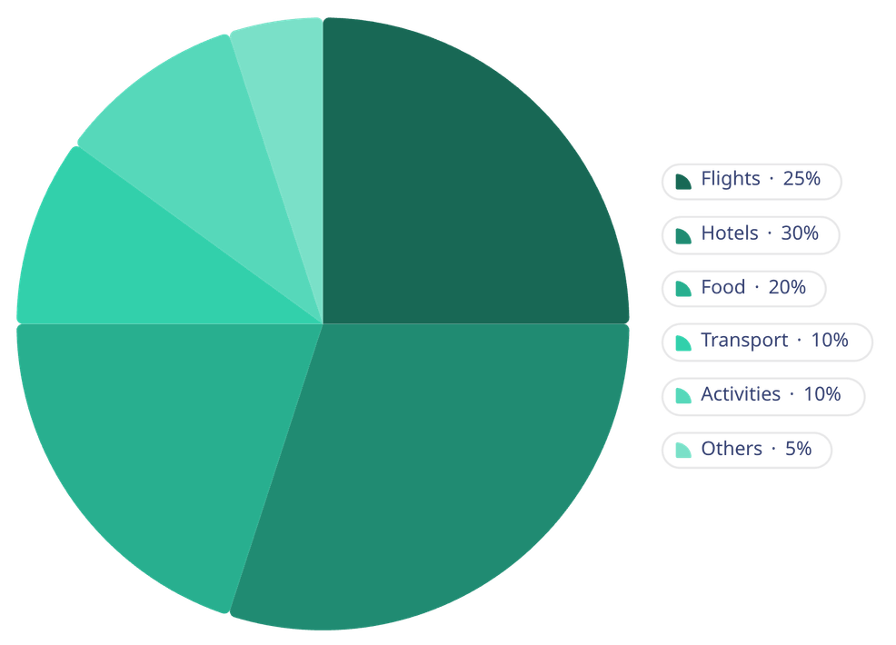





Smart Expense Management
Expense Categories
Key Features
Expense logging: Easy entry of all costs
Automatic equal split: Fair distribution among travelers
Team finance dashboard: Visual overview of group spending
Debt calculation: Clearly identifies who owes whom
Budget tracking: Helps stay within planned spending limits
Notes:
9

Slide 10






Global Currency Support
Travel the world without currency confusion. Instantly switch currencies throughout the application.
INR (Indian Rupee)
USD (US Dollar)
EUR (Euro)
GBP (British Pound)
JPY (Japanese Yen)
All budgets, expenses, statistics, and financial summaries automatically update when you switch currencies.
Notes:
10

Slide 11
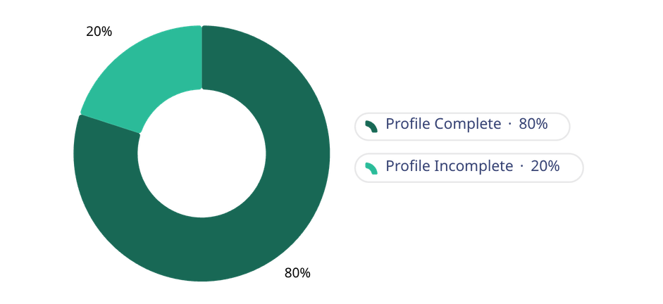
Building Trust in Travel Communities
Profile Information Collected
Trust Score Calculation
Age
Phone
Residence
Emergency Contact
Notes:
11

Slide 12


Security & Privacy First
Security Features
Privacy Protection
Only essential data is collected and protected in transit.
Password hashing using Bcrypt
JWT Authentication
Protected REST APIs
Secure Authorization
Notes:
12

Slide 13

Database Architecture
Trip Resources
Tasks, expenses, itinerary
Trip Members
Joins users to trips
Trips
Trip master records
User Profiles
Profile details linked to users
Users
Account records and credentials
Notes:
13

Slide 14
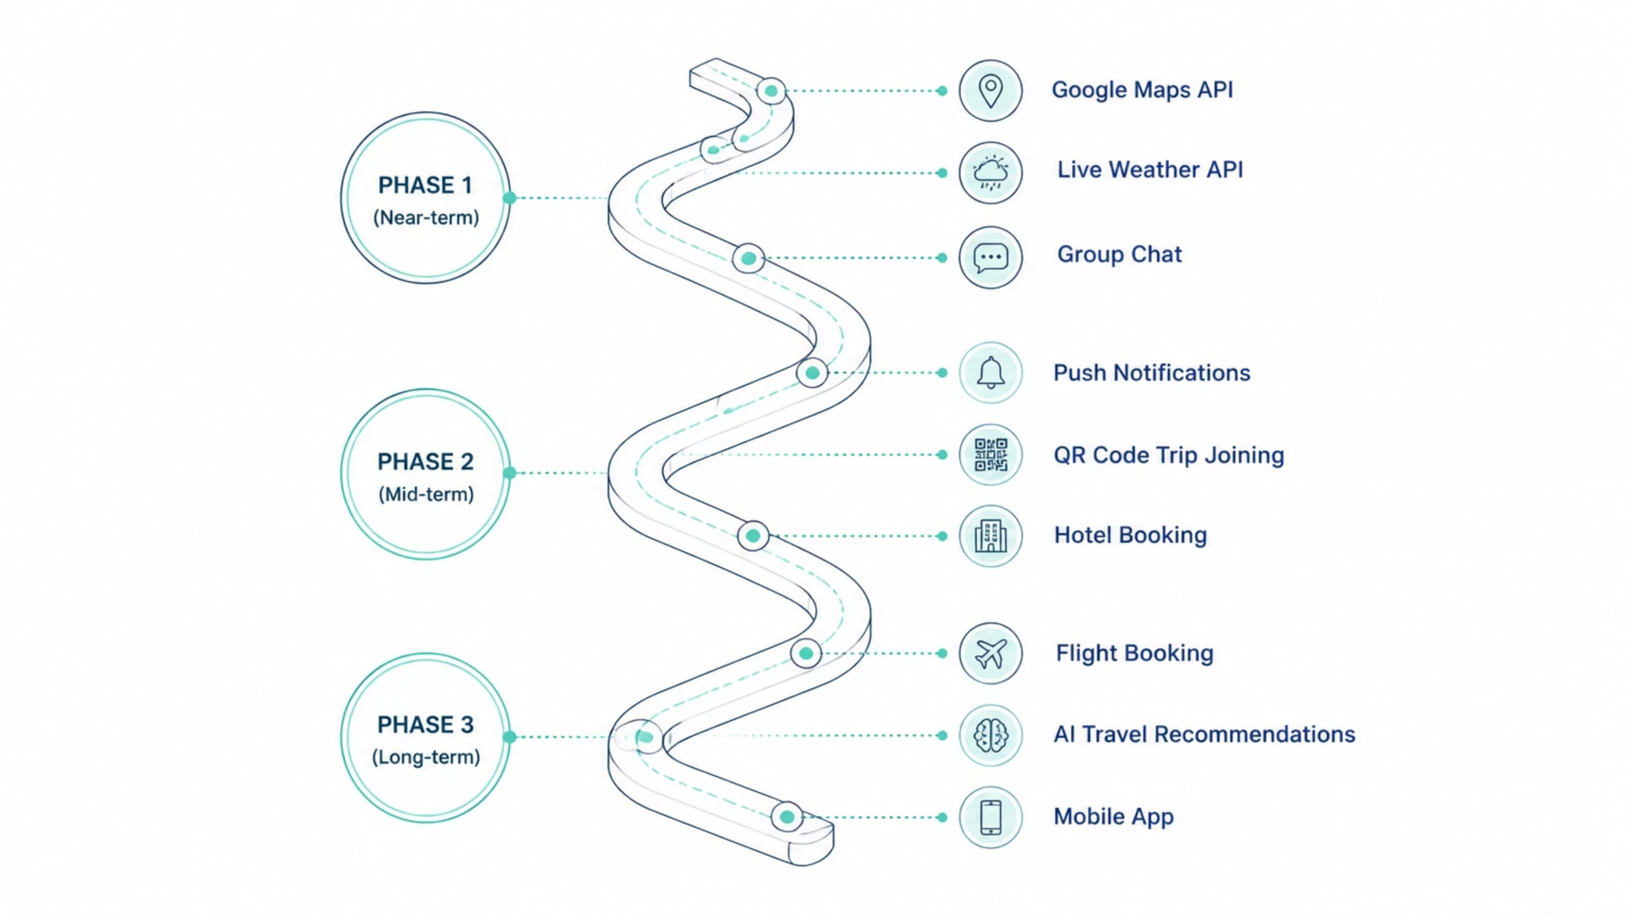
Roadmap & Future Vision
Notes:
14

Slide 15
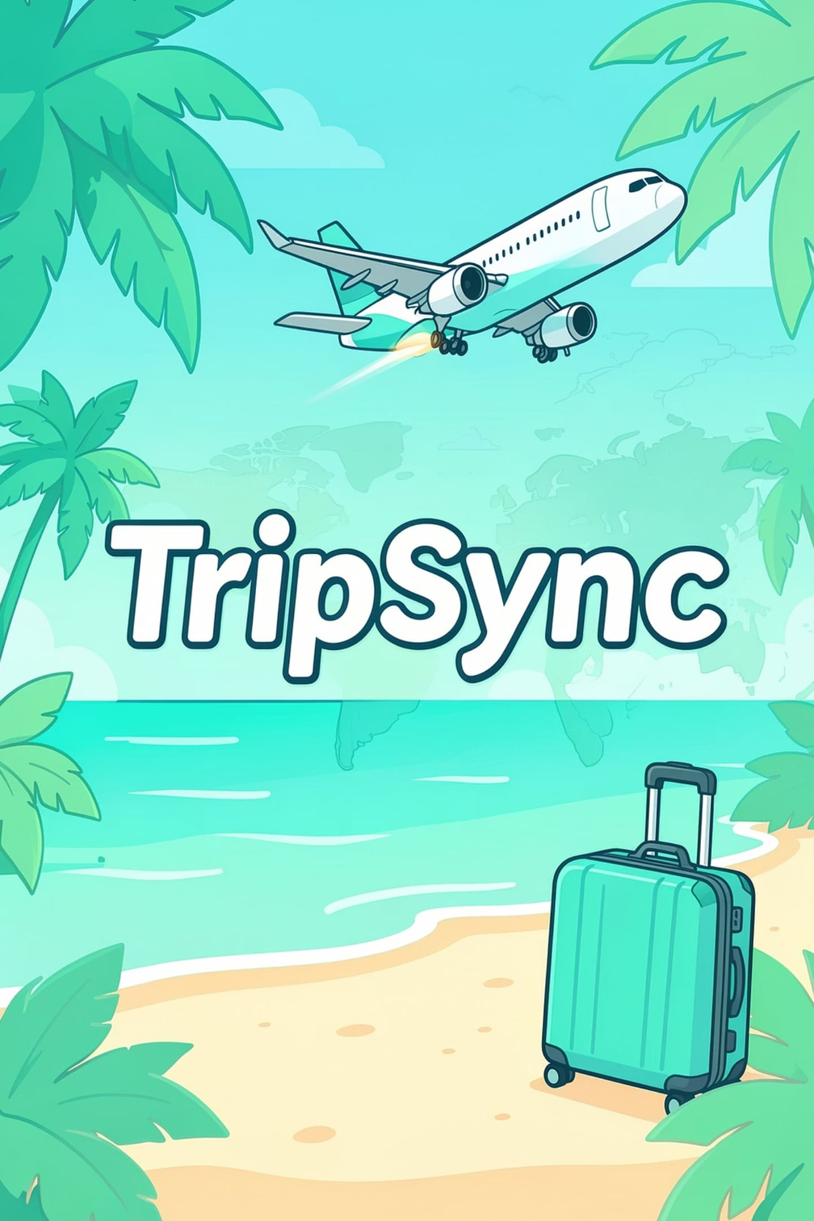
Thank You
TripSync is a modern collaborative travel planning platform that combines trip organization, budgeting, task management, traveler verification, and secure collaboration into one user-friendly application.
Questions?
Notes:
15

