Slide 1
A quick introduction to Unit Testing with JUnit
Cleveland Java Sig
March 13, 2002
DSteinberg@core.com

Slide 2
Extreme Programming
The other XP
The Planning Game
Small Releases
Metaphor
Simple Design
Testing
Refactoring
Pair Programming
Collective Ownership
Continuous Integration
40-Hour week
On-Site Customer
Coding Standards

Slide 3
In XP how you get started
Start with a User Story
Break the User Story into tasks
Estimate and sign up for tasks
Find someone to pair with you on a task

Slide 4
The process of Testing First
pick a small goal within the task
think of how you'll accomplish this goal
write the code that will test this goal (several of these may be needed -- write just one)

Slide 5
Example -- Conway's Life
Assume...
There is infrastructure to run the testing framework.
A suite of some sort will keep track of all of the classes containing tests that need to be run.
Each of these classes will extend TestCase and will use reflection to run any method named textXXX()

Slide 6
Example -- Conway's Life
Start by writing the test code first...

Slide 7
Example -- Conway's Life
public void testNewCellIsDead(){
Cell cell = new Cell();
assertTrue(!cell.isAlive());
}

Slide 8
Example -- Conway's Life
public void testNewCellIsDead(){
Cell cell = new Cell();
assertTrue(!cell.isAlive());
}
This won't even compile

Slide 9
Next task in Testing first
Get the test code to compile. We need
  Cell class with a
  Cell() no argument constructor and a
  isAlive() method that returns a boolean
Note how much we know about the code we need just from the test we've written
In XP we do the simplest thing that could possibly work

Slide 10
Cell class
public class Cell {
protected boolean isAlive(){
return true;
}
}

Slide 11
Test compiles but fails
Compile the code (minor success)
Run the tests
The test fails -- in fact it's often a good idea to make sure that your test fails before it passes so that you know it's actually being called
simplest thing might be just to change return to false

Slide 12
Temporary success
Tests pass

Slide 13
Another test
public void testLiveCellIsAlive(){
Cell cell = new Cell();
cell.setAlive(true);
assertTrue(cell.isAlive());
}

Slide 14
Need to:
add the setAlive() method to Cell so code compiles
fix isAlive() method so that both tests pass
let's assume you can do this

Slide 15
Clean up test code a little
public void testNewCellIsDead(){
Cell cell = new Cell();
assertTrue(!cell.isAlive());
}
public void testLiveCellIsAlive(){
Cell cell = new Cell();
cell.setAlive(true);
assertTrue(cell.isAlive());
}

Slide 16
Result
import junit.framework.TestCase;
public class TestCell extends TestCase{
Cell cell;
//more...

Slide 17
Result (cont.)
public TestCell(String name){
super(name);
}
protected void setUp() {
cell = new Cell();
}
//more...

Slide 18
Result
public void testNewCellIsDead(){
assertTrue(!cell.isAlive());
}
public void testLiveCellIsAlive(){
cell.setAlive(true);
assertTrue(cell.isAlive());
}
}

Slide 19
The Test Suite
import junit.framework.Test;
import junit.framework.TestSuite;
public class AllTests {
public static void main
(String[] args) {
junit.textui.TestRunner.
run (suite());
}
//more...

Slide 20
The Test Suite (cont.)
public static Test suite ( ) {
TestSuite suite= new TestSuite("All JUnit Tests");
suite.addTest( new TestSuite( life.model.TestCell.class ) );
return suite;
}
}

Slide 21
Running the suite
Want tests automated so you can run them all the time
Can use from ANT and other tools also
Can just run AllTests (it has a main())

Slide 22
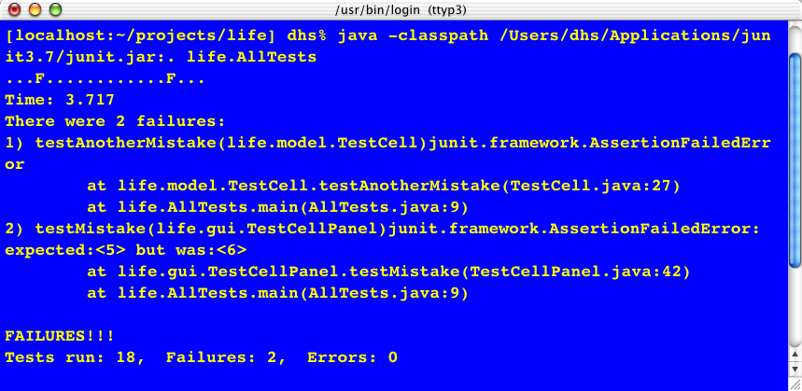
From Command line

Slide 23
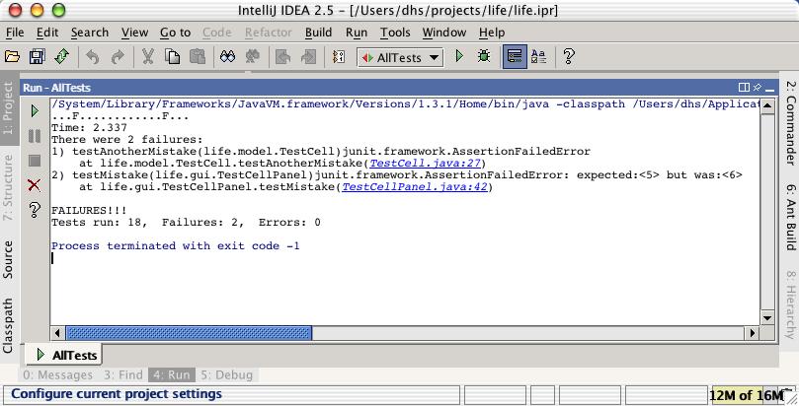
From within IDE

Slide 24
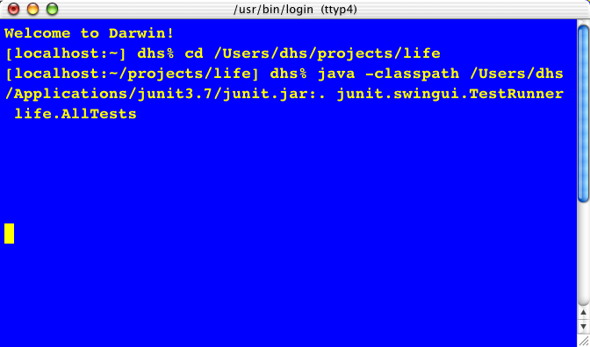
Using GUI TestRunner

Slide 25
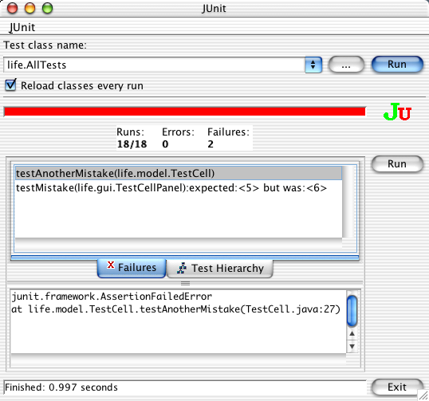
Show Failures

Slide 26
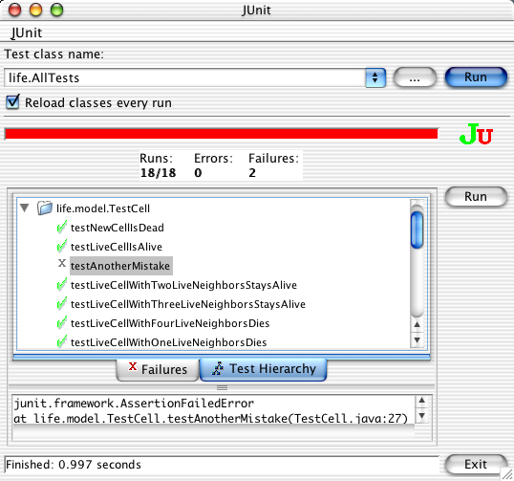
Show Test Hierarchy

Slide 27
Notes
JUnit is available at www.junit.org
Other languages have other frameworks
Challenges in the J2ME world
Challenges in distributed world
Mock objects and other solutions
Issues with acceptance tests

Slide 28
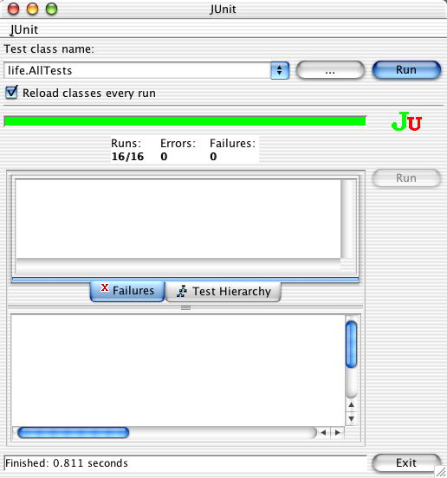

Slide 29
Resources
JUnit is available at www.junit.org
More resources at www.xprogramming.com
Contact me at DSteinberg@core.com

