Slide 1
Data Structures and Algorithms
Sorting Comparisons

Slide 2
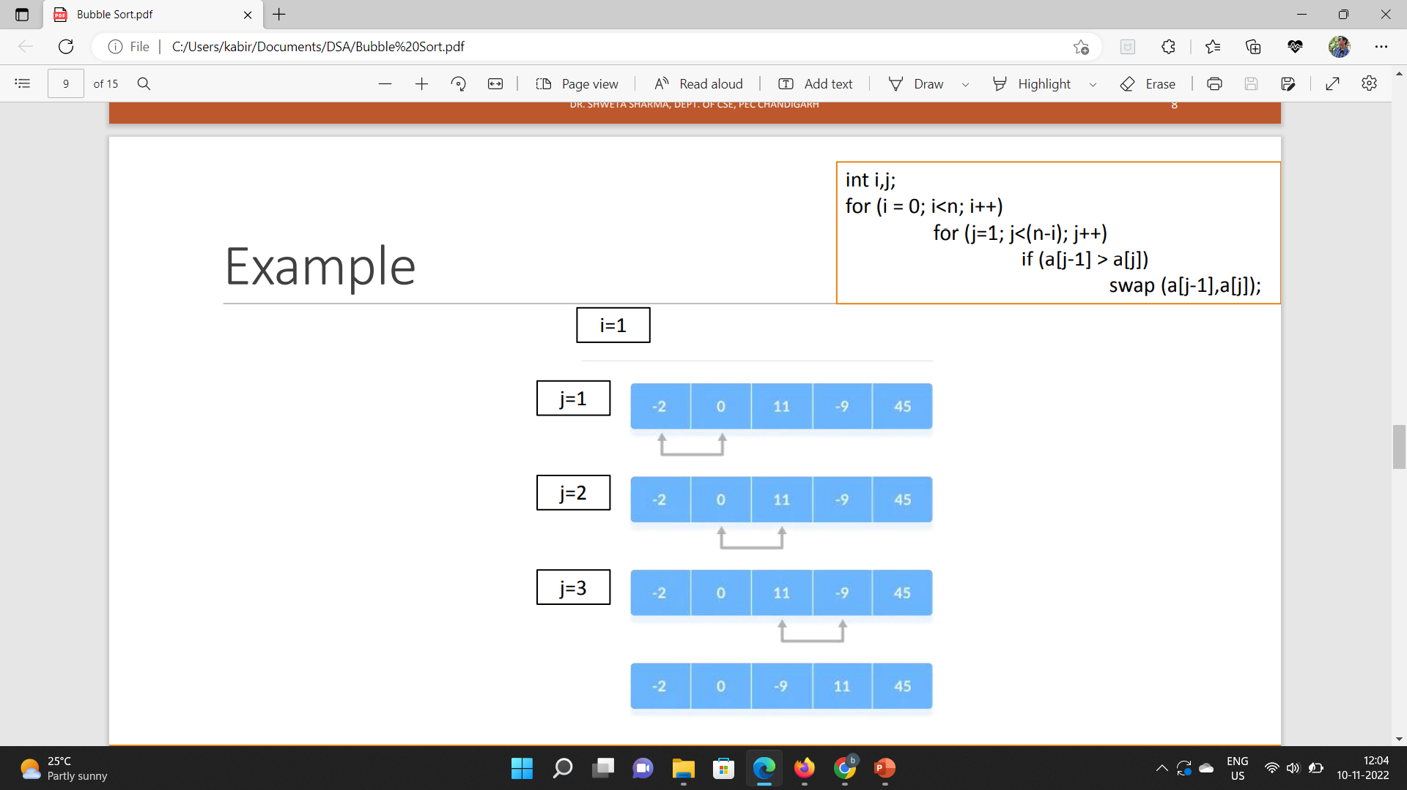
Bubble sort v/s selection sort
Bubble Sort- It is the sorting technique in which we compare two adjacent elements and swap them until we get our intended sequence.
Just like the movement of air bubbles in the water that rise up to the surface, each element of the array move to the end in each iteration Therefore, it is called a bubble sort.

Slide 3
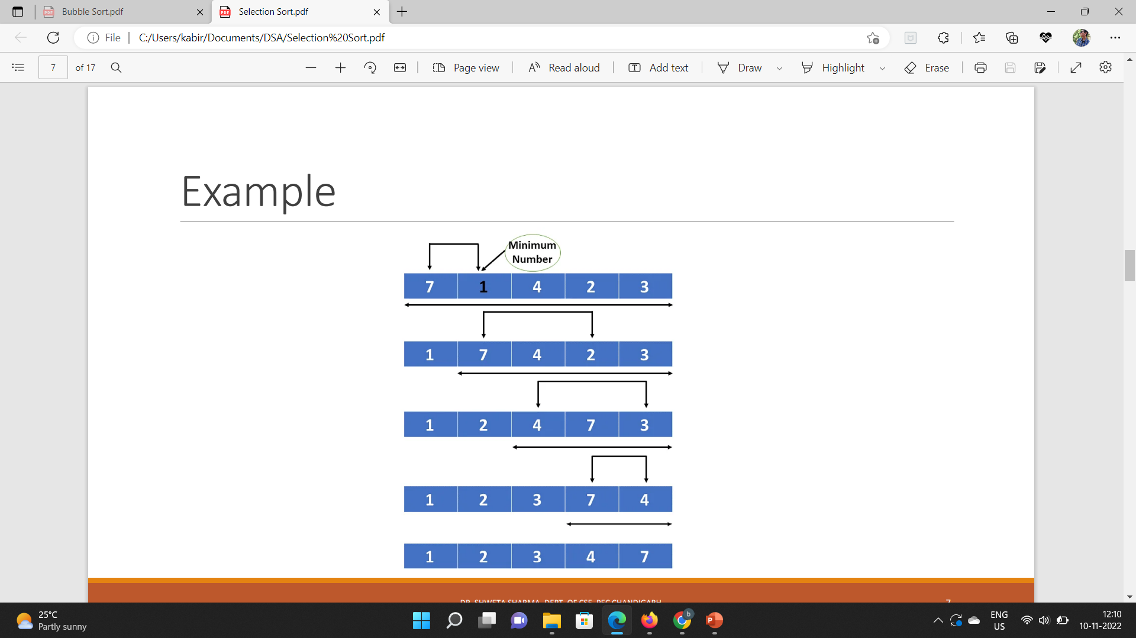
Continued….
Selection Sort- It is the sorting technique in which we select the first element of our list as the minimum element and then try to find out the smallest element in out list and then perform swapping.
By this the smallest element is placed at the first position in our list and then we solve the same technique for all the unsorted elements at the right of the swapped element.
We continue this technique until we get our intended sequence.

Slide 4
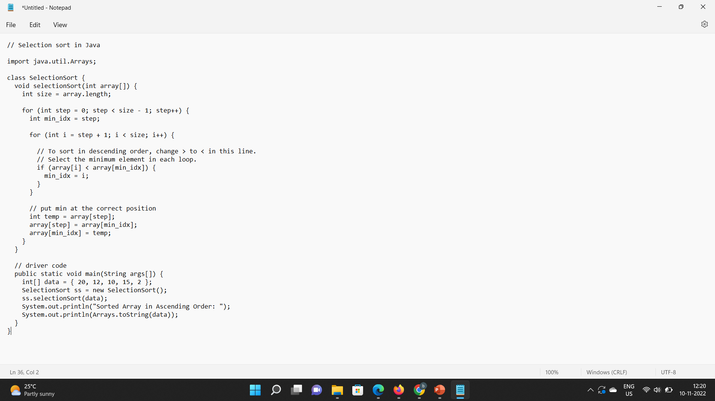
SELECTION sort (Java CODE)

Slide 5
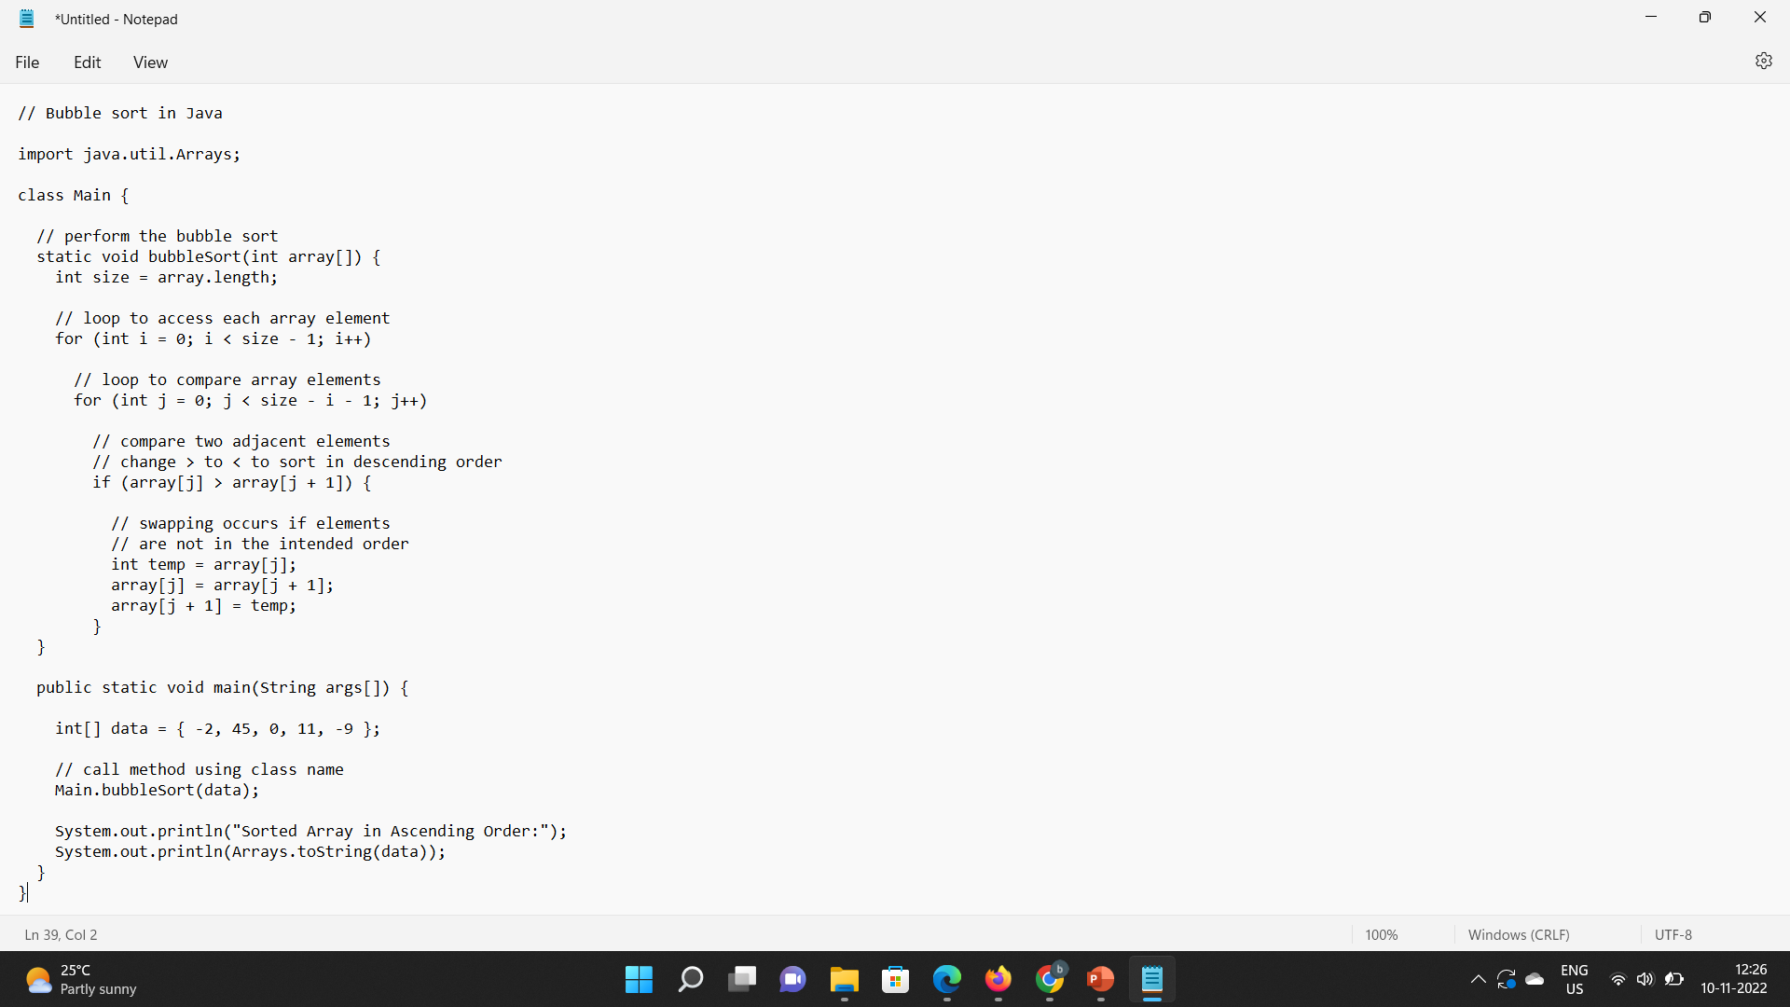
Bubble sort (java code)

Slide 6
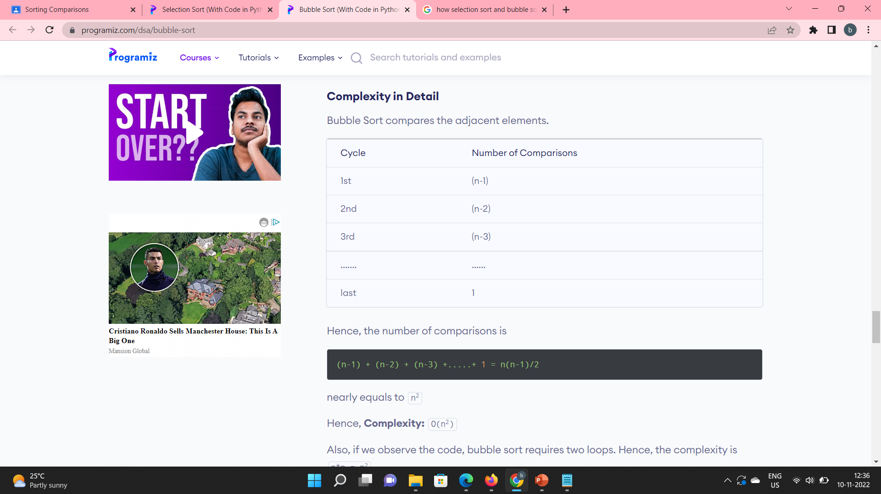
Bubble sort (Comparisons)
Bubble Sort compares the adjacent elements.
Hence, the number of comparisons is
(n-1)+(n-2)+(n-3)+…………+1=n(n-1)/2
Which is nearly equal to n²

Slide 7
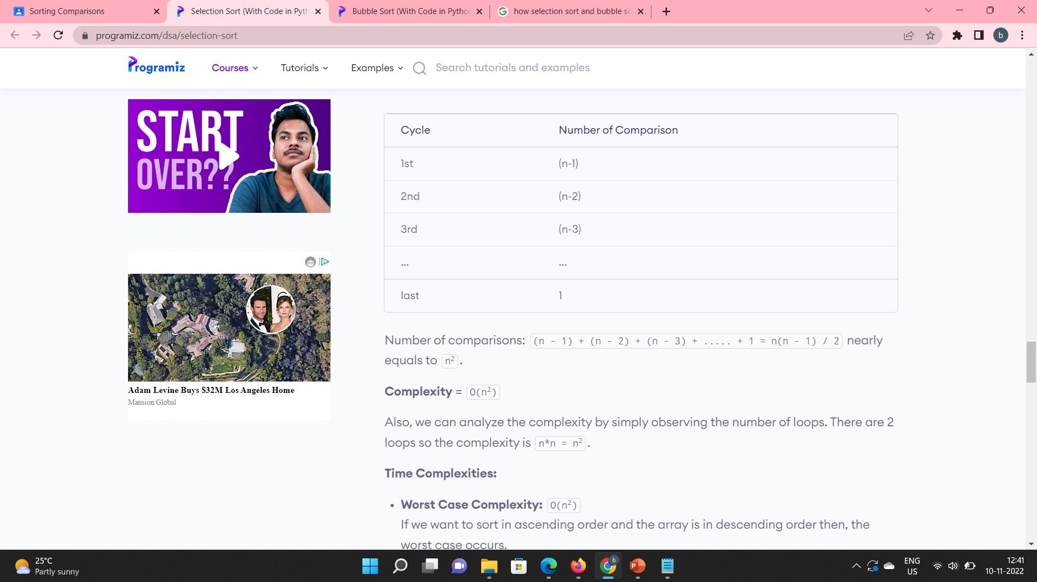
Selection sort (comparisons)
Number of comparisons: (n - 1) + (n - 2) + (n - 3) + ..... + 1 = n(n - 1) / 2 nearly equals to n²

Slide 8
Number of comparisons
Selection sort: As we can see from the code that to find the minimum element at every iteration, we will have to traverse the entire unsorted array.
Bubble sort: In this also we can see from the code that we will stop the procedure after a single pass.

Slide 9
Number of swaps
Selection Sort- We see in the code that in Selection sort i-th smallest element is selected and is placed at i-th position.
Bubble Sort- Whereas Bubble sort repeatedly compares and swaps (if needed) adjacent elements in every pass.

Slide 10
In-place and out-place implementations
Both Selection Sort and Bubble Sort are In Place sorting algorithms as they require O(1) extra space for exchanging elements.
So, they can’t be compared on the basis of In Place and Out Place sorting algorithms as both are In Place.
Only Merge Sort requires O(N) extra space and comes under the category of Out Place sorting algorithms.

Slide 11
THANKS….
Efforts By-
Yogesh Gupta
SID - 21104091

