Slide 1
IPC Lab 2
ex02_messageq

Slide 2
Overview
This is a MessageQ example using the client/server pattern.
Topics covered in this example
  Using SYS/BIOS heap for message pool
  Anonymous message queue
  Return address

Slide 3
ex02_messageq
This is a two processor example. It only builds for the HOST and DSP processors.
  You can build for either DSP1 or DSP2.
The DSP processor is the server.
  The server creates a named message queue.
  The server does not open any queues.
  The server returns all messages to the sender.
The HOST processor is the client application.
  The client creates an anonymous message queue
  The client creates and manages the message pool.
  The client sets the return address in the message header.

Slide 4

Data Flow
HOST
Reserved
Header
DSP1
Heap
client
server
5
1
3
msg
msg
ServerQ: MessageQ
NULL: MessageQ
msg
msg
2
4

Slide 5
Step 1 — Work Area
Create a work folder for this lab
  C:\TI_Demo
Extract the example into the work folder
  <ipc_3_30_pp_bb>\examples\DRA7xx_bios_elf\ex02_messageq.zip

Slide 6
Step 2 — Build Environment
Set the product install paths as defined by your physical environment.
  Edit ex02_messageq/products.mak
  DEPOT = C:/Products
  IPC_INSTALL_DIR = $(DEPOT)/ipc_m_mm_pp_bb
  BIOS_INSTALL_DIR = $(DEPOT)/bios_m_mm_pp_bb
  XDC_INSTALL_DIR = $(DEPOT)/xdctools_m_mm_pp_bb
Set the tool paths (only need the ones you actually plan to use).
  Edit ex02_messageq/products.mak
  gnu.targets.arm.A15F = $(DEPOT)/gcc_arm_none_eabi_m_m_p
  ti.targets.elf.C66 = $(DEPOT)/ti_c6x_m_m_p
Each example has its own products.mak file; you may also create a products.mak file in the parent directory which will be used by all examples.

Slide 7
Step 3 — Build Executables
Open a Windows Command Prompt
  Start > Run
  cmd
TIP: Use the following command to create an alias for the make command
  doskey make="C:\Products\xdctools_3_30_04_52\gmake.exe" $*
Build the example
  cd ex02_messageq
  make
The executables will be in their respective "bin" folders
  ex02_messageq\dsp1\bin\debug\server_dsp1.xe66
  ex02_messageq\host\bin\debug\app_host.xa15fg

Slide 8
Step 4 — Load Processors (1/2)
Load the HOST processor
  Debug view > CortexA15_0 > Select
  Run > Load > Load Program
  Click Browse, select the HOST executable
    C:\TI_Demo\ex02_messageq\host\bin\debug\app_host.xa15fg
Run HOST processor to main (if needed)
  CortexA15_0 > Select
  Run > Go Main
Set a breakpoint in App_delete
  Disassembly view > textbox > App_delete
  Double-click in margin (Ctrl+Shift+B) to set breakpoint

Slide 9
Step 4 — Load Processors (2/2)
To load the DSP processor, you must have the host processor running (when Auto Run to Main is enabled).
  Run the HOST processor. It will be spinning in the Ipc_attach loop.
Load the DSP1 processor
  Debug view > C66xx_DSP1 > Select
  Run > Load > Load Program
  Click Browse, select the DSP1 executable
    C:\TI_Demo\ex02_messageq\dsp1\bin\debug\server_dsp1.xe66
Run DSP processor to main (if needed)
  C66xx_DSP1 > Select
  Run > Go Main

Slide 10
Step 5 — Run to Completion
Set a breakpoint in
Run the DSP. The test completes very quickly.
Halt the DSP and then the HOST.
  It is best to always halt the HOST last because this will also top the timers from running.

Slide 11
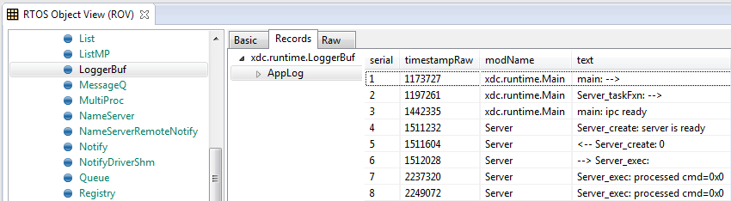
ROV — LoggerBuf Module
Use the RTOS Object Viewer (ROV) to inspect the LoggerBuf module.
  Debug view > C66xx_DSP1 > Select
  RTOS Object View (ROV) > LoggerBuf > Select
  Records (tab) > Select
  AppLog > Select
You will see a list of log events.

Slide 12
Congratulations!
End of Lab 2

