Slide 1
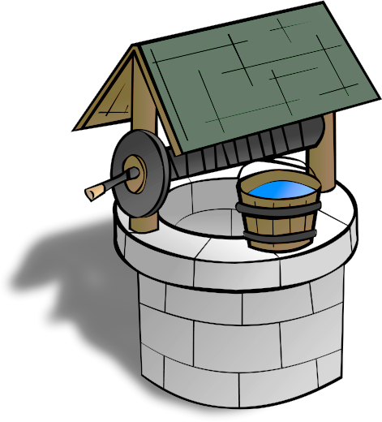
Vedavaapi वेदवापी
The Nourishing Stepwell of Indic Knowledge
Online Portal for modern seekers to easily
Assimilate, Exchange and Apply
India’s Native Scientific Knowledge

Slide 2
Vedavaapi Overview
Charter: Remove Barriers preventing Modern Seekers from understanding and applying Indic Knowledge, using Information Technology
Vedavaapi Foundation (Registered Non-profit Public Trust in India):
Key tenets: Not-for-profit, free access to IP for non-commercial and public use
Income sources: Donations (cash and infrastructure), support contracts
Products and Services
Vedavaapi.org: Web service to access, share and process Indic Knowledge content
Services: Tools for search, analysis and annotation of digitized Indic texts, media
Vedavaapi Labs (Tech centers):
Can be standalone or collocated with an educational institute

Slide 3
Indic Knowledge: Why Now?
Individual growth is highly skewed under modern education
High intellectual focus, low emotional balance, internal & external unrest
Its effects on society are dire
World needs a holistic alternative, now more than ever
Indic wisdom has the answers
Time-tested, ever-relevant, thorough

Slide 4
Indic Knowledge: Areas of Unique Value
Subjective Knowledge:
Integral psychology, consciousness studies
Where useful: Education, Social organization, Leadership & Administration, Wellness and peace
Objective Knowledge:
of Nature, its resources, properties, utilization
Where useful: Physical sciences, engineering, technology
Knowledge of Knowledge:
codifying, articulating, processing
Where useful: Linguistics, Math, logic, Knowledge mining, Automation Science

Slide 5
Indic Knowledge: Current State
Need to bridge the divide
with Multi-disciplinary Experts and Technology
Society
wants
Prosperity, Power, Peace
Traditional Shaastra Experts
preserve
Indic Knowledge for Posterity
Modern innovators
seek
new insights from Indic Knowledge

Slide 6
Indic Knowledge: Inhibitors to Adoption
Lack of Employability <- Unclear economic value
Lack of Pride in Indic Heritage <- Ignorance, degradation, foreign rule
Lack of Samskrit literacy <- Unnatural teaching via translation
Lack of Modernized Access <- Method unsuited to modern minds
Lack of Familiarity with Native Indic thought culture
Because India’s education got severed from its roots for generations

Slide 7
Indic Sciences: Unlocking New Value
Value (Known today)
Individual Peace
Ayurveda & Yoga
Wellness & Ecology
Agro (organic)
Value (Unrealized)
Enhanced human capacity
Harmonious, inclusive lifestyle
Socially Responsible Leadership
Tribal knowledge
Localized cures and Eco practices
How to Realize?
Familiarize modern students with Native Indic Thought
Launch a platform to easily imbibe and exchange Indic Knowledge
Spur Open-minded, Comparative Research
Notes:
BSc for soil engineering in a vedic way. Rather than having it as a separate linguistic stream?
BSc for Vaastu etc.
Send students out to local herbal experts to codify their knowledge.

Slide 8
Indic Knowledge: Road to Revival
Achieve Widespread Samskrit Literacy
Explore Bharat’s
Native Knowledge Base
Innovate for Holistic Living
जीवन-शिक्षणम्
Vedavaapi
focus area
शास्त्र-शिक्षणम्
भाषा-शिक्षणम्

Slide 9
Vedavaapi Project Agenda
Collect
Digitize
Textify
Analyze
Infer
Utilize
Recordings of experts
Palm leaf texts
Scanned Print
Audio
Video
Images
Text
Text
Syntax
Grammar
Semantics
Concepts
Cross-reference
Correlations
Inferences
Rule base
Services
Metadata
Wide sharing,
Human-readability
Text Search,
Machine-processing
Language assist,
Topic search,
Concept mining
Comparative
study,
New insights
Consultancy services,
Diagnosis,
Recommendations
Uses
Tech
Output
Vedavaapi.org Online Portal

Slide 10

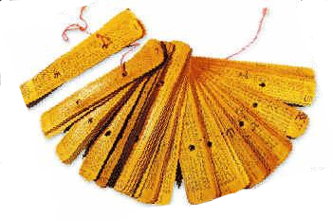






Vedavaapi Network
Oriental
Research Insitute
Campus
वेदवापी Portal
Subscriber University
Teaching aids
Custom deployment
वेदवापी Portal
Host University
Self-learning aids
Consultancy
services
Knowledge base
Business
Private archives
Public archives

Slide 11
Vedavaapi: Technology Areas and Applications
Language Assistance (Text to Concept)
Samskrit Assistant (grammar, kosha ready-reference) leveraging existing grammar tools
Grammar-aware Search engine for Samskrit texts
Knowledge Encoding (Concept to Insight)
Templates to summarize conceptual content of shaastras
Concept map tools: editing, search, mining, inference
Text Extraction (Media to Text)
Textract: Indic Manuscript Decoder, Image search tool
Samskrit Text-to-speech and Speech-to-text tools
Indexing and search tools for video and audio content

Slide 12
Vedavaapi Initiative: TEXTRACT Crowd-sourced Manuscript Decoding
Goal: Make Heritage Indic documents searchable and processable by blending human and machine intelligence to extract text content
Millions of heritage Indic texts are digitized but not amenable to content search, indexing and text processing
Manuscript deciphering is slow, laborious process (2 years / text)
Add search and indexing capabilities to digitized Indic content
Accelerate via crowd-sourcing, image processing, deep learning
Enables further study of heritage Indic knowledge and research

Slide 13
Vedavaapi Initiative: Shaastra Summary Maps
Goal: Help modern seekers with short attention span & low memory training to rapidly grasp and navigate Indic Shaastra content
Create a knowledge base + tools to curate it, browse it, process it
Populate the knowledge base (involve shaastra experts)
E.g., encode vaastu rules
Train in using the knowledge base (students)
E.g., help students navigate vaastu text easier
Create applications leveraging the knowledge base
E.g., create a vaastu compliance checker given a building plan
वेदवापी
Seekers
Experts
वेदवापी

Slide 14
Vedavaapi: Success Criteria
Vedavaapi used by majority of Indic Science students & scholars
High shaastra coverage of the Vedavaapi knowledge base
Popular applications built on Vedavaapi knowledge services

Slide 15
Vedavaapi: Current Status
Human-assisted OCR: Text Extraction from Scanned Book Images
Ready: Web-based editor for crowd-sourced deciphering of scanned texts
In progress: Automated text annotation using Deep learning techniques
Samskrit Language Analysis Service and Programmable (RESTful) API
Word analysis: Based on Univ of Hyderabad’s Samsaadhanii tools
Application: Automated Sentence generation for Samskrit E-learning Exercises
Future: Human-assisted Sentence analysis
Shaastra Summary Maps: Crowd-sourced concept mapping of texts
In design stage

Slide 16
Vedavaapi: Initial Funding Requirements
Item | Description | Tenure | Cost (INR)
Server platform (hardware) for 5 years | Amazon EC2 “t2-medium” server instance | 5 years | 100,000 / year * 5 years = 5,00,000
Software Platform Development (AngularJS web frontend + MongoDB+Python RESTful server backend) | 1 web UI developer, 1 backend developer cum architect | 1 year | 40,000 + 60,000 p.m * 12 = 12,00,000
Vaakya sangraha (Indic Logic text) concept mapping | Three people + one senior guide | 3 months | (30K + 30K + 40K) * 3 = 3,00,000
Text extraction of a scanned book using Vedavaapi platform (typing, proof-reading) – for Testing Purposes | Two full-time persons with Devanagari data typing experience | 6 months | 2 * 10000 p.m. * 6 months = 1,20,000
Total initial fund to launch Vedavaapi service for 5 years |  |  | 21,20,000 (21.2 Lakhs) INR or 30,000 USD

Slide 17
Vedavaapi: How you can Contribute
If you are | Potential Role as contributor
Shaastra Student | User, Content curator, Researcher
Technology Student | Software Intern, Big Data researcher
Shaastra Expert | Content Contributor, Curator, Annotator, Editor
Head of an Institution | Project Host, Paid subscriber of services
Philanthropist | Financial Supporter, fundraiser
IT developer | Platform Software and Application Developer
Enthusiast | Proof-reader, user, tester

Slide 18
Vedavaapi Application: Textract
Rapid Text Extraction from Digitized Indic Manuscripts and Printed Texts

Slide 19
Motivation: State of India’s Knowledge Base
Locked up in 4+ million manuscripts yet to be decoded
Inaccessible to young students and scholars
Hard to decipher and understand (e.g., taalapatras)
Steep learning curve, dwindling scholars
No end-to-end support for collaborative research
Deciphering laborious, repetitive, slow (2yrs/text)
Disconnected tools, no knowledge-sharing help
No cross-reference of texts for comparative study

Slide 20
Textract: Human-assisted OCR for Indic Texts
Auto-segment page (image -> snippets)
User annotation (snippet -> text)
Train OCR
Run OCR: Auto-label similar snippets
Use experts to train system
Image processing – agnostic to language, script, font, handwritten/printed
Can invoke any OCR here
And improve it over time.

Slide 21
Textract Benefits
Editors correct mistakes, system re-learns to reduce further mistakes
Rapid text extraction from scanned books via taking the repetitive work out of proof-reading OCR output
Language-, script- and font-agnostic text recognition unlike existing OCR
Can extract text from printed as well as handwritten text

Slide 22
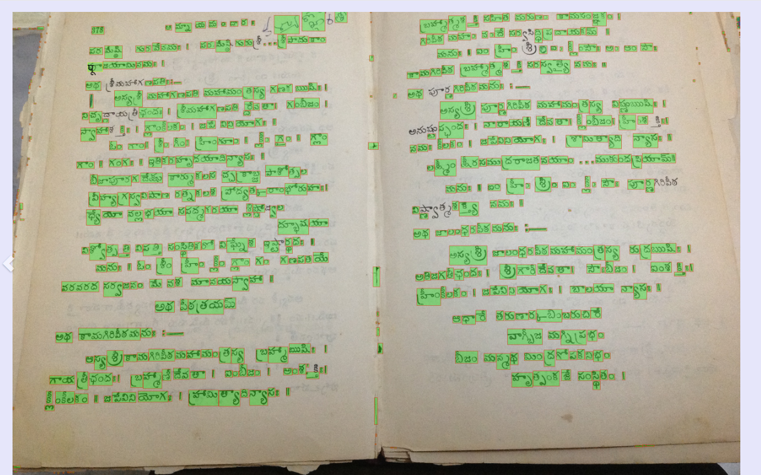
Textract: Example

Slide 23
Vedavaapi Application: Samvit
Automated Grammar Exercises for Samskrit Language E-learning

Slide 24
Samvit: Accelerating Samskrit E-learning
[वाहनम्, यानम्, द्विचक्रिका]^{तृतीया} x [गच्छति, याति, चलति]
. . .
. . .
. . .
Sentence Template
Sentence Generator
Word sources
Transform spec
Grammar API
Pruning hints
गच्छति तिङन्तः
TRANSFORM
(word, hints, newform)
गच्छन्ति
Result caching
Word-form Cache
RESTful API
संसाधनी
Toolkit by
U of Hyd
Morphological Analyzer
Noun form Generator
Verb form Generator

Slide 25
Vedavaapi Application:
Semi-automated Concept Mapping of Indic Shaastra Texts

Slide 26
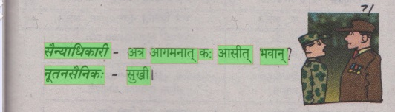
Indic Document Analysis Levels: Example
Image
Text
सैन्याधिकारी – अत्र आगमनात् कः आसीत् भवान् ?
नूतनसैनिकः – सुखी ।
Multiple data formats
Relationships
Lots of metadata
Scale this to
1000’s of books x 1000’s of pages/book
Grammar
नूतनः सैनिकः - “सुखी” ।
Semantics
(वदति)
(अहं) सुखी (आसम्) (इति)
Linkages
भवान्
Is same as
नूतनसैनिकः
Who?
नूतनसैनिकः
Inference
सुखी
When?
अत्र आगमनात् पूर्वम्

