Slide 1
Legal Tech: Advanced Analytics Applied
Verticalized Solution in Legal Domain
12 Dec 2016
Version: Ver 0.4

Slide 2
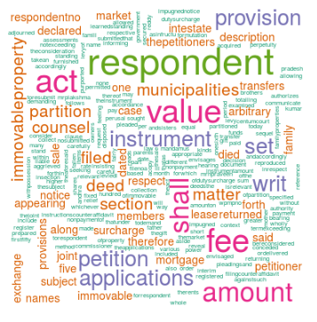
LegalTech
Robo Lawer, Case Outcome Prediction, Similarity Search and Auto Summarization Solution
Techniques
Machine learning / AI based Algos
Natural Languages Processing / Text Analytics
Solution
e.g. Finding nearest matching docs using various techniques
Predictive Analytics
Needs and Challenges
Time consuming and inefficient processes to find similar documents
Approach
Advanced analytics techniques to search similar docs
Case summarization take lot for effors in law firms as well as contracts in BFSI
There is no predictability of the case outcome, it impacts the planning
Low utilization of analytics and cloud
Use of NLP / Text Analytics to automatically generate the summary of legal doc / contract
Use of predictive analytics
Risk solution - Improve the understanding of risk, analyse entire portfolio of documents
Clientele
LPO/KPO, Legal Departments in BSFI

Slide 3
Solution Design
LegalTech – Technical details of the solution

Slide 4
Solution Design
Feature: Search, Find Nearest Matching Documents and Summarization
Interface
Find Similar Documents
Extract Summary
Refine The Results
Report Generation
Topic Search
Data Cleansing
Legal Docs
Metadata
Report
Summary
Collection of Supreme Court and High Court Judgments
Title, Names of Appellant-Respondents-Judges, important keywords-theme, Core of the judgement
Machine Learning, Natural Language Processing Algos
Keywords/topics, Stats, Summary Doc and Nearest Docs
Big Data Platform
Analytics Platform
Visual

Slide 5







rises Analytics Platform
Platform Architecture
rises Analytics Layer
Verticalized Analytics
FinTech
LegalTech
Analytics using R
Analytics using Python
Open Source Analytics Layer
Open Source R Libraries
Open Source Python Libraries
Big Data and Cloud Layer
Open Source Libraries

Slide 6
rises
rises.io software solutions
Company: rises software solutions
Website: rises.io
Contact Info: Pune, India
Ajit Deshpade, Founder
e-mail: ajit.deshpande@rises.io
Phone: +91 98224 48602
Thank you!

