Slide 1
MidcurveNN
Neural Network For Computing Midcurve of A Thin Polygon
CAD’21
Barcelona

Slide 2
Introduction
CAD'21, Barcelona
Yogesh Kulkarni

Slide 3
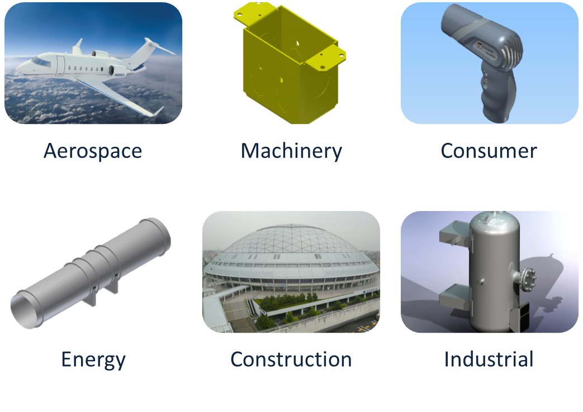
Strength Analysis by CAE
CAD'21, Barcelona
Yogesh Kulkarni

Slide 4
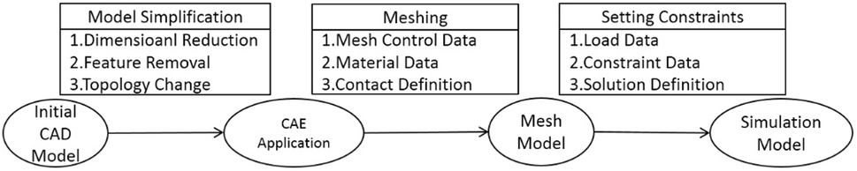
Can we use shapes directly?
CAD : Designing Shapes
CAE : Engineering Analysis
CAD->CAE: Simplification for quicker results.
CAD'21, Barcelona
Yogesh Kulkarni

Slide 5
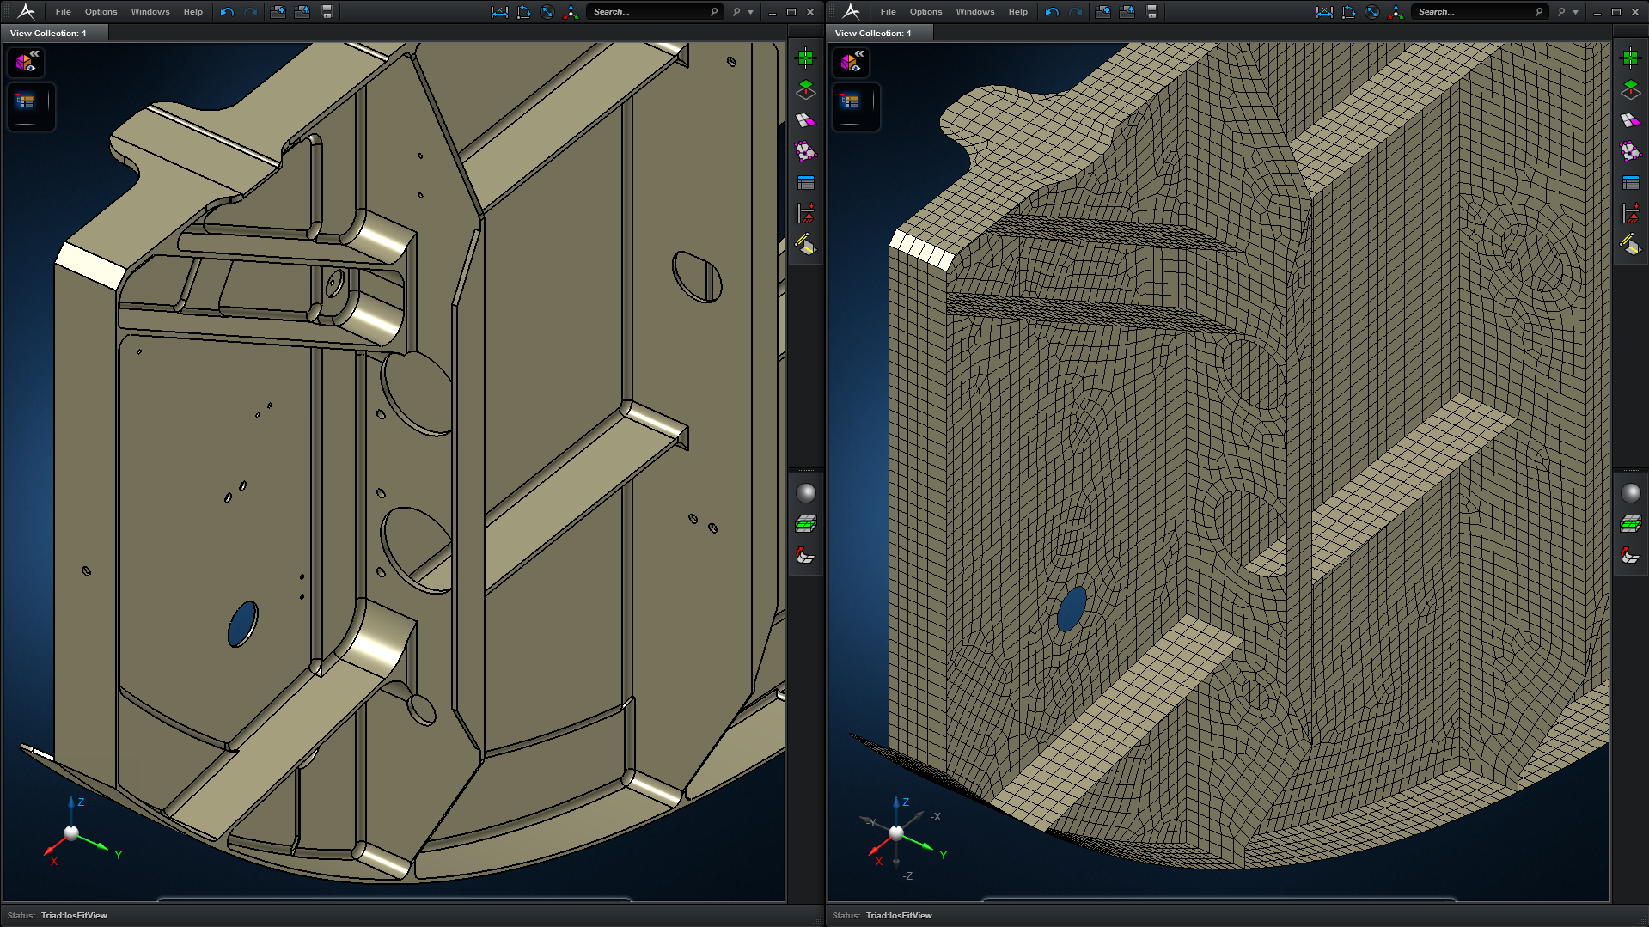
CAD-CAE
CAD'21, Barcelona
Yogesh Kulkarni

Slide 6
For Shapes like Sheet Metal…
 | Solid mesh | Shell+Solid mesh | Difference (%)
Element number | 344,330 | 143,063 | -58%
Node Number | 694,516 | 75,941 | -89%
Total Degrees of freedom | 2,083,548 | 455,646 | -78%
Maximum Von. Mises Stress | 418.4 MPa | 430 MPa | +3%
Meshing + Solving time | Out of memory | 22 mins | N/A (4G RAM)
Meshing + Solving time | 30 mins | 17 mins | -43% (12G RAM)
CAD'21, Barcelona
Yogesh Kulkarni

Slide 7
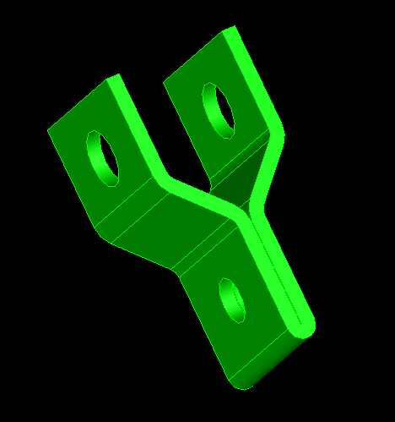
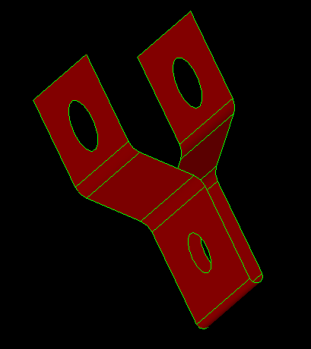
Midsurface is?
Input: Solid
Output: Midsurface
Widely used for CAE of Thin-Walled parts
Computation is challenging and still unsolved
CAD'21, Barcelona
Yogesh Kulkarni

Slide 8
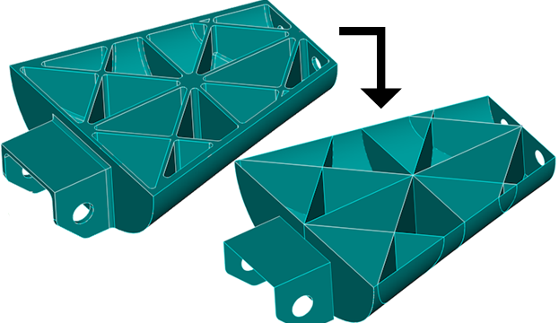
Getting Midsurface
Going on for decades…
Manually by offsetting and stitching, initially
Many CAD-CAE packages give automatic option, but…
CAD'21, Barcelona
Yogesh Kulkarni

Slide 9
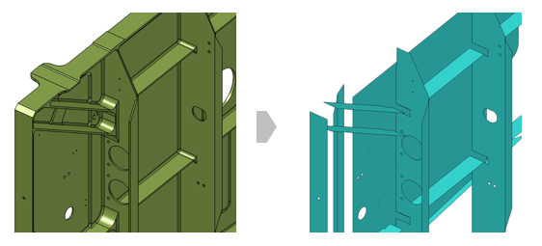
Look at the output
CAD'21, Barcelona
Yogesh Kulkarni

Slide 10
Can’t tolerate gaps
We have thickness sampling,
To recreate/represent the original shape
Input and output difference not desirable
CAD'21, Barcelona
Yogesh Kulkarni

Slide 11
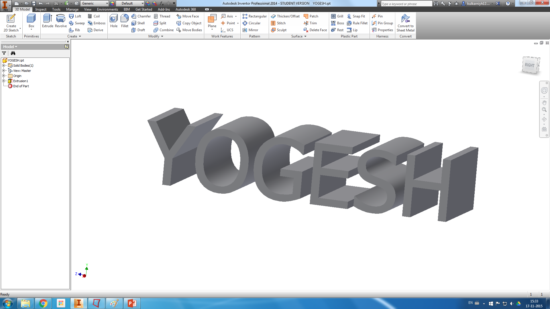
For a simple model like
CAD'21, Barcelona
Yogesh Kulkarni

Slide 12
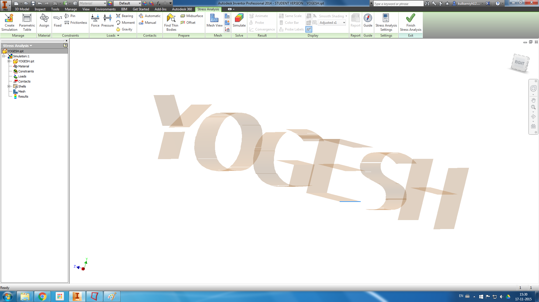
You get
CAD'21, Barcelona
Yogesh Kulkarni

Slide 13
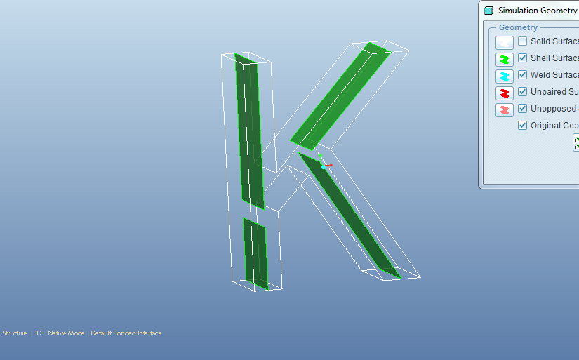
For a far simpler shape
CAD'21, Barcelona
Yogesh Kulkarni

Slide 14
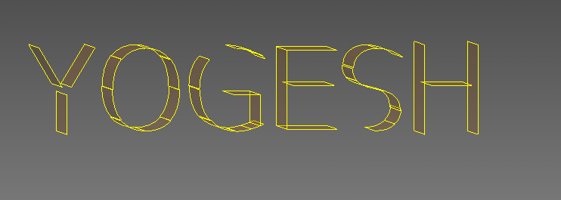
Current Quality
Errors take weeks to correct for complex parts.
But still preferred, due to vast savings time
From Days to hours…
CAD'21, Barcelona
Yogesh Kulkarni

Slide 15
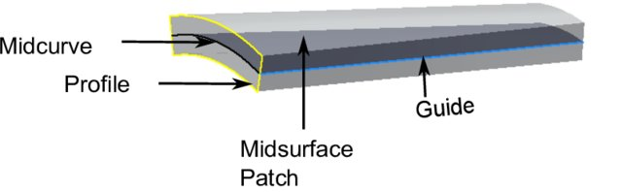
Midsurface Computation
Midsurface of a Patch is Midcurve of its profile extruded.
So, it boils down to computing 1D midcurve of a 2D profile
CAD'21, Barcelona
Yogesh Kulkarni

Slide 16
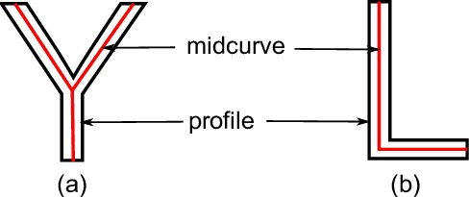
What is a Midcurve?
Midsurface : From 3D thin Solid to 2D Surface
Midcurve : From 2D Profile to 1D Curve
CAD'21, Barcelona
Yogesh Kulkarni

Slide 17
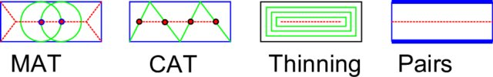
Many Approaches
More than 6 decades of research…
Most CAD-CAE packages…
Rule-based!! Heuristic!! Case-by-case basis!!
CAD'21, Barcelona
Yogesh Kulkarni

Slide 18
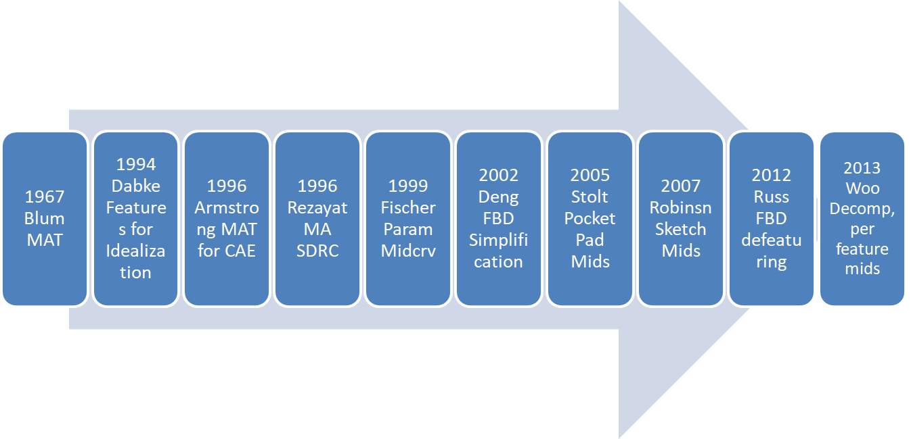
When-What
CAD'21, Barcelona
Yogesh Kulkarni

Slide 19
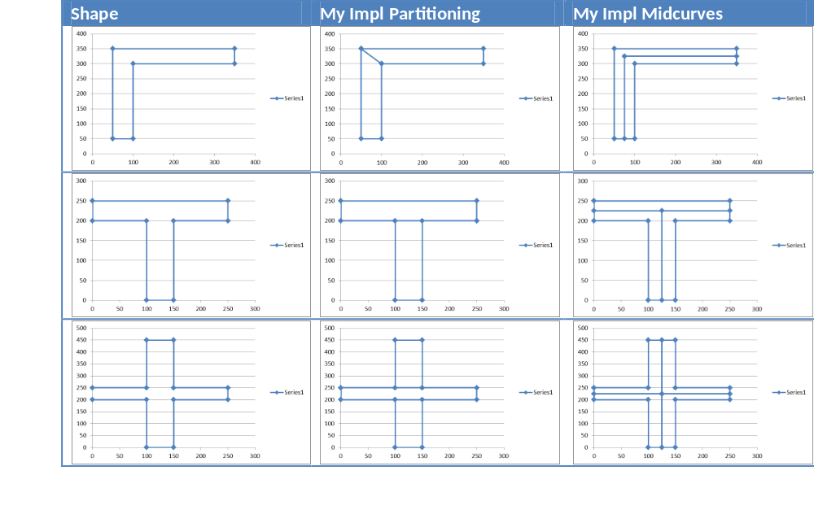
2017: My PhD Work: Rule-based
CAD'21, Barcelona
Yogesh Kulkarni

Slide 20

Limitations
Fully rule-based
Need to adjust for new shapes
So, not scalable
CAD'21, Barcelona
Yogesh Kulkarni

Slide 21

Idea
Can Neural Networks “learn” the dimension reduction transformation?
CAD'21, Barcelona
Yogesh Kulkarni

Slide 22
How?
Supply lots of training data of profiles and their corresponding midcurves and train.
Then given an unseen profile, can Neural Network compute a midcurve, mimicking the original profile shape?
CAD'21, Barcelona
Yogesh Kulkarni

Slide 23
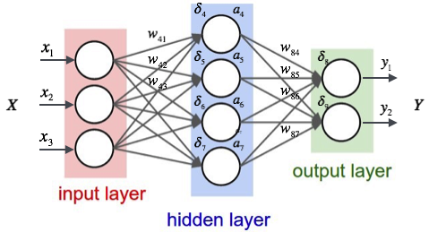
Midcurve by Neural network
CAD'21, Barcelona
Yogesh Kulkarni

Slide 24
Midcurve : The Problem
Goal: Given a 2D closed shape (closed polygon) find its midcurve (polyline, closed or open)
Input: set of points or set of connected lines, non-intersecting, simple, convex, closed polygon
Output: another set of points or set of connected lines, open/branched polygons possible
CAD'21, Barcelona
Yogesh Kulkarni

Slide 25
Midcurve == Dimension Reduction
Like PCA (Principal Component Analysis), wish to find Principal curve
That ‘represents’ the original profile shape
CAD'21, Barcelona
Yogesh Kulkarni

Slide 26
Midcurve == Translation
Left side (input): 2D Sketch Profile
Right Side (output): 1D Midcurve
Sequence 2 Sequence problem
CAD'21, Barcelona
Yogesh Kulkarni

Slide 27
Midcurve != Auto-Encoder Decoder
Its not Auto-Encoder as Input and Output are different
Its not fixed size i/o as Input and Output sizes are different
CAD'21, Barcelona
Yogesh Kulkarni

Slide 28
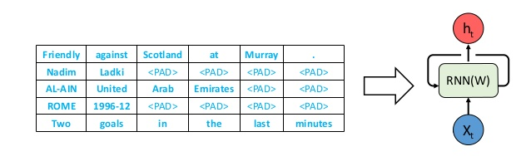
Variable Size Encoder Decoder
Batches need fixed lengths
Made fixed size by Padding.
CAD'21, Barcelona
Yogesh Kulkarni

Slide 29
Variable Size Encoder Decoder
OK for NLP, say Machine Translations, where padding values like “-1” can be added along with other words (vectors or indices)
But in Geometry, its not OK.
Because any value can represent a Valid Input, even though we don’t want it to be the input.
CAD'21, Barcelona
Yogesh Kulkarni

Slide 30
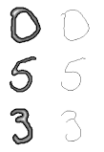
A Twist to the problem
Till we get good variable size encoder decoder network for geometry…
Decided to convert this Sequence 2 Sequence problem as Image 2 Image problem.
CAD'21, Barcelona
Yogesh Kulkarni

Slide 31
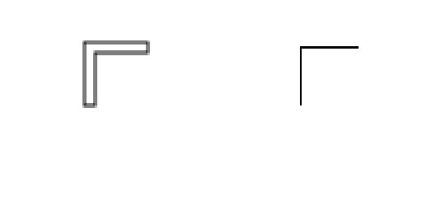
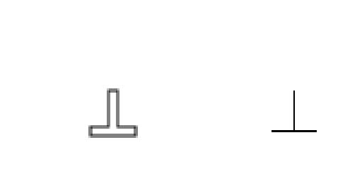
A Twist to the problem
Input: Black & White Image of 2D profile
Output: Black & White Image of 1D midcurve
CAD'21, Barcelona
Yogesh Kulkarni

Slide 32
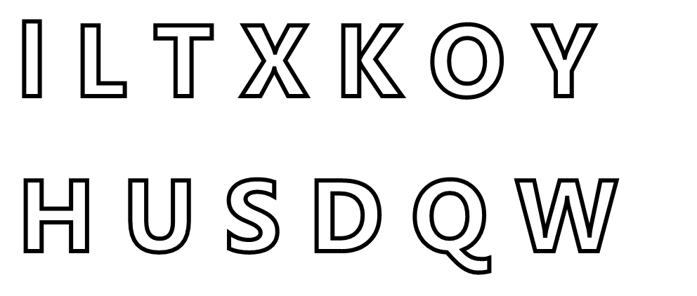
Solves …
Problems of Geometric sequences
Variable input/output sizes
Loops need to be crossed
Branches
CAD'21, Barcelona
Yogesh Kulkarni

Slide 33
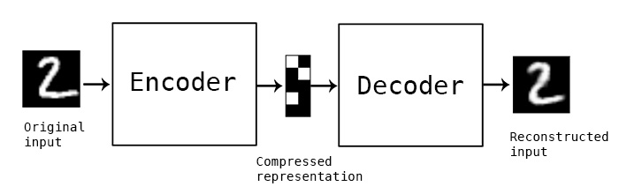
Reuse Image Encoder Decoder
CAD'21, Barcelona
Yogesh Kulkarni

Slide 34
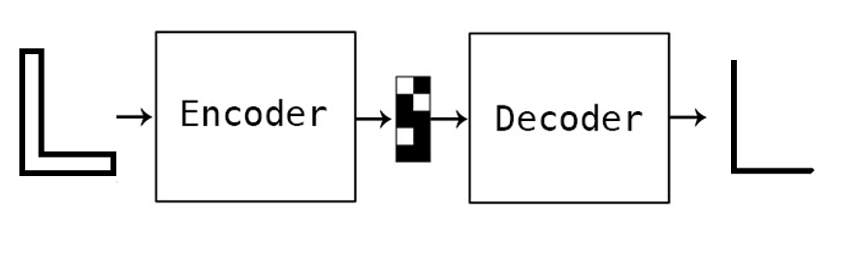
For Dimension Reduction
CAD'21, Barcelona
Yogesh Kulkarni

Slide 35
For Deep Learning
Need lots of data
Had just few input output image pairs
How to augment/populate large variations…
CAD'21, Barcelona
Yogesh Kulkarni

Slide 36
DATA PREPARATION
CAD'21, Barcelona
Yogesh Kulkarni

Slide 37
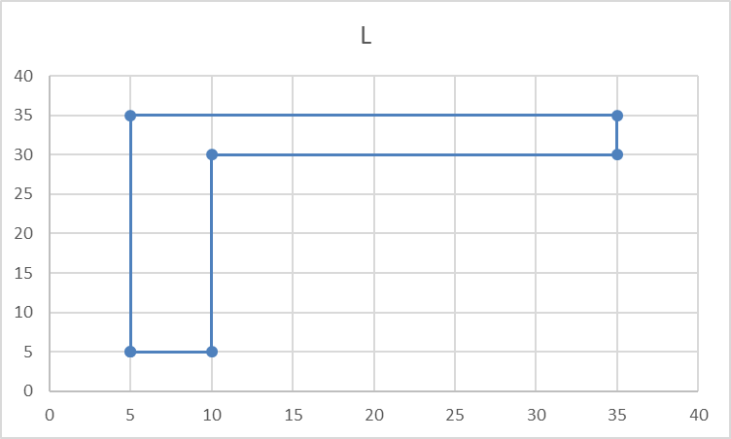
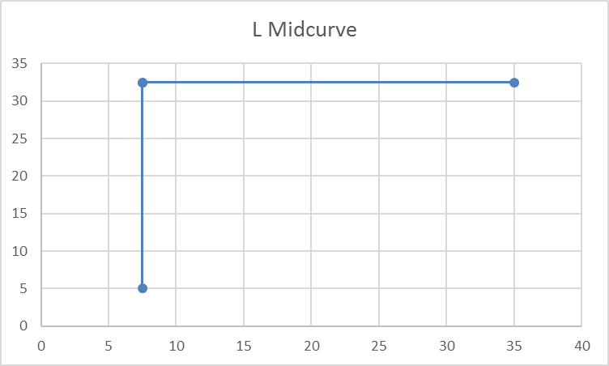
Data
Original input and output are in the form of polylines, meaning a list of points, each having x,y coordinates
Profile Data | Profile Picture | Midcurve Data | Midcurve Picture
5.0 5.0 10.0 5.0 10.0 30.0 35.0 30.0 35.0 35.0 5.0 35.0 |  | 7.5 5.0 7.5 32.5 35.0 32.5 7.5 32.5
CAD'21, Barcelona
Yogesh Kulkarni

Slide 38
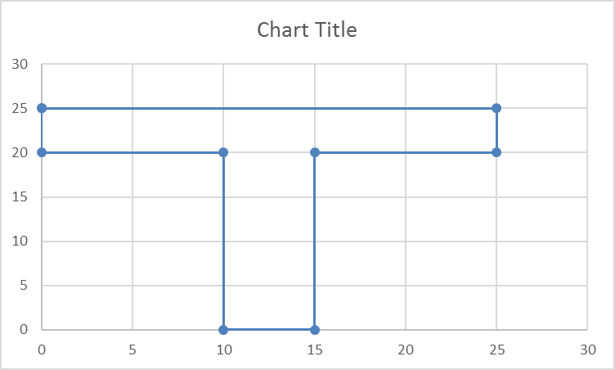
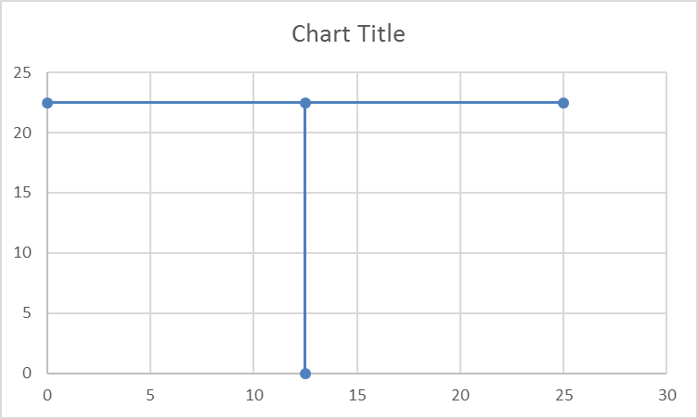
Data
Profile Data | Profile Picture | Midcurve Data | Midcurve Picture
0 25.0 25.0 25.0 25.0 20.0 15.0 20.0 15.0 0 10.0 0 10.0 20.0 0 20.0 |  | 12.5 0 12.5 22.5 25.0 22.5 0 22.5
For each shape, we have this pair of input and output. That’s it.
We need to start with these few samples only
CAD'21, Barcelona
Yogesh Kulkarni

Slide 39
Augmentation
Such few profile shapes, are just not enough for Neural Networks to train.
Need more with as much diversity as possible.
Will need to artificially augment data with transformations, like pan, rotate, mirror, etc.
All needs to be automatically, programmatically
CAD'21, Barcelona
Yogesh Kulkarni

Slide 40
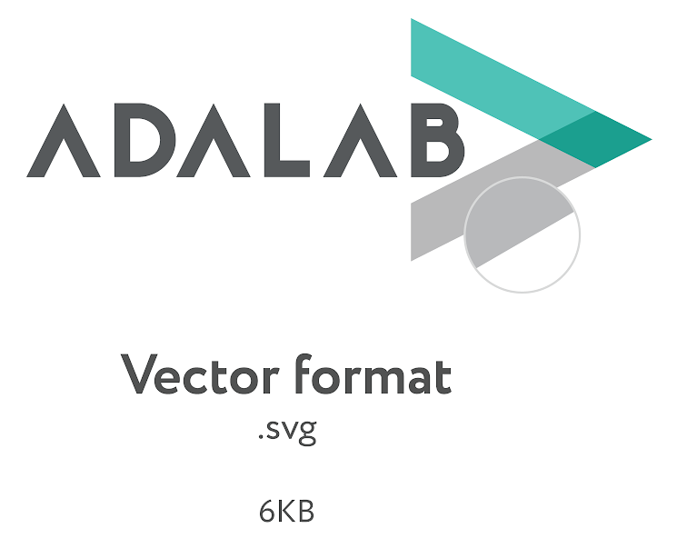

Geometry to Image
Raw input data is in the Vector format
Converted it to fixed size (100x100) image by rasterization of drawSVG library.
CAD'21, Barcelona
Yogesh Kulkarni

Slide 41
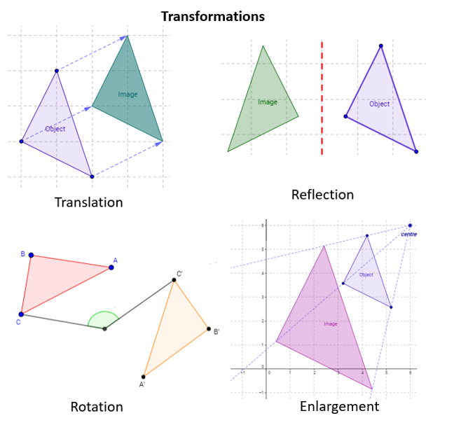
Variations
Inputs: I, L, Plus, T
Operations:
  Translated
  Rotated
  Mirrored
  Mirrored Translated
  Mirrored Rotated
Total: 896 images (still less, but not bad)
CAD'21, Barcelona
Yogesh Kulkarni

Slide 42
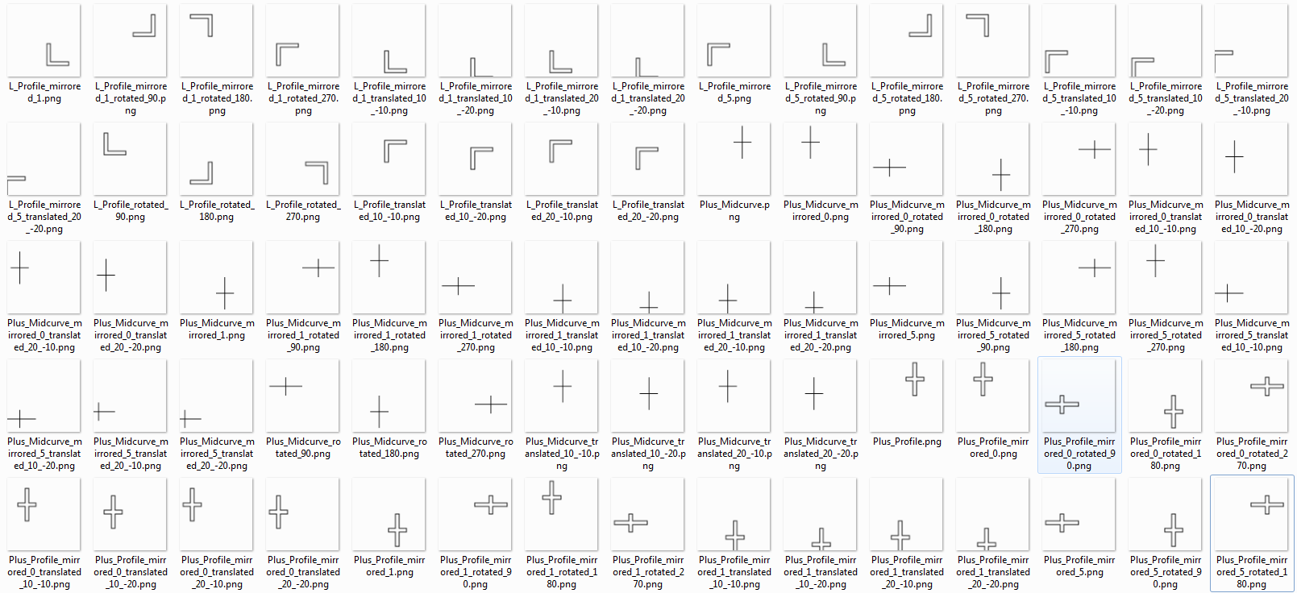
Training Data Samples
CAD'21, Barcelona
Yogesh Kulkarni

Slide 43
MIDCURVE BY NEURAL NETWORK
CAD'21, Barcelona
Yogesh Kulkarni

Slide 44
Options For Architectures
Simple Encoder Decoder (one layer each)
Dense Encoder Decoder
Convolutional Encoder Decoder
Pix2Pix
…
CAD'21, Barcelona
Yogesh Kulkarni

Slide 45
SIMPLE ENCODER DECODER
CAD'21, Barcelona
Yogesh Kulkarni

Slide 46
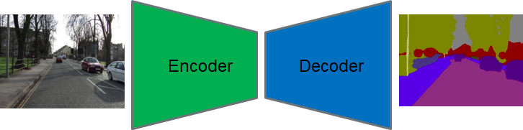
Simple Encoder Decoder
CAD'21, Barcelona
Yogesh Kulkarni

Slide 47
Keras Implementation
input_img = Input(shape=(input_dim,))
encoded = Dense(encoding_dim, activation='relu',activity_regularizer=regularizers.l1(10e-5))(input_img)
decoded = Dense(input_dim, activation='sigmoid')(encoded)
autoencoder = Model(input_img, decoded)
encoder = Model(input_img, encoded)
encoded_input = Input(shape=(encoding_dim,))
decoder_layer = autoencoder.layers[-1]
decoder = Model(encoded_input, decoder_layer(encoded_input))
autoencoder.compile(optimizer='adadelta', loss='binary_crossentropy')
CAD'21, Barcelona
Yogesh Kulkarni

Slide 48
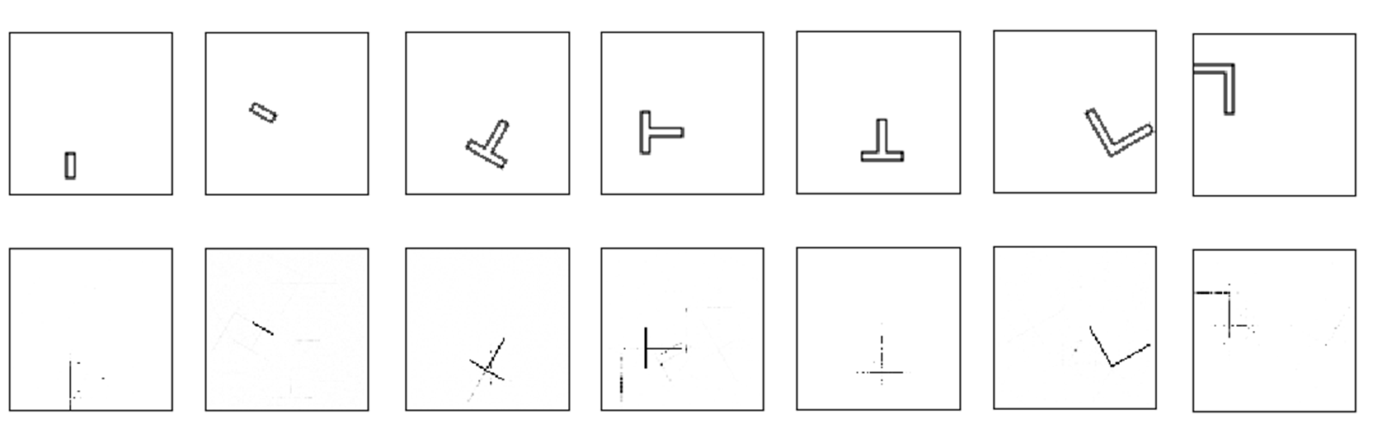
Results
CAD'21, Barcelona
Yogesh Kulkarni

Slide 49
Results
Not very perfect but encouraging
NN is correct with
  The location (bounding box)
  Dimension Reduction is seen
But, still some stray points and misses
CAD'21, Barcelona
Yogesh Kulkarni

Slide 50
What can be done?
For the noise, use bounding boxes
Feedback into error term: differencing with the known output expected
Classify single pixel image as the skeleton, and rest as noise.
CAD'21, Barcelona
Yogesh Kulkarni

Slide 51
What Next?
Add denoiser network after the current one
More Network Architectures
Sequence-to-Sequence based approaches, taking closed thin polygon as input and polyline as output
Extending to 3D, ie Midsurface
CAD'21, Barcelona
Yogesh Kulkarni

Slide 52
END NOTES
CAD'21, Barcelona
Yogesh Kulkarni

Slide 53
Summary
Various applications need lower dimensional representation of shapes.
Midcurve is one- dimensional(1D) representation of a two-dimensional (2D) planar shape.
Used in animation, shape matching, retrieval, finite element analysis, etc.
CAD'21, Barcelona
Yogesh Kulkarni

Slide 54
Summary
Approaches: Thinning, Medial Axis Transform (MAT), Chordal Axis Transform (CAT), Straight Skeletons, etc., all of which are rule-based.
Proposing a novel method called MidcurveNN which uses Encoder-Decoder neural network for computing midcurve from images of 2D thin polygons in supervised learning manner.
CAD'21, Barcelona
Yogesh Kulkarni

Slide 55
Summary
This dimension reduction transformation from input 2D thin polygon image to output 1D midcurve image is learnt by the neural network,
Which can then be used to compute midcurve of an unseen 2D thin polygonal shape.
CAD'21, Barcelona
Yogesh Kulkarni

Slide 56
Thank you
yogeshkulkarni@yahoo.com
CAD'21, Barcelona
Yogesh Kulkarni

