Slide 1
An Open Feature Based Design System for Generalized Orthohedral Components
M.S. Thesis
By
Yogesh Kulkarni

Slide 2
Overview of the Presentation
Background – Solid Modeling
Introduction
Data Representation
Operations
Implementation
Conclusions and Recommendations

Slide 3
Background
Solid Modeling (CSG/Brep)
FBD approaches by Hijazi and Chennapragada
Process planning implementation by Vivekanand, Vaidyanathan and Daftari
Research by Dr. Jami Shah

Slide 4
Definition of a Feature
A feature can be defined as a higher level grouping of geometrical, topological and functional primitives into an entity more suitable for use in design, analysis or manufacturing operations

Slide 5
Advantages of FBD
Captures designer’s intent of modeling
May eliminate the problem of feature extraction
Provides designer with the manufacturing evaluation at the design time, facilitating suitable changes in design

Slide 6
Generalized Orthohedral Block Structure
True Orthohedral: All faces perpendicular to coordinate axes
External Shape
Internal Shape
Component as a list of blocks
Advantages

Slide 7
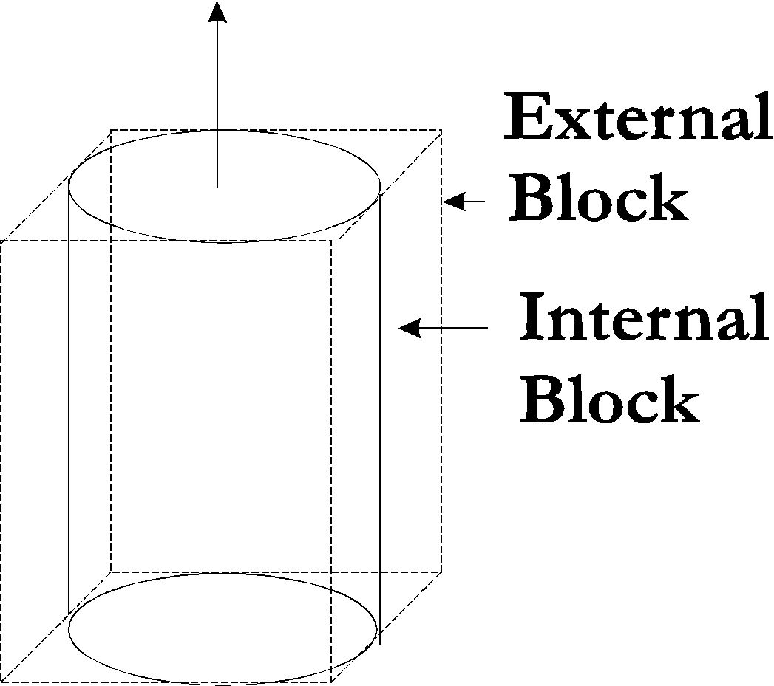
Example of Generalized Orthohedral Block

Slide 8
Modeling
Geometry: Planes (Min, Mid, Max) and Length
Constructive and Subtractive features
Topology: Graph Representation

Slide 9
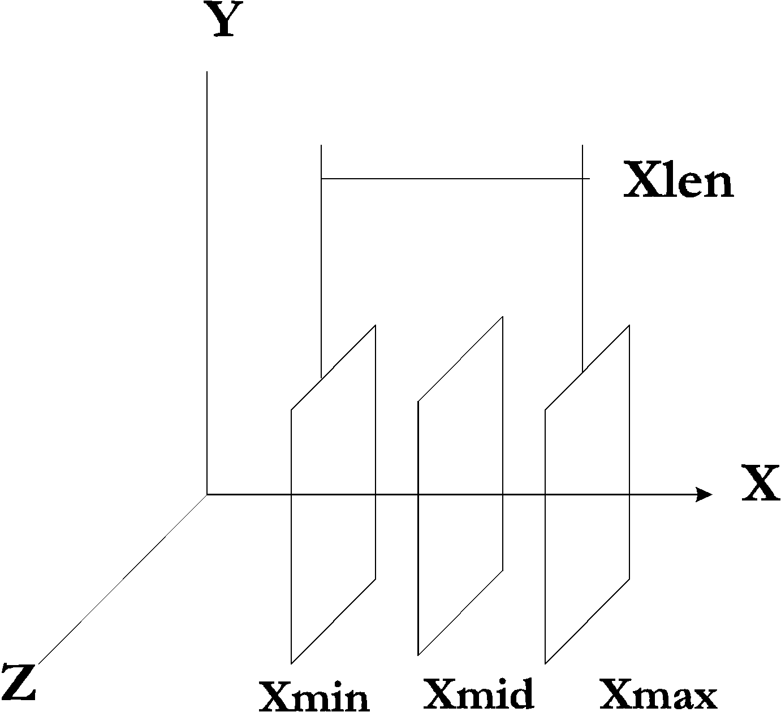
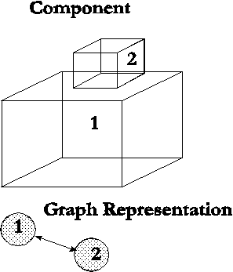
Data Representation

Slide 10
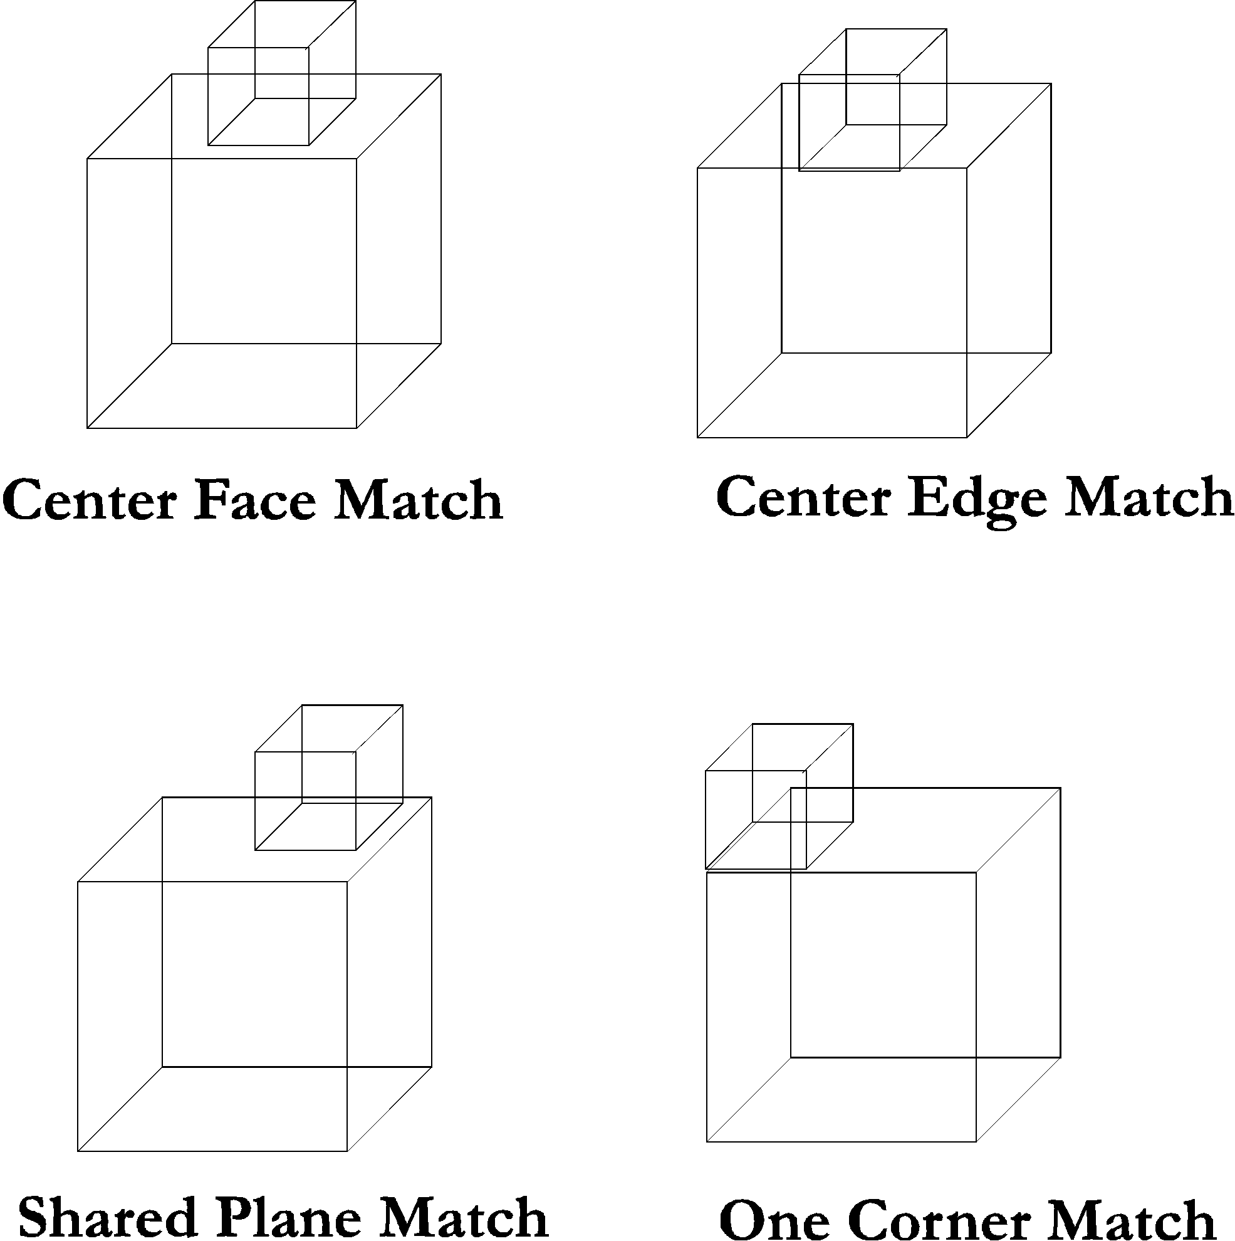
Topological Link

Slide 11
Operations
Creation of Component, Block, Topological Link
Editing
Display
Dimensioning

Slide 12
Encapsulation
Encapsulation divide the real Shape into two parts
External Shape, which gives idealized external geometry
Internal Shape, which defines the actual geometry
Operations on the encapsulated block are inherited from the external block, but may be overridden

Slide 13
Advantages of Encapsulation
Provides a mechanism to extend and customize the Shape library
Allows handling of complex geometry while maintaining simplicity of the block structure
Reduces coding needed to add new shapes

Slide 14
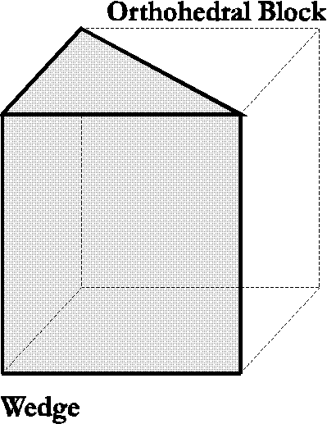
Wedge Block
Wedge encapsulated in Orthohedral Block Structure

Slide 15
B-spline Block
Swept B-spline encapsulated in the Orthohedral Block structure
Gives capability to model free form surfaces
Parameterization of control points with respect to the external block dimensions

Slide 16
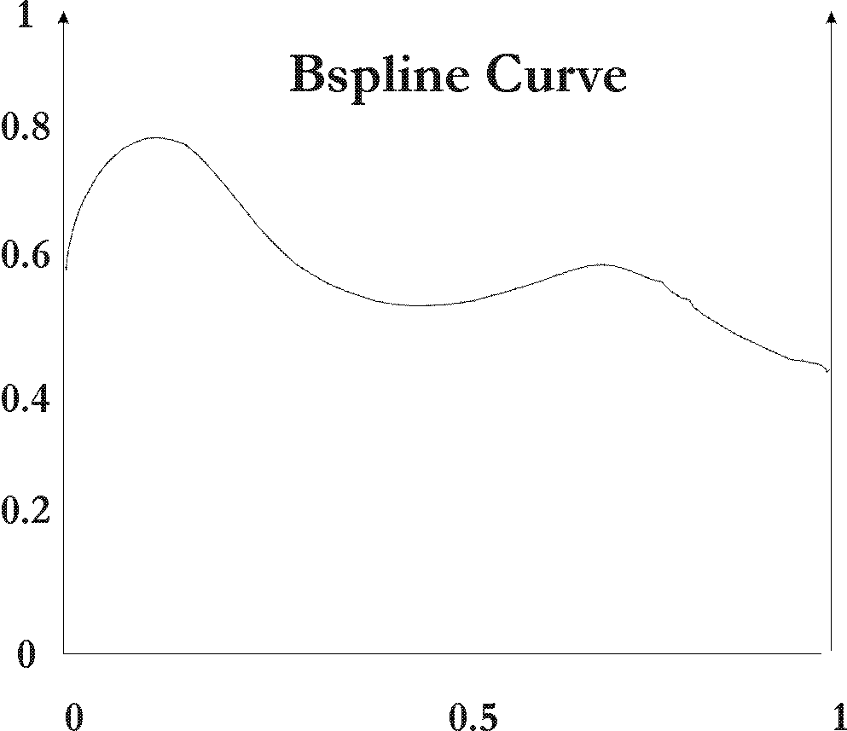
Parametric B-Spline Definition
As B-spline control points are defined on 0 to 1 scale with respect to the outer block dimensions, changes in the size of the outer block changes the position of the control vertices

Slide 17
Editing
Geometric Editing
External Shape Editing
Internal Shape Editing
Topology must be preserved
Topological Editing

Slide 18
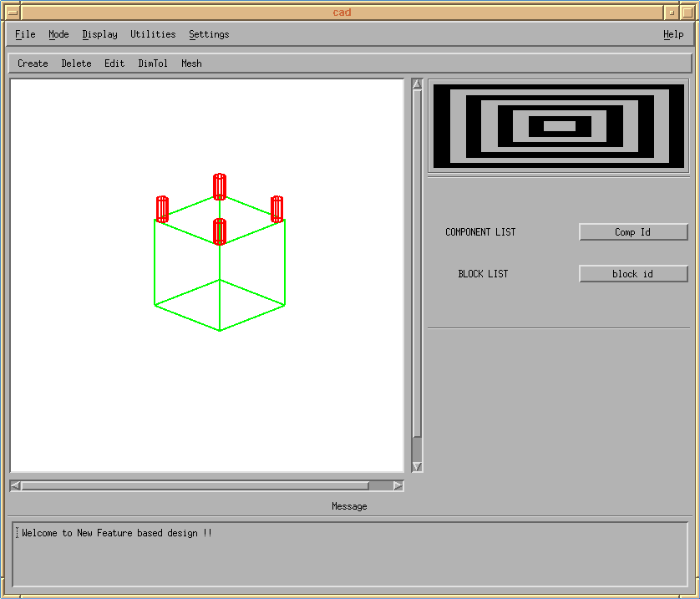
Component before editing

Slide 19
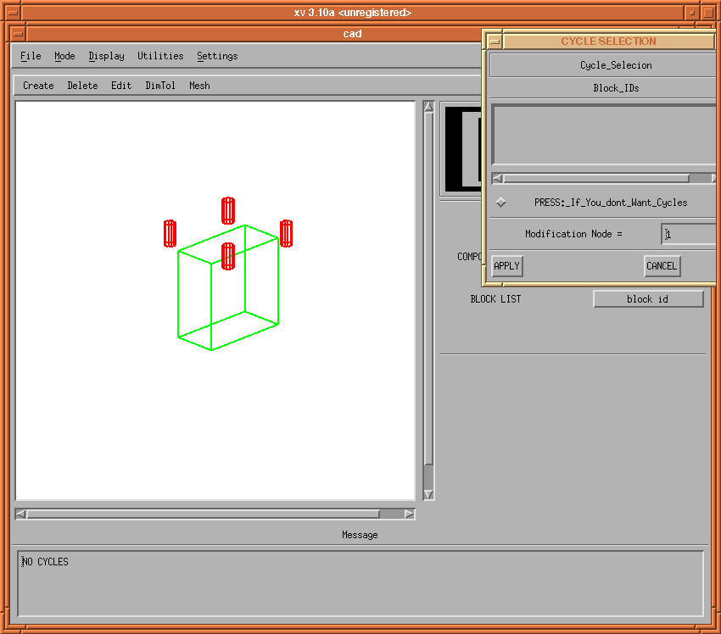
If Topology is not preserved

Slide 20
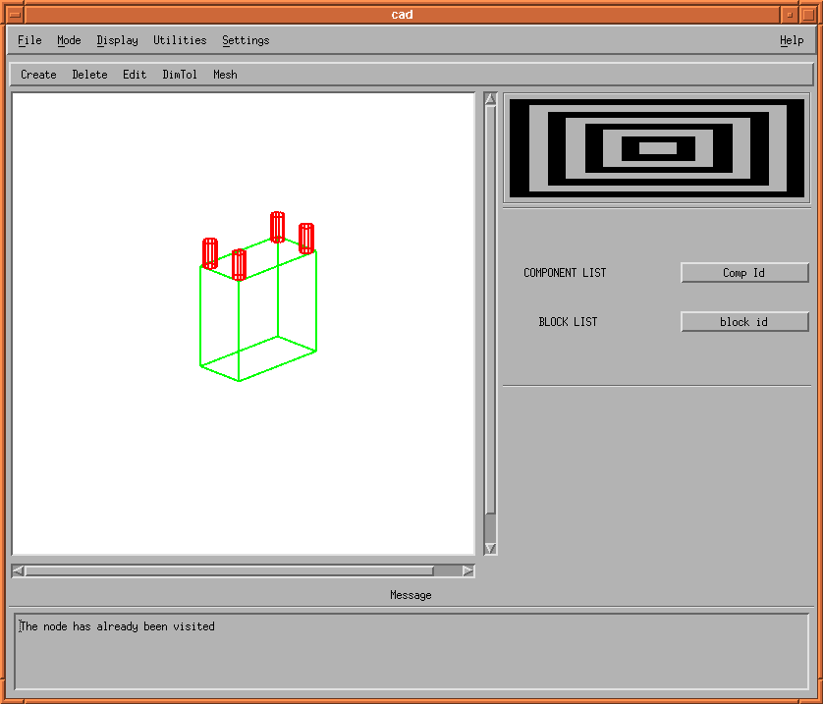
After editing is over

Slide 21
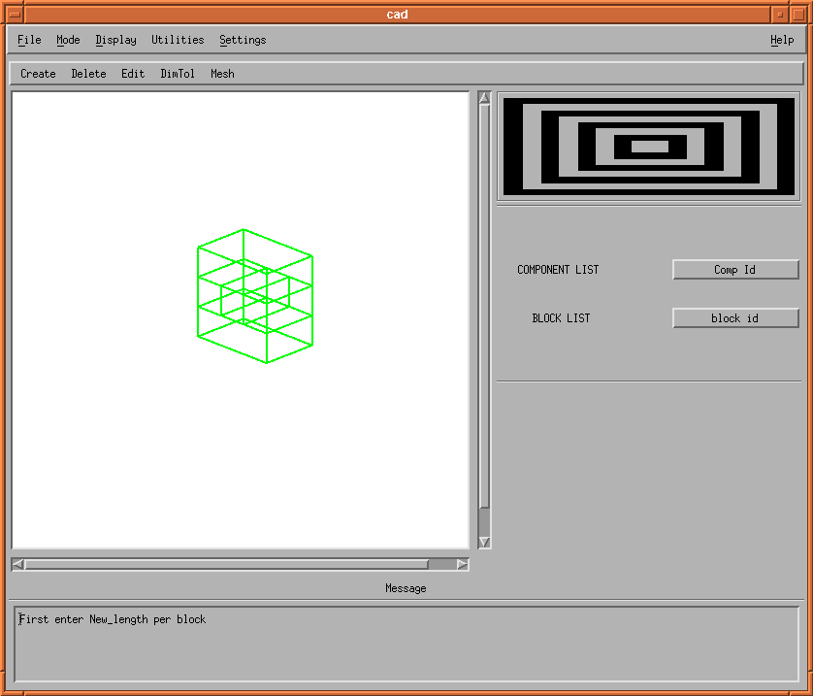
Cycle in the Component

Slide 22
Display
Block wise display
Polygon-set display
Creation of Polygons
Formation of Polygon-sets
Common Edge Detection
Polygon merging

Slide 23
Dimensioning and Tolerancing
External (Locational) dimension
Internal (Size) dimension
Graph Representation:
Reference Dimension Graph (RDG)
Specified Dimension Graph (SDG)
Each block contributes a set of planes depending upon its shape

Slide 24
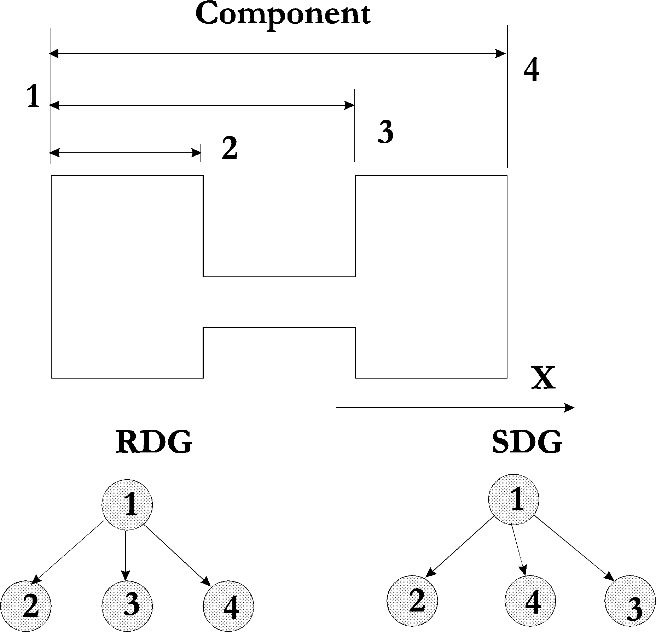
Default Dimension Graph

Slide 25
Dimensioning Operations
Creation of the dimension graph
Specifying the dimension between two primitives
Avoidance of redundancy
Query of the dimension
Change of Datum
Merging of common planes

Slide 26

Specifying the Dimension

Slide 27
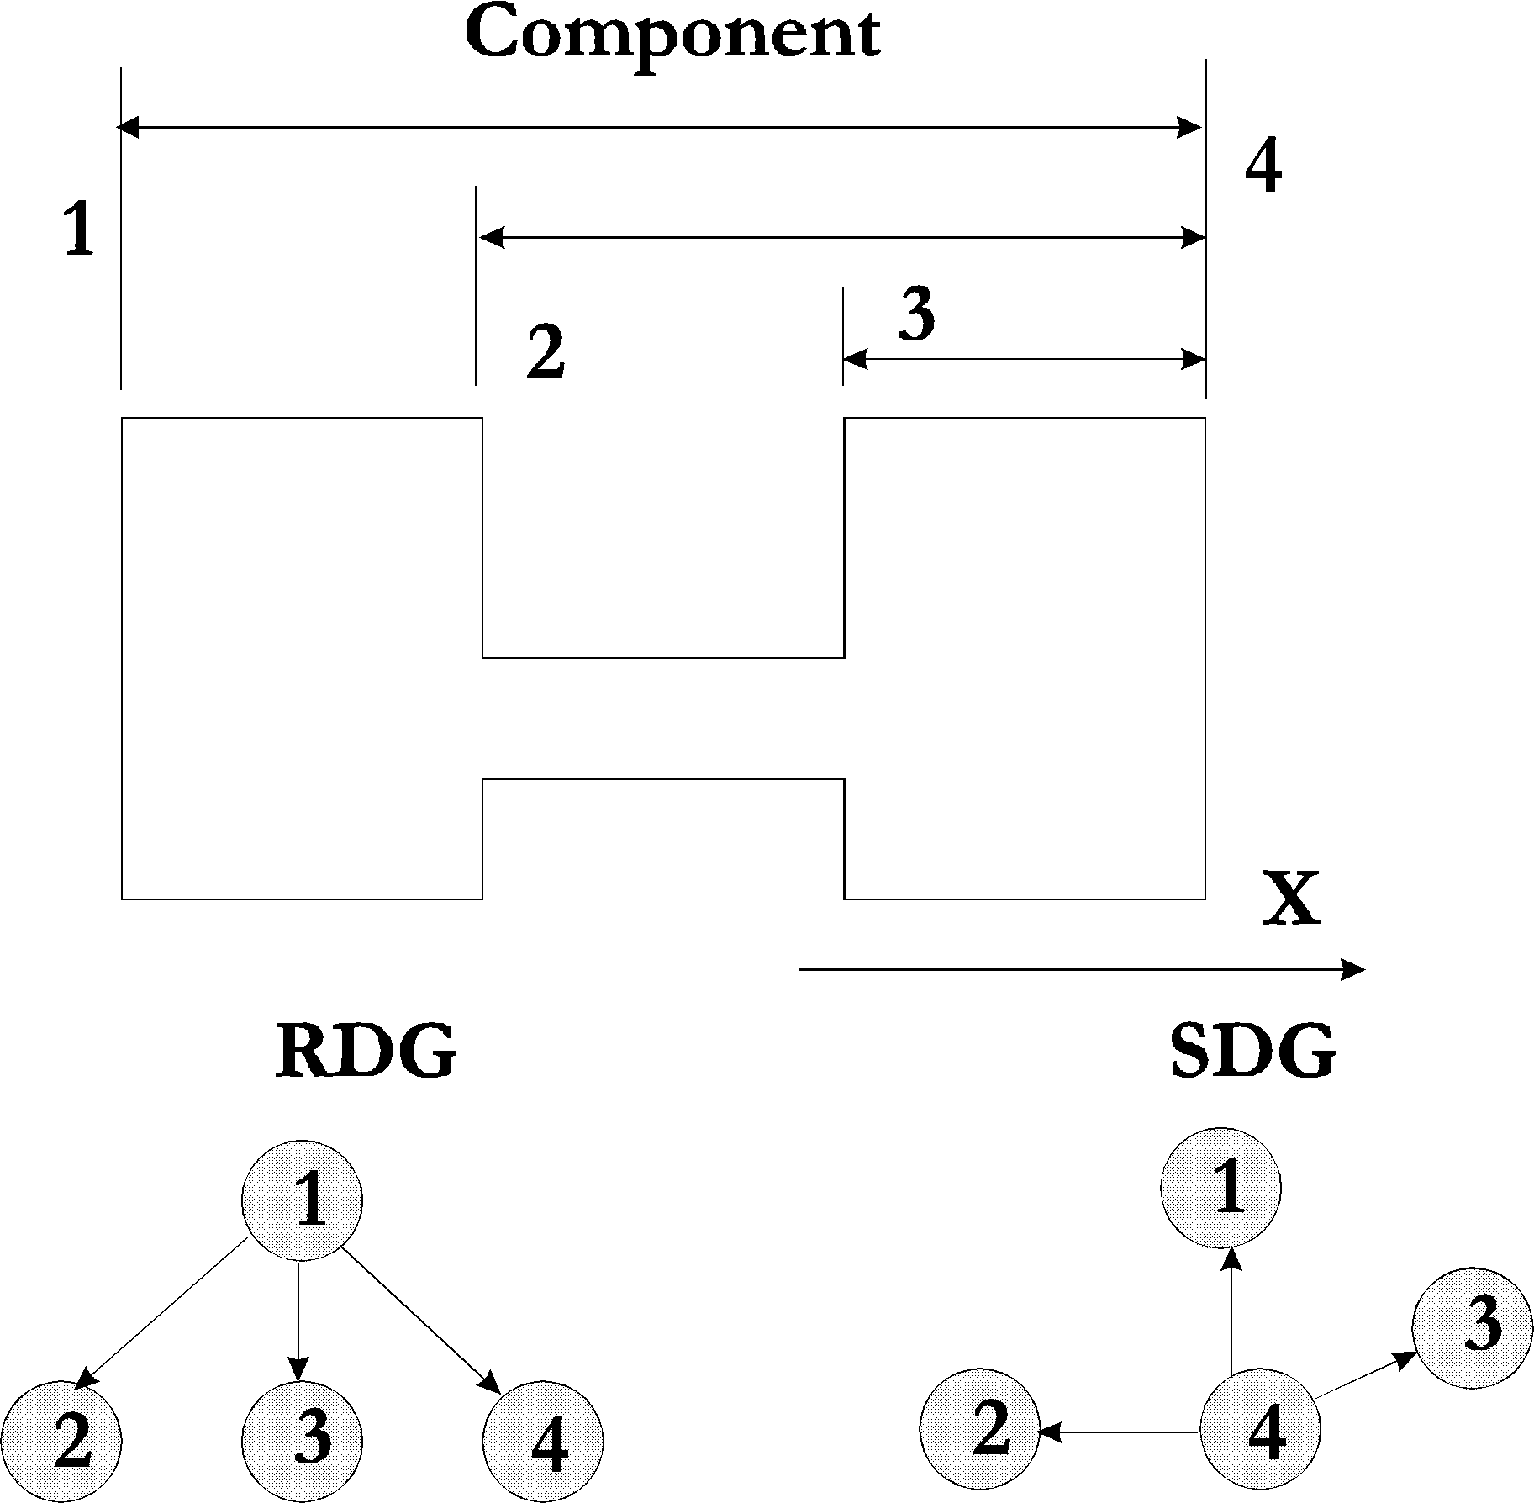
Change of Datum

Slide 28
B-spline Dimensioning
For pre-specified intervals, values of X1 to Xn are generated
For each Xi a corresponding parameter Ui is calculated by solving Non-linear B-spline function by using the Secant method
For each Ui corresponding Yi is calculated from profile equation
DimPlanes along Xi and Yi are generated

Slide 29
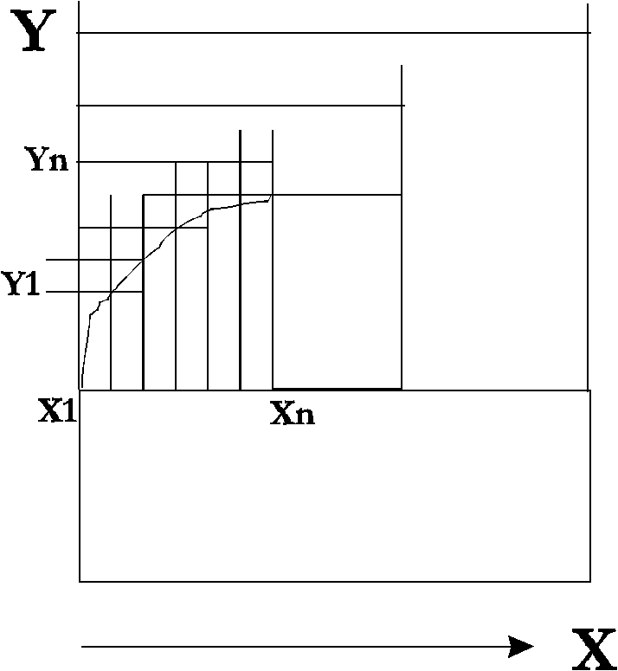
B-Spline Plane Generation

Slide 30
Implementation
Object Oriented Implementation
Graphical User Interface
C++, Motif, SunPHIGS

Slide 31
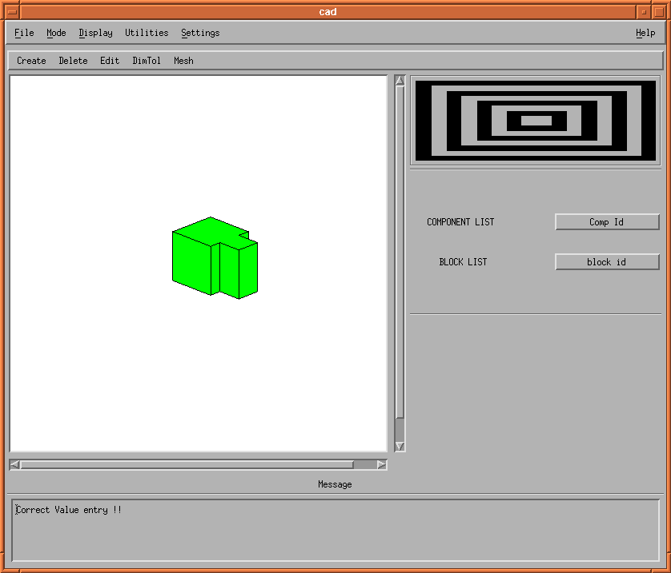
Graphical User Interface

Slide 32
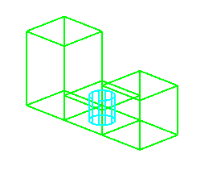
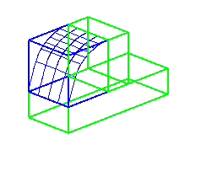
Examples

Slide 33
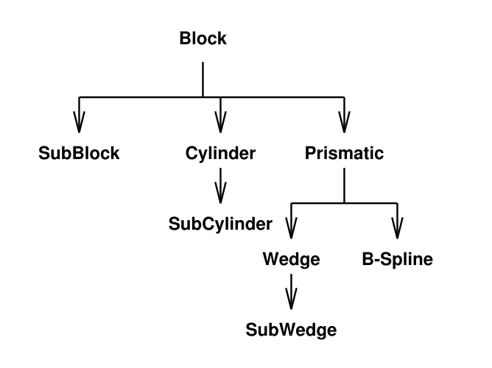
Block Hierarchy

Slide 34
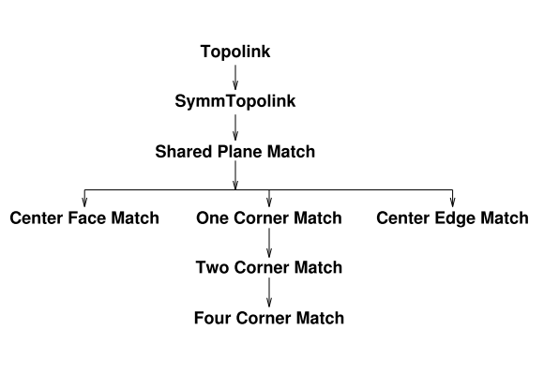
Topology Hierarchy

Slide 35
Conclusions
Development and implementation of a FBD system for Orthohedral components
Extension of the feature library
Dimensioning capability
Free form surface modeling and Dimensioning

Slide 36
Recommendations
More work on Free form surfaces
Process Planning Capability
Tolerance Analysis
User Interface development
Support for international standards such as PDES/STEP

