Slide 1
MidcurveNN
Application of Deep Learning to Geometric Algorithms
Yogesh Kulkarni
IACC’21
Malta

Slide 2
Introduction
Yogesh Kulkarni

Slide 3
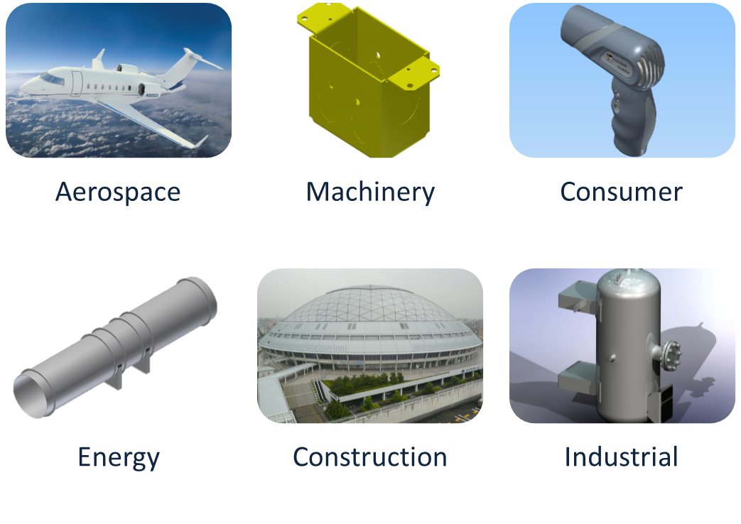
Strength Analysis by CAE
Yogesh Kulkarni

Slide 4
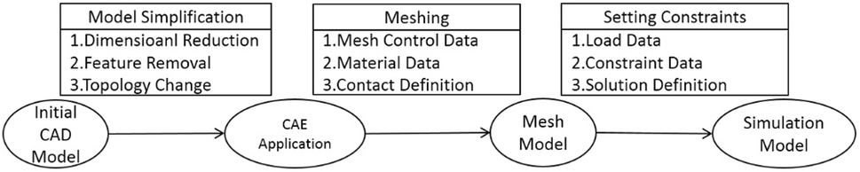
Can we use shapes directly?
CAD : Designing Shapes
CAE : Engineering Analysis
CAD->CAE: Simplification for quicker results.
Yogesh Kulkarni

Slide 5
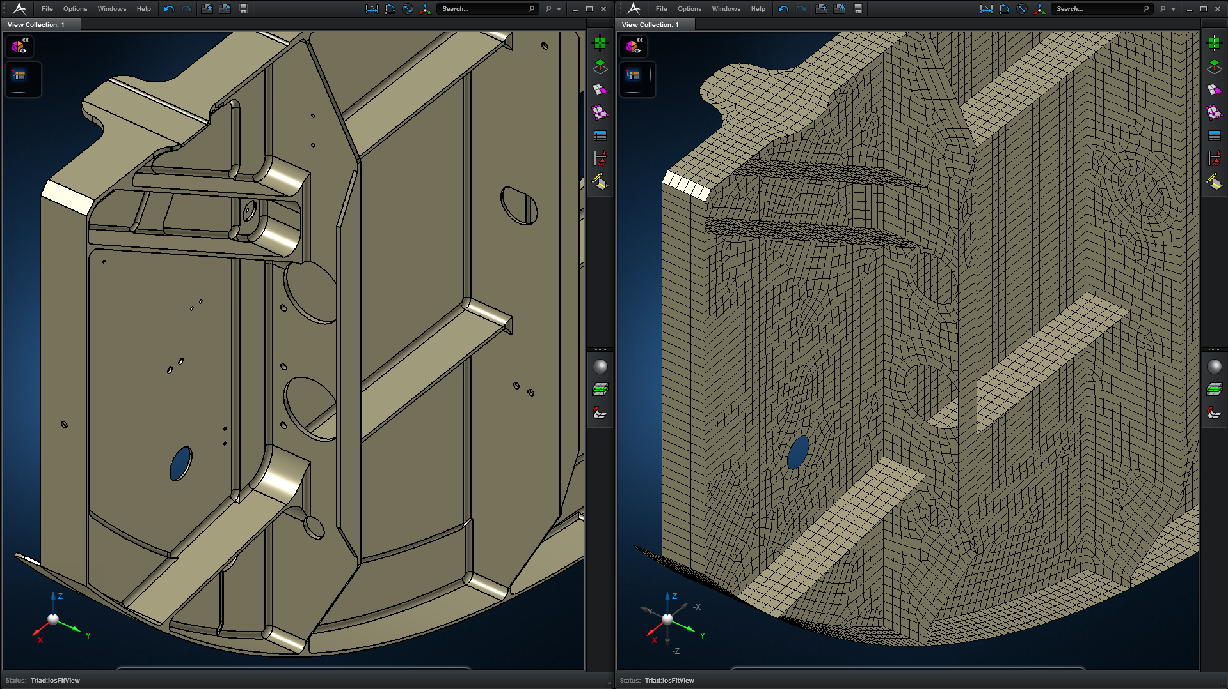
CAD-CAE
Yogesh Kulkarni

Slide 6
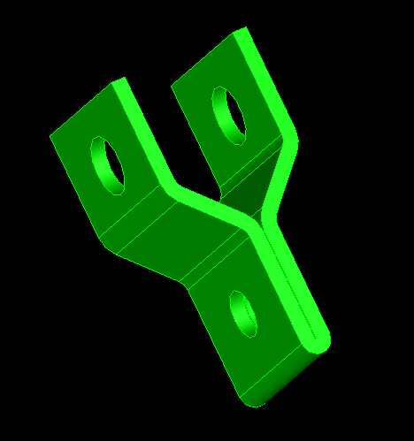
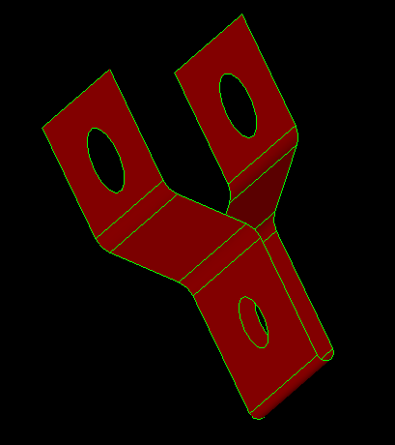
Midsurface is?
Input: Solid
Output: Midsurface
Widely used for CAE of Thin-Walled parts
Computation is challenging and still unsolved
Yogesh Kulkarni

Slide 7
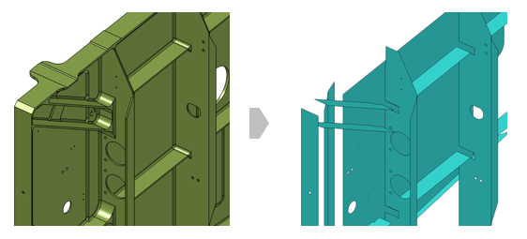
Look at the output
Yogesh Kulkarni

Slide 8
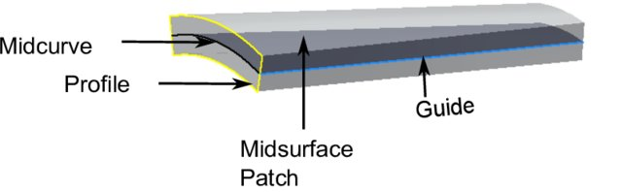
Midsurface Computation
Midsurface of a Patch is Midcurve of its profile extruded.
So, it boils down to computing 1D midcurve of a 2D profile
Yogesh Kulkarni

Slide 9
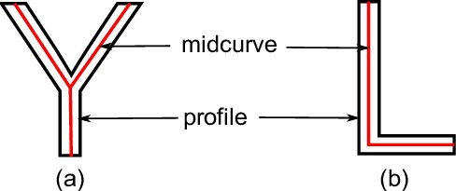
What is a Midcurve?
Midsurface : From 3D thin Solid to 2D Surface
Midcurve : From 2D Profile to 1D Curve
Yogesh Kulkarni

Slide 10
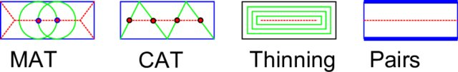
Many Approaches
More than 6 decades of research…
Most CAD-CAE packages…
Rule-based!! Heuristic!! Case-by-case basis!!
Yogesh Kulkarni

Slide 11
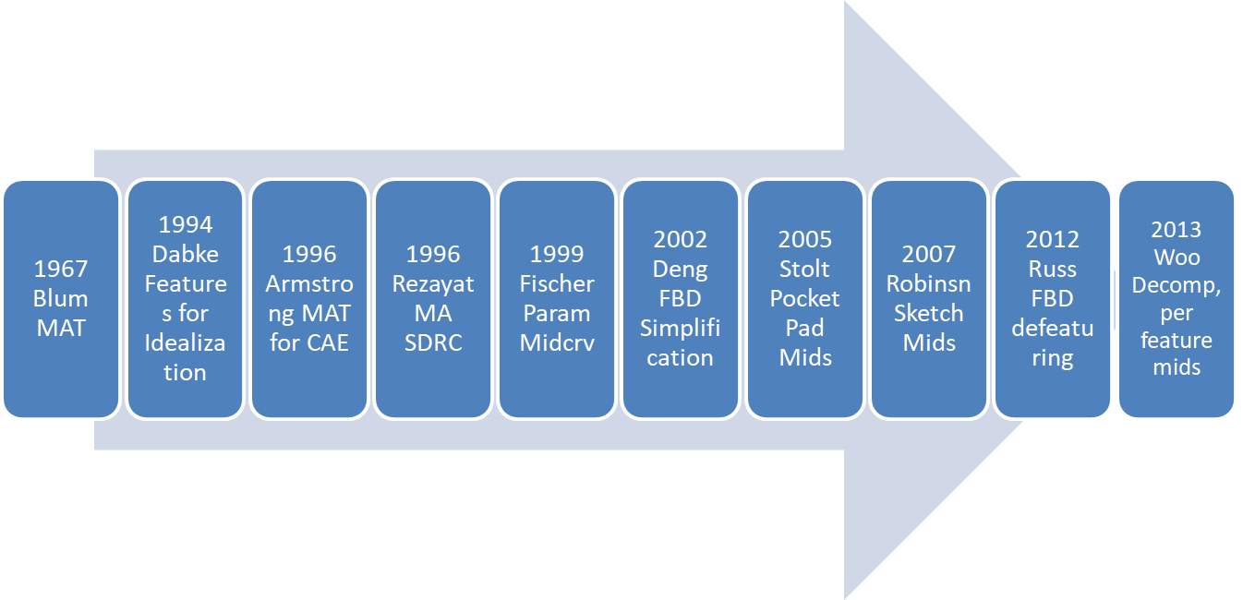
When-What
Yogesh Kulkarni

Slide 12
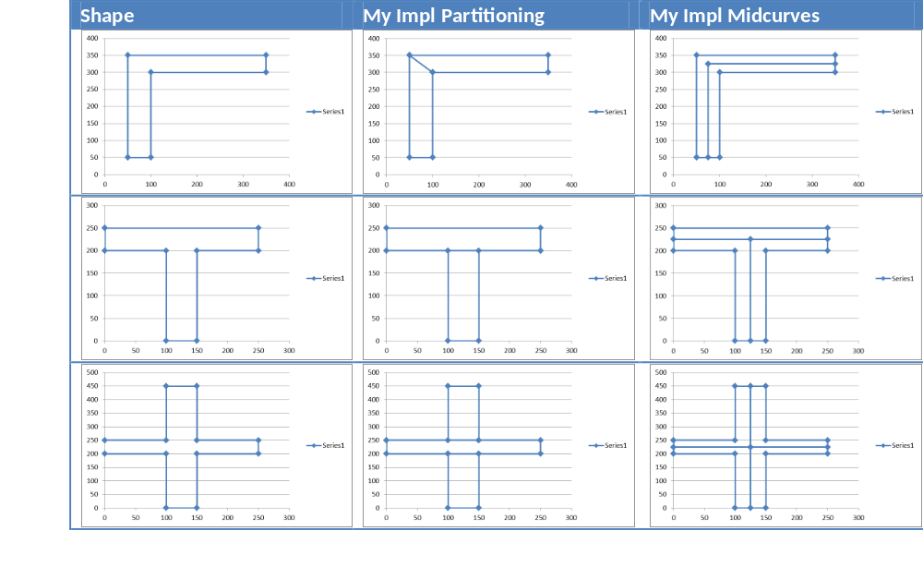
2017: My PhD Work: Rule-based
Yogesh Kulkarni

Slide 13

Limitations
Fully rule-based
Need to adjust for new shapes
So, not scalable
CAD'21, Barcelona
Yogesh Kulkarni

Slide 14

Idea
Can Neural Networks “learn” the dimension reduction transformation?
Yogesh Kulkarni

Slide 15
How?
Supply lots of training data of profiles and their corresponding midcurves and train.
Then given an unseen profile, can Neural Network compute a midcurve, mimicking the original profile shape?
Yogesh Kulkarni

Slide 16
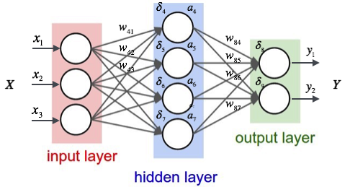
Midcurve by Neural network
Yogesh Kulkarni

Slide 17
Midcurve == Dimension Reduction
Like PCA (Principal Component Analysis), wish to find Principal curve
That ‘represents’ the original profile shape
CAD'21, Barcelona
Yogesh Kulkarni

Slide 18
Variable Size Encoder Decoder
OK for NLP, say Machine Translations, where padding values like “-1” can be added along with other words (vectors or indices)
But in Geometry, its not OK.
Because any value can represent a Valid Input, even though we don’t want it to be the input.
Yogesh Kulkarni

Slide 19
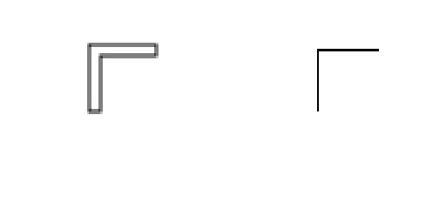
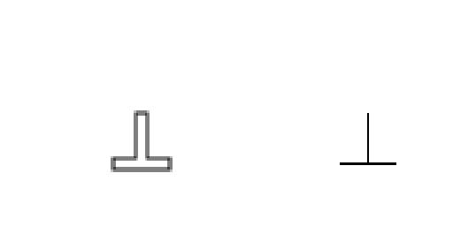
A Twist to the problem
Input: Black & White Image of 2D profile
Output: Black & White Image of 1D midcurve
Yogesh Kulkarni

Slide 20
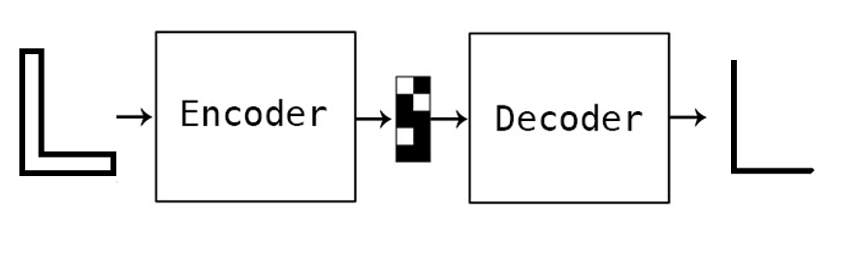
For Dimension Reduction
Yogesh Kulkarni

Slide 21
For Deep Learning
Need lots of data
Had just few input output image pairs
How to augment/populate large variations…
Yogesh Kulkarni

Slide 22
DATA PREPARATION
Yogesh Kulkarni

Slide 23
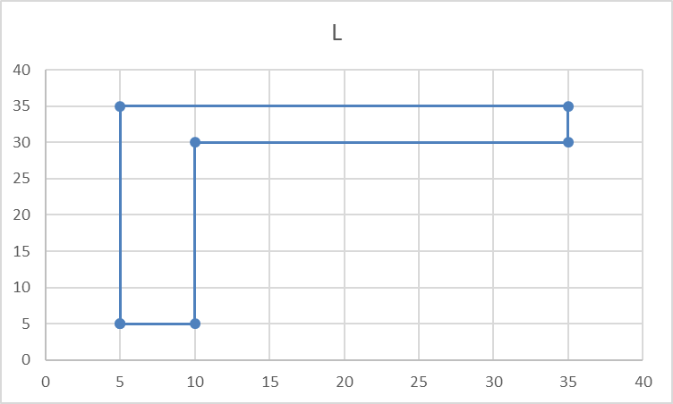
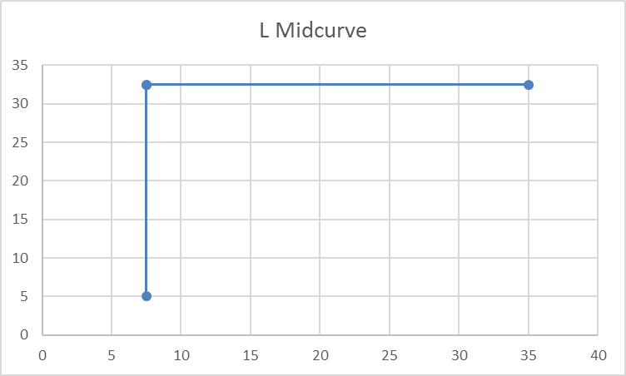
Data
Original input and output are in the form of polylines, meaning a list of points, each having x,y coordinates
Profile Data | Profile Picture | Midcurve Data | Midcurve Picture
5.0 5.0 10.0 5.0 10.0 30.0 35.0 30.0 35.0 35.0 5.0 35.0 |  | 7.5 5.0 7.5 32.5 35.0 32.5 7.5 32.5
Yogesh Kulkarni

Slide 24
Augmentation
Such few profile shapes, are just not enough for Neural Networks to train.
Need more with as much diversity as possible.
Will need to artificially augment data with transformations, like pan, rotate, mirror, etc.
All needs to be automatically, programmatically
Yogesh Kulkarni

Slide 25
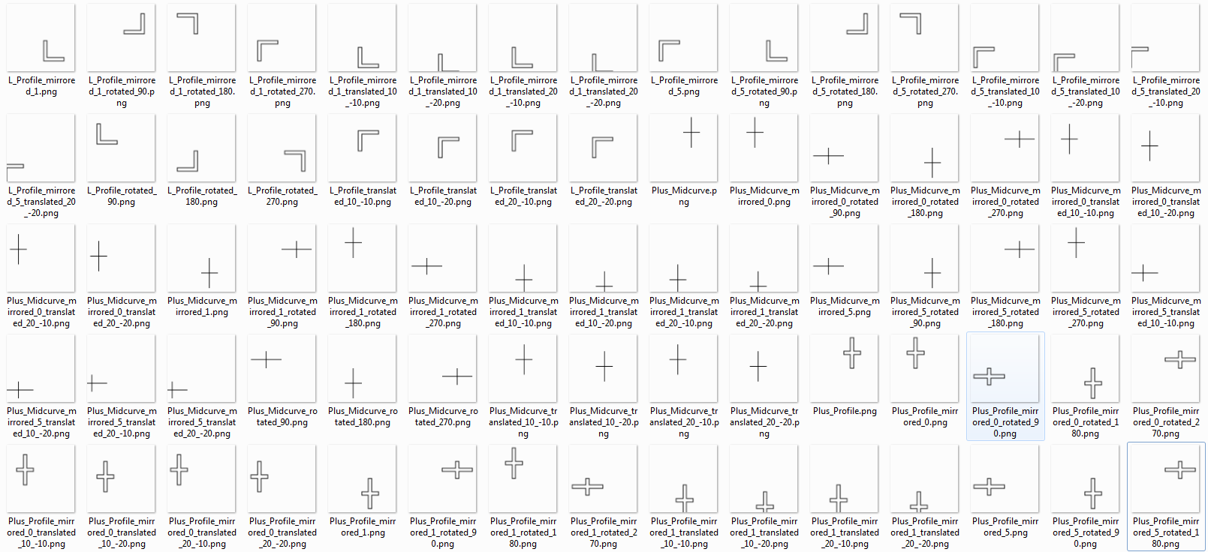
Training Data Samples
Yogesh Kulkarni

Slide 26
MIDCURVE BY NEURAL NETWORK
Yogesh Kulkarni

Slide 27
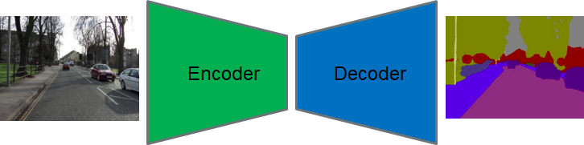
Simple Encoder Decoder
Yogesh Kulkarni

Slide 28
Keras Implementation
input_img = Input(shape=(input_dim,))
encoded = Dense(encoding_dim, activation='relu',activity_regularizer=regularizers.l1(10e-5))(input_img)
decoded = Dense(input_dim, activation='sigmoid')(encoded)
autoencoder = Model(input_img, decoded)
encoder = Model(input_img, encoded)
encoded_input = Input(shape=(encoding_dim,))
decoder_layer = autoencoder.layers[-1]
decoder = Model(encoded_input, decoder_layer(encoded_input))
autoencoder.compile(optimizer='adadelta', loss='binary_crossentropy')
Yogesh Kulkarni

Slide 29
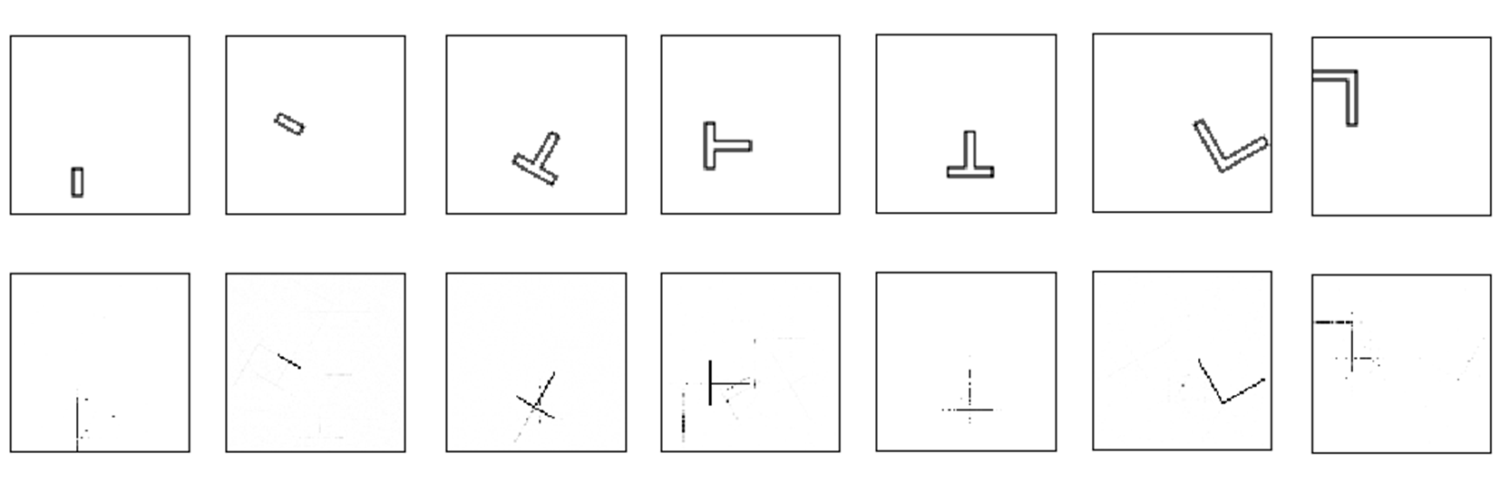
Results
Yogesh Kulkarni

Slide 30
Results
Not very perfect but encouraging
NN is correct with
  The location (bounding box)
  Dimension Reduction is seen
But, still some stray points and misses
Yogesh Kulkarni

Slide 31
What can be done?
For the noise, use bounding boxes
Feedback into error term: differencing with the known output expected
Classify single pixel image as the skeleton, and rest as noise.
Yogesh Kulkarni

Slide 32
What Next?
Add denoiser network after the current one
More Network Architectures
Sequence-to-Sequence based approaches, taking closed thin polygon as input and polyline as output
Extending to 3D, ie Midsurface
Yogesh Kulkarni

Slide 33
Thank you
yogeshkulkarni@yahoo.com
Yogesh Kulkarni

