Slide 1
Now, what next?
Yogesh Kulkarni

Slide 2
What got you here, Won’t get you there!!
- Marshall Goldsmith

Slide 3
About the Future*
Hype Cycles
IKIGAI
*Disclaimer
No one knows about the future. That’s it.
We can just speculate and prepare accordingly.
Accept the following content, only if you like.
Basically, be your own judge.

Slide 4
Hype Cycles
What is the future?

Slide 5
What is a Hype Cycle?
Popularized by Gartner
Publishing Hype Cycles > 2 decades
Oﬀers a snapshot and a trend of relative maturity of the technology.
Assessment of Hype and Maturity

Slide 6
Definition
-- “The Gartner Hype Cycle is a device that lays out the path that technologies generally take, from their initial introduction into the market until their eventual maturation into useful components of broader solutions” --

Slide 7
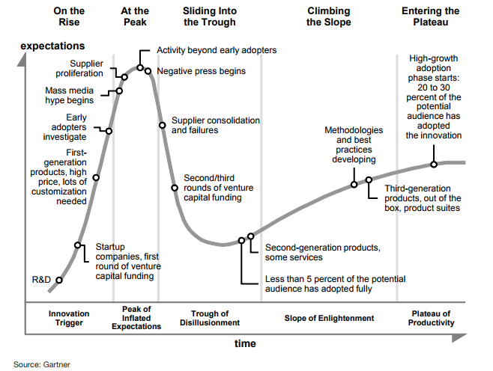
Phases

Slide 8
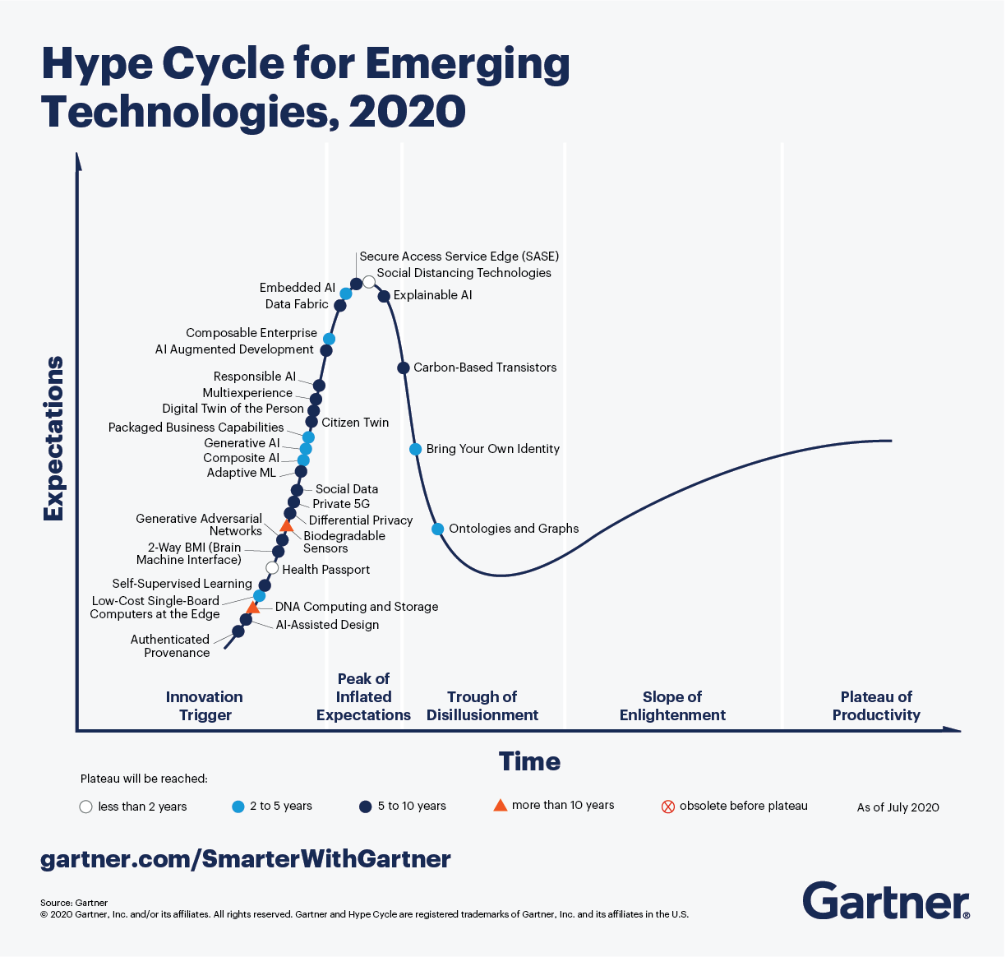
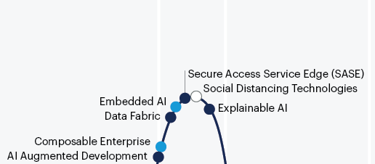

Slide 9
IKIGAI
How to prepare for the future?

Slide 10
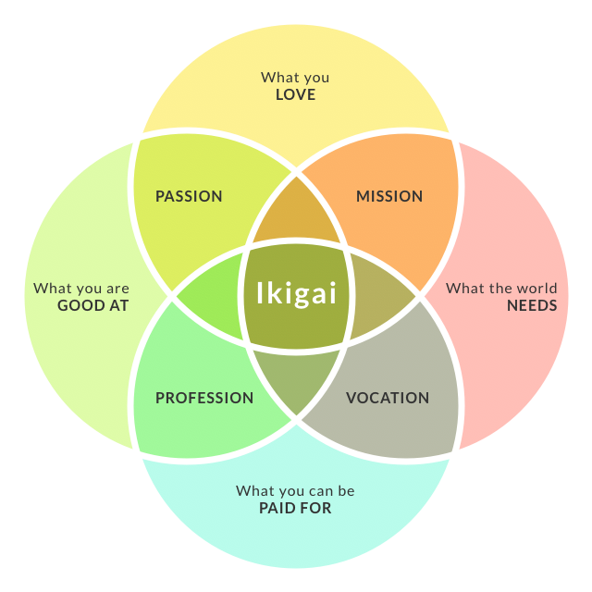

Slide 11
The Goal: Happiness
Happiness = Health + Wealth + Good Relationships
Health = Exercise + Diet + Sleep
Exercise = High Intensity Resistance Training + Sports + Rest
Diet = Natural Foods + Intermittent Fasting + Plants
Sleep = No alarms + 8–9 hours + Circadian rhythms
Wealth = Income + Assets-that-earn-while-you-sleep * (RoI)
Income = Accountability + Leverage + Specific Knowledge
Accountability = Personal Branding + Personal Platform + Taking Risk?
Leverage = Capital + People + Intellectual Property
Specific Knowledge = Knowing to do something society cannot yet easily train others
Return on Investment = ``Buy-and-Hold'' + Valuation + Margin of Safety

Slide 12
$$$
YOU need to get PAID at SCALE.
YOU – your uniqueness, and accountability.
PAID – your specific knowledge and judgement.
SCALE – the leverage you’re able to deploy.

Slide 13


Slide 14
To find me...
!WhatsApp
!Facebook
~Twitter
Career talk @ YouTube
Always on LinkedIn
Email yogeshkulkarni@yahoo.com

