Slide 1
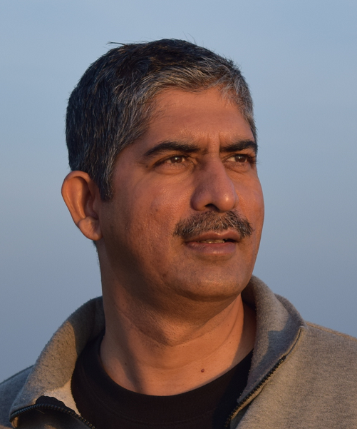
Introduction to Large Language Models (LLMs)
Yogesh Kulkarni
AI Coach

