Slide 1
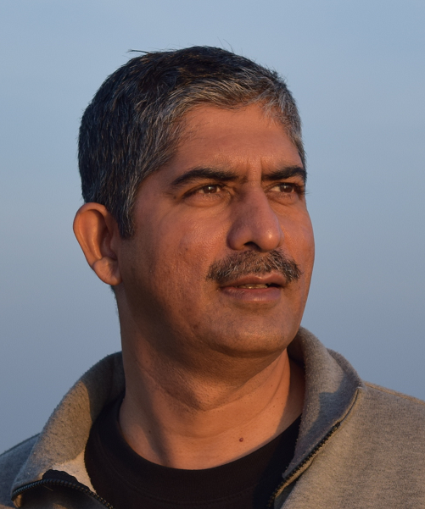

Introduction to Graph Neural Networks
Yogesh Kulkarni
Principal Architect, CTO Office, Icertis, Pune, India
9 to 10 am IST, 19th February 2022
User Group Pune
https://www.meetup.com/Tensorflow-User-Group-Pune

