Slide 1
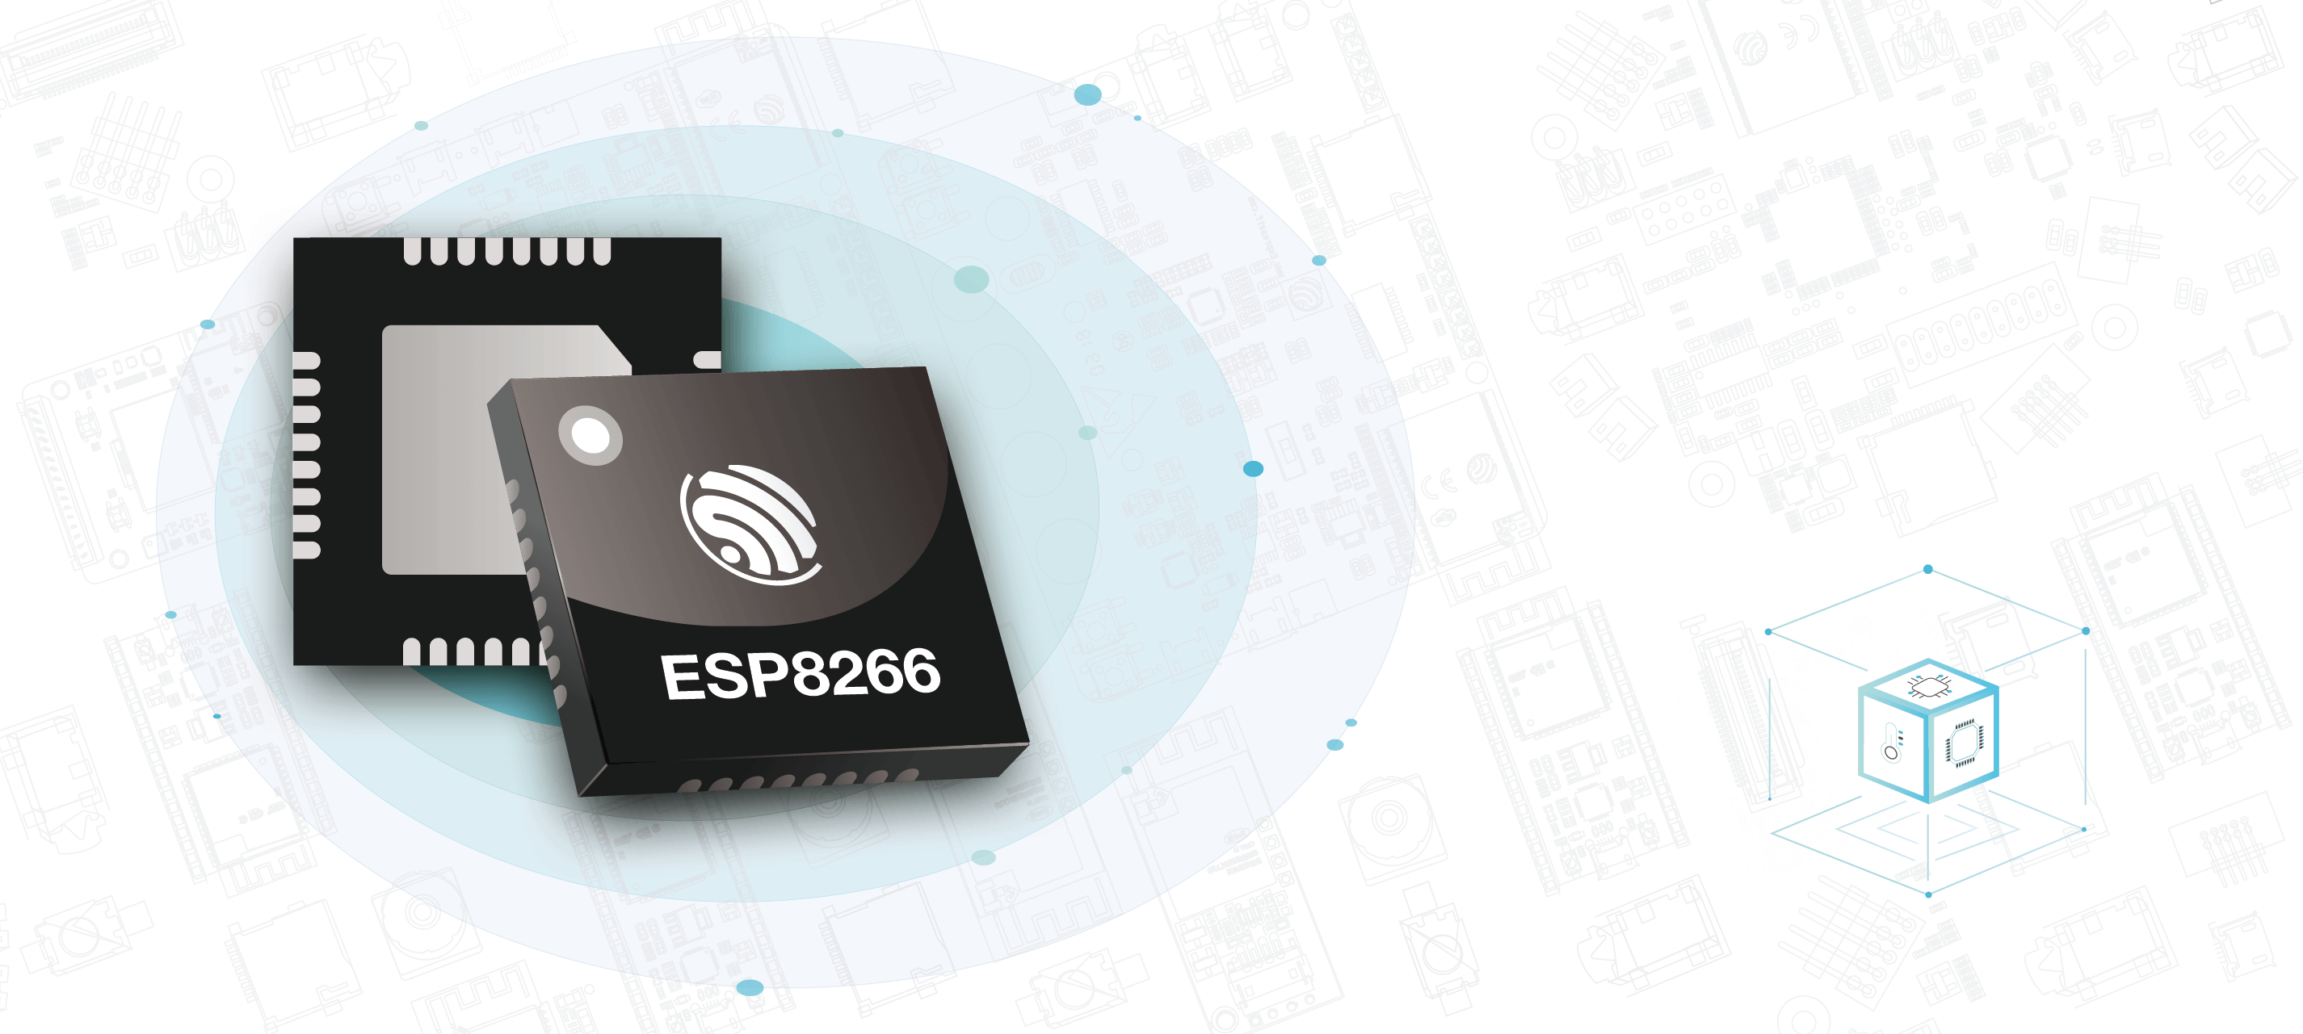
Basics of ESP8266 Microprocessor
Yogesh M Iggalore

Slide 2
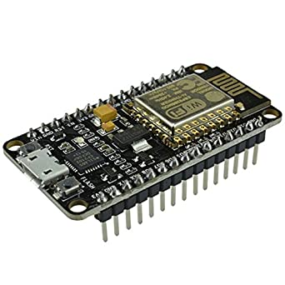
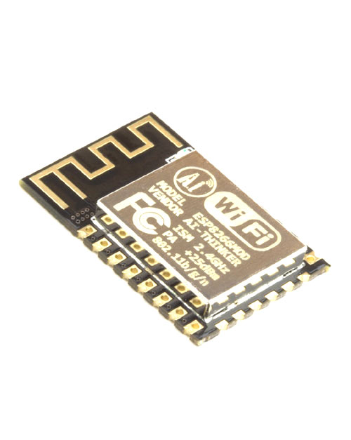
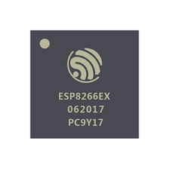
IC vs Module vs Development Kit
IC
Module
Kit
ESP8266EX
ESP8266-12E
NodeMCU

Slide 3
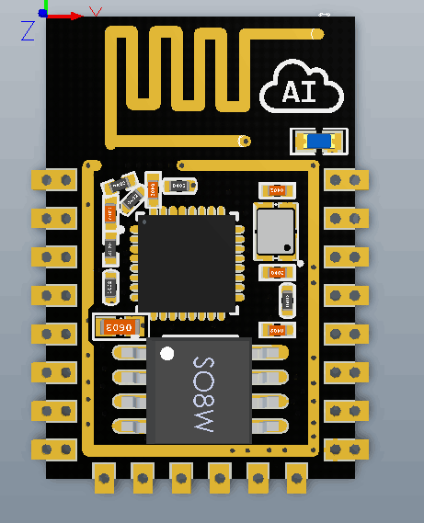
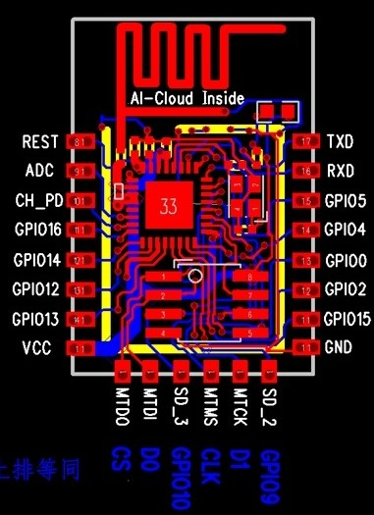
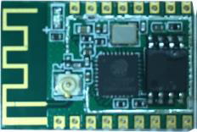
Inside ESP826612E
Component | Used
Processor | ESP8266EX
Flash | 25Q80A
Crystal | 26Mhz
Antenna | PCB trace
Certificate | FCC

Slide 4
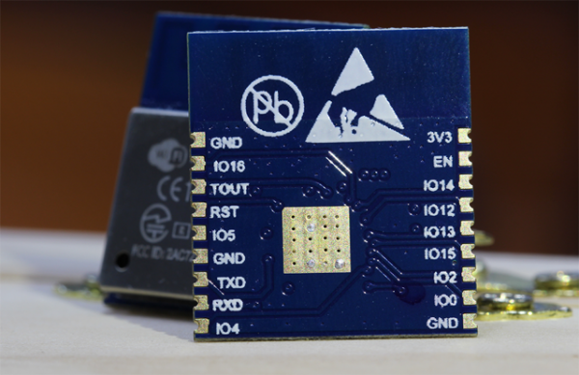
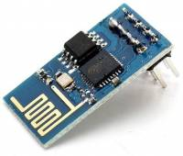
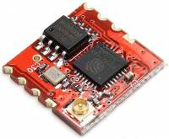
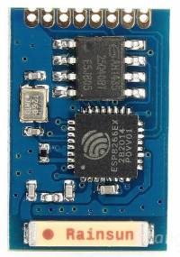
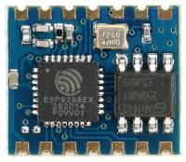
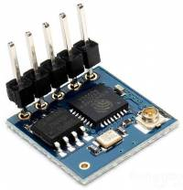
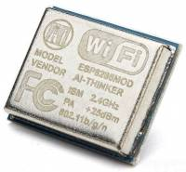
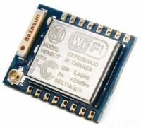
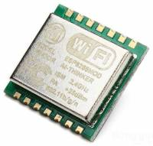
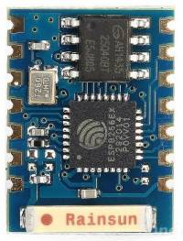
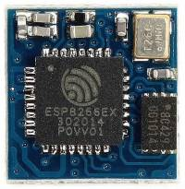
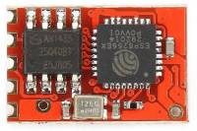
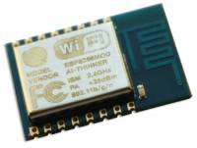
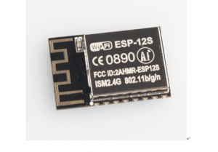
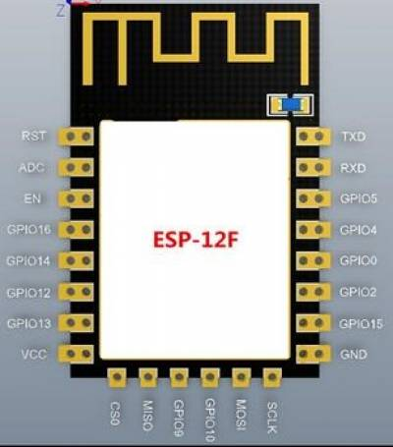
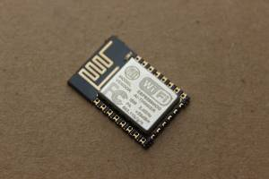
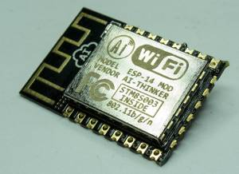
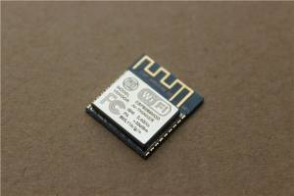
ESP8266 Module family

Slide 5
ESP8266EX Features
802.11 b/g/n WiFi support
Supports station/Access point and promiscuous mode
Operating voltage 2.5V – 3.6V
Operating current Average 80mA
Operating temperature -40 – 125 degree C
WPA/WPA2 WiFi security
WEP/TKIP/AES encryption
Adjustable WiFi transmitting power
UART & OTA firmware support
IPV4,TCP/UDP/HTTP network protocol support
UART,I2C,I2S,SPI protocol support
Single channel ADC support
Support active, modern-sleep, light sleep and deep sleep mode

Slide 6
ESP8266EX Pins
Pins | Name | Type | Functions
1 | VDDA | P | Analog power 2.5V – 3.6V
2 | LNA | I/O | RF antenna interface,
3 | VDDP3 | P | Amplifier 2.5V – 3.6V
4 | VDDP3 | P | Amplifier 2.5V – 3.6V
5 | VDD_RTC | P | NC (1.1V)
6 | TOUT | I | ADC pin Voltage testing pin
7 | CHIP_EN | I | Chip enable, High: On, chip works properly Low: Off, small current consumed
8 | XPD_DCDC | I/O | GPIO16 Deep-sleep wake up pins
9 | MTMS | I/O | GPIO14 HSPI_CLK
10 | MTDI | I/O | GPIO12 HSPI_MISO
11 | VDDPST | P | Digital/IO power supply (1.8V – 3.6V)

Slide 7
ESP8266EX Pins
Pins | Name | Type | Functions
12 | MTCK | I/O | GPIO 13; HSPI_MOSI; UART0_CTS
13 | MTDO | I/O | GPIO 15; HSPI_CS; UART0_RTS
14 | GPIO2 | I/O | GPIO 02; UART TX during flash programming
15 | GPIO0 | I/O | GPIO 00; SPI_CS2
16 | GPIO4 | I/O | GPIO 04; GPIO04
17 | VDDPST | P | Digital/IO Power Supply (1.8 V ~ 3.6 V)
18 | SDIO_DATA_2 | I/O | GPIO 09; Connect to SD_D2 (Series R: 20 Ω); SPIHD; HSPIHD;
19 | SDIO_DATA_3 | I/O | GPIO 10; Connect to SD_D3 (Series R: 200 Ω); SPIWP; HSPIWP;
20 | SDIO_CMD | I/O | GPIO 11; Connect to SD_CMD (Series R: 200 Ω); SPI_CS0;
21 | SDIO_CLK | I/O | GPIO 06; Connect to SD_CLK (Series R: 200 Ω); SPI_CLK;
22 | SDIO_DATA_0 | I/O | GPIO 07; Connect to SD_D0 (Series R: 200 Ω); SPI_MISO;

Slide 8
ESP8266EX Pins
Pins | Name | Type | Functions
23 | SDIO_DATA_1 | I/O | GPIO 08; Connect to SD_D1 (Series R: 200 Ω); SPI_MOSI;
24 | GPIO05 | I/O | GPIO 05
25 | U0RXD | I/O | GPIO 03; UART Rx during flash programming; GPIO3
26 | U0TXD | I/O | GPIO 01; UART Tx during flash programming; SPI_CS1
27 | XTAL_OUT | I/O | Connect to crystal oscillator output, can be used to provide BT clock input
28 | XTAL_IN | I/O | Connect to crystal oscillator input
29 | VDDD | P | Analog Power 2.5 V ~ 3.6 V
30 | VDDA | P | Analog Power 2.5 V ~ 3.6 V
31 | RES12K | I | Serial connection with a 12 kΩ resistor and connect to the ground
32 | EXT_RSTB | I | External reset signal (Low voltage level: active)

Slide 9
ESP8266EX Pins
Label | GPIO | Input | Output | Notes
D0 | GPIO16 | no interrupt | no PWM or I2C support | HIGH at boot used to wake up from deep sleep
D1 | GPIO05 | OK | OK | often used as SCL (I2C)
D2 | GPIO04 | OK | OK | often used as SDA (I2C)
D3 | GPIO00 | pulled up | OK | connected to FLASH button, boot fails if pulled LOW
D4 | GPIO02 | pulled up | OK | HIGH at boot connected to on-board LED, boot fails if pulled LOW
D5 | GPIO14 | OK | OK | SPI (SCLK)
D6 | GPIO12 | OK | OK | SPI (MISO)
D7 | GPIO13 | OK | OK | SPI (MOSI)
D8 | GPIO15 | pulled to GND | OK | SPI (CS) Boot fails if pulled HIGH
RX | GPIO03 | OK | RX pin | HIGH at boot
TX | GPIO01 | TX pin | OK | HIGH at boot debug output at boot, boot fails if pulled LOW
A0 | ADC0 | Analog input | X | Analog pin 1.8V

Slide 10
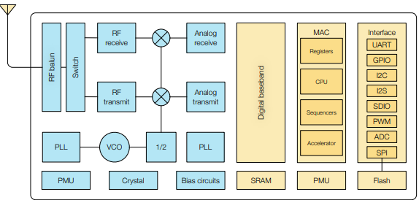
ESP8266EX Functional Description

Slide 11
ESP8266EX Functional Description
Tensilica L106 32-bit RISC processor
Maximum clock speed of 160 MHz
Programmable RAM/ROM interfaces
Data RAM interface,
Advance Peripheral Bus(APB) interface

Slide 12
ESP8266EX Functional Description
32 KiB instruction RAM
32 KiB instruction cache RAM
80 KiB user-data RAM
16 KiB ETS system-data RAM

Slide 13
ESP8266EX Functional Description
Supports external Flash
Communication SPI
Max 16MB supported
OTA disabled min 512kB
OTA enabled min 1MB

Slide 14
ESP8266EX Functional Description
GPIO (General Purpose Input and Output)
UART (universal asynchronous receiver transmitter)
I2C (Inter Integrated circuit)
I2S (Inter IC sound)
SDIO (Secure Digital Input Output)
PWM (Pulse Width Modulation)
ADC (Analog to Digital Conversion)
SPI (Serial Peripheral Interface)

Slide 15
ESP8266EX Functional Description
Receiver receives modulated RF signal and demodulates its signals.
Transmitter transmits the modulated radio values
RF balun converts between balanced and unbalanced signals
Switch helps in switching between receiver and transmitter

Slide 16
ESP8266EX Functional Description
PLL (Phase Lock Loop) control system generate output signal whose phase is related phase of input signal
VCO (Voltage controlled Oscillator) oscillation frequency controlled by voltage input
PMU (Power Management Unit) does power management
External crystal 26MHz

