Slide 1
Embedded C/C++ basics
Yogesh M Iggalore

Slide 2
Which is C ?
“K & R C”
Invented in the 1970s by Dennis Ritchie
The first published “standard” ca.1978
“ANSI C”, “ISO C”, “C90”
Joint ANSI/ISO standard (ISO/IEC 9899:1990)
Amended in 1995”
“C99”
A 1999 update of ISO C( ISO/IEC 9899:1990)

Slide 3
Difference with conventional C
It's not about the language - it's about how you apply the language!
C use the resources of desktop computers (memory, OS, etc)
Embedded C use only limited resources available in chip (limited RAM, ROM, ports, etc).
Embedded C is a subset of Conventional C
Conventional C
Embedded C

Slide 4
Language vs. Libraries
Programming Language
Keywords and primitive data types
Program flow and syntax
Acceptable variable and function names
Standard Libraries
A set of functions useful on many platforms
Eg: strenlen(),memcpy() ,etc.
Not always available with cross compilers

Slide 5
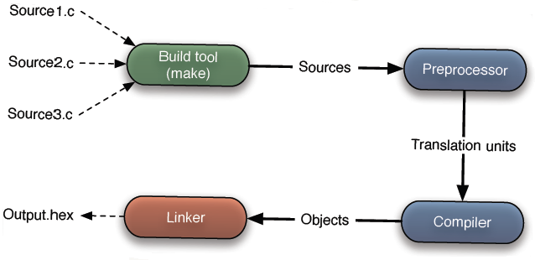
Compiler concept
C:Two types of files- .h and .c
Build tool: collect all .h and .c files and provide to preprocessor
Preprocessor: looking at “# include” directive, replace’s the “#include” with entire contents of header file. This combination called translation units one per each source file.
Compiler: Compiles source files and create object file per source file
Linker: combines all object file and produces final executable hex file

Slide 6
Fixed width integers
Desktop programmers use int routinely
But size matters in embedded systems
Peripheral registers has widths (in bits)
RAM/ROM (Flash) is frequently in short supply
The C standard says only that
Sizeof (char) <=sizeof(short)<=sizeof(int)<=sizeof(long)
Short is at least 16 bit wide
Long is at least 32 bit wide
Common compiler schemes
Char:8 bits,short:16 bits,int:16 bits,long:32 bits
Char:8 bits,short:16 bits,int:32 bits,long:32 bits
Char:8 bits,short:32 bits,int:32 bits,long:64 bits

Slide 7
When Size Matters
Peripherals
I/O device registers have specific widths
16 bit “count” register in timer/counter
8 bit data register in DAC
Communications
May want to overlay two or more different types in a union

