Slide 1
I2C Basics
Yogesh M Iggalore

Slide 2
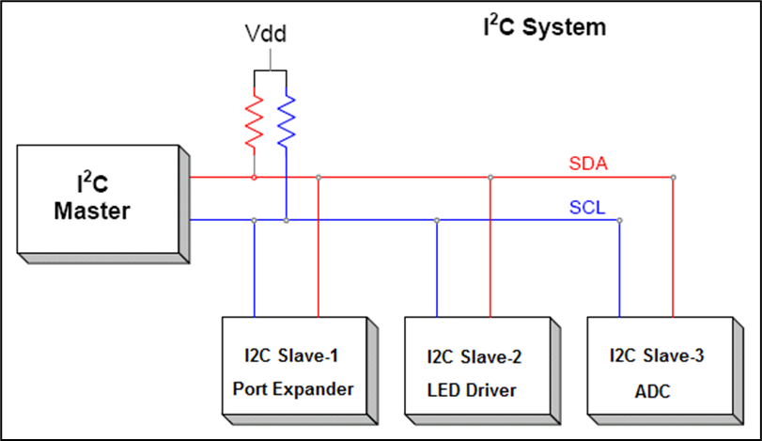
What is I2C?
Inter-Integrated Circuit (IIC or I2C) is a common chip-to-chip digital communications protocol.
I2C was originally designed by Phillips Semiconductor (now NXP) in the early '80s
It’s a simple two wire synchronous protocol
It supports multiple slaves on the same bus
It also supports multiple masters on the same bus

Slide 3
Why do we need I2C?
Applications : Wide usage
Simple to use and quick to implement into designs
Intended to control, check & update the status and do maintenance functions
Enhance feature set of applications
Standard adopted by all Industry segments and used in many system applications
Interface : Well known bus interface standard
Bidirectional transfer of data between a master and several slave devices on the bus
The master device controls the bus
Each slave device on the same bus has an unique I2C address
More than 25 years of existence

Slide 4

Why do we need I2C?
Architecture :
Two-wire communication bus
Speed: Three modes of operation
Standard mode (0 to 100 KHz)
Fast mode (0 to 400 KHz)
High-speed mode (0 to 3.4 MHz)

Slide 5
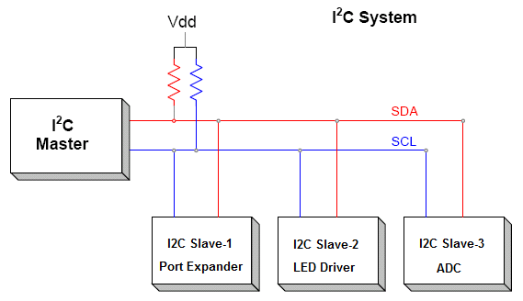
I2C - Master and slave
A master device is in charge of the bus and this device controls the clock and generates START and STOP signals.
Slaves simply listen to the bus and act on controls and data that they are sent.
The master can send data to a slave or receive data from a slave - slaves do not transfer data between themselves.

Slide 6
I2C - Data and Clock lines
The I2C interface uses two bi-directional lines – Serial Clock (SCL) and Serial Data (SDA)
The two wires must be driven as open collector/drain outputs by all devices in the bus, and must be pulled high using one resistor each
This implements a 'wired AND function' - any device pulling the wire low causes all devices to see a low logic value - for high logic value all devices must stop driving the wire (make it as High-Z)

Slide 7
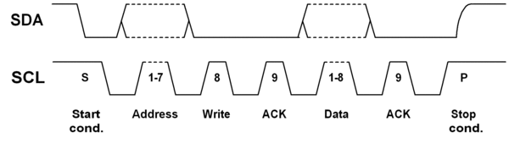
I2C - Basic Command Sequence
Send the START sequence - SDA transitions to low with SCL being high
Send the slave address - You can use 7 bit or 10 bit addresses.
Send the Read(R)-1 / Write(W)-0 bit.
Wait for/Send an acknowledge bit (A) – (ACK-0 / NACK-1)
Send/Receive the data byte (8 bits) (DATA).
Expect/Send acknowledge bit – (ACK-0 / NACK-1)
Send the STOP sequence - SDA transitions to high with SCL being high

Slide 8
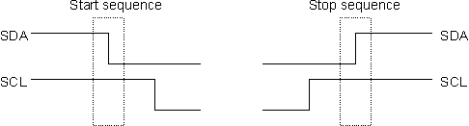


The I2C Physical Protocol
Start and Stop sequence
Sending Device Address
Transfer of data

Slide 9
I2C - MASTER writes to a SLAVE (typical)
Send a START sequence
Send the I2C address of the SLAVE with the R/W bit low (even address)
send the device register you want to write to
Send the data byte
send any further data bytes
Send the STOP sequence.
ACK/NACKs
Slave will ACK/NACK after every 8 bits
If Slave ACKs, master can send one more byte of data
If Slave NACKs, master should abort the communication
 | START | ADDRESS | W | ACK | [device register] DATA | ACK | DATA | ACK | STOP
Bits |  | 7 | 0 | 0 | 8 | 0 | 8 | 0
 |  |  | W |  | 1 |  | 0x10
 | START | ADDRESS | W | ACK | DATA | NACK | STOP
Bits |  | 7 | 0 | 0 | 8 | 1
 | Sent by master
 | Sent by Slave

Slide 10
I2C - MASTER reads from a SLAVE
Typical Read :
Send a START sequence
Send I2C address of the SLAVE with the R/W bit high (odd address)
Read data byte from SLAVE
Send the STOP sequence.
Read from register address: (Concept : First write, then read)
Send a START sequence
Send I2C address of the SLAVE with the R/W bit low (even address)
Send device register address you want to read from
Send a START sequence again (or a repeated start – see next page)
Send I2C address of the SLAVE with the R/W bit high (odd address)
Read data byte from SLAVE
Send the STOP sequence.
Device Registers
Address | Definition
0 | Status
1 | LED1_Status
2 | LED2_Status
3 | ADC_MSB
4 | ADC_LSB
..
..
..

Slide 11
I2C - MASTER reads from a SLAVE
General Read:
OR
Read from register address:
 | START | ADDRESS | R | ACK | DATA | ACK | DATA | NACK | STOP
Bits |  | 7 | 1 | 0 | 8 | 0 | 8 | 1
 | START | ADDRESS | W | ACK | Register Data | ACK | Repeat START | ADDRESS | R | ACK | DATA | ACK | DATA | NACK | STOP
Bits |  | 7 | 0 | 0 | 8 | 0 |  | 7 | 1 | 0 | 8 | 0 | 8 | 1
ACK/NACKs
Slave will ACK only once for the address byte
Master will ACK, if it wants to read one more byte from slave
Master will NACK, if it wants to stop the reading
Note that the slave does not have an option to stop the communication once it has acknowledged the address.
 | Sent by master
 | Sent by Slave

Slide 12
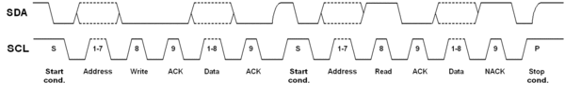
Repeated Start
A way to claim the bus : During an I2C transfer there is often the need to first send a command and then read back an answer right away. This has to be done without the risk of another (multimaster) device interrupting this atomic operation.
Send a start condition before sending a stop
Typically used when you want to write and read immediately or when you want to write to two different registers sequentially
Note : Regardless of the number of start conditions sent during one transfer the transfer must be ended by exactly one stop condition.

Slide 13
Clock stretching
A slow slave device may need to stop the bus while it gathers data or services an interrupt etc.
It can do this while holding the clock line (SCL) low forcing the master into the wait state.
The master must then wait until SCL is released before proceeding.
As per specification,
the slave can hold the SCL line after any clock bit
any device can hold down SCL as long as it likes!!

Slide 14
Arbitration
Occurs in Multi-master mode.
Happens when two masters start a transfer at the same time.
During the transfer, the masters constantly monitor SDA and SCL.
If one of them detects that SDA is low when it should actually be high, it assumes that another master is active and immediately stops its transfer.
This process is called arbitration.

Slide 15
I2C - Typical devices types
IO expanders
EEPROMs
DACs, ADCs
LCD/LED drivers
Capacitive sensors
NVRAM
Real-Time clocks (RTC)
Digital Temperature ICs
Accelerometers
Compass
Third party sensors with an I2C interface (sonars, IR range finders, NXT I2C sensors)

Slide 16
More materials on I2C…
Want to learn more?
Check the I2C Primer from http://www.i2c-bus.org
The latest I2C specification is available directly from NXP.
There are a number of I2C-like buses, see Definitions and Differences Between I2C, ACCESS.bus and SMBus.
The I2C-Bus and how to use it is a well-known document from Philips discussing the use of this bus in applications.

Slide 17
Wire Lib
void begin(int sda, int scl, uint8_t address)
Description | This function to start i2c module
Parameter | sda, scl and address
Return | Void
Example | Wire.begin(D2,D1,0x10); // starts i2c master with address 0x10
void setClock(uint32_t frequency)
Description | This function sets i2c clock speed
Parameter | frequency
Return | Void
Example | Wire.setClock(400000); // set clock speed to 400Khz

Slide 18
Wire Lib
void beginTransmission(uint8_t address)
Description | This function begins i2c transmission
Parameter | address
Return | Void
Example | Wire. beginTransmission(0x10); //begins transmission to i2c address 0x10
uint8_t endTransmission(uint8_t sendStop)
Description | This function ends i2c transmission
Parameter | address
Return | Void
Example | Wire. endTransmission(0x10); // ends i2c transmission to address 0x10

Slide 19
Wire Lib
size_t write(uint8_t data)
Description | This function writes data to i2c
Parameter | Data
Return | Void
Example | Wire. write(‘a’); // writes character ‘a’ to i2c
size_t write(const uint8_t *data, size_t quantity)
Description | This function writes array bytes to i2c
Parameter | Data, quantity
Return | Void
Example | Wire. write(buffer,10); //writes 10 bytes of data in buffer.

Slide 20
Wire Lib
int available(void)
Description | This function checks any i2c data available
Parameter | None
Return | int
Example | Wire. available();
int read(void)
Description | This function reads data from i2c
Parameter | None
Return | int
Example | Wire. read();

