Slide 1
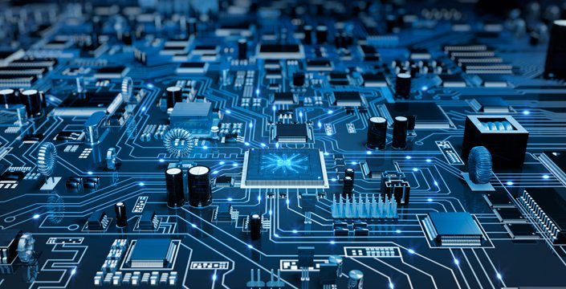
Introduction to Embedded Systems
Yogesh M Iggalore

Slide 2

Agenda
Embedded systems - Overview
Embedded is everywhere
Embedded Systems – Architecture, segments & roles
Moore’s Law – Transistor trend
Embedded Systems Market - Career & Opportunities
Some more insight to Embedded systems

Slide 3
Embedded Systems
A system built to perform its duty, completely or partially independent of human intervention.
Specially designed to perform a few tasks in the most efficient way.
Interacts with physical elements in our environment, viz. sensing temperature, controlling and driving a motor etc.,

Slide 4
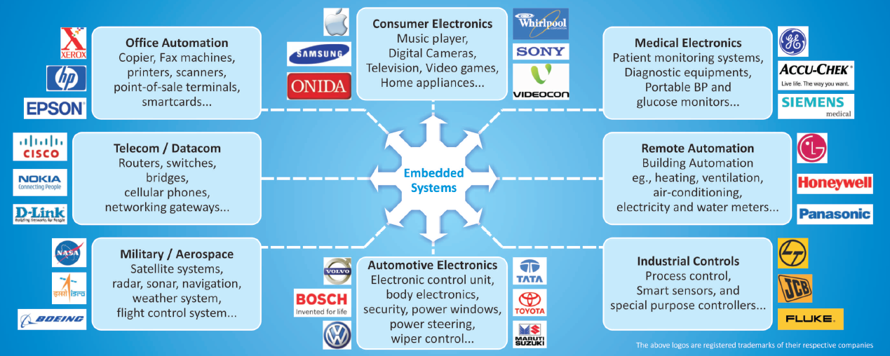
Embedded is everywhere…

Slide 5
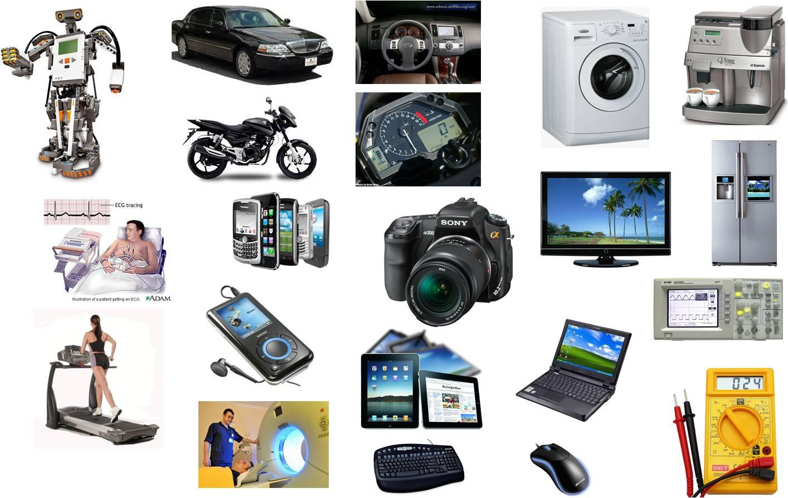
Embedded is everwhere

Slide 6
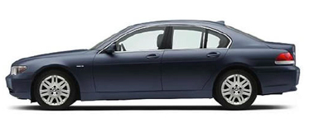
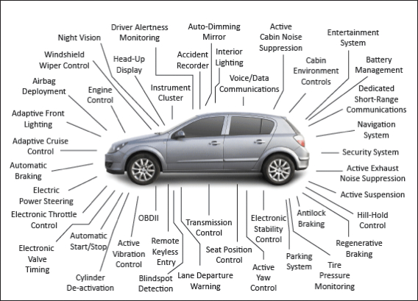
Example: Automotive Electronics
BMW 745i
Modern cars: Around 50 microcontrollers run complex software
Engine and emissions control, stability and traction control, diagnostics, gearless automatic transmission and more
http://www.howstuffworks.com/car-computer.htm
2 million lines of code
53 8-bit μC
11 32-bit μC
7 16-bit μC
Multiple comm. networks

Slide 7
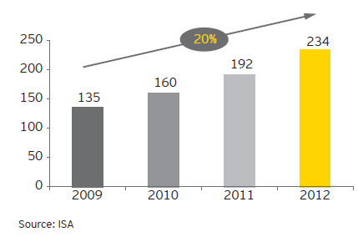
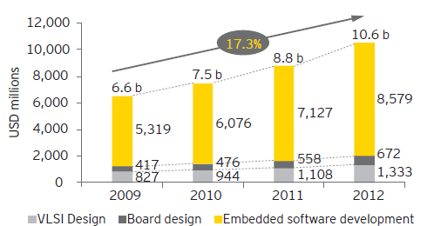
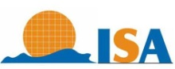
Embedded Systems – Growth potential
The Embedded systems field is poised for a huge growth throughout the world
In consumer segment alone, there are 2 billion embedded devices hitting the market every year
The worldwide R&D in the field of Embedded Systems is expected to double over the next 10 years
Professionals trained in embedded systems are a rare commodity in the recruitment market place.
in thousands
Source:
Installed talent pool in India
Indian semiconductor design industry

Slide 8
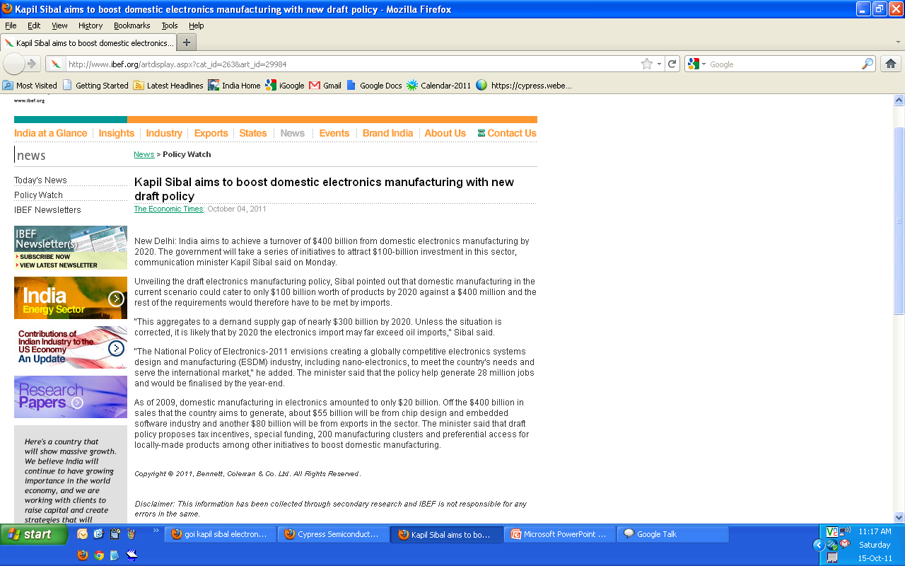
India’s new electronic policy targets $400 billion
http://mit.gov.in/sites/upload_files/dit/files/Draft-NationalPolicyonElectronics2011_4102011(2).pdf

Slide 9
Embedded Systems Market
The global market for embedded systems is expected to increase from $101.6 billion in 2009 to an estimated $158.6 billion by the end of 2015, a compound annual growth rate (CAGR) of 7%
Embedded hardware was worth $108.8 billion in 2010 and is expected to grow at a CAGR of 7% to reach $152.4 billion in 2015
Embedded software generated $4.2 billion in 2010. This should increase to $6.1 billion in 2015, for a CAGR of 7.8%
http://www.bccresearch.com/report/embedded-systems-technologies-markets-ift016d.html (published Jan 2012)

Slide 10
Embedded Systems Market - Contd….
More than 5 billion ARM-based processors sold in 2010 alone (Intel has sold close to 4 billion processors during its entire history!)
In consumer segment alone, there are 2 billion embedded devices hitting the market every year
The worldwide R&D in the field of Embedded Systems is expected to double over the next 10 years
The average person (mostly unknowingly) uses around 100 embedded microcontrollers in his/her day-to-day life
Professionals trained in embedded systems are a rare commodity in the recruitment market place.
GOI is coming out with a plan to grow Indian electronic industry to $400 billion.

Slide 11
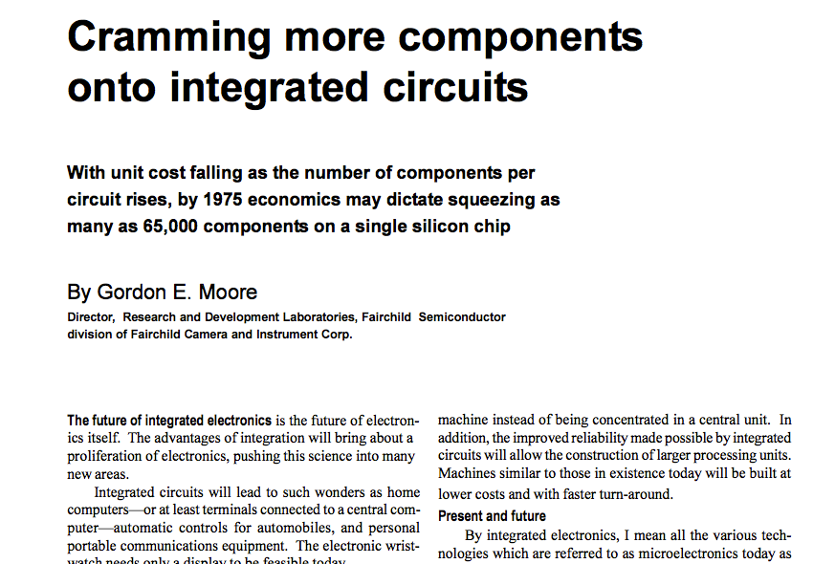
Moore’s Prediction in 1965 – His law
The number of transistors that can be placed inexpensively on an integrated circuit doubles approximately every two years

Slide 12
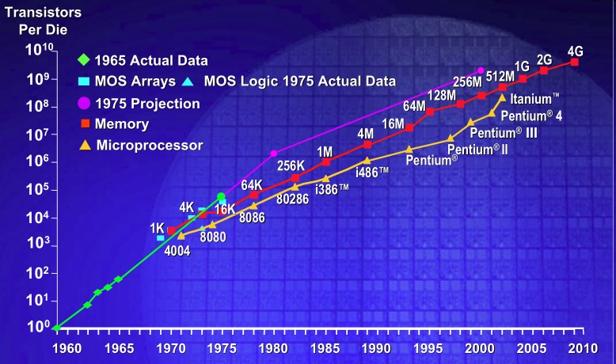
Moore’s Law
Over ten crore transistors

Slide 13
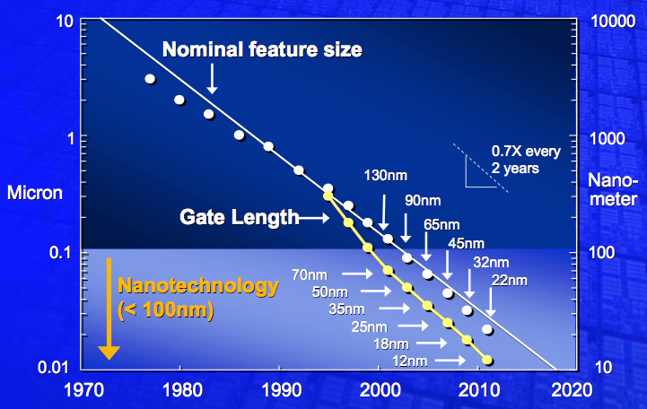
The Shrinking Transistor

Slide 14
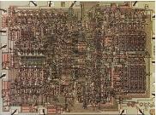
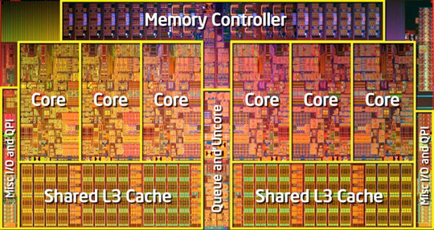
Chip of 1971 vs. Chip of 2010
Intel 4004 (first microprocessor)
Intel Core i7-980X (Gulftown)
2300 transistors
10 μm feature size
12 mm² die area
1.17 billion transistors
32 nm feature size
248 mm² die area

Slide 15
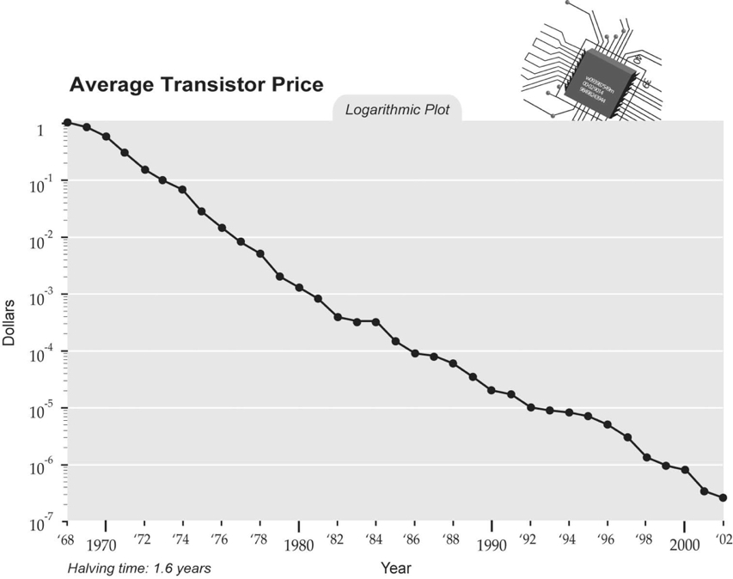
Decreasing Cost per Transistor
Average cost of a transistor halves every 1.6 years
Note that the transistor also gets faster, so you can do more with it
Rough price of a transistor now = one printed newspaper character.

Slide 16
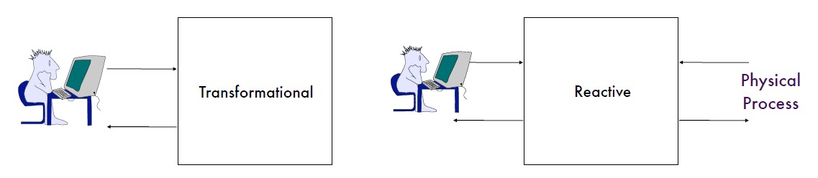
Reactive Operation
Interactive
Reactive
Personal computer
Embedded systems
Computation is in response to external events, as opposed to operations in interactive systems
Need to deal with a mix of periodic and aperiodic events
Interaction with environment causes problems
Indeterminacy in execution
e.g., waiting for events from multiple sources
Physical environment is delay intolerant
can’t put it on wait with an hour glass icon!
Handling timing constraints crucial to the design of embedded systems

Slide 17
What is Real-Time?
Time is a major discriminator relative to general purpose computing
Time: correctness of system depends not only on the logical result of the computation, but also on the time at which the results are produced
Real: reaction of the system to external events must occur during their evolution
Real-time != Fast
Fast is relative, and does not capture the “real” constraint
Concept of time is not an inherent property of an embedded system. Rather, it is strictly related to environment in which the system operates
Erroneous belief: faster hardware will solve the problem
Faster hardware improves throughput but does not imply that individual timing constraints will be met
Fast vs. predictable: Just because a system is fast, cannot guarantee that individual timing requirements will be met under all circumstances
Worst case performance is often the issue

Slide 18
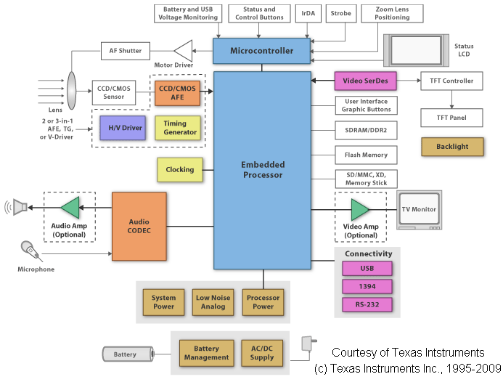
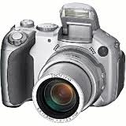
Modern Embedded Systems

Slide 19
Embedded HW Considerations
Processor
energy, computation
Network interface
wired, RF, acoustic, optical
energy, range, bandwidth, interference-robustness
Energy supply
wired, battery, scavenging
lifetime, size
User interface
type, energy, complexity
Sensing
type, energy, range, accuracy, resolution, frequency, reliability
Actuation
type, energy, range
Storage
energy, capacity, bandwidth
Packaging
form-factor, weight, weather-proof
Overall cost

Slide 20
Processing Choices
Microprocessors
Domain-specific processors
DSPs
Network processors
Microcontrollers
Reconfigurable SoC (PSoC...)
FPGA
ASIC

Slide 21
Hardware vs. Software
Hardware = functionality implemented via a custom architecture
e.g., datapath + controller (Finite State Machine - FSM)
Software = functionality implemented on a programmable processor
Key differences:
Multiplexing
software modules multiplexed with others on a processor
hardware modules are typically mapped individually on dedicated hardware
Concurrency
processors usually have one “thread of control”
dedicated hardware often has concurrent datapaths

Slide 22
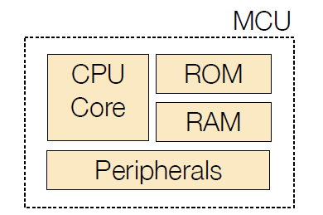
Microcontrollers (MCU)
Chip vendors either develop own CPU core or license IP
Specific chips usually targeted toward a small set of applications (unlike PSoC, which targets multiple applications)

Slide 23
Microcontrollers
Different from your regular desktop CPU
Smaller in size
Reduced instruction set
Less power consumption
Lower frequencies
Within microcontrollers, there is a large variation (typical variations are represented below)
Bus Width | CPU Speeds | RAM | ROM
8-bit | 1-8 MHz | 128-1K | 512 to 10K
16-bit | 4-25 MHz | 1K to 10K | 10K to 128K
32-bit | 10-1000 MHz | 10K to 512M | 128K to 512M

Slide 24
Communication Interfaces
Communication is an important aspect of embedded systems
Often contain specialized communication chips
Wired
Interfacing with sensors and other system components (like comm. chips)
I2C
SPI
UART
USB
CAN
Communication with other embedded systems
Ethernet
RS485
Wireless
Becoming more and more important because of ease of installation
Many different standards for short, mid, and long range communication

Slide 25
Wireless Technologies
Short Range
IEEE 802.15.4, ZigBee Alliance
Home automation
Sensor Networks
z-Wave
Home automation
Bluetooth
Short range communication
Audio headsets
Proprietary (Eg:CyFi)
Mid Range
802.11
Wide Area Networks
GSM/CDMA
Satellite
Proprietary point to point links

Slide 26
Programming techniques
Microcontroller's flash are programmed in different ways
ISSP - In-system serial programming
JTAG - Joint Test Action Group is an IEEE standard
Boot loading

Slide 27
One Possible Taxonomy
Signal processing systems
E.g., Radar, sonar, real-time video, set-top boxes, DVD players, medical equipment, residential gateways
Key challenge: Need for high computational power
Mission critical systems
E.g., Avionics, space-craft control, nuclear plant control
Key challenge: Need for extreme reliability
Distributed control
E.g., Smart grid, mass transit systems, elevators in buildings
Key challenge: Need to deal with distributed nature of system
Small systems
E.g., Cellular phones, pagers, home appliances, toys, smart cards, MP3 players, PDAs, digital cameras and camcorders, sensors, smart badges
Key challenge: Deal with stringent resource constraints
Several embedded systems fall into more than one category

Slide 28
Typical Characteristics
Physically coupled
Interact (sense, manipulate) with physical world processes and phenomena
Hybrid dynamics (mix of continuous-state and discrete-state)
Passage of time is extremely important
Correctness of results also depends on time at which they are produced
Operation is almost always time constrained: latency, throughput
HW and SW do application-specific function – not general purpose
Application is typically known a priori
Some degree of re-programmability is essential (upgrading, bug fixing, product differentiation, customization)
Inherently concurrent
Never terminate (ideally)
Various constraints: computation, memory, bandwidth, power, size, weight, heat, reliability, cost, etc.

Slide 29
Key Recent Trends
Increasing computation demands
e.g., multimedia processing in set-top boxes, HDTV
Increasingly networked
e.g., embedded web servers, cameras, disks, etc., that sit directly on networks
Increasing need for flexibility
Time-to-market under ever changing standards! This is where PSoC comes into picture
Increasing share of SW development in terms of cost

Slide 30
Embedded Product Development Process
Production
9
Final Integration and testing
8
Hardware and Firmware testing
7
Firmware architecture and development
6
Design of Preliminary hardware (Schematic and board design)
5
Component selection
4
Project scheduling
3
Develop design specifications
2
Market Research & Feasibility study
1

Slide 31
Thank You
yogesh@meti.in
yogesh.ineclat@gmail.com
+91 9900022929
https://www.linkedin.com/in/yogesh-m-iggalore-38b41470/

