Slide 1
Online Courses
IoT Product Development
& Its Applications

Slide 2
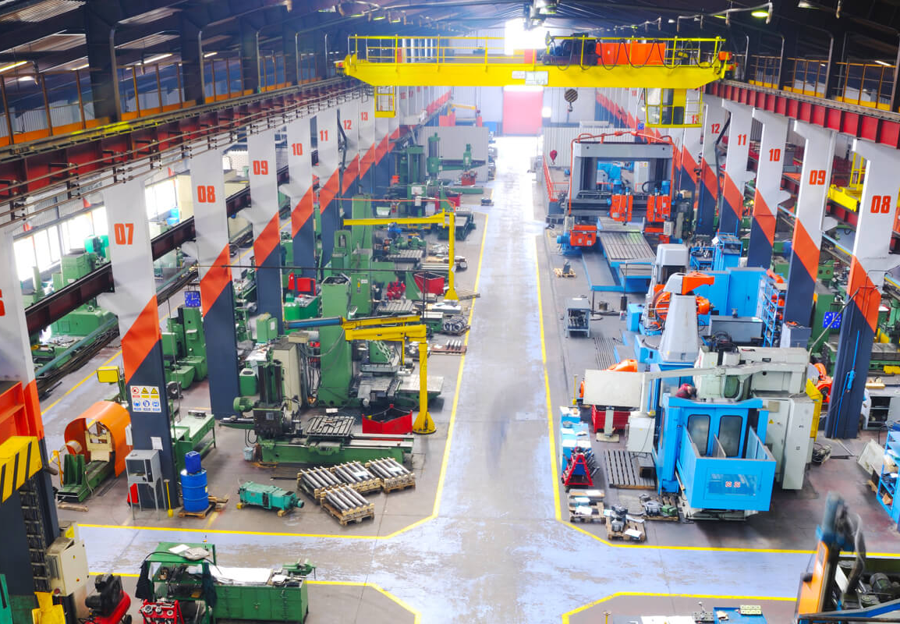
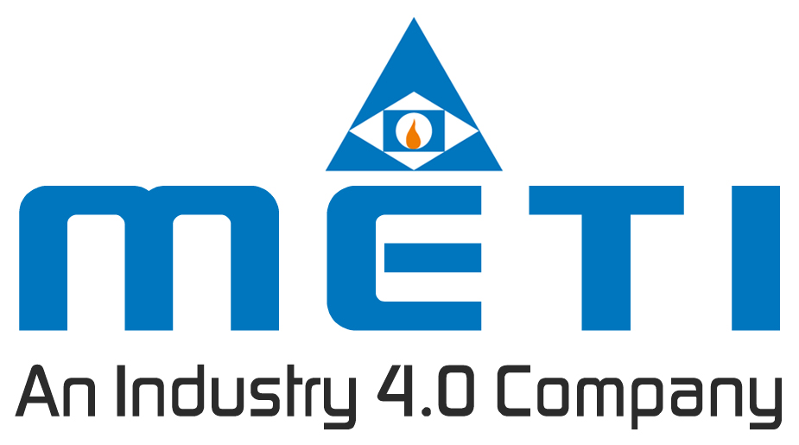

Slide 3
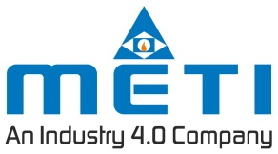
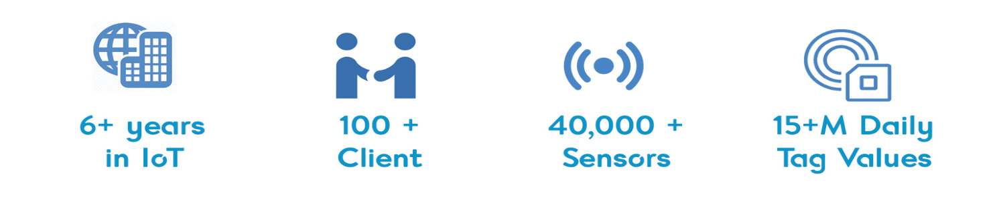
About US
METI M2M India Pvt Ltd started in the year 2012 with an unflinching focus to empower Indian industries with Industry 4.0 solution that gives a competitive edge.
Over the past six years, by serving more than 100+ clients, our team has gained experience and expertise to develop and deploy Industry 4.0 solutions. This makes our solution reliable and easy to adapt.
With effective consultation and requirement analysis we offer the right Industry 4.0 hardware and analytics platform that is aimed at increasing the efficiency of the industries.

Slide 4
What we Do?
We make Industries increase shop-floor efficiency dramatically.
We do this by offering Industry 4.0 solutions as a go-to-tool for managers to remotely monitor shop floor and to make data decision towards operational excellence.
We help you reduce manual work and, Implement Industry 4.0 for
Smart management
Smart decisions
Smart maintenance
Process optimization
Have your decisions supported by real-time data to boost efficiency.
Alerts to help you predict machine and tool failure.
You will get live graphs and reports to optimize process
Easy to use dashboard to help you manage shop-floor remotely.

Slide 5
Core Competency
IIoT enabled
Hardware
APIs for ERP integration
Secured IoT platform
Industry
4.0
solution
All our hardware works agnostically without voiding the warranty of any machines.
Alerting Engine
Big Data Management
Analytics Platform

Slide 6
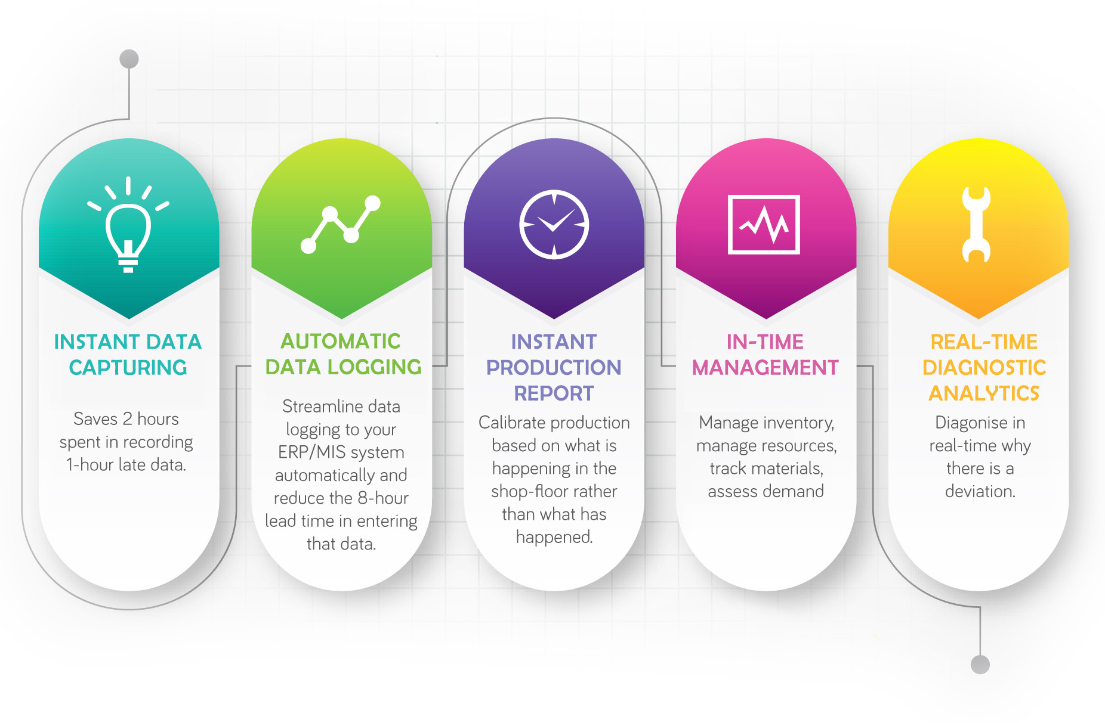
Core Competency

Slide 7
IoT Product development & Its Applications
With Overwhelming response and high demand from engineering students ,we bring you the best experience for IoT product development and its applications.
This program includes 3 courses
IoT development beginner
IoT development intermediate
IoT development Combined
Overview
Learn from Industry Experts
Get Internship certified from METI M2M INDIA PVT LTD
Get theory as well as development tool access
Get Assignments and projects
Get Online support
6 to 8 Hours a week
Duration :- 4 weeks

Slide 8
IoT Development beginner
Basic electronics component overview
Product development process
Introduction to IoT architectural design
Introduction to Hardware design and component selection
Introduction to Circuit design
Introduction to PCB design
Hands-on on Kicad PCB design software
Introduction to firmware development
Manufacturing process overview
Introduction to industrial shop floor process

Slide 9
IoT Development Intermediate
Basic Microcontroller and Microprocessor Overview
Introduction to General purpose input and output and demo programs.
Introduction to Timer and pulse width modulation technique
Introduction to EEPROM
Introduction Analog to digital converter
Introduction to SPIFFS Filesystem of microprocessor
Introduction to UART protocol
Introduction to I2C protocol
Introduction to IoT standard MQTT protocol
Introduction to industrial standard modbus protocol
IoT hardware webserver development
Alexa integration with IoT hardware
Thingspeak and Adafruit IoT examples
WiFi protocol theory and programming examples

Slide 10
IoT Development Combined
This course includes both IoT development beginner and IoT development intermediate.
All the concept mentioned in IoT development beginner and IoT development intermediate are included here.
Student can able to learn both hardware and firmware development with kits provided.

Slide 11
Welcome to Industry 4.0 Journey
“We at METI foster Industry 4.0 implementation to effective implementation.”
Name: Imam Shariff
Ph no: 9986630241
Email:- shariff@meti.in
METI M2M INDIA PVT. LTD
Mysuru

