Slide 1
Modbus Protocol
Yogesh M Iggalore

Slide 2
What is modbus
Modbus is a open source protocol developed by modicon.
Developed in year 1979 to communicate with PLC.
Standard communication protocol in industry.
The device which request the data are called modbus master.
The device which response the data are called modbus slave.
In standard network, there is one master and can be up to 247 slaves.
Modbus is often used to connect SCADA systems.

Slide 3
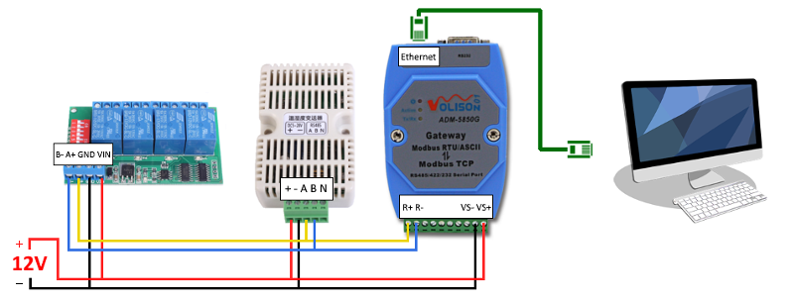
Modbus protocol modes
Modbus RTU
Modbus ASCII
Modbus TCPIP

Slide 4
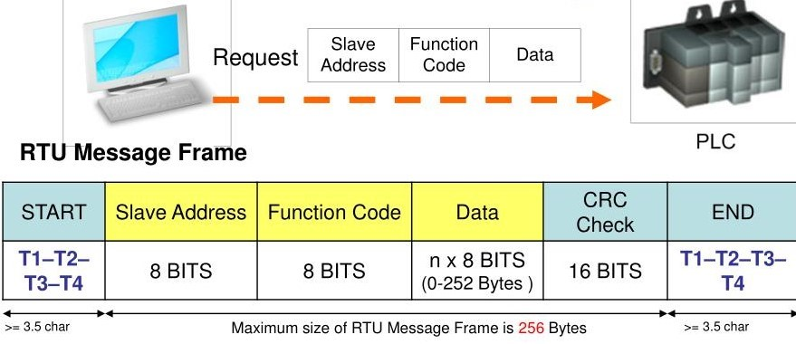
Modbus RTU frame

Slide 5
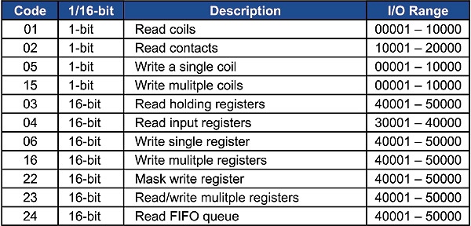
Modbus Function codes

Slide 6
Read Coil Status (FC=01)
ON/OFF status of discrete coils
Request command:
11: slave address
01: fun code read coil status
0013: data address to start read from
0025: total 25 number of coil status requested
0E84: CRC value
Slave id | Function code | Start register | Number of coils | CRC
11 | 01 | 0013 | 0025 | 0E84
Response data:
Slave id | Function code | Data byte follow | data | CRC
11 | 01 | 05 | CD6BB20E1B | 45E6
11: slave address
01: fun code read coil status
05: number of bytes followed by
CD6BB20E1B: coil status
CD coil 27 to 20 (b’11001101)
6B coil 35 to 28 (b’01101011)
B2 coil 43 to 36 (b’10110010)
0E coil 51 to 44 (b’00001110)
1B coil 56 to 52 (b’00011011)
45E6: CRC value

Slide 7
Read Input Status (FC=02)
ON/OFF status of di screte input
Request command:
11: slave address
02: fun code read input status
00C4: data address to start read from
0016: total 25 number of input status requested
BAA9: CRC value
Slave id | Function code | Start register | Number of input | CRC
11 | 02 | 00C4 | 0016 | BAA9
Response data:
Slave id | Function code | Data byte follow | data | CRC
11 | 02 | 03 | ACDB35 | 2018
11: slave address
02: fun code read input status
03: number of bytes followed by
ACDB35: input status
AC input 204 to 197 (b’10101100)
DB input 212 to 205 (b’11011011)
35 input 218 to 213 (b’00110101)
2018: CRC value

Slide 8
Read Holding Registers (FC=03)
the content of analog output holding registers
Request command:
11: slave address
03: fun code read holding register
006B: start register address
0003: number of registers
7687: CRC value
Slave id | Function code | Start register | Number of register | CRC
11 | 03 | 006B | 0003 | 7687
Response data:
Slave id | Function code | Data byte follow | data | CRC
11 | 03 | 06 | AE4156524340 | 49AD
11: slave address
03: fun code read holding register
06: number of bytes followed by
AE4156524340: register values
AE41 value of register 108
5652 value of register 109
4340 value of register 110
49AD: CRC value

Slide 9
Read Input Registers (FC=04)
the content of analog input registers
Request command:
11: slave address
04: fun code read holding register
0008: start register address
0001: number of registers
B298: CRC value
Slave id | Function code | Start register | Number of register | CRC
11 | 04 | 0008 | 0001 | B298
Response data:
Slave id | Function code | Data byte follow | data | CRC
11 | 04 | 02 | 000A | F8F4
11: slave address
04: fun code read input register
02: number of bytes followed by
000A: register values
000A value of register 8
49AD: CRC value

Slide 10
Force Single Coil (FC=05)
Writing content of discrete coil
Request command:
11: slave address
05: fun code force single coil
00AC: coil address
FF00: FF00 (ON) 0000 (OFF)
4E8B: CRC value
Slave id | Function code | Start register | Coil value | CRC
11 | 05 | 00AC | FF00 | 4E8B
Response data:
Slave id | Function code | Start register | Coil value | CRC
11 | 05 | 00AC | FF00 | 4E8B
11: slave address
05: fun code force single coil
00AC: coil address
FF00: coil ON
4E8B: CRC value

Slide 11
Preset Single Register (FC=06)
writing the contents of analog output holding register
Request command:
11: slave address
06: fun code force single register
0001: holding register address
0003: write value
9A9B: CRC value
Slave id | Function code | Start register | Register value | CRC
11 | 06 | 0001 | 0003 | 9A9B
Response data:
Slave id | Function code | Register address | value | CRC
11 | 06 | 0001 | 0003 | 9A9B
11: slave address
06: fun code force single register
0001: holding register address
0003: write value
9A9B: CRC value

Slide 12
Force Multiple Coils (FC=15)
writing the contents of a discrete coils
Request command:
11: slave address
0F: fun code force multiple coils
0013: start register address
000A: number of coils
02: bytes followed by
CD01: coil values
9A9B: CRC value
Slave id | Function code | Start register | Number of coils | Byte followed | Values | CRC
11 | 0F | 0013 | 000A | 02 | CD01 | BF0B
Response data:
Slave id | Function code | Start register | Number of coils | CRC
11 | 0F | 0013 | 000A | 2699
11: slave address
0F: fun code force multiple coils
0013: start register address
000A: number of coils
2699: CRC value

Slide 13
Preset Multiple Registers (FC=16)
writing the contents of multiple registers
Request command:
11: slave address
10: fun code preset multiple register
0001: start register address
0002: number of register
04: bytes followed by
000A0102: registers values
c6F0: CRC value
Slave id | Function code | Start register | Number of register | Byte followed | Values | CRC
11 | 10 | 0001 | 0002 | 04 | 000A0102 | C6F0
Response data:
Slave id | Function code | Start register | Number of Register | CRC
11 | 0F | 0001 | 0002 | 1298
11: slave address
10: fun code preset multiple register
0001: start register address
0002: number of register
1298: CRC value

Slide 14
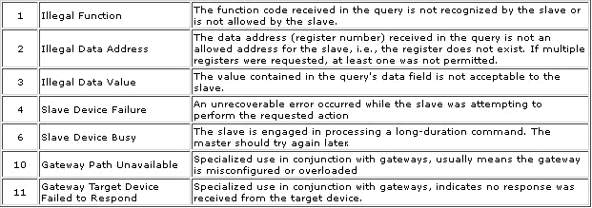
Modbus exceptions

Slide 15
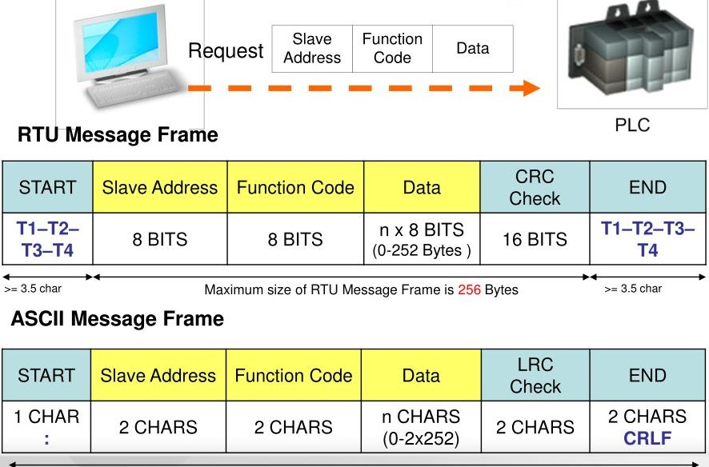
Modbus ASCII

Slide 16
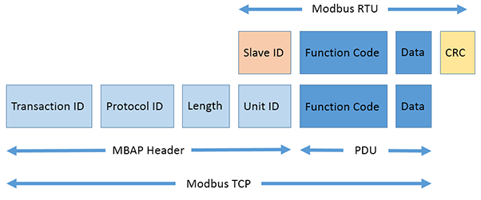
Modbus TCPIP

