Slide 1
Pulse Width Modulation
Yogesh M Iggalore

Slide 2
PWM: Introduction
Most frequently used peripheral in embedded applications
PWM is employed in a wide variety of applications, ranging from measurement and communications to power control and conversion.
PWM is a powerful technique for controlling analog circuits with a microcontroller’s digital outputs.
By controlling analog circuits digitally, system costs and power consumption can be drastically reduced.
By keeping the signal digital, noise effects are minimized. Noise can only affect a digital signal if it is strong enough to change a logical-1 to a logical-0, or vice versa

Slide 3
PWM - Duty Cycle
The duty cycle (the width of the signal) is modulated.
It is a percentage measurement of how long the signal stays on.
Duty Cycle is determined by:
On
Off
V_{H}
Duty Cycle (D)
Average signal can be found as
V_{L}
Period (T)
Usually, VL is taken as zero volts for simplicity.

Slide 4
PWM - Resolution
PWM resolution = PWM clock ÷ PWM Switching Frequency
Case 1:
PWM clock = 3 MHz; PWM Switching Frequency = 23.44KHz
PWM Resolution = 3,000,000 ÷23437
= 128( 2^ 7or 7 bit)
Case 2:
PWM clock = 3MHz; PWM Switching Frequency = 15.63KHz
PWM Resolution = 3,000,000 ÷15625
= 192(1.5x2^7or 7.5 bit)
If DC voltage is 5V DC, each bit represents:
7 bit PWM resolution: 5VDC ÷128 = 39.06mV (Each step = 0.78%)
7.5 bit PWM resolution: 5VDC ÷192 = 26.04mV (Each step = 0.52%)
Case 2 yields higher PWM resolution, less Voltage variation per bit change. So the voltage ripple on output will be smaller.

Slide 5
Types of PWM – Left Aligned
Left edge is fixed with respect to period, the trailing edge is modulated
Signal changes when counter is equal to period register
On
Off
On
Off
V_{hi}
V_{hi}
Duty Cycle
~30%
Duty Cycle
~60%
V_{lo}
V_{lo}
Period
Period

Slide 6
Types of PWM – Center Aligned
Center of signal is fixed with respect to period, both edges are modulated
In the center aligned mode, the PWM counter goes from a down-count to a up-count to down-count, etc.
V_{hi}
V_{hi}
Duty Cycle
~30%
Duty Cycle
~60%
V_{lo}
V_{lo}
Period
Period

Slide 7
PWM Applications
Telecommunications
DC motors
RC devices
Audio/video effects
Power delivery
Voltage regulation
Use as DAC

Slide 8
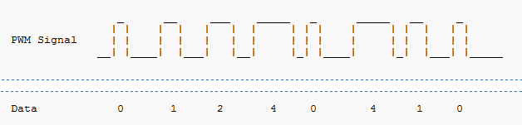
PWM Application- Telecommunications
Used in communication since a digital signal is more robust and less vulnerable to noise.
Effective at data transmission over long distance transmission lines
The widths of the pulses correspond to specific data values encoded at one end and decoded at the other.
Pulses of various lengths (the information itself) will be sent at regular intervals (the carrier frequency of the modulation).

Slide 9
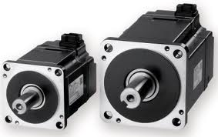
PWM Application - DC Motors
Voltage supplied is directly proportional to the duty cycle
Ability to control the speed of the motor via the duty cycle
Example
Can be used in regulating room temperature. Sense the current temperature (using an analog-to-digital converter) and then automatically increase/decrease the fan's speed accordingly.

Slide 10




PWM Application-RC Devices
Transmitters send PWM signals to the receivers on board of Radio controlled devices for specific control like speed, navigation.

Slide 11

PWM Application-Video devices
PWM dimming provides superior color quality in LED video display

Slide 12
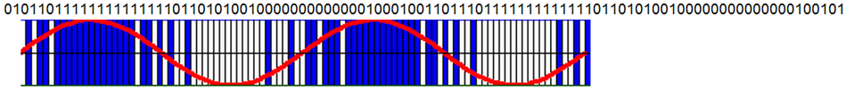
PWM Applications-Audio devices
Used in audio amplifiers to generate output signals for cellphone speakers to high-power stereo systems
Produce less heat than traditional analog amplifiers
Saving energy. Critical for hand held electronics.
Gives a sound effect similar to chorus when used in audio circuit.
Pulse-density modulation, or PDM, is a form of modulation used to represent an analog signal with digital data. In a PDM signal, it is the relative density of the pulses that corresponds to the analog signal's amplitude. PWM is the special case of PDM where all the pulses corresponding to one sample are contiguous in the digital signal.
Two periods of a sine wave would appear as shown below:
1s represented by blue, 0s represented by white, overlaid with the sine wave.
In pulse-density modulation, a high density of 1s occurs at the peaks of the sine wave, while a low density of 1s occurs at the troughs of the sine wave.

Slide 13
PWM Applications - Power delivery
Effective at data transmission over long distance transmission line
Power transfer: PWM used to reduce the total power given to a load without relying on resistive losses
Variable-speed fan controllers for computers
Light dimmers
In electric cookers, continuously-variable power is applied to the heating elements such as the hob or the grill using a simmer start that employs PWM to vary duty cycle
PWM-controlled brake- The output of a PWM controller could be connected to a switch between the supply and the brake. To produce more stopping power, the software need only increase the duty cycle of the PWM output. If a specific amount of braking pressure is desired, measurements would need to be taken to determine the mathematical relationship between duty cycle and pressure

Slide 14
PWM Application-Voltage Regulation
PWM is also used in efficient voltage regulators like SMPS. By switching voltage to the load with the appropriate duty cycle, the output will approximate a voltage at the desired level. The switching noise is usually filtered with an inductor and a capacitor

Slide 15
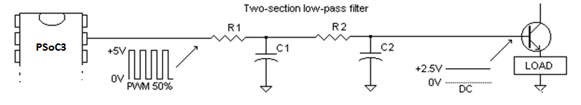
PWM Application- As DAC
Any shape waveform can be created
PWM frequency should be much higher than the frequency of waveform generated

Slide 16
Choosing PWM Frequency
Application dependent.
Not too low:
Audible frequencies
10 Times higher than control system frequency
Not too high:
Transistors generate more heat at higher frequencies
Some loads will not respond at higher frequencies

Slide 17
PWM – Advantages & Disadvantages
Advantages
Average value proportional to duty cycle, D
Low power used in transistors used to switch the signal
Fast switching possible due to MOSFETS and power transistors at speeds in excess of 100 kHz
Digital signal is resistant to noise
Less heat dissipated versus using resistors for intermediate voltage values
Disadvantages
Cost
Complexity of circuit
Radio Frequency Interference
Voltage spikes
Electromagnetic noise

