Slide 1
IoT Product Development
Yogesh M Iggalore

Slide 2
Agenda
What is IoT
IoT Product development
Plan your Engineering life

Slide 3
Internet of Things(IoT)
Definition:
The Internet of Things (IoT) is a system of interrelated computing devices, mechanical and digital machines, objects, animals or people that are provided with unique identifiers and the ability to transfer data over a network without requiring human-to-human or human-to-computer interaction.

Slide 4
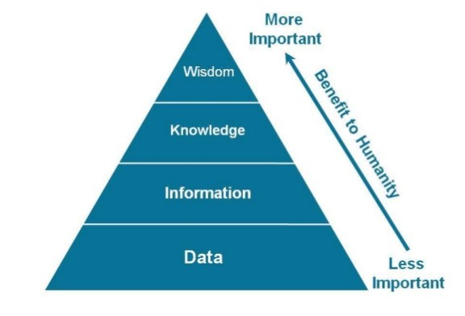
Goal of IoT

Slide 5




Turing Data into Wisdom
Knowledge
Information
Data

Slide 6
IoT Product Development Process
Production
11
Final Integration and testing
10
10
Server communication testing
9
Server communication development
8
Hardware and Firmware testing
7
Firmware architecture and development
6
Design of Preliminary hardware (Schematic and board design)
5
Component selection
4
Project scheduling
3
Develop design specifications
2
Market Research & Feasibility study
1

Slide 7
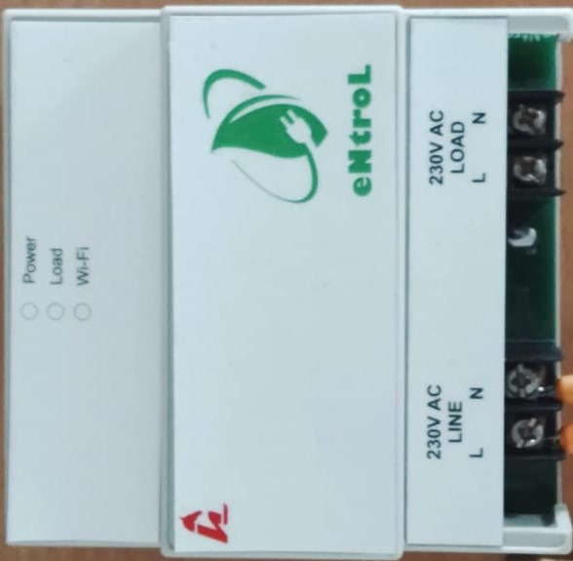
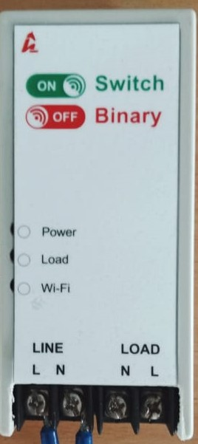
eNtroL
SwitchBinary

Slide 8
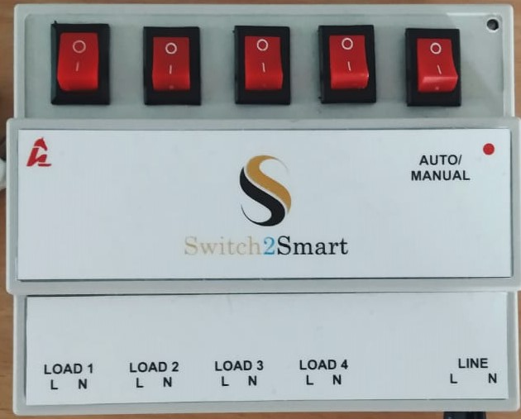
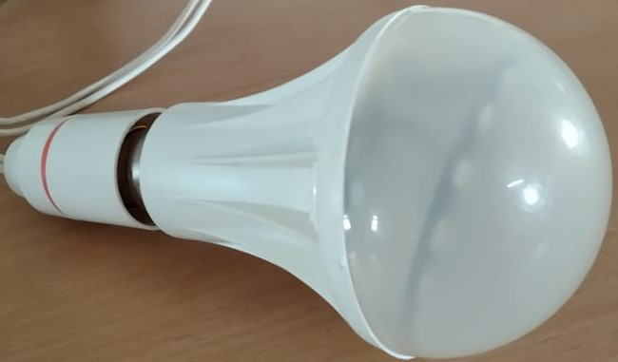
LightOn
Switch2Smart

Slide 9
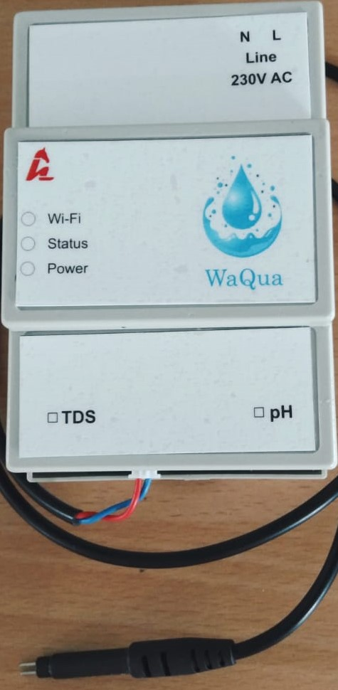
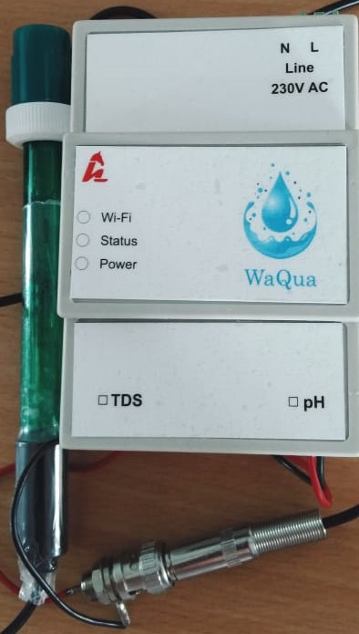
WaQua
WaQua
TDS
pH

Slide 10
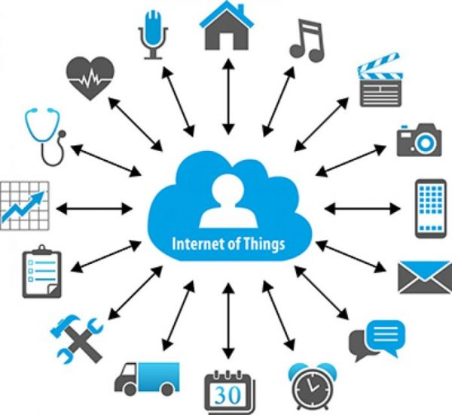
1
Market Research & Feasibility study

Slide 11


2 Develop design specifications
Hardware
Sensors
Alexa
Google home
WiFi

Slide 12
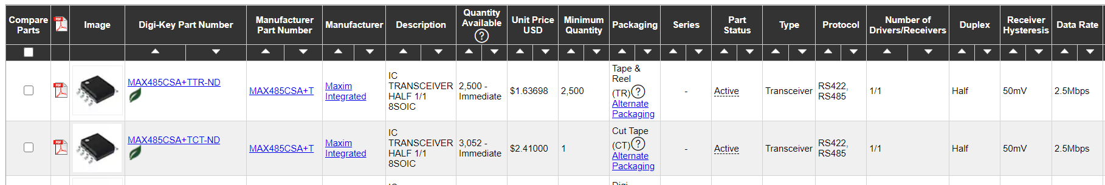
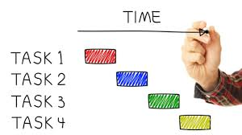
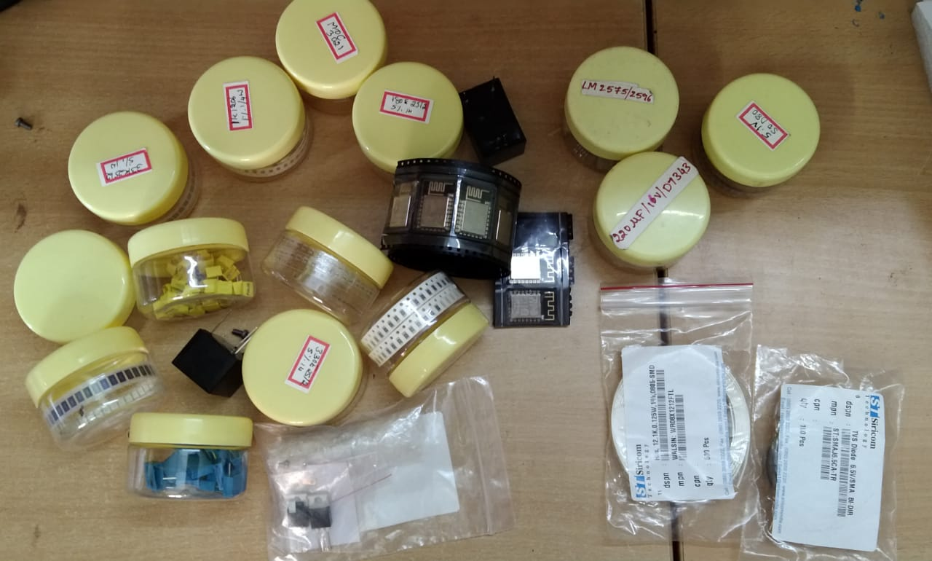
Project scheduling
Component selection

Slide 13
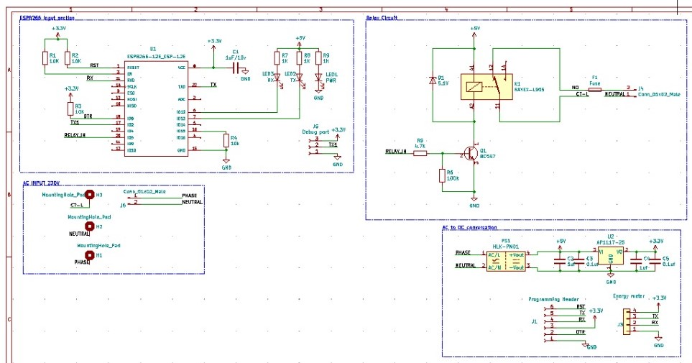
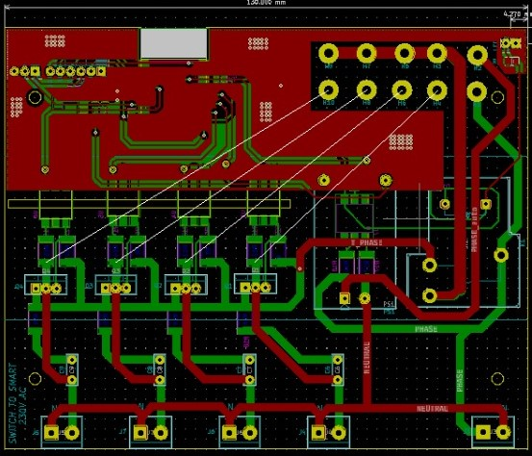
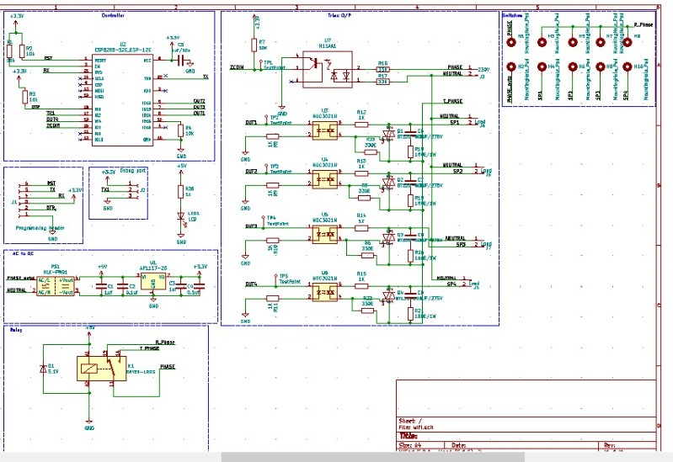
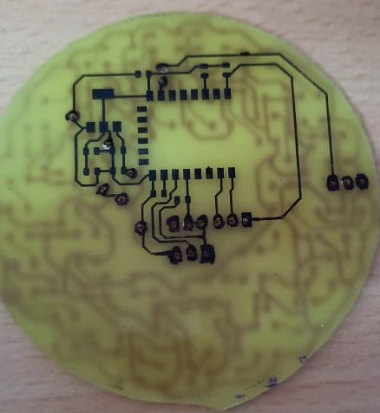
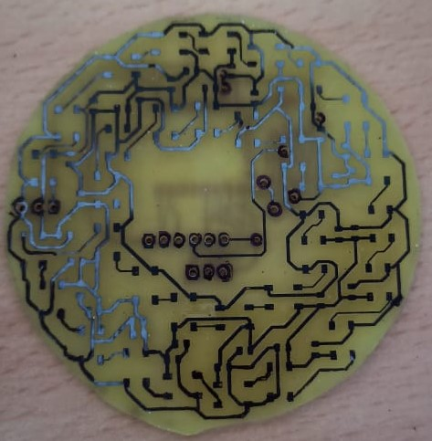
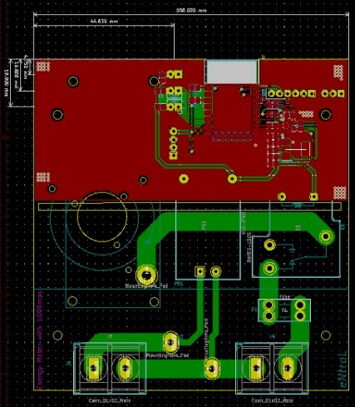
Design of Preliminary hardware (Schematic and board design)

Slide 14
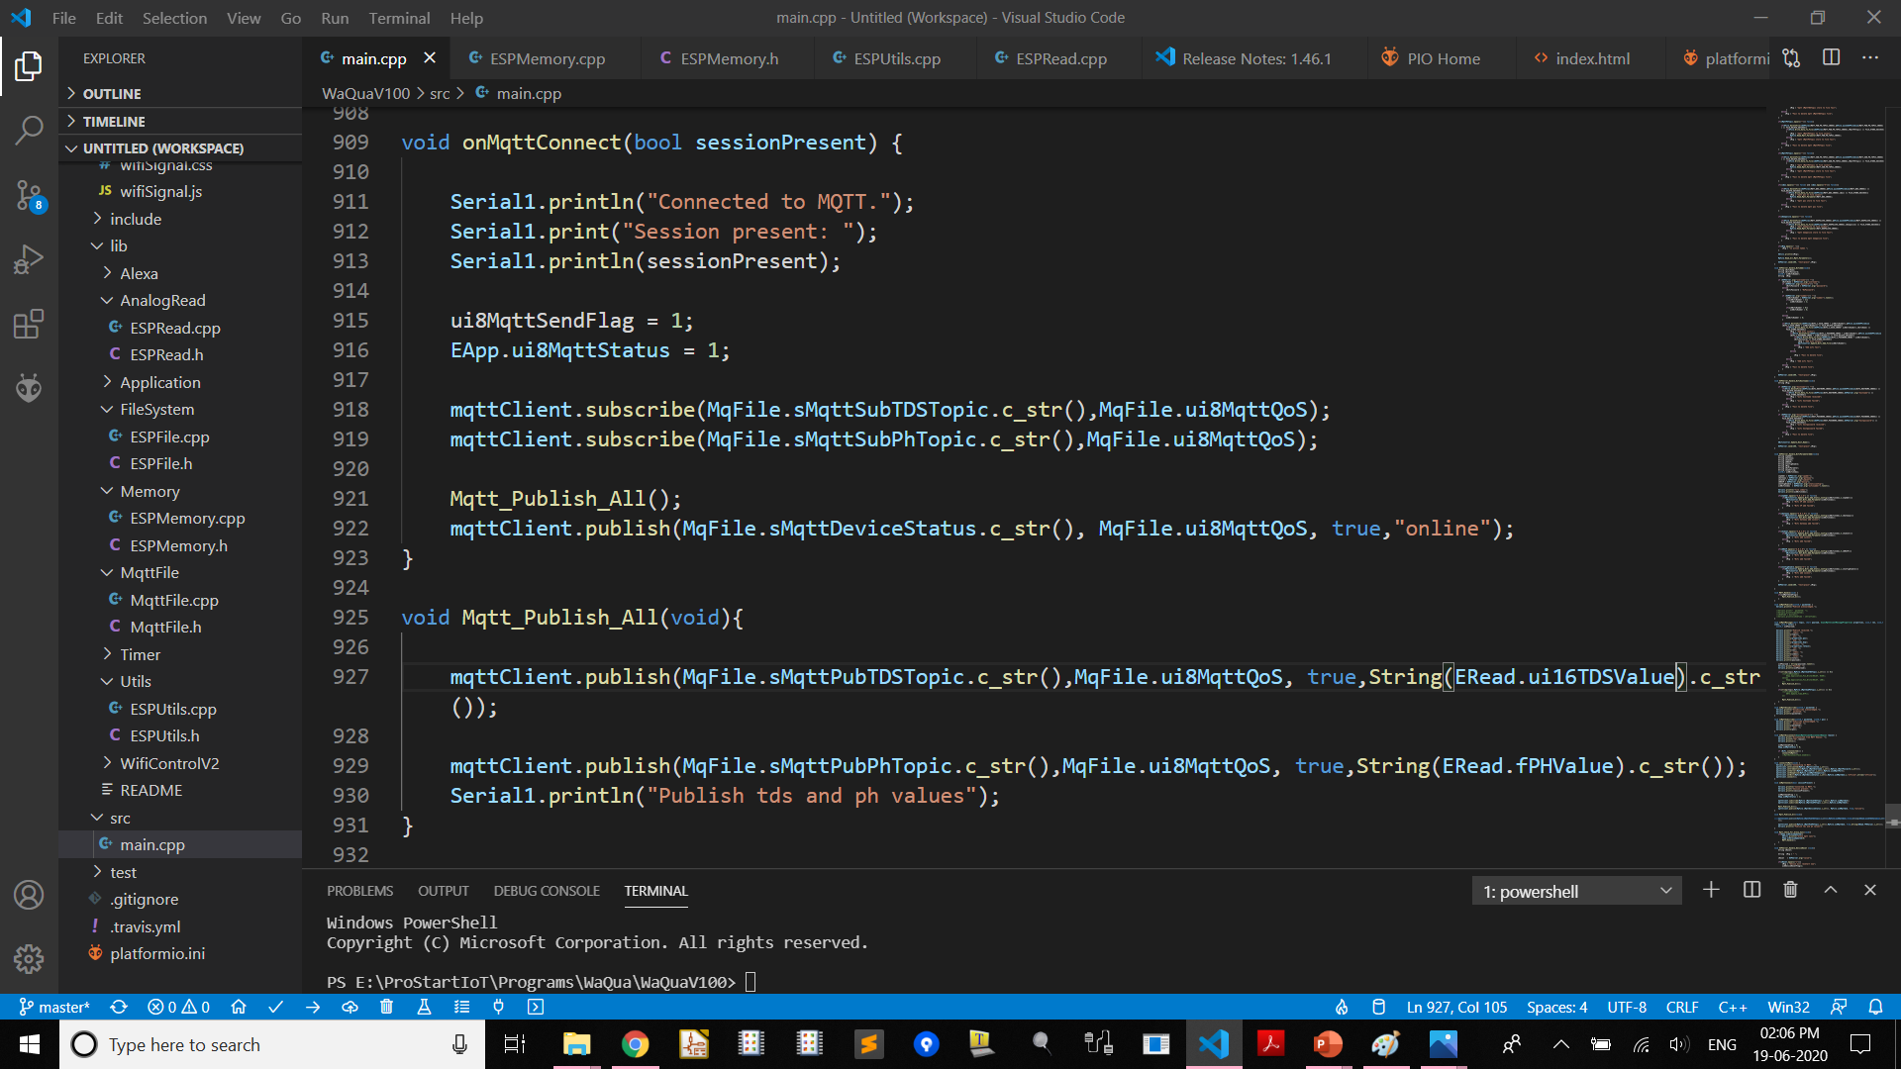
Firmware architecture and development

Slide 15
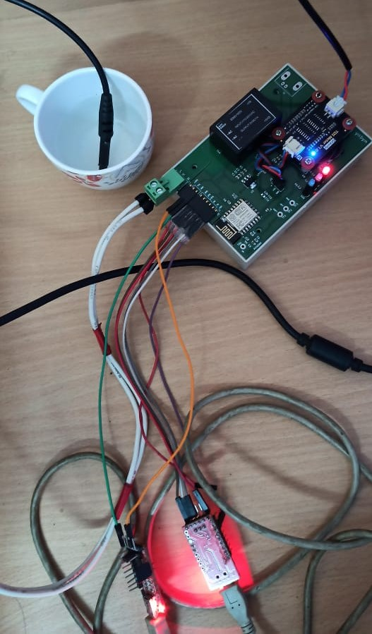
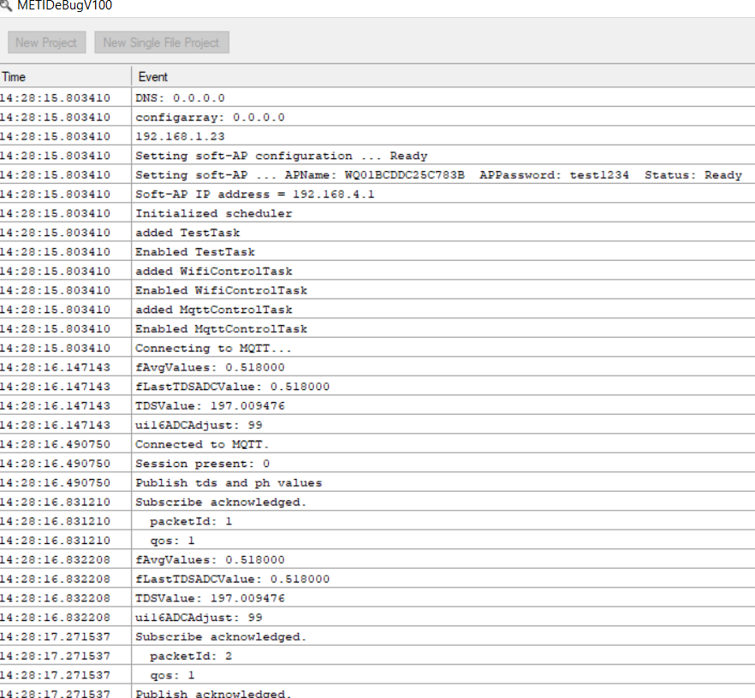
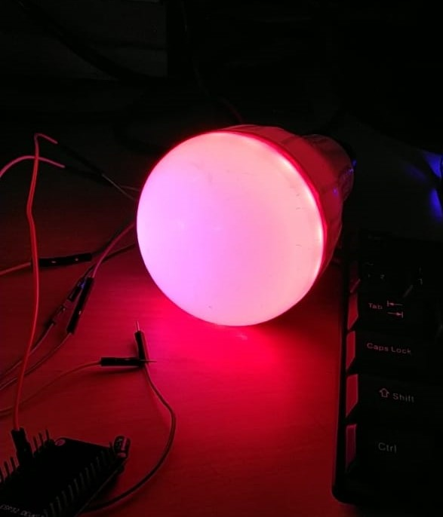
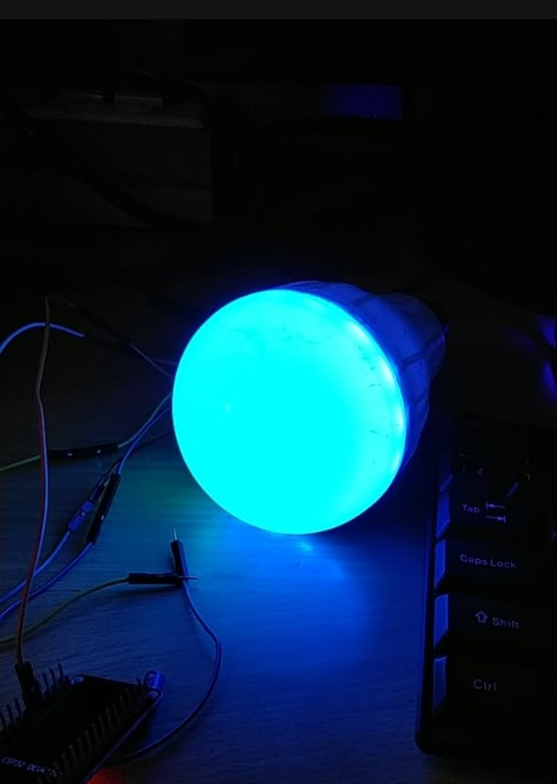
Hardware and Firmware testing

Slide 16
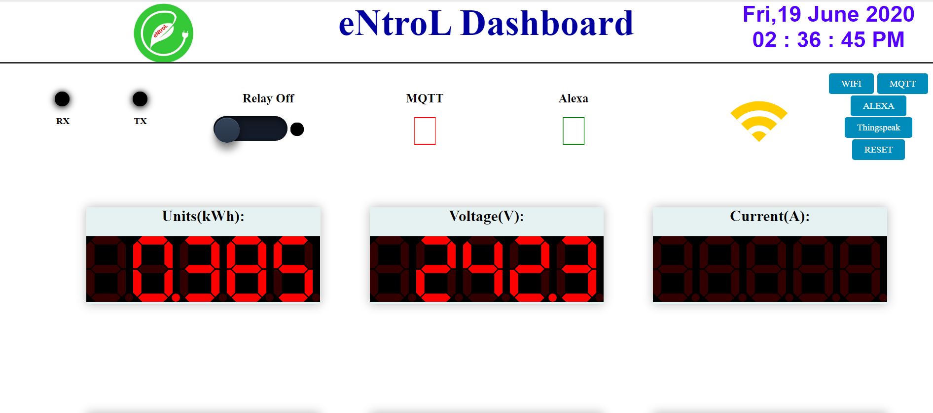
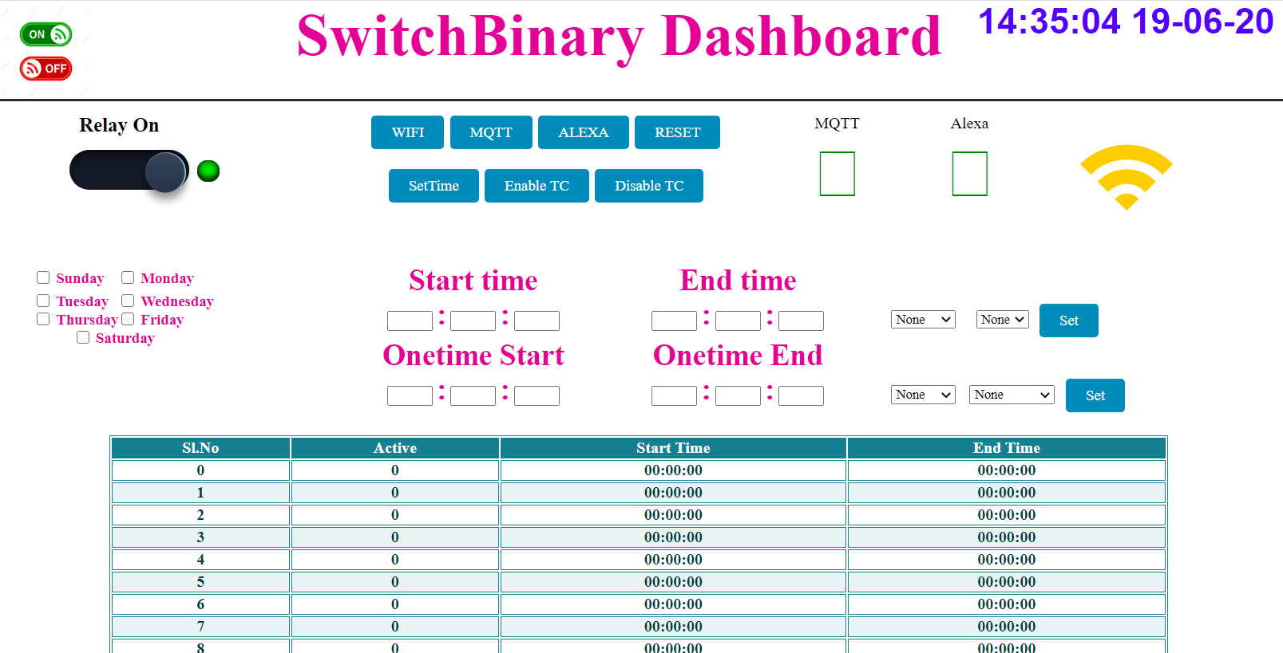
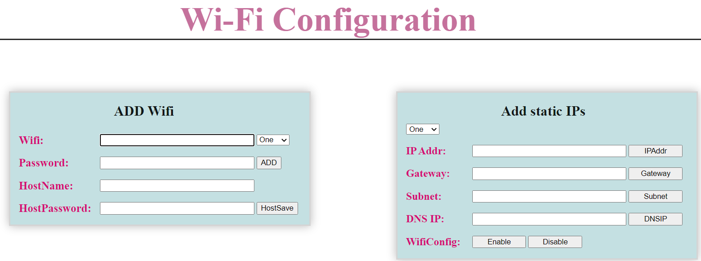
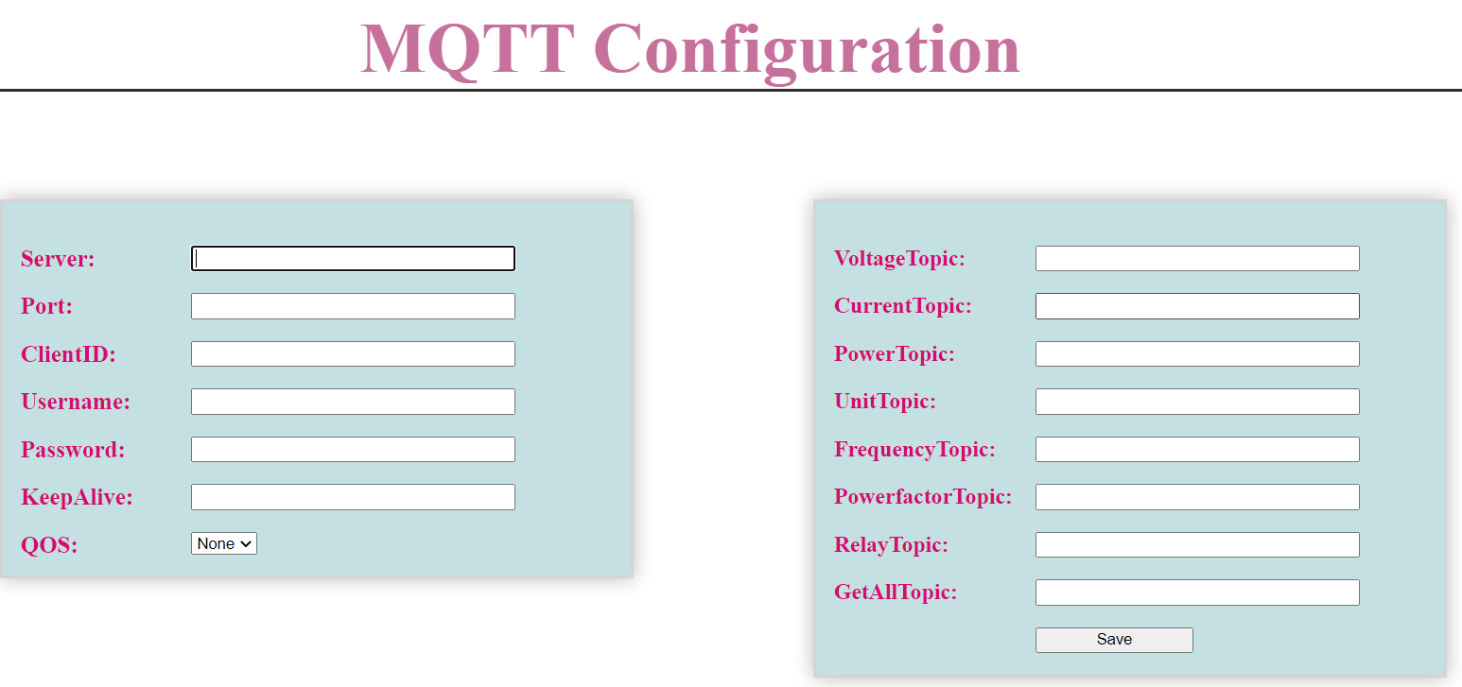
Server communication development

Slide 17
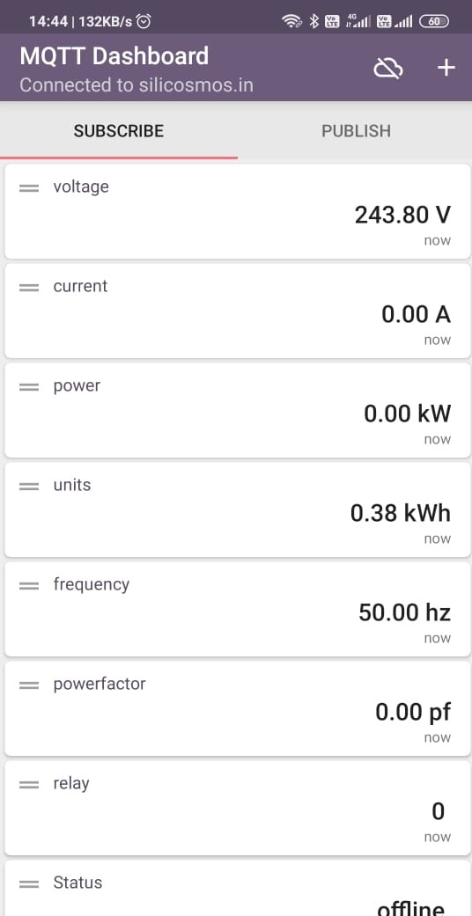
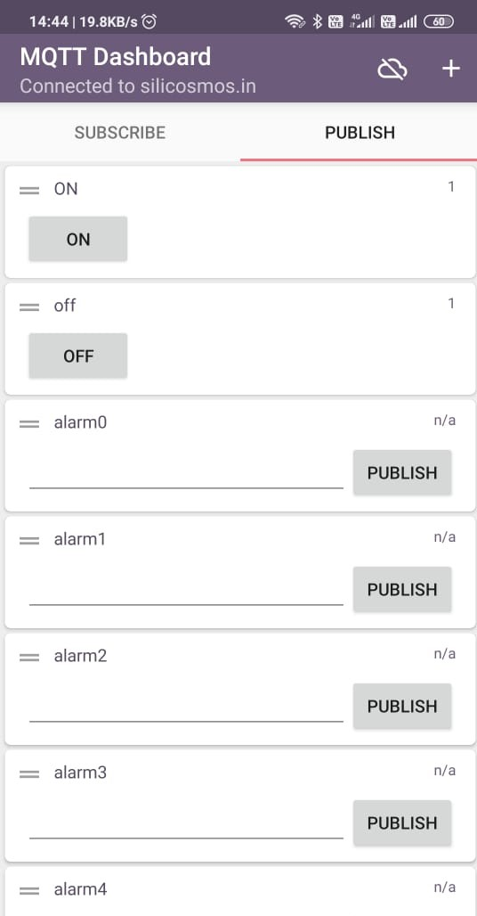
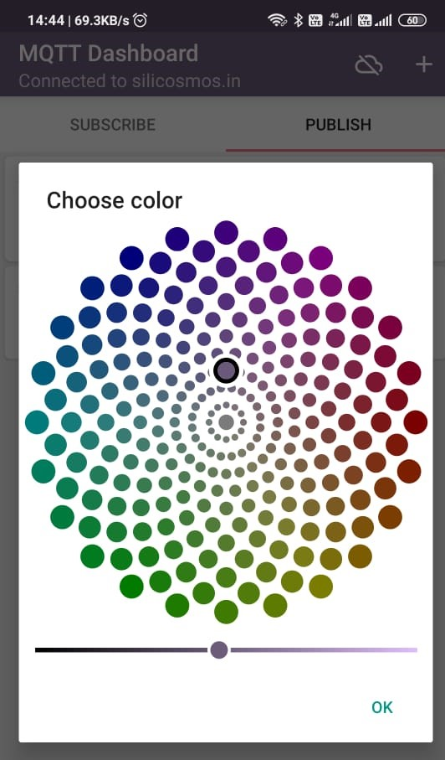
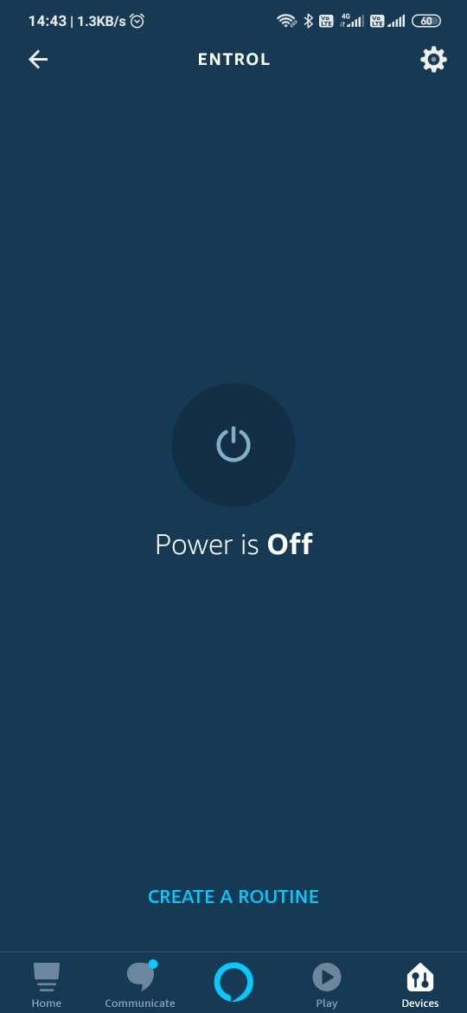
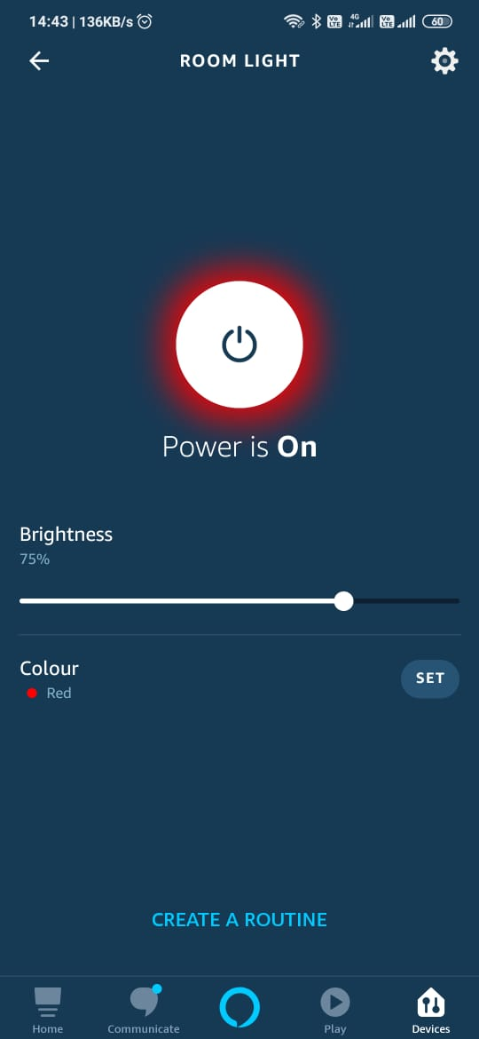
Final Integration and testing

Slide 18
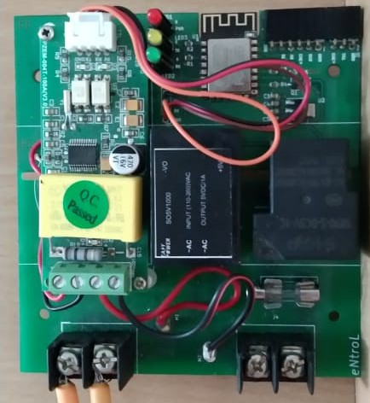
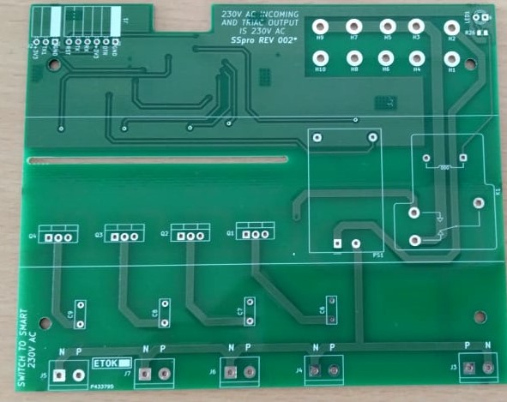
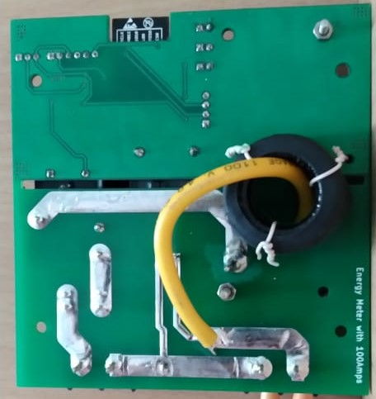
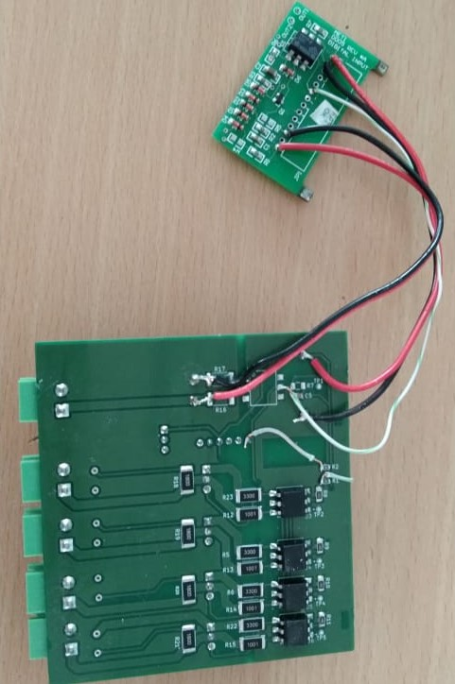
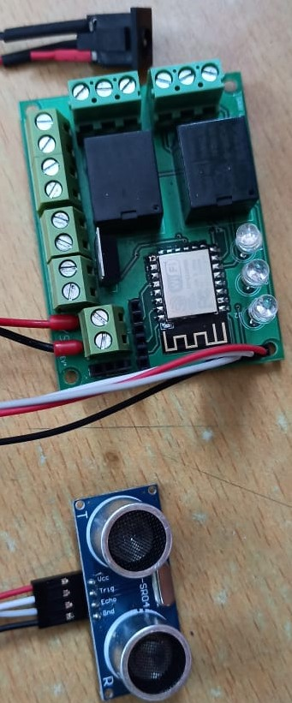
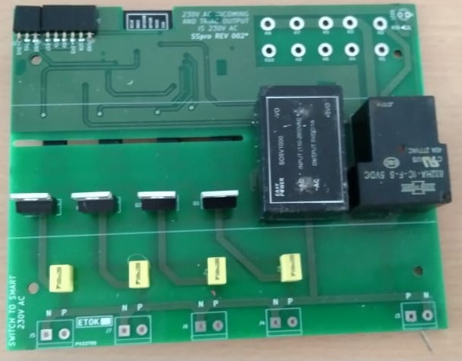
Production

Slide 19
Plan your Engineering life

Slide 20



3345
1.5 Million
18%

Slide 21

Technical Skills
Communication Skills
Interpersonal Skills
Commitment
Problem Solving

Slide 22
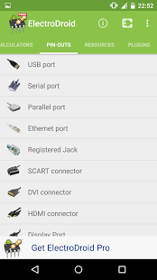
Technical Skills
Engineering subjects
Massive Open Online Courses (MOOCs)
Language C and Java/Python
Embedded programing(Arduino)
PCB Designing (Kicad, easyeda, falstad)
Reading technical Magazine
ElectroDroid
Notes:
Online courses
https://ocw.mit.edu/index.htm
https://www.edx.org/
https://www.coursera.org/
https://in.udacity.com/
https://thenewboston.com/
https://www.khanacademy.org/
Kicad : http://kicad-pcb.org/
Arduino : https://www.arduino.cc/en/Tutorial/HomePage
Magazine: https://electronicsforu.com/

Slide 23
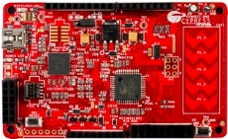
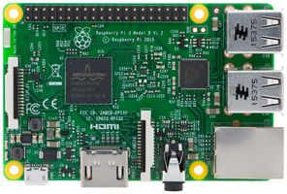
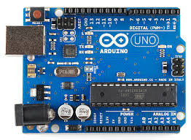
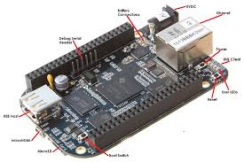
Microcontrollers and Microprocessors

Slide 24

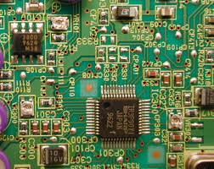
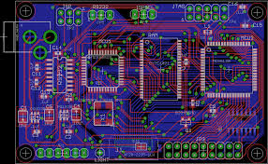
PCB Designing

Slide 25



Communication Skills
Improve your English
Build your resume everyday
Read more and more

Slide 26


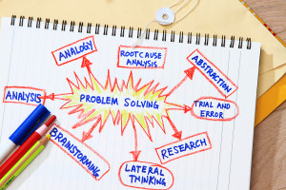
Interpersonal Skills
Commitment
Problem Solving

Slide 27
Links to learn IoT
https://www.youtube.com/channel/UCu7_D0o48KbfhpEohoP7YSQ
https://www.youtube.com/channel/UC6mIxFTvXkWQVEHPsEdflzQ
https://www.youtube.com/channel/UCu94OHbBYVUXLYPh4NBu10w
https://www.youtube.com/channel/UCzml9bXoEM0itbcE96CB03w
https://www.youtube.com/channel/UC7GMT3ohvYEAJFDenzj9EMQ
https://www.jeremyblum.com/
https://www.arduino.cc/
https://kicad-pcb.org/
https://platformio.org/
https://www.espressif.com/
https://randomnerdtutorials.com/
https://www.youtube.com/channel/UCvsMfEoIu_ZdBIgQVcY_AZA

Slide 28
Thank You
Email: yogesh.ineclat@gmail.com
Ph: +91 9900022929

