Slide 1
Timer and Counter
Yogesh M Iggalore

Slide 2
Timer/Counter - Importance
Timer/Counter hardware is a crucial component of most embedded systems
The names Timer and Counter can be used interchangeably when talking about the hardware
The difference in terminology has more to do with how the hardware is used in a given application
Case1: Timer measures elapsed time by counting clock ticks
Case 2: To count or time external events

Slide 3
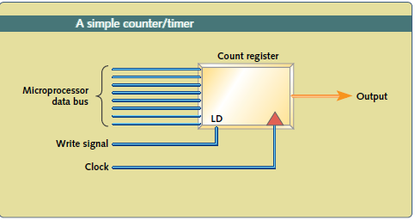
Timer/Counter - Basics
Example: 8 bit-Timer:
Consists of a loadable 8-bit count register, an input clock signal, and an output signal
Software loads the count register with an initial value between 0x00 and 0xFF.
Each subsequent transition of the input clock signal increments/Decrements that value
When 8-bit count register over flows, the output signal is asserted
The output signal may
Trigger an interrupt at the processor or
Set a bit that the processor can read
Processor can read the current value of the count register at any time, over the data bus
To restart the timer, software reloads the count register with the same or a different initial value
Application Example:
This output could be used to generate a periodic interrupt like a real-time operating system (RTOS) timer tick, provide a baud rate clock to a UART, or drive any device that requires a regular pulse.

Slide 4
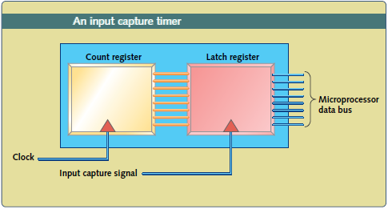
Timer/Counter – Basics contd…
8 bit-Timer – Capture input
Has a latch connected to the timer’s count register.
The timer is run at a constant clock rate (usually a derivative of the processor clock), so that the count register is constantly incrementing (or decrementing, for a down counter)
An external signal latches the value of the free-running timer into the processor-visible register and generates an output signal (typically an interrupt)
Two modes of operation
Periodic-Count will repeat automatically
One-shot-Count will not repeat automatically
Application Example:
To measure the time between the leading edge of two pulses. By reading the value in the latch and comparing it with a previous reading, the software can determine how many clock cycles elapsed.

