Slide 1
Universal Asynchronous Receiver Transmitter
Yogesh M Iggalore

Slide 2
Agenda
Synchronous & Asynchronous Serial Transmission
What is UART?
Difference between RS232 and UART
UART – Errors
ESP8266 UART
Project

Slide 3
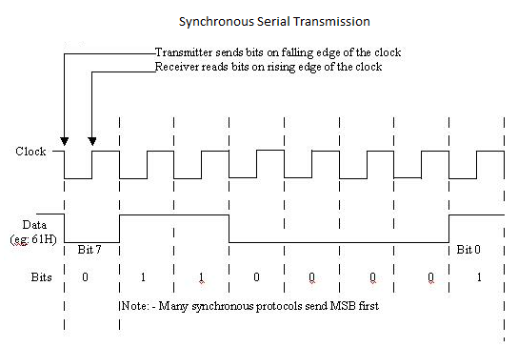
Synchronous Transmission
Synchronous serial transmission requires that the sender and receiver share a common clock “or” that the sender provide a strobe or other timing signal so that the receiver knows when to “read” the next bit of the data is usually more efficient because only data bits are transmitted between sender and receiver Most of the serial and almost all parallel communication devices use synchronous transfers only

Slide 4
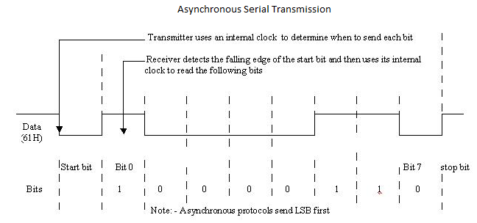
Asynchronous Transmission
Asynchronous transmission allows data to be transmitted without the sender having to send a clock signal to the receiver
The sender and receiver must agree on timing parameters in advance
Special bits are added to each word which are used to synchronize the sending and receiving units

Slide 5
Synchronous vs. Asynchronous transmission
 | Synchronous transmission | Asynchronous transmission
Advantages | Lower overhead and thus, greater throughput | Simple, doesn't require synchronization of both communication sides Cheap, timing is not as critical as for synchronous transmission, therefore hardware can be made cheaper Set-up is faster than other transmissions, so well suited for applications where messages are generated at irregular intervals, for example data entry from the keyboard
Disadvantages | Slightly more complex Hardware is more expensive | Large relative overhead, a high proportion of the transmitted bits are uniquely for control purposes and thus carry no useful information

Slide 6
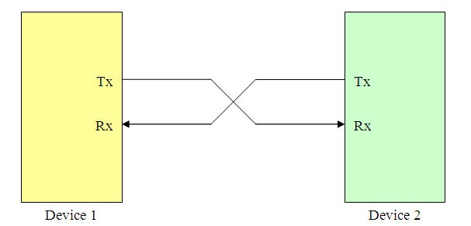
What is UART?
Universal Asynchronous Receiver/Transmitter
The universal designation indicates that the data format and transmission speeds are configurable
Devices communicate in 1:1 mode
One wire for each direction of data (TxD, RxD)
Supports full-duplex operation (TxD and RxD works independently and is not synchronized)
Typical speeds (in bps) are 1200, 2400, 9600, 19200, 38400, 57600, 115200, 230400, 460800, 921600, 1382400

Slide 7
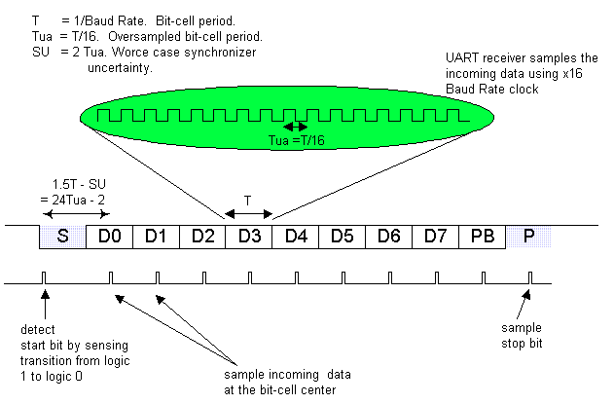
UART - Data transmission
The idle or no data state is logic high
Each byte is sent as a logic low start bit
sampled immediately by receiver
Then the data bits
usually 8, but configurable
typically LSB first
sampled at the center of the bit time
An optional parity bit
One or more stop bits - logic high

Slide 8
UART Clock Requirements
A UART needs a clock input for bit timing
UART baud rates are usually much lower than the MCU system clock, so the system clock cannot be directly used as the UART clock
Typically Timers/clock dividers are used to generate the UART baud rate by dividing down the system clock
Example: MCU system clock—24 MHz; UART baud rate—57600
A bit time accuracy of 2.5% or better is required at both the transmitter and receiver ends to be able to communicate without errors
Ensure that the system clock is ±2 % max over PVT (process, voltage and temperature)

Slide 9
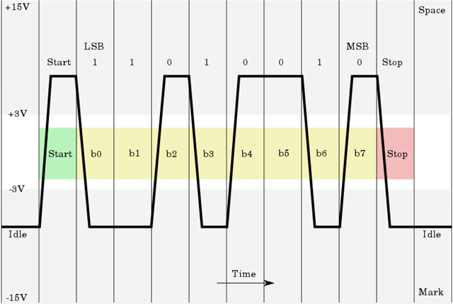
RS-232
RS-232 (Recommended Standard 232) is a standard for serial binary data signals connecting between a Data Terminal Equipment (DTE, eg Computer) and a Data Communication Equipment (DCE, eg: Modem). Commonly used in computer serial ports. One major difference between TTL level UART and RS-232 is the voltage level Valid signals in RS-232 are ±3 to ±15V, and signals, near 0V is not a valid RS-232 level.

Slide 10
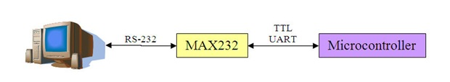
Difference between RS232 and UART
RS232
a specification for serial communications between a Data Communication Equipment(DCE) and Data Terminal Equipment (DTE) (eg, computer and modem);
it defines electrical characteristics
has different voltage levels than UART
valid signals are plus or minus 3 to 15 volts
specifies various handshaking signals
specifies the standard D-connector pinouts
UART
is an electronic circuit which handles communication over an asynchronous serial interface
UART is only used on PCB level, to communicate between processors
or to be extended outside the PCB through a transceiver, such as for example a RS-232 transceiver.
Typically the voltage levels are 0 and 5 (or Vdd)
TTL
UART

Slide 11
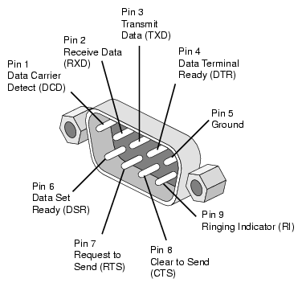
RS232 - Signals
Signal |  |  | Origin
Name | Typical purpose | Abbrevia- tion | DTE | DCE
Data Terminal Ready | Indicates presence of DTE (PC) to DCE (Modem). | DTR | ●
Data Carrier Detect | Asserted by DCE when a connection has been established with remote equipment | DCD |  | ●
Data Set Ready | DCE is ready to receive commands or data. | DSR |  | ●
Ring Indicator | DCE has detected an incoming ring signal on the telephone line. | RI |  | ●
Request To Send | DTE requests the DCE prepare to receive data. | RTS | ●
Clear To Send | Indicates DCE is ready to accept data. | CTS |  | ●
Transmitted Data | Carries data from DTE to DCE. | TxD | ●
Received Data | Carries data from DCE to DTE. | RxD |  | ●
Common Ground |  | GND | common
Protective Ground |  | PG | common

Slide 12
UART - Errors
Overrun error
An "overrun error" occurs when the receiver cannot process the character that just came in before the next one arrives. Various devices have different amounts of buffer space to hold received characters. The CPU must service the UART in order to remove characters from the input buffer. If the CPU does not service the UART quickly enough and the buffer becomes full, an Overrun Error will occur, and incoming characters will be lost.
Underrun error
An "underrun error" occurs when the UART transmitter has completed sending a character and the transmit buffer is empty. In asynchronous modes this is treated as an indication that no data remains to be transmitted, rather than an error, since additional stop bits can be appended. This error indication is commonly found in USARTs, since an underrun is more serious in synchronous systems.
Framing error
A "framing error" occurs when the designated "start" and "stop" bits are not valid. As the "start" bit is used to identify the beginning of an incoming character, it acts as a reference for the remaining bits. If the data line is not in the expected idle state when the "stop" bit is expected, a Framing Error will occur.
Parity error
A "parity error" occurs when the number of "active" bits does not agree with the specified parity configuration of the UART, producing a Parity Error. Because the "parity" bit is optional, this error will not occur if parity has been disabled. Parity error is set when the parity of an incoming data character does not match the expected value.

Slide 13
ESP8266 UART
ESP8266 has 2 UART, UART0 and UART1
UART0 pins
U0TXD - GPIO01
U0RXD - GPIO03
U0CTS - GPIO13
U0RTS - GPIO15
UART1 pins
U1TXD - GPIO02
UART0 swap pins
U0TXD - GPIO15
U0RXD - GPIO13
UART1 only Tx
UART0 used code downloading and communication

Slide 14
UART Lib
void begin(unsigned long baud, SerialConfig config)
Description | This function to start serial module
Parameter | Baudrate, serial config
Return | Void
Example | Serial.begin(9600, SERIAL_8N1); // starts UART0 with baudrate 9600 parity none and stopbit 1
void end();
Description | This function to stops serial module
Parameter | void
Return | Void
Example | Serial.end(); // stops UART0

Slide 15
UART Lib continue..
void updateBaudRate(unsigned long baud);
Description | This function to update the baudrate value
Parameter | Baudrate
Return | Void
Example | Serial.updateBaudRate(19200); //updating baudrate of UART0 to 19200
size_t setRxBufferSize(size_t size);
Description | This function sets rx buffer size
Parameter | size
Return | size
Example | Serial. setRxBufferSize(32); //sets rx buffer size of UART0 to 32 bytes

Slide 16
UART Lib continue..
size_t getRxBufferSize()
Description | This function returns rx buffer size
Parameter | Void
Return | Size_t
Example | ui8Size = Serial.getRxBufferSize(); //returns rx buffer size of UART0
void swap();
Description | This function swaps rx and tx pins of UART0
Parameter | Void
Return | Void
Example | Serial. swap(); //swaps rx and tx pins of UART0

Slide 17
UART Lib continue..
int available(void)
Description | This function returns available bytes to read, -1 indicates no bytes to read
Parameter | Void
Return | Int
Example | iBytes = Serial. available(); //returns available byte size
int read(void)
Description | This function read character in rx buffer if no rx data then return -1
Parameter | Void
Return | int
Example | Byte = Serial. read(); // reads character sents to UART0

Slide 18
UART Lib continue..
size_t read(char* buffer, size_t size)
Description | This function reads mentioned byte size
Parameter | Void
Return | Size_t
Example | ui8Size = Serial. read(buffer, 10); //reads 10 characters from UART0
size_t write(uint8_t c)
Description | This function write bytes
Parameter | Uint8_t
Return | Size_t
Example | Serial. write(10); //writes value 10 to UART0

Slide 19
UART Lib continue..
size_t write(const uint8_t *buffer, size_t size)
Description | This function writes bytes array of mentioned size
Parameter | Uint8_t array, uint8_t size
Return | Size_t
Example | Serial.write(buffer, 10); //writes 10 bytes array
void print();
Description | This function prints mentioned data types, data types can int, float, char, string
Parameter | Data types
Return | Void
Example | Serial. print(“test”); Serial. print(‘a’); Serial. print(10); Serial. print(22.34);

Slide 20
UART Lib continue..
void println();
Description | This function prints mentioned data types with \r\n, data types can int, float, char, string
Parameter | Data types
Return | Void
Example | Serial. println(“test”); Serial. println(‘a’); Serial. println(10); Serial. println(22.34);
Note: Read serial library for other functions

