Slide 1
Voice Assistance in IoT
Yogesh M Iggalore

Slide 2

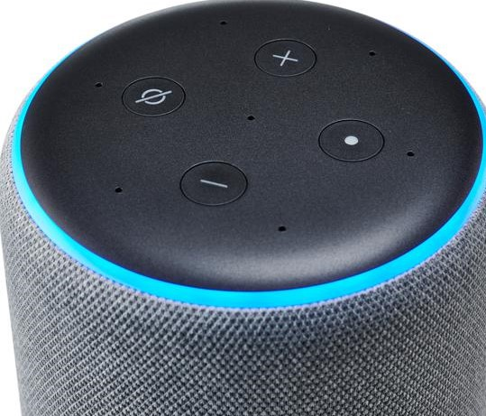
Alexa skills architecture
IoT Device
IFTTT
Alexa, turn on led
AWS Server
MUSIC
Sinric
NEWS

Slide 3

OK google architecture
IoT Device
IFTTT
OK google, turn on led
Google Server
MUSIC
Sinric
NEWS

Slide 4

Alexa skills architecture
IoT Device
Alexa, turn on led
AWS
Sinric

