Slide 1
WiFi Basics
Yogesh M Iggalore

Slide 2

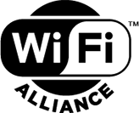
WiFi History
WiFi – Wireless Fidelity
WiFi is a wireless network protocol based on IEEE 802.11
Invented by Australian radio-astronomer Jhon o’Sullivan in CSIRO
More than 800 companies have WiFi certificate
WiFi alliance is non profit organisation
As of 2019, more than 3.05 billion WiFi enabled shipped globally.

Slide 3
WiFi versions
Year | IEEE | Name | Frequency(GHz) | Link rate(Mbit/s)
1997 | 802.11 |  | 2.4 | 1 to 2
1999 | 802.11b | WiFi1 | 2.4 | 1 to 11
1999 | 802.11a | WiFi2 | 5 | 6 to 54
2003 | 802.11g | WiFi3 | 2.4 | 6 to 54
2008 | 802.11n | WiFi4 | 2.4/5 | 72 to 600
2014 | 802.11ac | WiFi5 | 2.4/5 | 433 to 6933
2019 | 802.11ax | WiFi6 | 2.4/5 | 600 to 9608
2019 | 802.11ax | WiFi6E | 6 | 600 to 9608

Slide 4
802.11a WiFi-2
Introduced in year 1999
Radio Frequency band 5GHz
Maximum data rate 54 Mbps
Typical data rate 25Mbps
Typical range 30 meters
Number of stream 1
Modulation OFDM : Orthogonal frequency division multiplexing
Channel width 20Mhz

Slide 5
802.11b WiFi-1
Introduced in year 1999
Radio Frequency band 2.4GHz
Maximum data rate 11Mbps
Typical data rate 5Mbps
Typical range 30 meters
Modulation CCK(DSSS) : complementary code keying (direct sequence spread spectrum)
12 non overlapping channels
Channel width 20Mhz
Number of stream 1

Slide 6
802.11g WiFi-3
Introduced in year 2003
Radio Frequency band 2.4GHz
Maximum data rate 54Mbps
Typical data rate 25Mbps
Typical range 30 meters
Modulation CCK(DSSS) or OFDM
Channel width 20Mhz
Number of stream 2

Slide 7
802.11n WiFi-4
Introduced in year 2008
Radio Frequency band 2.4GHz and 5GHz
Maximum data rate 600Mbps
Typical range 100 meters
Modulation CCK(DSSS) or OFDM
Number of streams 1,2,3 or 4
Channel width 20MHz or 40MHz
Backward compatibility to 802.11a, 802.11b and 802.11g
Beam forming technique
MIMO channels

Slide 8
MIMO : Multiple-Input Multiple-Output
MIMO is a wireless technology that uses multiple transmitters and receivers to transfer more data at the same time.
All wireless products with 802.11n support MIMO.
The technology helps allow 802.11n to reach higher speeds.
MIMO technology uses a natural radio-wave phenomenon called multipath.
With multipath, transmitted information bounces off walls, ceilings, and other objects, reaching the receiving antenna multiple times at different angles and slightly different times
An adapter with two antennas has a speed of 300 Mbps.
A adapter with three antennas can have a speed of 600 Mbps

Slide 9
802.11ac WiFi-5
Introduced in year 2014
Radio Frequency band 2.4GHz and 5GHz
Maximum data rate 6.93Gbps
Modulation BPSK, QPSK, 16-QAM, 64-QAM and 256-QAM
Number of streams 8
Channel width 20,40 and 80MHz
Backward compatibility to 802.11n
Beam forming

Slide 10
802.11ax WiFi-6
Introduced in year 2019
Radio Frequency band 2.4GHz and 5GHz
Maximum data rate 14Gbps
Modulation OFDM
Number of streams 8
Channel width 20,40 and 80MHz
Backward compatibility to 802.11ac
Beam forming
Target wakeup time

Slide 11
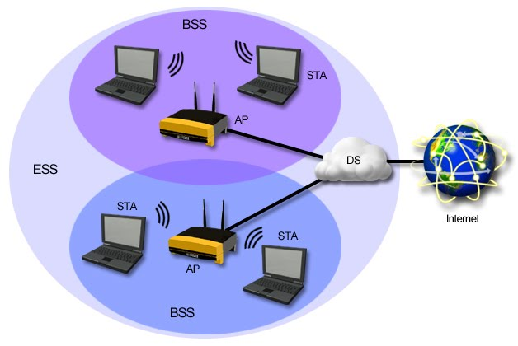
Basic components of wireless network
STA : Station, any device in a network is called STA or station
SSID: Service set identifier is wireless network name, configured in AP
BSS : Basic service set is a wireless network consist of AP supporting one or more client
BSSID: BSS identifier unique identity each BSS in network. MAC address of AP
IBSS :- An Independent BSS is a wireless network, consisting of at least two STAs, used where no access to a DS is available. An IBSS is also sometimes referred to as an ad hoc wireless network.
ESS :- Extended Service Set (ESS) is two or more group of interconnected BSS that share the Same SSID. Because all BSS use the same name SSID is called as ESSID in ESS.
AP :- Access Point (AP) is base the base station in the network. It provide the capability to connect the physical network to wireless network.

Slide 12
Basic components of wireless network
DS :- Distribution System (DS) is the logical component used to interconnect the AP. It helps the STA to roam from one BSS to other BSS.
WEP and WPA/WPA2 :- Wired equivalence privacy(WEP)and WiFi Protected Access (WPA/WPA2) are the security mechanism used to provide the secured communication between STA and AP
BAND :- wireless network basically works in between 2 Band frequency that in 2.4GHZ and 5GHZ. So band is frequency in which WiFi Devices can work, it’s all depend on the hardware capability of device
CHANNEL :- Band is further divided in sub group called channel. This is used to handle the interference between the 2 wireless devices. There is around 13 channels in 2.4GHz band and 42 channels 5GHz band. There is some restriction on use of this channels which differ from country to country

Slide 13
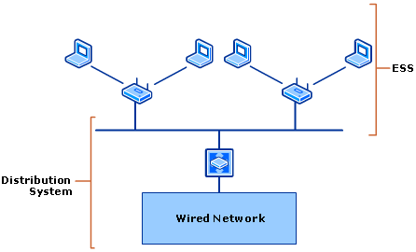

Operating modes
Ad-Hoc
Infrastructure
In Ad-hoc wireless client or STA communicate with each other without any wireless AP. Ad hoc mode is also called as peer to peer mode. Wireless client in Ad hoc mode IBSS. In Ad hoc first wireless client takes some responsibility AP. This responsibility include periodic beacon and authenticating the other STA or client. But this client dose not relay the communication between 2 other clients.
In infrastructure mode there is at least one AP and one wireless client present. Wireless client use the wireless AP to access the resource on traditional wired network.

Slide 14
Protocol
802.11 uses data link and physical layer of OSI model
802.11 works at 2.4GHz, 5GHz, 6GHz, 900MHz(802.11ah) and 60GHz(802.11ai)
14 channel with 20MHz bandwidth
5MHz channel spacing

Slide 15
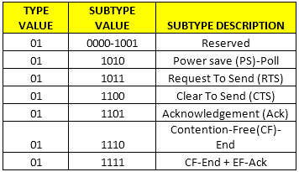
WiFi MAC Frame
Control :- Control frame is basically used for RTS(Request to send), CTS(Clear to send),PS (Power save Poll), ACK (Acknowledgement) control frame assist the reliability of data.

Slide 16
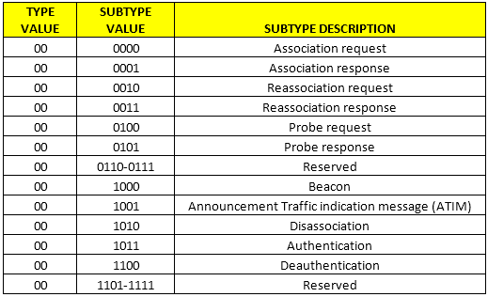
WiFi MAC Frame
Management :- Actual work of management frame is for transmitting the Beacon, probe for request and response, authentication and De-authentication, Association request and response, disassociation, Re-association request and response .

Slide 17
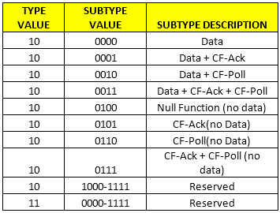
WiFi MAC Frame
Data :- Data frame is used to carry the data.

Slide 18
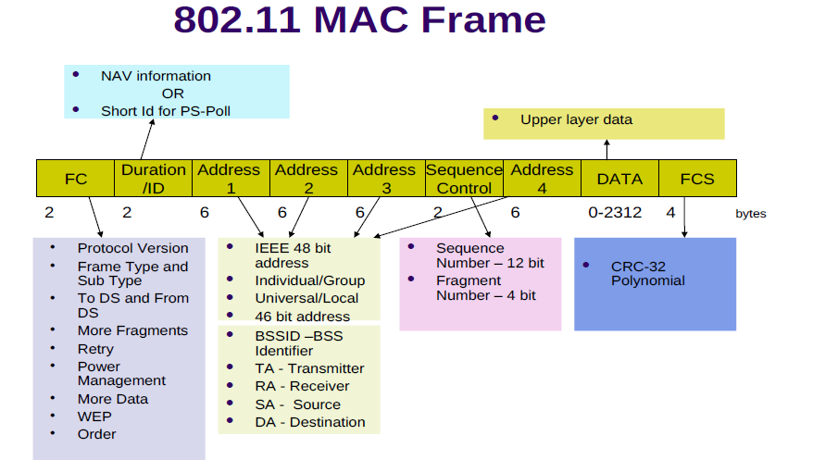

Control frame
Management frame
Data frame

Slide 19

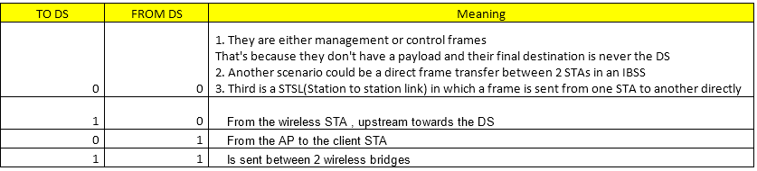
WiFi MAC Frame
Frame Control :- Made up of 2 Bytes, contain following fields.
Protocol version : – By default value is 0. Used to represent 802.11.
Type :- used to represent type of frame Control (01), Management (00), Data (10).
Subtype :- used to represent subtype of frame.
TO DS and FROM DS :- This Indicates the direction of the flow. There are 4 values.

Slide 20
WiFi MAC Frame
More Fragments:- Present in management frame. Indicates fragments.
Retry :- 0 represent original transmission, 1 represent retransmission.
Power Mgt :- 1 Represent STA is using power save Mode. AP the buffer the data meant to send to STA
More Data :- When the client receives a frame with the more data field when it’s awake, it knows that it cannot go to sleep and it sends out a PS-POLL message for getting that data
WEP or protected frame :- indicates whether or not encryption and authentication are used in the frame. It can be set for all data frames and management frames, which have the subtype set to authentication.
Order :- indicates that all received data frames must be processed in order.

Slide 21
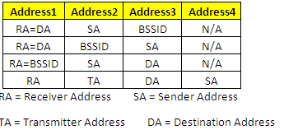
Duration/ID:- it used define the transmission time.
Address 1, Address 2, Address 3 and Address 4:- the value of 4 address field is depend on the frame type
Sequence Control :- indicates the sequence number of each frame. The sequence number is the same for each frame sent for a fragmented frame; otherwise, the number is incremented by one until reaching 4095, when it then begins at zero again.
Frame Body :- Actual data
FCS :- 32 bit CRC Check

Slide 22


Packet exchange between Station and Access point
Station
Access point
probe request
probe response
authentication request
authentication response
association request
association response
Notes:
In a station’s WiFi network discovery process, a Probe Request will be sent from the station to the BSSID listed in a Beacon frame the station received.
The access point responds with a Probe Response frame. After the station receives the Probe Response frame, it acknowledges the receipt of the frame with an Acknowledgement Frame
Next, the station transmits an Authentication Request frame; this frame is also responded with an Acknowledgement Frame from the access point.
Upon completion of successful Authentication frame exchanges, the station moves forward with associating. The station transmits an Association Request frame containing the station’s capabilities within fields and information elements of the frame.
When the access point receives the Association Request frame, it responds with an Acknowledgement Frame and transmits an Association Response frame with the result of successful or unsuccessful. The station must support the required parameters defined by the WiFi network. If successful, the station will be assigned an Association ID which can be identified within the Association Response frame.

Slide 23



WiFi modes
Station mode
Access point mode
Ad-Hoc mode

Slide 24
WiFi Security
Wired Equivalent Privacy (WEP)
Most used WiFi security protocol
Introduced in year 1997, security algorithm to provide data confidentiality for wireless network
It uses two key Unicast session key and Multicast session key
In WEP-40, a 40 bit WEP key is concatenated with a 24 bit initialization vector, to generate a 64 bit RC4 key.
In WEP-104, a 104 bit WEP key is concatenated with the 24 bit initialization vector, to generate a 128 bit RC4 key.
WEP operates at the data link and physical layer.
Wi-Fi Protected Access(WPA)
This security introduced in 802.11i
Uses temporal key integrity protocol (pre packet mixing, integrity checking and extending rekeying)
Most secured wifi protocol as of now

