Slide 2
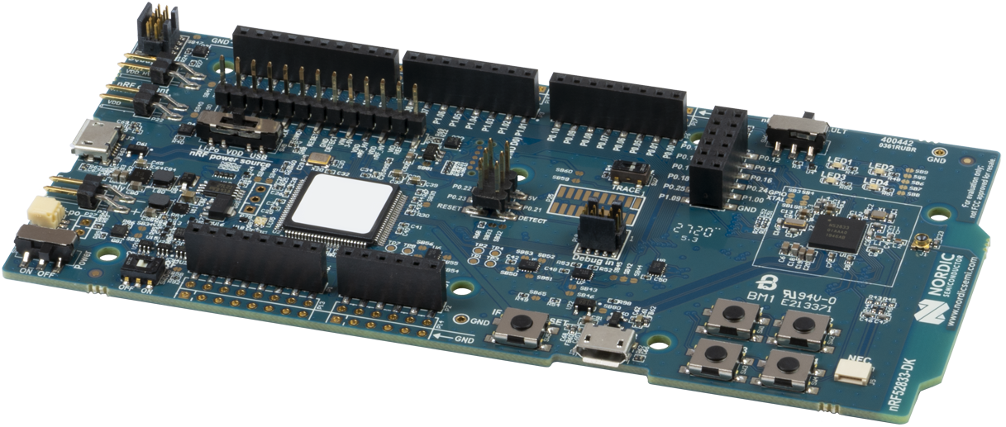

Slide 3
NRF pin | description | Addon-card
P1.01 | UART1-Tx | Lora-Rx
P1.02 | UART1-Rx | Lora-Tx
P0.20 | SPI3-SS | SDCard-CS
P0.21 | SPI3-MOSI | SDCard-MOSI
P0.22 | SPI3-MISO | SDCard-MISO
P0.23 | SPI3-CLK | SDCard-CLK
P0.26 | I2C0-SDA | I2C-SDA
P0.27 | I2C0-SCL | I2C-SCL
 |  | DHT
 |  | Pot
 |  | SF_SCK
 |  | SF_CS
 |  | SF_IO0
 |  | SF_IO1
 |  | SF_IO2
 |  | SF_IO3

