Slide 1
ESP32 General Purpose Input Output
Yogesh M Iggalore

Slide 2
GPIO | Input | Output | Functions | Board | Notes
GPIO00 | Pulled up | OK | ADC2_CH1, TOUCH1, RTC_GPIO11 | DTR pin pulled high | Output PWM signal at boot
GPIO01 | UART0 TX | OK | UART0 TX pin | UART0 TX pin | Debug output pin at boot
GPIO02 | OK | OK | ADC2_CH2, TOUCH2, RTC_GPIO12 | GREEN LED | Connected to GREEN led
GPIO03 | OK | UART0 RX | UART0 RX | UART0 RX | High at boot
GPIO04 | OK | OK | ADC2_CH0, TOUCH0, RTC_GPIO10 | RED LED | Connected to RED LED
GPIO05 | OK | OK | VSPI CS0 | SPI_CS sd card | SD card chip select
GPIO12 | OK | OK | ADC2_CH5, TOUCH5, HSPI_MISO, RTC_GPIO15 | TOUCH-2 | Boot fail if pulled high
GPIO13 | OK | OK | ADC2_CH4, TOUCH4, HSPI_MOSI, RTC_GPIO14 | BLUE LED | Connected to blue led
GPIO14 | OK | OK | ADC2_CH6, TOUCH6, HSPI_CLK, RTC_GPIO16 | TOUCH-3 | Output PWM signal at boot
GPIO15 | OK | OK | VSPI_CS0 | TOUCH-1 | Touch input 1
GPIO16 | OK | OK | UART2 RX | COMM_RX | UART communication RX pin

Slide 3
GPIO | Input | Output | Functions | Micro | Notes
GPIO17 | OK | OK | UART2 TX | COMM_TX | UART communication TX pin
GPIO18 | OK | OK | VSPI_CLK | SPI_CLK | SD card clock pin
GPIO19 | OK | OK | VSPI_MISO | SPI_MISO | SD card miso pin
GPIO21 | OK | OK | I2C_SDA | I2C_SDA | I2C sda pin
GPIO22 | OK | OK | I2C_SCL | I2C_SCL | I2C scl pin
GPIO23 | OK | OK | VSPI_MOSI | SPI_MOSI | SD card mosi pin
GPIO25 | OK | OK | ADC2_CH8, DAC1, RTC_GPIO06 | Relay | Connected to relay control
GPIO26 | OK | OK | ADC2_CH9, DAC2, RTC_GPIO07 | SPI_Extra | External SPI chip select
GPIO27 | OK | OK | ADC2_CH7,TOUCH-7, RTC_GPIO17 | TOUCH-4 | Touch input 4
GPIO32 | OK | OK | ADC1_CH4,TOUCH-9, RTC_GPIO09 | ADC/POT | Analog pins
GPIO33 | OK | OK | ADC1_CH5,TOUCH-8, RTC_GPIO08 | DHT | Dht sensor
GPIO34 | OK | - | ADC1_CH7, RTC_GPIO05 | Switch-1 | INPUT Only
GPIO35 | OK | - | ADC1_CH7, RTC_GPIO05 | Switch-2 | INPUT Only
GPIO36 | OK | - | ADC1_CH0, Sensor_VP, RTC_GPIO00 | Switch-3 | INPUT Only
GPIO39 | OK | - | ADC1_CH0, Sensor_VN, RTC_GPIO03 | Switch-4 | INPUT Only

Slide 4
Drive Mode: Strong and Slow Strong
VCC
VCC
To MCU Input Logic
To MCU Input Logic
Port Pin
Port Pin
From MCU
core
From MCU Core
GND
GND
Strong Drive Mode
Slow Strong Drive Mode
Normal output mode. Works like an inverter.
Rise/Fall times 12ns Max
Controlled rise/fall times. Rise/Fall times 60 ns Max.
Saves power

Slide 5
Drive Mode: Open Drain - Drives High/Low
From MCU Core
VCC
To MCU Input Logic
To MCU Input Logic
Port Pin
Port Pin
From MCU Core
GND
Open Drain-Drives high
Open Drain-Drives Low
Connect a resistor externally from pin to ground
Connect a resistor externally from pin to Vdd

Slide 6
Drive Mode: Hi-Z and Analog Hi-Z
VCC
VCC
To MCU Digital Input Logic
To MCU Analog Input Logic
Port Pin
Port Pin
GND
GND
Hi-Z Mode
Analog Hi-Z Mode
Digital Input Mode
Analog Input Mode.
Select when port is unused since it consumes no power.

Slide 7
Drive Mode: Resistive Pull-Up and Pull-Down
Resistive Pull-Up
Resistive Pull-Down
VCC
VCC
To MCU Input Logic
To MCU Input Logic
5.6KΩ
Port Pin
Port Pin
From MCU Core
5.6KΩ
From MCU Core
GND
GND
Effective Circuit if written with ‘0’
Effective Circuit if written with ‘1’
To MCU Input Logic
VCC
To MCU Input Logic
NOTE: If you are using this mode as input-only, make sure to write correct value to port!
Port Pin
5.6KΩ
5.6KΩ
Port Pin

Slide 8
Example: Switches and Pushbutton Inputs
SPST Button: Produces either Vcc or Floating input.
To MCU Input Logic
VCC
Button
VCC
Button
Port Pin
5.6KΩ
Adding a pull-down resistor fixes it.
5.6KΩ
MCU port in Pull-Down mode
Don’t Forget: Write ‘0’ to port

Slide 9
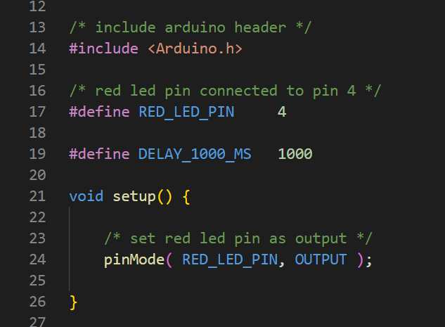
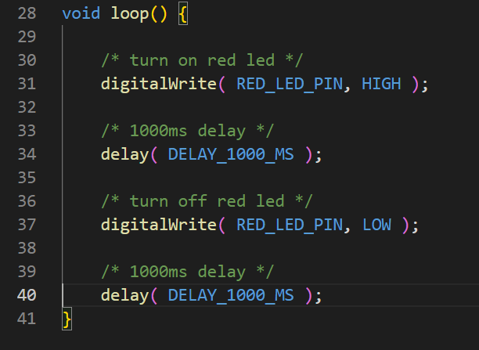

Slide 10
GPIO API
void pinMode(uint8_t pin, uint8_t mode)
Description | This function to start serial module
Parameter | Baudrate, serial config
Return | Void
Example | Serial.begin(9600, SERIAL_8N1); // starts UART0 with baudrate 9600 parity none and stopbit 1
void end();
Description | This function to stops serial module
Parameter | void
Return | Void
Example | Serial.end(); // stops UART0

