Slide 1
ESP32 I2C

Slide 2
Agenda

Slide 3
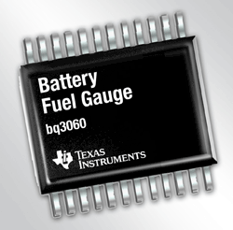
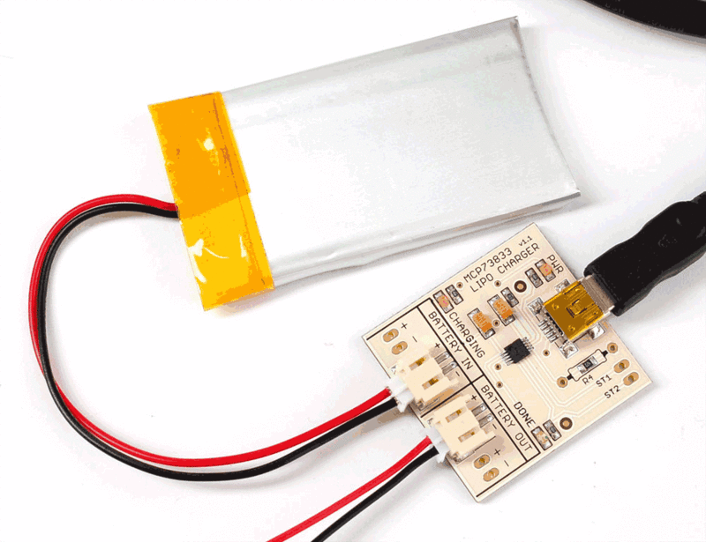
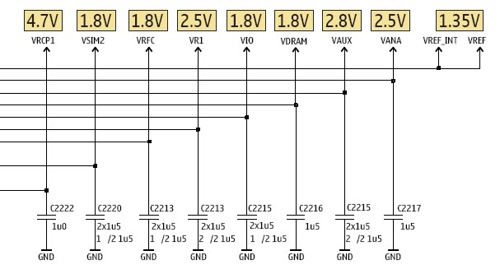
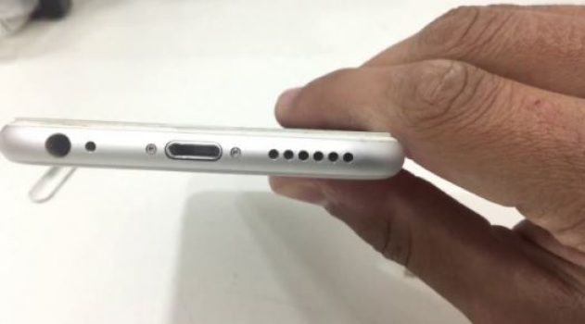

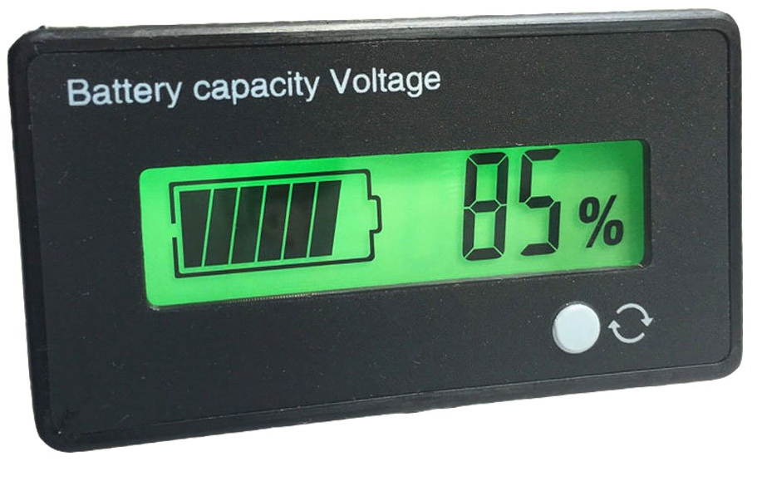
Mobile Phone - Use case example
Power
3.3 VDC
I2C Slave Devices
Power Management IC
Battery Charging IC
Main CPU
I2C Master
Fuel Gauge IC
Audio IC
SCL
Capacitive Touch Controller
SDA

Slide 4
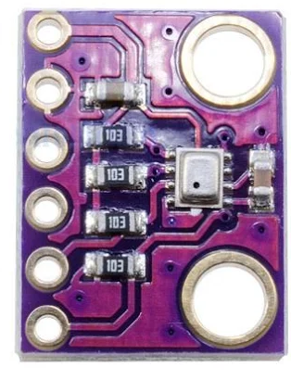
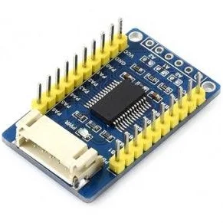
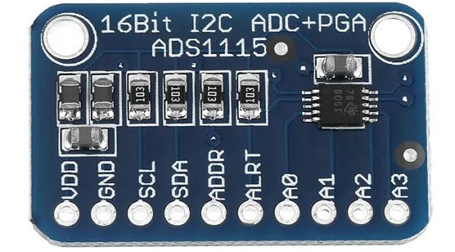
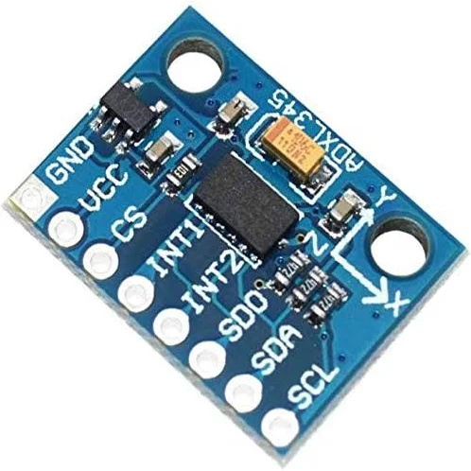
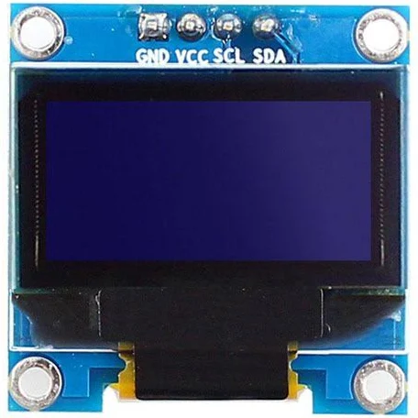
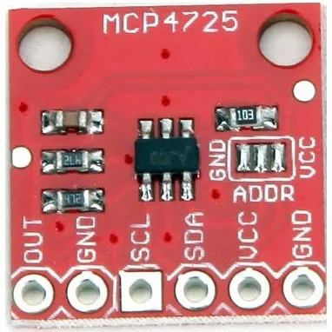
Use case – Modules available
BMP280 Pressure sensor
MCP23017 IO expander
ADS1115 16 bit ADC
MCP4725 DAC
AXD345 Accelerometer
SSD1306 OLED Display

Slide 6
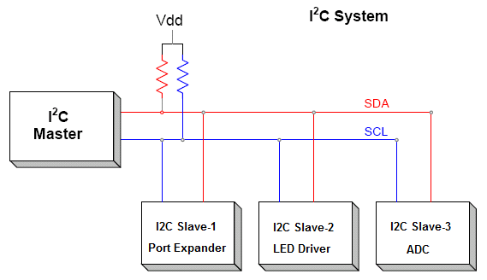
What is I2C?
Inter-Integrated Circuit (IIC or I2C) is a common chip-to-chip digital communications protocol.
I2C was originally designed by Phillips Semiconductor (now NXP) in the early '80s
Advantages
It’s a simple two wire synchronous protocol
It supports multiple slaves on the same bus
Saves tons of wiring.
It also supports multiple masters on the same bus
Makes projects easier (especially on breadboard
e.g. 2 wires instead of 8!)
Robust ACK signalling

Slide 7
Why do we need I2C?
Applications : Wide usage
Simple to use and quick to implement into designs
Intended to control, check & update the status and do maintenance functions
Enhance feature set of applications
Standard adopted by all Industry segments and used in many system applications

Slide 8
Why do we need I2C?
Interface : Well known bus interface standard
Bidirectional transfer of data between a master and several slave devices on the bus
The master device controls the bus
Each slave device on the same bus has an unique I2C address
More than 40 years of existence
Architecture :
Two-wire communication bus
Speed: Three modes of operation
Standard mode (0 to 100 KHz) – (Widely used)
Fast mode (0 to 400 KHz)
High-speed mode (0 to 3.4 MHz)

Slide 9
I2C - Master and slave
A master device is in charge of the bus and this device controls the clock and generates START and STOP signals.
Slaves simply listen to the bus and act on controls and data that they are sent.
The master can send data to a slave or receive data from a slave - slaves do not transfer data between themselves.

Slide 10
I2C - Data and Clock lines
The I2C interface uses two bi-directional lines – Serial Clock (SCL) and Serial Data (SDA)
The two wires must be driven as open collector/drain outputs by all devices in the bus, and must be pulled high using one resistor each
This implements a 'wired AND function' - any device pulling the wire low causes all devices to see a low logic value - for high logic value all devices must stop driving the wire (make it as High-Z)

Slide 11
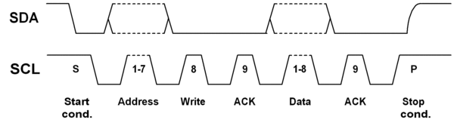
I2C - Basic Command Sequence
Send the START sequence - SDA transitions to low with SCL being high
Send the slave address - You can use 7 bit or 10 bit addresses.
Send the Read(R)-1 / Write(W)-0 bit.
Wait for/Send an acknowledge bit (A) – (ACK-0 / NACK-1)
Send/Receive the data byte (8 bits) (DATA).
Expect/Send acknowledge bit – (ACK-0 / NACK-1)
Send the STOP sequence - SDA transitions to high with SCL being high

Slide 12
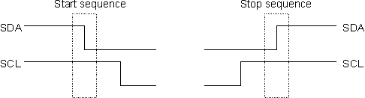


The I2C Physical Protocol
Start and Stop sequence
Sending Device Address
Transfer of data

Slide 13
I2C - MASTER writes to a SLAVE (typical)
Send a START sequence
Send the I2C address of the SLAVE with the R/W bit low (even address)
[Typically, send the device register you want to write to]
Send the data byte
[Optionally, send any further data bytes]
Send the STOP sequence.
ACK/NACKs
Slave will ACK/NACK after every 8 bits
If Slave ACKs, master can send one more byte of data
If Slave NACKs, master should abort the communication
 | START | ADDRESS | W | ACK | [device register] DATA | ACK | DATA | ACK | STOP
Bits |  | 7 | 0 | 0 | 8 | 0 | 8 | 0
 |  |  | W |  | 1 |  | 0x10
 | START | ADDRESS | W | ACK | DATA | NACK | STOP
Bits |  | 7 | 0 | 0 | 8 | 1
 | Sent by master
 | Sent by Slave

Slide 14
I2C - MASTER reads from a SLAVE
Typical Read :
Send a START sequence
Send I2C address of the SLAVE with the R/W bit high (odd address)
Read data byte from SLAVE
Send the STOP sequence.
Read from register address: (Concept : First write, then read)
Send a START sequence
Send I2C address of the SLAVE with the R/W bit low (even address)
Send device register address you want to read from
Send a START sequence again (or a repeated start – see next page)
Send I2C address of the SLAVE with the R/W bit high (odd address)
Read data byte from SLAVE
Send the STOP sequence.
Device Registers
Address | Definition
0 | Status
1 | LED1_Status
2 | LED2_Status
3 | ADC_MSB
4 | ADC_LSB
..
..
..

Slide 15
I2C - MASTER reads from a SLAVE
General Read:
OR
Read from register address:
 | START | ADDRESS | R | ACK | DATA | ACK | DATA | NACK | STOP
Bits |  | 7 | 1 | 0 | 8 | 0 | 8 | 1
 | START | ADDRESS | W | ACK | Register Data | ACK | Repeat START | ADDRESS | R | ACK | DATA | ACK | DATA | NACK | STOP
Bits |  | 7 | 0 | 0 | 8 | 0 |  | 7 | 1 | 0 | 8 | 0 | 8 | 1
ACK/NACKs
Slave will ACK only once for the address byte
Master will ACK, if it wants to read one more byte from slave
Master will NACK, if it wants to stop the reading
Note that the slave does not have an option to stop the communication once it has acknowledged the address.
 | Sent by master
 | Sent by Slave

Slide 16
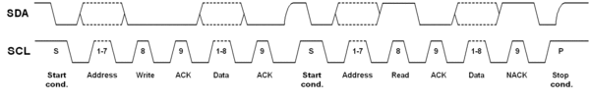
Repeated Start
A way to claim the bus : During an I2C transfer there is often the need to first send a command and then read back an answer right away. This has to be done without the risk of another (multimaster) device interrupting this atomic operation.
Send a start condition before sending a stop
Typically used when you want to write and read immediately or when you want to write to two different registers sequentially
Note : Regardless of the number of start conditions sent during one transfer the transfer must be ended by exactly one stop condition.

Slide 17
Clock stretching
A slow slave device may need to stop the bus while it gathers data or services an interrupt etc.
It can do this while holding the clock line (SCL) low forcing the master into the wait state.
The master must then wait until SCL is released before proceeding.
As per specification,
the slave can hold the SCL line after any clock bit
any device can hold down SCL as long as it likes!!

Slide 18
Arbitration
Occurs in Multi-master mode.
Happens when two masters start a transfer at the same time.
During the transfer, the masters constantly monitor SDA and SCL.
If one of them detects that SDA is low when it should actually be high, it assumes that another master is active and immediately stops its transfer.
This process is called arbitration.

Slide 19
I2C - Typical devices types
IO expanders
EEPROMs
DACs, ADCs
LCD/LED drivers
Capacitive sensors
NVRAM
Real-Time clocks (RTC)
Digital Temperature ICs
Accelerometers
Compass
Third party sensors with an I2C interface (sonars, IR range finders, NXT I2C sensors)

Slide 20
More materials on I2C…
Want to learn more?
Check the I2C Primer from http://www.i2c-bus.org
The latest I2C specification is available directly from NXP.
There are a number of I2C-like buses, see Definitions and Differences Between I2C, ACCESS.bus and SMBus.
The I2C-Bus and how to use it is a well-known document from Philips discussing the use of this bus in applications.

Slide 21
I2C –Debugging
Ruling out the obvious
Is there a stable supply voltage Vcc?
Is the GND of Master and slave common? If not, make it.
Are you using the correct pins for I2C? Check your data sheet and verify.
Are SDA and SCL interchanged?
Do all I2C devices support the I2C supply voltage used on the bus?
Do all I2C devices support the maximum SCL clock rate used on the bus?
If more than one I2C master is connected to the bus: do all masters provide multi-master support?
Are the high and low level voltages on SDA and SCL correct during I2C transfers? The I2C standard defines the low level threshold with 0.3 Vcc, the high level threshold with 0.7 Vcc. Modifying the termination resistance Rp, the serial resistors Rs or lowering the SCL clock rate could help here.
Are there spikes or noise on SDA, SCL or even Vcc? They may result from interferences from other components. The effects can often be reduced by using shorter interconnections.
Further diagnostics is possible with Vcc, SCL and SDA connected to an oscilloscope and/or an appropriate I2C monitor device like an MSO with a serial decoder or using the tool like Beagle I2C/SPI Protocol Analyzer.

Slide 22
I2C –Debugging – Continued…
Are you sure that you are using an I2C device? Some I2C devices are marketed as serial devices. Some serial devices are not I2C devices, ie use SPI instead, which is another serial protocol.
Verify that the speed you are using is supported by the I2C device. When all else fails go back to using 100kHz.
Are you accessing the correct device? Verify the device address you are sending on the I2C bus. Verify that the correct R/W bit is set depending on the operation that you are performing.
Getting weird or totally incorrect values? Verify if your I2C device requires a delay period before reading the results. Also note that some EEPROMs are slow. So the value for the delay period should be in the ms (millisecond) range. For I2C devices describes as a “24xx series EPROM, with a different I2C address” but is not actually an EEPROM, you likely have an I2C device that needs a delay period before reading (ie. WRITE => DELAY PERIOD (ms)=> READ).
An oscilloscope and/or a logic analyzer is good to have when troubleshooting problems on the I2C bus.

Slide 23
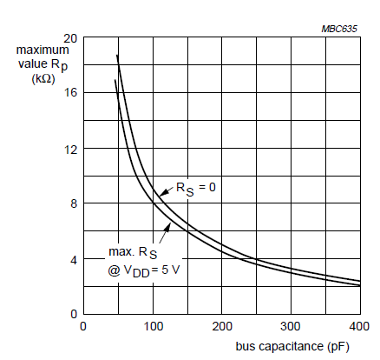
Rp Vs Bus Cap
Value of Pull up resistor Vs Bus Capacitance

Slide 24
I2C APIs
bool begin(int sda=-1, int scl=-1, uint32_t frequency=0);
Description | This function to start i2c module
Parameter | sda, scl and frequency
Return | Return true if successful else returns false
Example | Wire.begin( D21, D22, 100000 ); // starts i2c with 100KHz frequency
bool begin(uint8_t slaveAddr, int sda=-1, int scl=-1, uint32_t frequency=0);
Description | This function starts i2c slave with address mentioned
Parameter | Slave address, sda, scl and frequency
Return | Returns true if successful else returns false
Example | Wire.begin( 0x08, D21, D22, 100000 ); // starts i2c slave with address 0x08

Slide 25
I2C APIs
bool setPins(int sda, int scl);
Description | This function sets i2c pins for communication
Parameter | sda and scl
Return | Return true if successful else returns false
Example | Wire.setPins( D21, D22 ); // sets i2c pins D21 and D22
bool end();
Description | This function ends i2c communications
Parameter | None
Return | Returns true if successful else returns false
Example | Wire.end( ); // ends i2c communications

Slide 26
I2C APIs
void setTimeOut(uint16_t timeOutMillis);
Description | Timeout for i2c transcations
Parameter | Timeout in milliseconds
Return | None
Example | Wire.set TimeOut( 100 ); //sets timeout to 100ms
bool setClock(uint32_t);
Description | This function sets frequency
Parameter | Frequency
Return | Returns true if successful else returns false
Example | Wire.setClock( 100000 ); //sets frequency to 100khz

Slide 27
I2C APIs
uint32_t getClock();
Description | Get i2c set frequency
Parameter | None
Return | Frequency
Example | Wire.getClock( ); //returns set frequency
void beginTransmission(uint16_t address);
Description | This function begins transmission
Parameter | Address
Return | None
Example | Wire.beginTransmission( 0x10 ); //starts i2c comm with address 0x10

Slide 28
I2C APIs
void beginTransmission(int address);
Description | This function begins transmission
Parameter | Address
Return | None
Example | Wire.beginTransmission( 0x10 ); //starts i2c comm with address 0x10
void beginTransmission(uint8_t address);
Description | This function begins transmission
Parameter | Address
Return | None
Example | Wire.beginTransmission( 0x10 ); //starts i2c comm with address 0x10

Slide 29
I2C APIs
uint8_t endTransmission(bool sendStop);
Description | This function ends transmission
Parameter | Sendstop
Return | Returns status of transmission
Example | Wire.endTransmission( 1 ); //stops transmission
uint8_t endTransmission(void);
Description | This function ends transmission
Parameter | None
Return | Returns status of transmission
Example | Wire.endTransmission( ); //stops transmission

Slide 30
I2C APIs
uint8_t requestFrom(uint16_t address, uint8_t size, uint8_t sendStop);
Description | This function request from mentioned address and required bytes
Parameter | Address, size and sendstop
Return | Number of bytes can be read.
Example | Wire.requestFrom( 0x10, 2, 1 ); //request 2 bytes from address 0x10 and stop comm
uint8_t requestFrom(uint16_t address, uint8_t size, bool sendStop);
Description | This function request from mentioned address and required bytes
Parameter | Address, size and sendstop
Return | Number of bytes can be read.
Example | Wire.requestFrom( 0x10, 2, 1 ); //request 2 bytes from address 0x10 and stop comm

Slide 31
I2C APIs
size_t requestFrom(uint16_t address, size_t size, bool sendStop);
Description | This function request from mentioned address and required bytes
Parameter | Address, size and sendstop
Return | Number of bytes can be read.
Example | Wire.requestFrom( 0x10, 2, 1 ); //request 2 bytes from address 0x10 and stop comm
size_t requestFrom(uint8_t address, size_t len, bool stopBit);
Description | This function request from mentioned address and required bytes
Parameter | Address, length and stopbit
Return | Number of bytes can be read.
Example | Wire.requestFrom( 0x10, 2, 1 ); //request 2 bytes from address 0x10 and stop comm

Slide 32
I2C APIs
uint8_t requestFrom(uint16_t address, uint8_t size);
Description | This function request from mentioned address and required bytes
Parameter | Address, size
Return | Number of bytes can be read.
Example | Wire.requestFrom( 0x10, 2 ); //request 2 bytes from address 0x10
uint8_t requestFrom(uint8_t address, uint8_t size, uint8_t sendStop);
Description | This function request from mentioned address and required bytes
Parameter | Address, size and sendstop
Return | Number of bytes can be read.
Example | Wire.requestFrom( 0x10, 2, 1 ); //request 2 bytes from address 0x10 and stop comm

Slide 33
I2C APIs
uint8_t requestFrom(uint8_t address, uint8_t size);
Description | This function request from mentioned address and required bytes
Parameter | Address, size
Return | Number of bytes can be read.
Example | Wire.requestFrom( 0x10, 2 ); //request 2 bytes from address 0x10
uint8_t requestFrom(int address, int size, int sendStop);
Description | This function request from mentioned address and required bytes
Parameter | Address, size and sendstop
Return | Number of bytes can be read.
Example | Wire.requestFrom( 0x10, 2, 1 ); //request 2 bytes from address 0x10 and stop comm

Slide 34
I2C APIs
uint8_t requestFrom(int address, int size);
Description | This function request from mentioned address and required bytes
Parameter | Address, size
Return | Number of bytes can be read.
Example | Wire.requestFrom( 0x10, 2 ); //request 2 bytes from address 0x10
size_t write(uint8_t);
Description | This function write byte to i2c slave device
Parameter | Byte
Return | Status of write
Example | Wire.write( 2 ); //write value 2 to device

Slide 35
I2C APIs
size_t write(const uint8_t *, size_t);
Description | This function writes byte array to slave device
Parameter | Buffer, size
Return | Status of write
Example | Wire.write( buf, 2 ); //writes 2 bytes from buffer array
int available(void);
Description | This function number of bytes available to read
Parameter | None
Return | Number of bytes
Example | Wire.available( );

Slide 36
I2C APIs
int read(void);
Description | This function read int value
Parameter | None
Return | Integer value
Example | Wire.read( );
void onReceive( void (*)(int) );
Description | Callback on data receive
Parameter | Callback function
Return | None
Example | Wire.onReceive( callback_on_rcv );

Slide 37
I2C APIs
int read(void);
Description | This function read int value
Parameter | None
Return | Integer value
Example | Wire.read( );
void onRequest( void (*)(void) );
Description | Callback on data request
Parameter | Callback function
Return | None
Example | Wire.onRequest( callback_on_rqst );

Slide 38
I2C APIs
size_t slaveWrite(const uint8_t *, size_t);
Description | This function writes data from slave
Parameter | Buffer , size
Return | status
Example | Wire.slaveWrite( buf, 2 ); //write buffer of 2 bytes

Slide 39
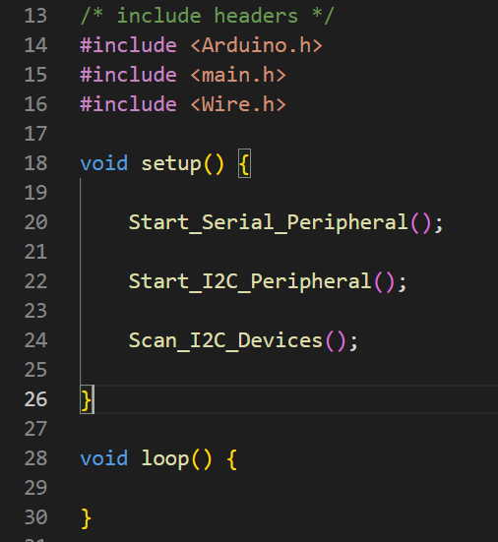
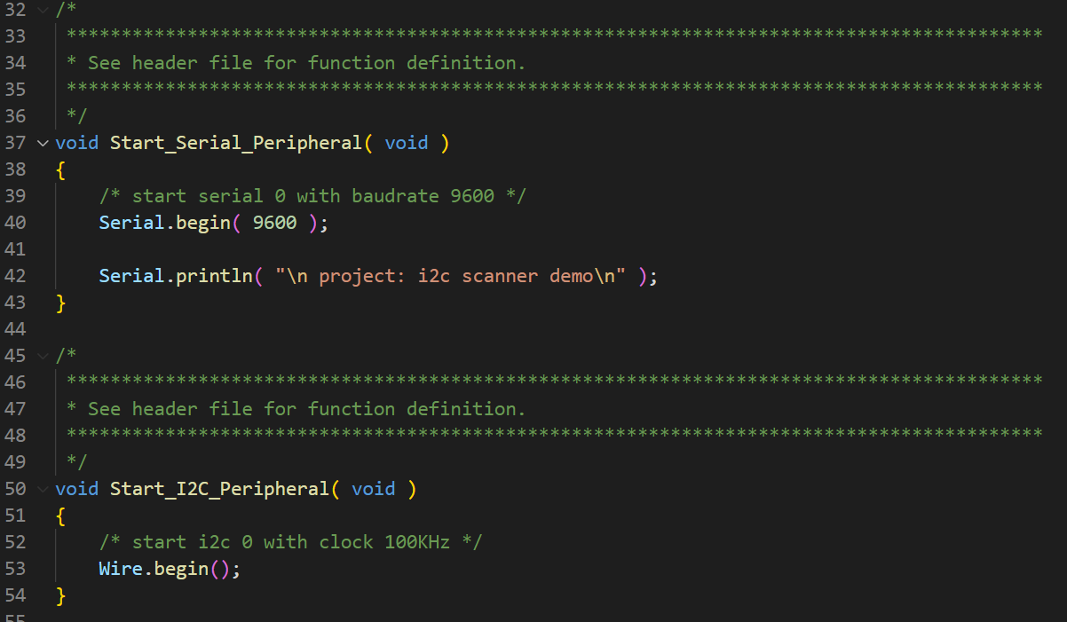
I2C scanner program

Slide 40
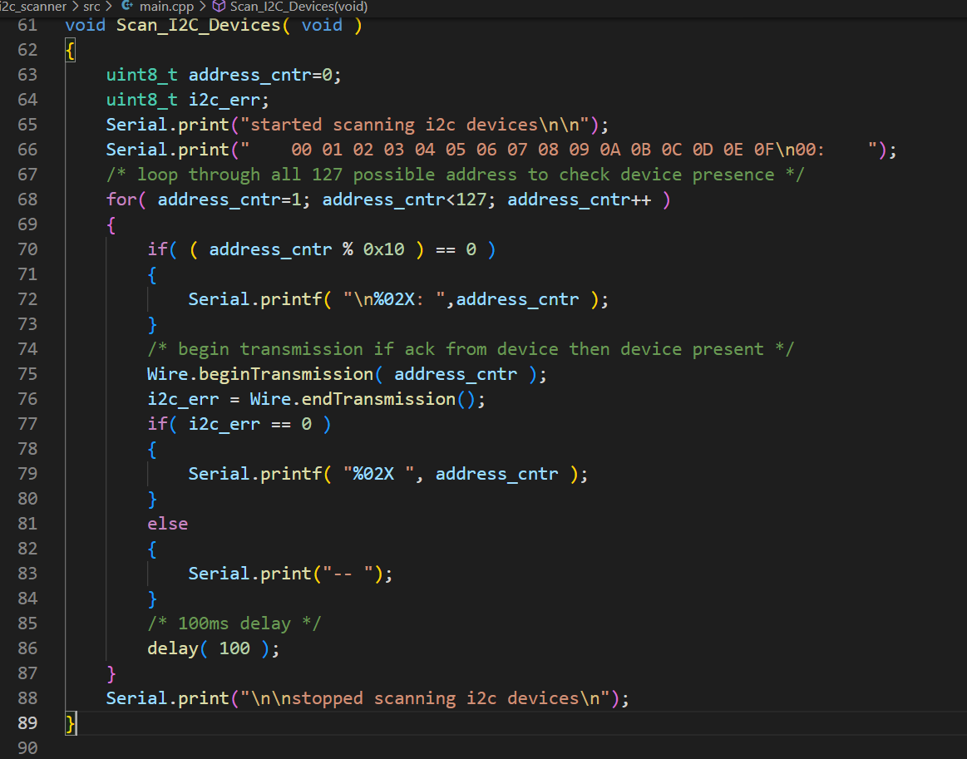
I2C scanner program

Slide 41
I2C questions start of the class
What is I2C communication?
What does I2C stand for?
What is SDA and SCL
How many wires are required for I2C communications?
I2C half-duplex or full-duplex communication?
Is I2C serial communication or parallel communication
I2C is synchronous communication or asynchronous communication?
What is start bit
What is stop bit
What is standard speed in I2C communications
How many devices can be connected to I2C port
What is the application of i2c protocol
Advantages of I2C bus
I2C is edge trigger or level trigger
Is in I2C two slave have the same address
How will the master indicate that it is either address/data?
What is the voltage level in I2C
Is I2C master oriented protocol or slave oriented protocol

Slide 42
I2C questions at end of the class
Explain the physical layer of I2C communication
Explain operation and frame of I2C protocol
What is repeated start conditions
Who sends start bit
Who sends acknowledgement
What is the maximum bus length of I2C bus
How many kinds of addressing strictures are there in I2C
Is it possible to have multiple I2C master in a single bus
What is bus arbitration
What is clock stretching
What is I2C clock synchronization
When must data be stable for a correct I2C bus transaction
Is hot swapping possible in I2C protocol
Can device be added and removed while system is running
What is locking and unlocking in I2C protocol
What is byte order in I2C
Does I2C need pullup resistor
What is advantage and disadvantage of I2C protocol

Slide 43
I2C tarkas
Which is better to use I2C UART or SPI
If a slave is servicing an interrupt, what will it do to avoid losing data
Can we monitor I2C bus
What is the limitation of I2C interface
What is the difference between I2C and SPI
What pull-up resistor value suits.
Can 5v I2C device works with 3.3V device.
Can multi-master works in I2C bus
Can two master communicate at same time?

Slide 44
Thank you….

Slide 45
Warning: The protocol is designed for single board communication it is not a long distance communication system. You can find instances (horror stories) of people designing a multi drop inter office communication system with I2C extenders - just don't do it - it ends in tears!
Warning: You must have one pull-up resistor per signal wire (SCL and SDA) and not more! More means stronger pull-up action (keep above 1k).

