Slide 1
ESP32 embedded course
Yogesh M Iggalore

Slide 2
Electronics
theory
Electronics fundamentals : resistors, capacitors, diodes, transistors etc
Analog and digital electronics basics
Embedded theory
Embedded system architecture, uP & uC architecture, peripherals, communication protocol
Power system and regulators
Hardware design
Component selection, manufacturing process
IoT
Data -> information -> knowledge -> wisdom
Introduction to Internet of things
Embedded Programming
Basics of C language, embedded c language
Firmware development of peripherals, communication protocol
Schematic, PCB editor, gerber generation, bill of material generation.

Slide 3
Basic Electronics concepts
Shot noise
Thermal noise
Ohm's Law
Power - electrical power
Q, quality factor
Resistance
Resistivity
Semiconductors
Transformers
Voltage - potential difference
Waveforms
Capacitance
Current - electric current
Decibel, dB
Inductance
Kirchoff's laws
Noise - electrical & RF
Avalanche noise
Burst noise
Flicker noise
Phase noise

Slide 4
Embedded theory
Theory and hands-on
Theory and demo
Microcontroller and microprocessor architecture
ARM and ESP32 architecture
General purpose input and output
Timer, Counter and PWM
Analog to digital converter & DAC
Communication protocol UART, I2C, SPI
Wifi and Bluetooth low energy
EEPROM and SPIFFS file systems
MQTT, Alexa and telegram application
Firmware Over the air

Slide 5
Embedded C language
Basics
Variable Declaration, Definition and Scope
Constants, keywords
Data Types
Input/Output
Operators
Preprocessor
Arrays & Strings, structure, union, pointers
If, else, else if, switch
For, while loops
Functions and sub-routines
Pass-by value and pass-by reference
Notes:
Pass by value and passing by reference

Slide 6
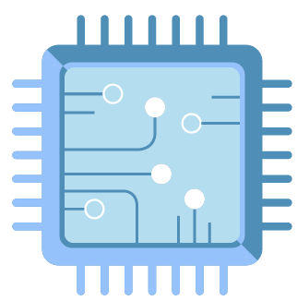
Embedded Programming
System applications
GPIO
Webserver
Filesystem
OTA
UART
INTERRUPT
I2C
TIMER
communication protocol
SPI
PWM
EEPROM
microcontroller peripherals
ADC
WIFI
COUNTER
Bluetooth
CLOCK
BLE
wireless protocol
DAC
Telegram
Alexa
MQTT
Thingsboard
IoT protocol

Slide 7
Embedded Programming
GPIO:
LED blinking with firmware delay.
Two LED blinking with firmware delay.
Timer:
LED blinking with timer.
Two LED blinking with timer.
Counter:
Switch press counter
Frequency measurement
Interrupt:
Switch input to turn on/off LED.
PWM:
Blink led with PWM
LED fade-in fade-out
Colour mixing
Memory:
Store LED status to Memory
UART:
Send sample string to PC
Reading data from tere-term software
ADC and DAC:
send LM35 reading to PC using UART
DAC demo
I2C:
Display name on oled
Display LED status on oled
Display LM35 and DHT22 on oled
RTC time read
WiFi and Webserver:
Control LED on/off using Webserver using access point mode
Control LED on/off using Webserver using station mode
DHT11:
Read DHT11 and send these values to UART

Slide 8
Embedded Programming (demo)
SPIFFS:
Webserver using File System
WiFi configuration using webserver and File System
Internet:
NTP time display on oled
Clock display on oled
MQTT:
LED control using MQTT
LM35 and DHT11 reading values MQTT
Alexa:
LED controlling using Alexa
Telegram:
LED control using Telegram.
LM35 and DHT11 reading using Telegram
OTA:
OTA IP
OTA webserver
OTA http

Slide 9
RTOS concepts
Scheduler:
Preemptive scheduler that guarantees the highest priority thread is running.
Communication Mechanism:
Semaphores, Message Queues, Queues, etc.
Critical Region Mechanisms:
Mutexes, Gates, Locks, etc.
Power Management:
For low power devices, power management is generally part of the RTOS since it knows the state of the device.
Memory Management:
Variable-size heaps, fixed-size heaps, etc.

Slide 10
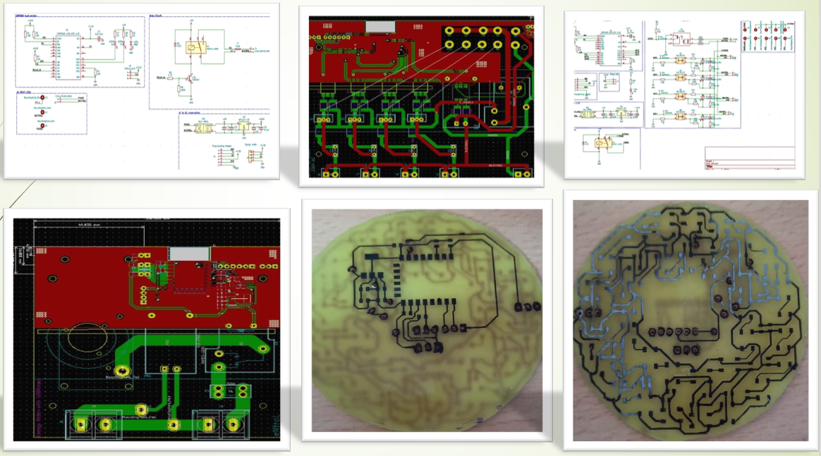
Hardware design

Slide 11
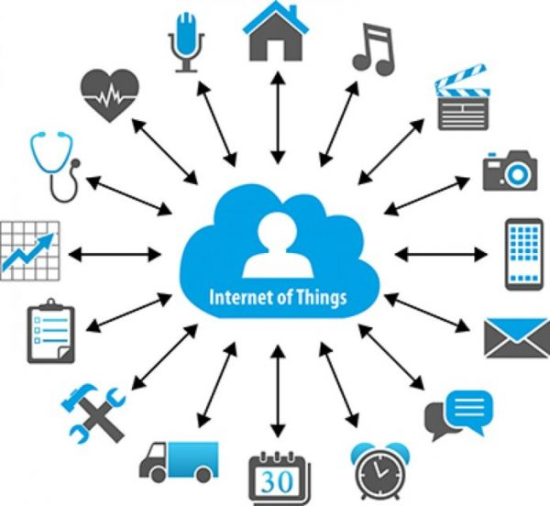
Internet of Things

