Slide 1
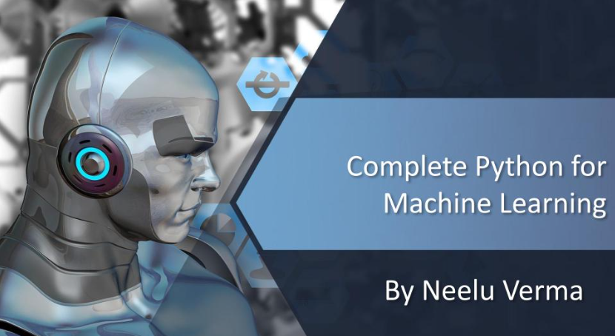

Slide 2
Basics of Python
Python is an interpreted( meaning that code can be executed as soon as it is written), object-oriented, high-level programming language with dynamic semantics. It is used for: web development (server-side), software development, mathematics, system scripting.
Key Features & Applications
Easy to Learn: Simple and beginner-friendly syntax.
Large Community Support: Extensive resources, libraries, and tutorials available.
Cross-Platform: Runs on Windows, macOS, and Linux.
Automation: Ideal for automating tasks like file handling and calculations.
Data Science: Popular for data analysis and machine learning (NumPy, pandas, TensorFlow).
Game Development: Create simple games with Pygame.
Security and Testing: Useful for testing and securing applications (pytest).

Slide 3
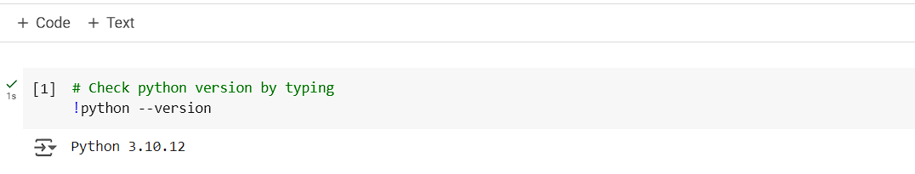
Introduction to Python Versions
Python 2 (Released 2000):
Legacy version, no longer supported.
Syntax differences compared to Python 3.
Python 3 (Released 2008):
Current and actively supported version.
Improved syntax and features (e.g., print() function, type hints).
Latest Version:
Python 3.11 (or latest available version).
Enhancements in performance, security, and new libraries.
Key Differences:
Python 3 offers better support for Unicode, advanced data types, and modern libraries.

Slide 4
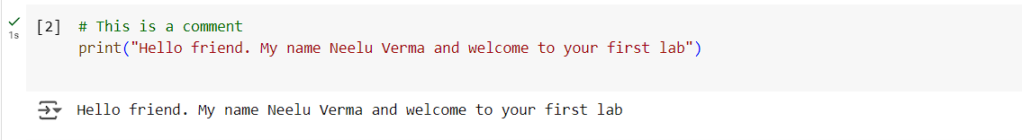
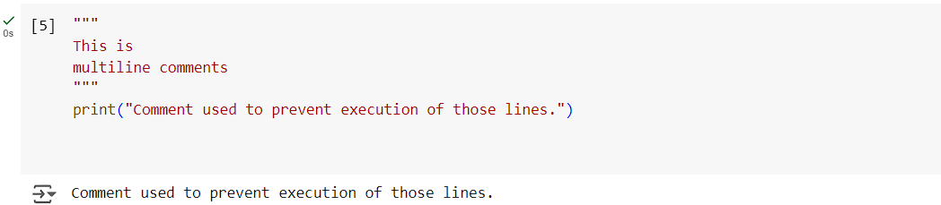
Comments Examples
Single-line Comment: Used to explain code.
Multiline Comment: Used for longer explanations or to prevent code from running.

Slide 5
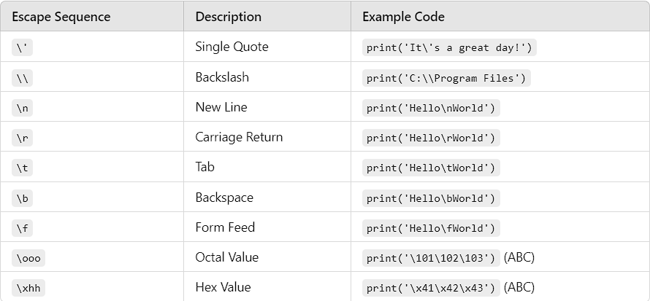
Python Escape Sequences with Examples

Slide 6
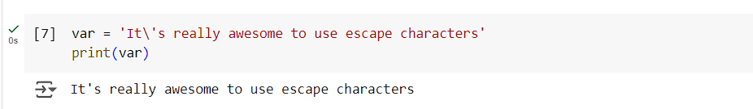
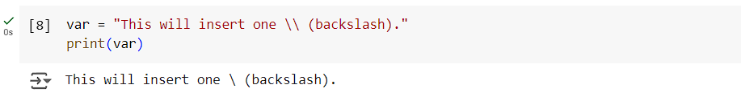
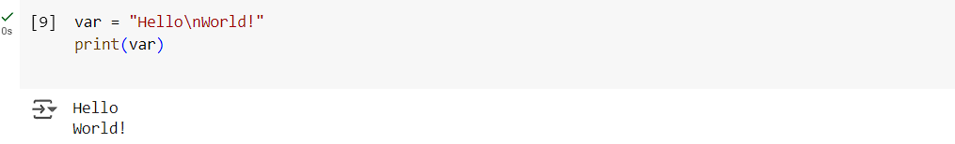
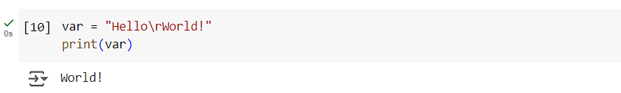
Examples:

Slide 7
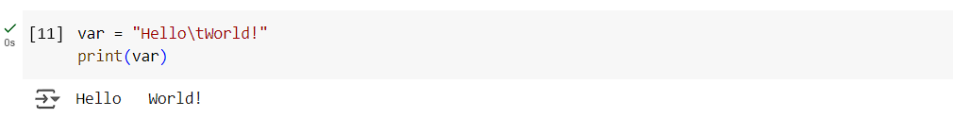
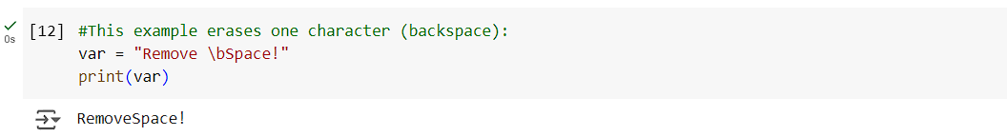
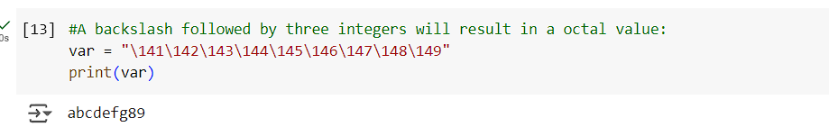
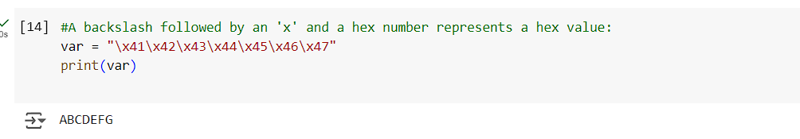

Slide 8
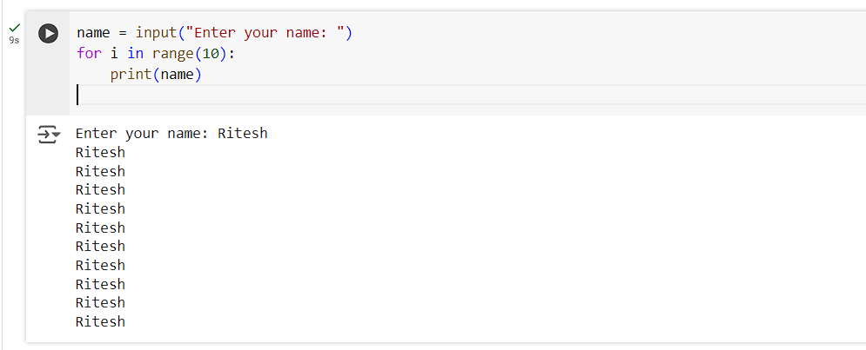
Basic Python Programs
Q: Take name as input from user and print it 10 times

Slide 9
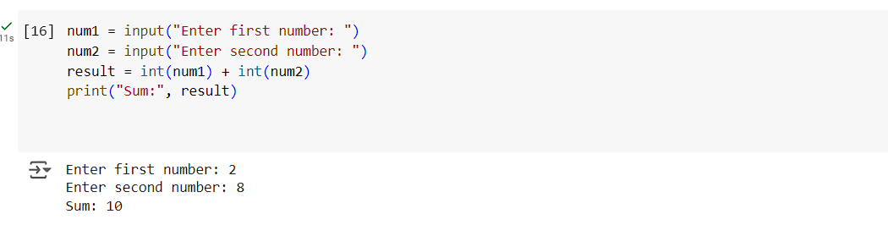
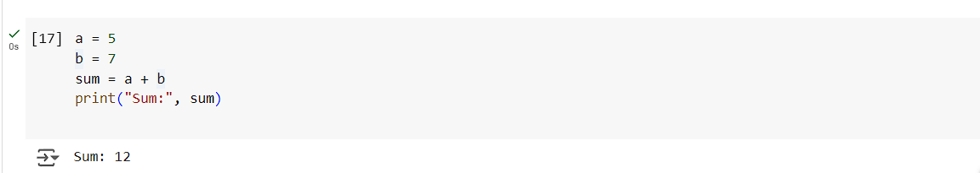
Q: Take two inputs from user and add both
Q: Program to add two numbers

Slide 10
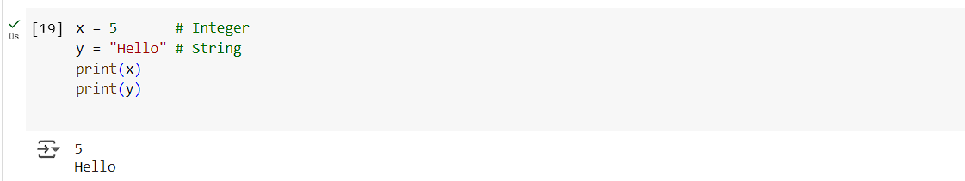
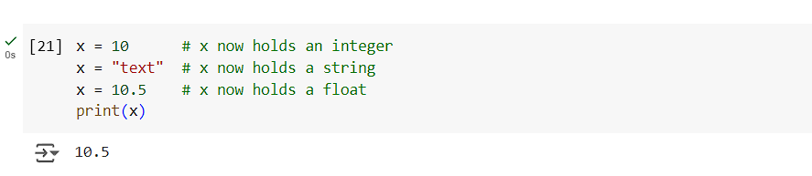
Variables
Definition: Variables in Python are used to store information that can be referenced and manipulated in a program. Each variable is associated with a memory location where the data is stored.
Dynamic Typing: Python is dynamically typed, meaning the type of the variable is determined at runtime. You don’t need to declare the data type of a variable.
Reassignment: Variables can be reassigned to new values or types.

Slide 11
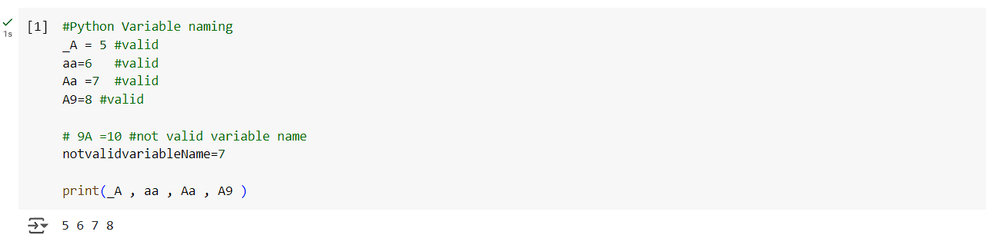
Multiple Assignment: Python allows assigning values to multiple variables in one line.
Must start with a letter or underscore ( _ )
Cannot start with a number
Can contain letters, numbers, and underscores
Case-sensitive (e.g., myVar and myvar are different)
Naming Rules:

Slide 12
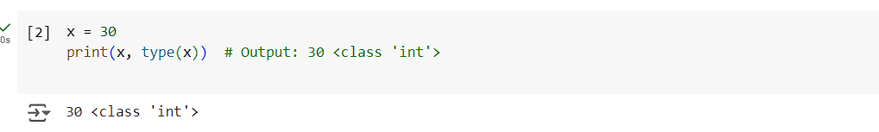
Variable Types and Casting
Print the Type of a Variable
Data Types in Python
Text Type: str
Numerical Types: int, float, complex
Sequence Types: list, tuple, range
Mapping Type: dict
Boolean Type: bool
Binary Types: bytes, bytearray, memoryview
Set Types: set, frozens

Slide 13
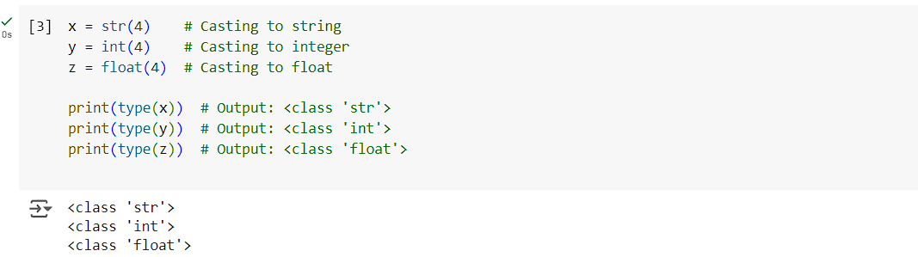
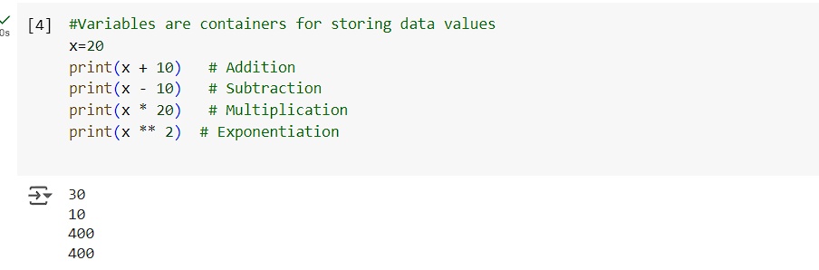
Q. Take a number from user, print its type, then change its type to int, float

Slide 14
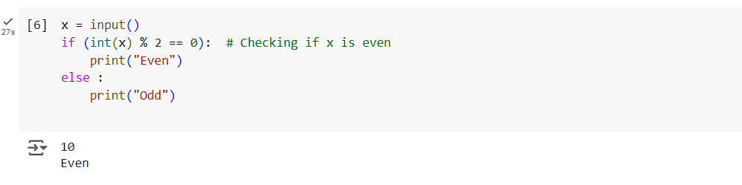
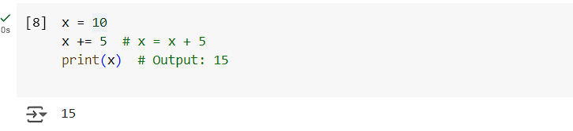
1. Arithmetic Operators
Operators Overview
+ (Addition), - (Subtraction), * (Multiplication), / (Division), % (Modulus), ** (Exponentiation)
2. Assignment Operators
=, +=, -=, *=, /=, %=

Slide 15
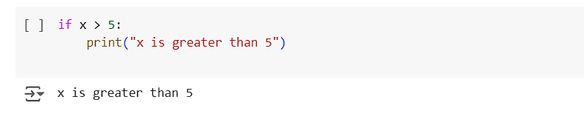
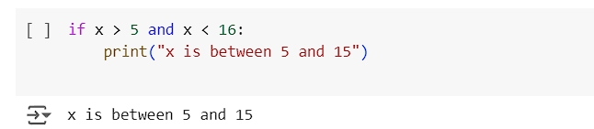
3. Comparison Operators
==, !=, >, <, >=, <=
4. Logical Operators
and, or, not

Slide 16
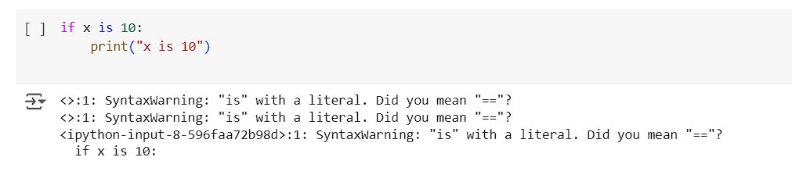
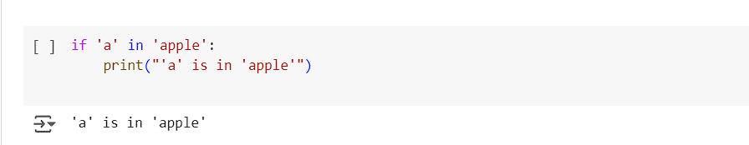
5. Identity Operators
is, is not
6. Membership Operators
in, not in

Slide 17
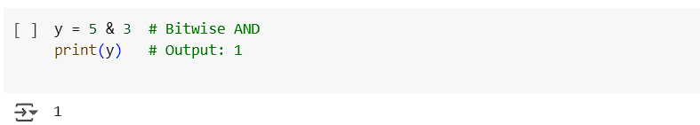
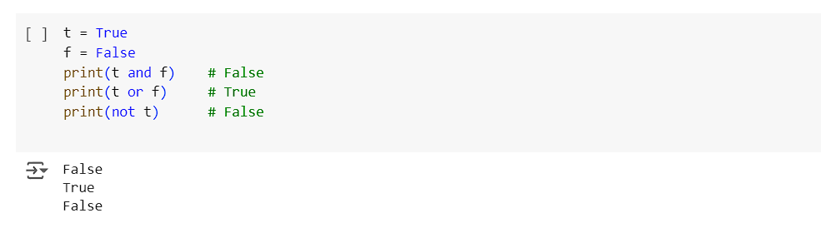
7. Bitwise Operators
&, |, ^, ~, <<, >>
8. Boolean Operations
True or False

Slide 18
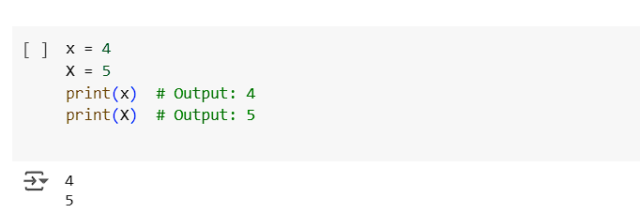
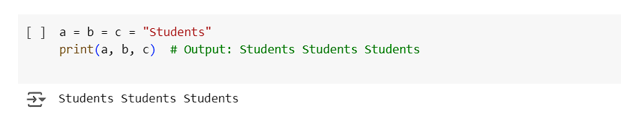
Some more facts about variables in Python:
1. Variables Are Case Sensitive
2. Assigning One Value to Multiple Variables

Slide 19
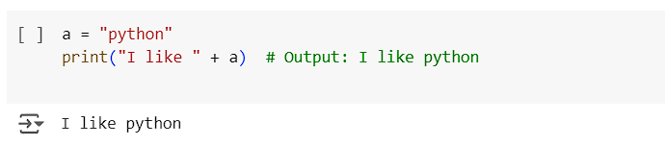
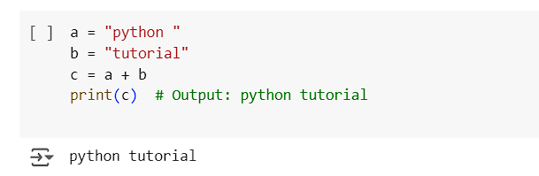
3. Output Variables
4. Adding Strings

Slide 20
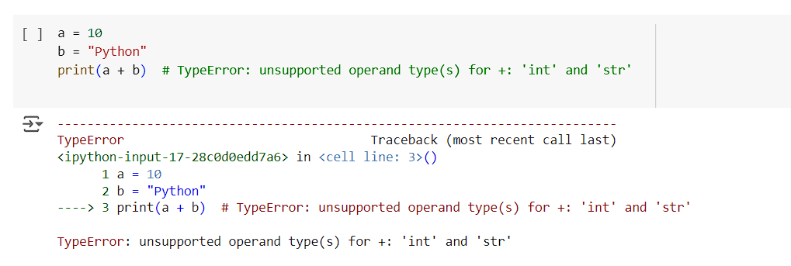
5. Combining Numbers and Strings
You cannot directly add numbers and strings together. It will raise a TypeError

Slide 21
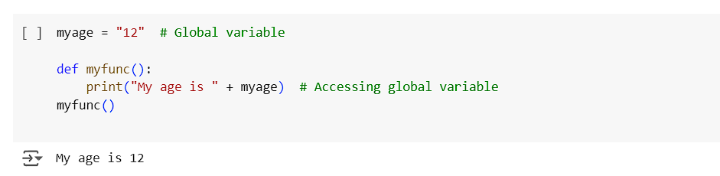
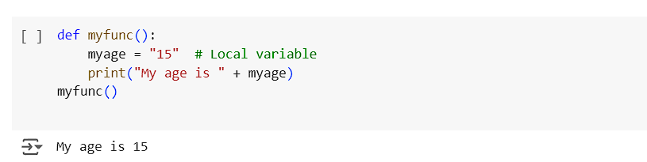
Global and Local Variables
Global Variable:
A global variable is declared outside any function and is accessible throughout the code.
Example:
Local Variable:
A local variable is declared inside a function and can only be accessed within that function.
Example:

Slide 22
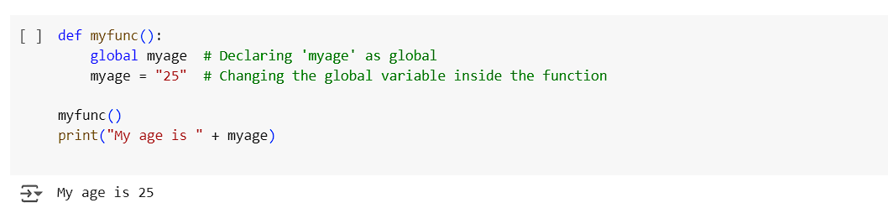
Making a Local Variable Global
Converting Local Variable to Global:
You can use the global keyword to make a local variable global, which will modify the global version of the variable.
Example:

Slide 23
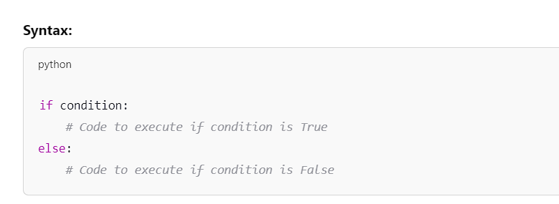
If-Else Statements in Python
if-else statements allow you to make decisions in your code based on conditions.
The if statement checks a condition. If it's True, the code block under it is executed.
If the condition is False, the block under the else statement is executed.

Slide 24
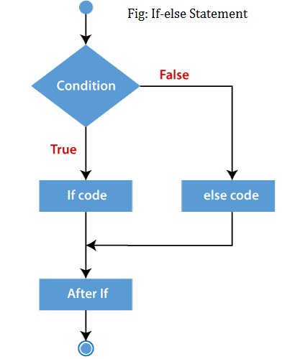
[Condition]
/ \
True False
| |
[Execute] [Execute]
If Else

Slide 25
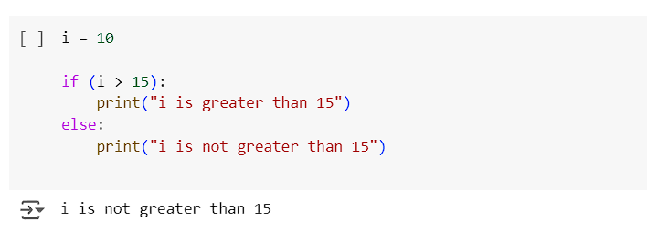
Example of If-Else
Simple If-Else:
Explanation:
The variable i is 10.
The if condition checks if i is greater than 15.
Since 10 is less than 15, the condition is False, so the else block is executed

Slide 26
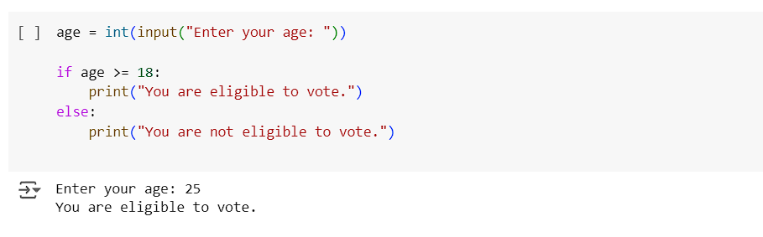
If-Else with User Input
More Practice:
Q. If the number is positive, print an appropriate message
Q. take a number from user and check whether is is greater than 20 or not
Q. take a number from user check whether it is even or odd
Q. Program to print the largest of the three numbers
Q. Program to check whether a person is eligible to vote or not.

Slide 27
Loops in Python
What is a Loop?
A loop is used in programming to repeat a block of code multiple times.
Python has two main types of loops:
For Loop
While Loop
Why Use Loops?
Loops allow for efficient repetition of code without manually writing it multiple times.
They are useful when you need to iterate over elements in a sequence (like a list) or repeat a task until a condition is met.
Types of loops:
For loop: Used when you know exactly how many times you want to repeat a block of code, often iterating through elements in a sequence (like a list).
While loop: Used when you need to repeat a block of code until a certain condition becomes false, where the number of iterations might not be known beforehand.

Slide 28
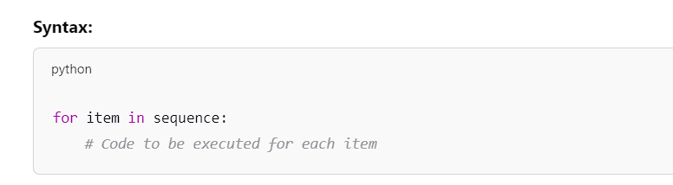
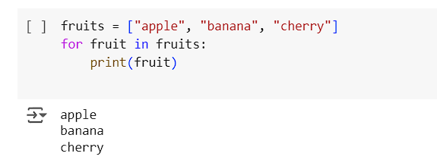
For Loops in Python
For Loop Overview:
A for loop is used to iterate over a sequence (like a list, string, or tuple) or other iterable objects like range().
Example 1: Iterating Over a List

Slide 29
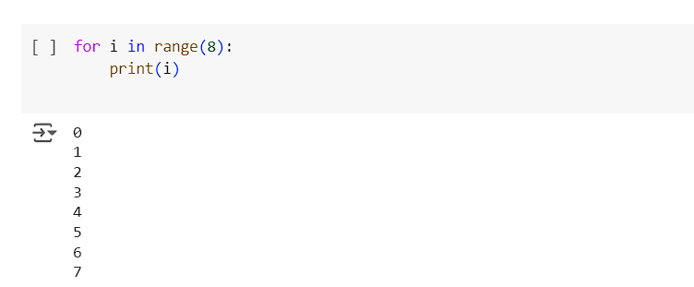
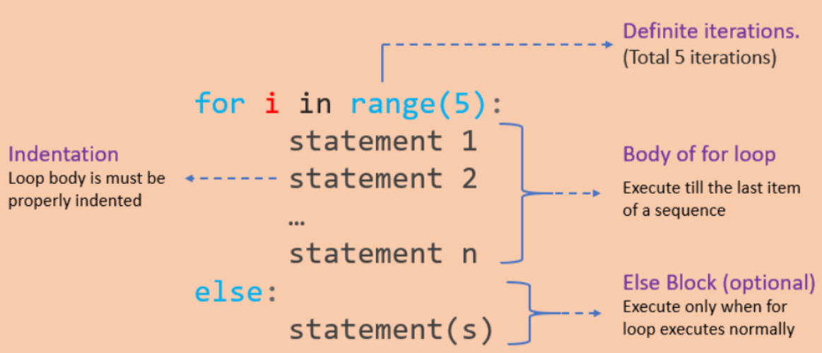
Example 2: For Loop with Range

Slide 30
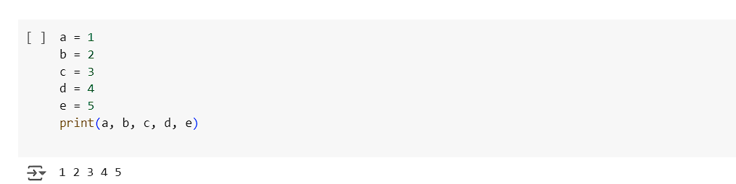
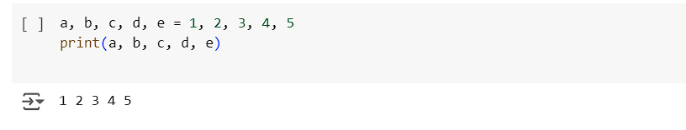
Python Basics - Variables and Loops
1. Assigning and Printing Variables
2. Multiple Variable Assignment

Slide 31
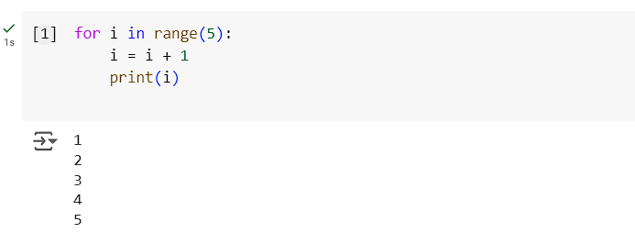
3. Using For Loops
Example 1: Looping through Range:
Example 2: Incrementing Values in a Loop

Slide 32
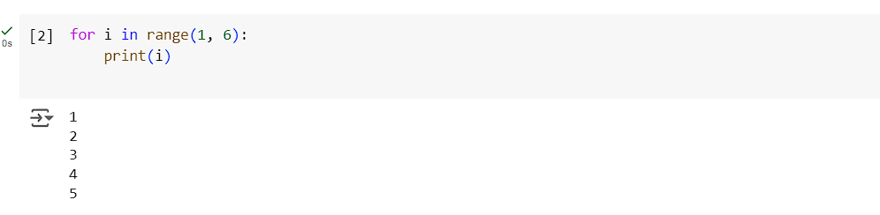

4. For Loop with Custom Range
5. Looping Through a String

Slide 33

Control Flow in Python:

Slide 34

Python provides three important control flow statements for altering the behavior of loops:
break – Exits the loop completely.
continue – Skips the current iteration and proceeds with the next one.
pass – Does nothing, serves as a placeholder.
Break:

Slide 35


Continue:
Pass:

Slide 36

Combining break, continue, and pass

Slide 37


Slide 38


More Practice:
Q: Print First 10 Natural Numbers Using For Loop
Q: Calculate the Sum of All Numbers from 1 to a Given Number

Slide 39


Q: Write a Program to Print Multiplication Table of a Given Number
Q: Display Numbers from a List Using For Loop

Slide 40


Q: Count the Total Number of Digits in a Number
Q: Print List in Reverse Order Using a Loop

Slide 41


Q: Display Numbers from -10 to -1 Using For Loop
Q: Use Else Block to Display a Message “Done” After Successful Execution of For Loop

Slide 42

Q: Write a Program to Display All Prime Numbers Within a Range

Slide 43


Q: Display Fibonacci Series Up to 10 Terms
Q: Find the Factorial of a Given Number

Slide 44


Q: Reverse a Given Integer Number
Q: Use a Loop to Display Elements from a Given List Present at Odd Index Positions

Slide 45


Q: Calculate the Cube of All Numbers from 1 to a Given Number
Q: Find the Sum of the Series Up to n Terms

Slide 46


While loop
What is a While Loop?
A while loop repeats a block of code as long as the given condition remains True

Slide 47


Example: Print Numbers 1 to 5

Slide 48
Practice Questions:
Print the first 10 natural numbers using a while loop.
Calculate the sum of all numbers from 1 to a given number using a while loop.
Write a program to print the multiplication table of a given number using a while loop.
Display numbers from a list using a while loop.
Count the total number of digits in a number using a while loop.
Print a list in reverse order using a while loop.
Display numbers from -10 to -1 using a while loop.
Use an else block to display a message "Done" after the successful execution of a while loop.
Write a program to display all prime numbers within a range using a while loop.
Display Fibonacci series up to 10 terms using a while loop.
Find the factorial of a given number using a while loop.
Reverse a given integer number using a while loop.
Display elements from a given list present at odd index positions using a while loop.
Calculate the cube of all numbers from 1 to a given number using a while loop.
15. **Find the sum of a series up to n terms using a while loop.**

Slide 49


Strings in Python
In Python, strings are arrays of bytes representing Unicode characters. They can be created using either single or double quotes, and they are immutable, meaning once a string is created, it cannot be modified directly. Let's explore some operations and features of strings.
String Creation and Basic Operations
Strings can be created using single or double quotes:
You can check the length of a string using len():

Slide 50


2. String Concatenation
Strings can be concatenated using the + operator:
You can also format strings using % (sprintf style):

Slide 51

3. Common String Methods
Python provides many built-in methods to manipulate strings:
capitalize: Converts the first character to uppercase.
upper: Converts all characters to uppercase.
rjust: Right-justifies a string.
center: Centers a string.
replace: Replaces all occurrences of a substring with another.
strip: Removes leading and trailing spaces.

Slide 52


4. String Indexing and Slicing
Strings in Python can be indexed, starting from 0. You can also access slices of strings:
String slicing allows you to access a range of characters:

Slide 53


5. Looping Through Strings
You can loop through a string using a for loop:
6. Checking Substrings with in and not in
You can check for the presence of a substring using in or not in:

Slide 54


You can also use an if condition to check for substrings:
7. Boolean and Strings
In Python, strings have a Boolean value. An empty string is considered False, while non-empty strings are True.

Slide 55

8. Examples of Values Evaluated as False
The following values are considered False in Python:

Slide 56

Containers in Python
a. List
A list is a collection that is ordered, changeable, and allows duplicate values.

Slide 57


List Constructor
Slicing

Slide 58


Dictionaries
A dictionary is a collection of key-value pairs that are ordered and changeable but do not allow duplicates.
Iterating Over Dictionaries

Slide 59


Sets
A set is an unordered, unindexed collection that does not allow duplicates.
Set Comprehension

Slide 60


Tuples
A tuple is an ordered, unchangeable collection that allows duplicates.

Slide 61


Practice Questions:
How to convert a list into a string?
2. How to convert a list into a tuple?

Slide 62



3. How to convert a list into a set?
4. How to count the occurrences of a particular element in the list?
Another way:

Slide 63


5. What is the output of the below program?
6. What is the Enumerate() function in Python?

Slide 64

7. Create a set with strings and perform a search in a set:

Slide 65


8. Write a function that returns the addition of two numbers:
9. What will be the output of the following code using classes?

Slide 66

Numpy
Numpy is a library used for numerical computing in Python. It allows the creation of arrays and matrices, and provides mathematical functions to operate on these arrays.
A Numpy array is a grid of values, all of the same type, and is indexed by a tuple of nonnegative integers. The number of dimensions is called the rank of the array. The shape of an array is a tuple representing the size along each dimension.

Slide 67

1.1 Creating Numpy Arrays
.

Slide 68

1.2 Functions to Create Arrays

Slide 69

1.3 Array Slicing

Slide 70

1.4 Boolean Indexing

Slide 71

Pandas
Pandas is a library that provides data structures for efficient data analysis. The two main data structures in Pandas are Series and DataFrame.
A Series is a one-dimensional array-like object, and a DataFrame is a two-dimensional table with rows and columns.

Slide 72

2.1 Pandas Series
.

Slide 73

2.2 Pandas DataFrame

Slide 74

2.3 Loading a CSV File into DataFrame

Slide 75

Matplotlib
Matplotlib is a plotting library used to create visualizations in Python. It provides functions for creating various types of plots such as line plots, bar charts, histograms, and scatter plots.

Slide 76

3.1 Line Plot

Slide 77

3.2 Bar Plot

Slide 78

3.3 Histogram

Slide 79

3.4 Scatter Plot

Slide 80

Summary
Numpy is for numerical operations, handling multi-dimensional arrays and matrices efficiently.
Pandas is for data manipulation and analysis, offering two main structures: Series (1D) and DataFrame (2D).
Matplotlib is for plotting data, enabling various types of visualizations such as line plots, bar charts, and histograms.

