Slide 1





inventory® MANAGEMENT SYSTEM
Yogesh Jha

Slide 2


Project description
Our Inventory Management system provide user’s the process by which they can track their goods throughout their entire supply chain, from purchasing to production to end sales. It governs how they approach inventory management for business.
Whole web portal is divided in Item, Vendor, Purchase, Sale and Report Menus to opt.
Each menu has a dedicated role in managing the inventory much more effectively and efficiently.
Yogesh Jha

Slide 3











Inventory blueprint
ITEM
VENDOR
PURCHASE
STOCK
REPORT
SALE

Slide 4
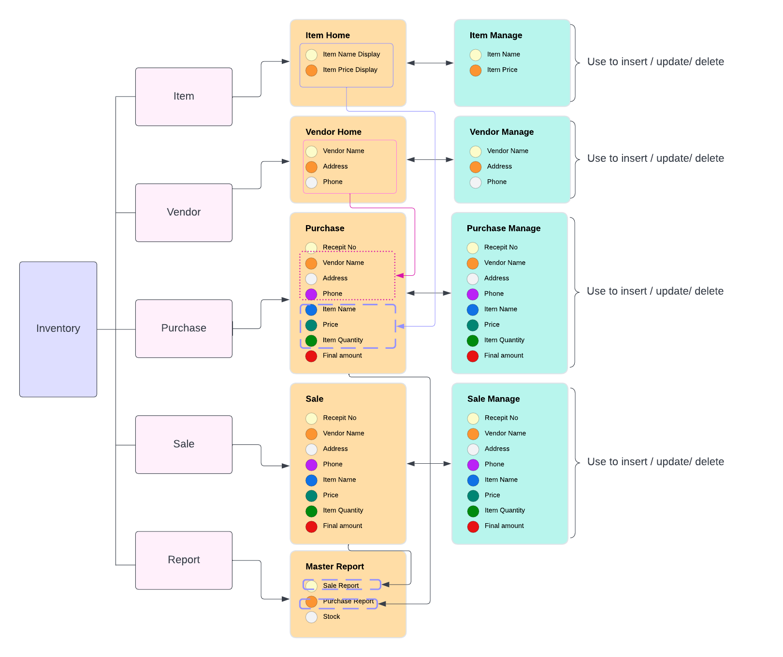
Inventory
Management System
This blueprint is the complete work flow of the inventory management system which was sum-up as follow.
Main Pages:
Item: where new items along with its price is enlisted.
Vendor: where new supplier along with their address and contact is added.
Purchase: where item was purchase with added suppliers.
Sale: where item was sold to new client
Report: it contains sale record, purchase record as well the stock description.

Slide 5
