Slide 1
COMMUNITY SERVICE PROJECT · 2026
Presented by
Gramin Career Setu
Anaparthi Rakesh Kumar
25765A0532
Choragudi Sowmya
25765A0533
A Digital Career-Guidance Bridge for the Youth
Kamisetty Yogesh
25765A0534
Bahubalendrunigudem, Gannavaram Mandal, Krishna District, Andhra Pradesh
Katru Sruthi
25765A0535
Kuppala Surya Teja
25765A0536
Under the guidance of
Mrs. M. Gayathri, Sr. Assistant Professor
Pilla Bhanu
25765A0537
Department of CSE · Lakireddy Bali Reddy College of Engineering (Autonomous) · November 2026
Notes:
Introduce the team and the project. Gramin Career Setu is the digital solution we built after visiting Bahubalendrunigudem in May 2026.

Slide 2
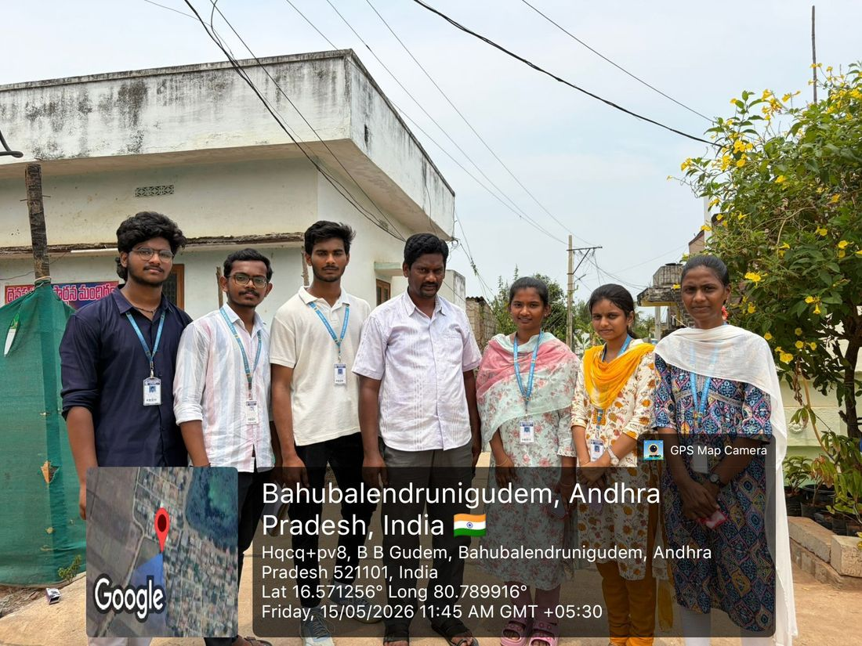
Our village: Bahubalendrunigudem
1,790
541
residents
households
70.6%
58%+
literacy rate
of the workforce are agricultural labourers
324 hectares of flat, well-irrigated land, about 6 km from Gannavaram. Farming is the main livelihood, so many young people look to jobs outside it.
Notes:
Village profile figures were provided from the village census data for this report.

Slide 3



The problem we saw on the ground
Scattered information
No clear next step
Risk of wrong advice
Job, exam and scholarship details sit on many portals, mostly in English, and young people don't know where to start.
After 10th, Intermediate or ITI, students rarely see which careers are open to them or what each one needs.
Without a trusted source, families can fall for agents and fake offers that ask for money.
Three gaps we set out to close
Can a student name three or more career paths open to them? Do they know how to apply online? Can they produce a PDF resume?
Notes:
These three yes/no questions are the same ones used in the before-and-after survey.

Slide 4



Our approach: listen, build, teach
1 Listen
2 Build
3 Teach and measure
Village visits from 15 May 2026. Interviews with students, unemployed youth, residents and ASHA workers to learn what they know and what they lack.
Gramin Career Setu, designed around what we heard: simple, in Telugu, light enough for a basic phone and weak signal.
Show students how to use it, and ask the same three survey questions before and after, so change is measured, not assumed.
Six weeks of community service in Bahubalendrunigudem, 15 May to 25 June 2026
Notes:
Dates follow the six-week CSP plan with six working days a week, starting on the day of our first recorded village visit.

Slide 5
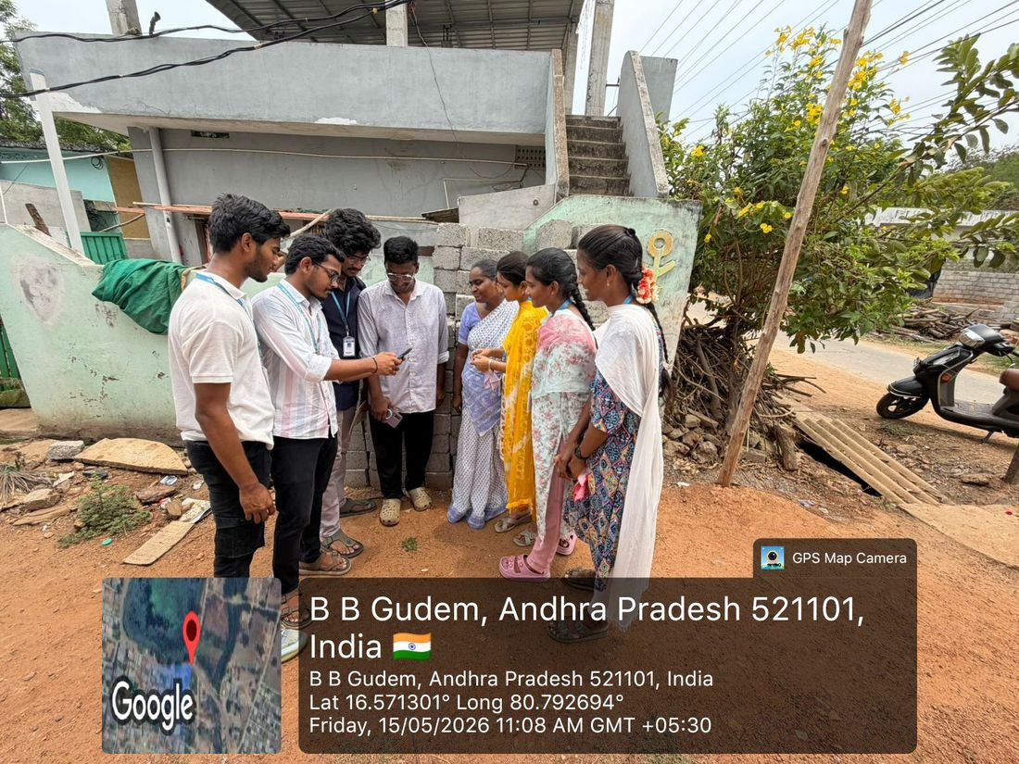
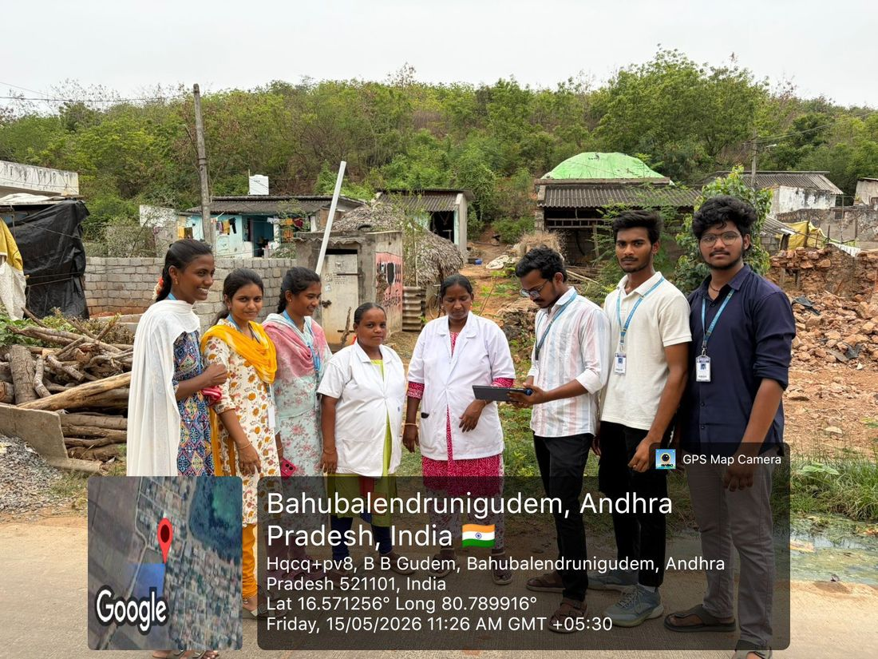
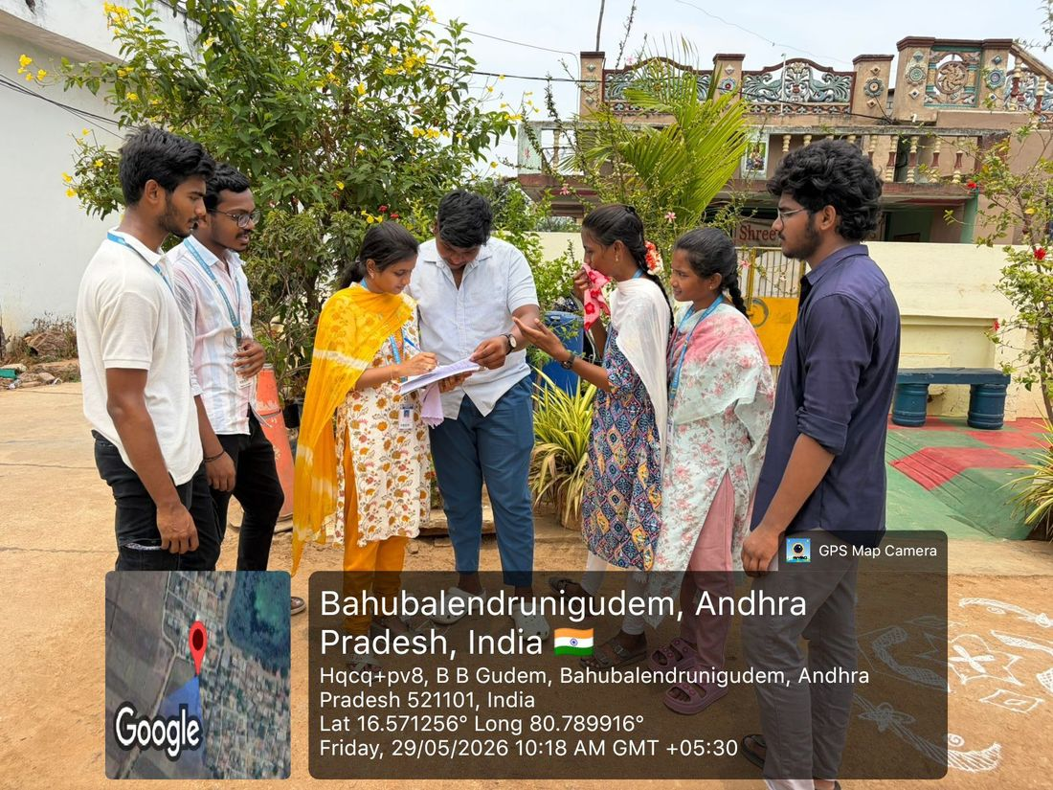
In the village, May 2026
15 May: interviewing residents
15 May: with ASHA workers
29 May: explaining the survey
Who we spoke to
How we asked
What we learned
Students, unemployed youth, residents and ASHA workers
In Telugu, on paper, with consent and no names recorded
Where guidance is missing and which tools people can really use
Notes:
Photos are GPS-stamped from Bahubalendrunigudem on 15, 16, 23 and 29 May 2026.

Slide 6
How we measure impact
Can you name three or more career paths open to you after your current qualification?
Survey design
1
Three yes/no questions, in Telugu and English
Asked on paper before and after each session
Same people both times; only complete pairs counted
Voluntary and anonymous: no names or phone numbers
Honest limits: small sample, one village, self-reported
Do you know how to apply for a job or an exam online?
2
Can you produce a PDF resume for yourself?
3
Findings are compiled from the filled paper forms and reported in the final project report
Notes:
Results are deliberately not shown on this slide: only counts taken from the real forms will be presented. The site's impact dashboard stays empty until those counts are entered.

Slide 7




Gramin Career Setu: one place, six tools
Skill quiz
Career roadmap
Job roles
Five quick questions point to career tracks that suit the student.
Step-by-step paths for 7 goals, based on the student's education.
35 role types filtered by qualification, each linking to the official site.
Resume builder
Schemes and scholarships
Village workshops
A clean PDF resume in minutes, with Telugu supported.
Government support gathered in one place.
Free sessions in Telugu, listed only when they are really scheduled.
Telugu and English · Works offline once opened · Installs like an app on any phone
Notes:
The site is a progressive web app, so a student can open it once with signal and keep using the core pages with none.

Slide 8
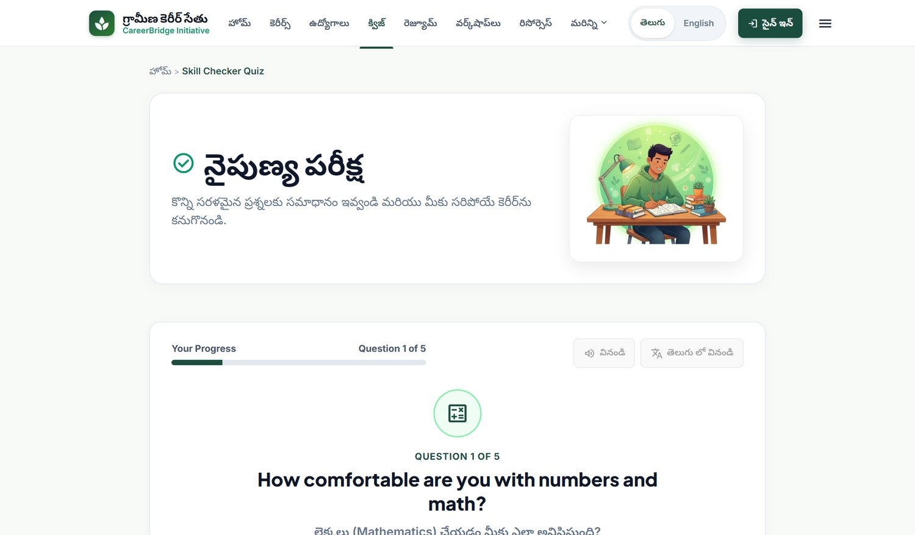
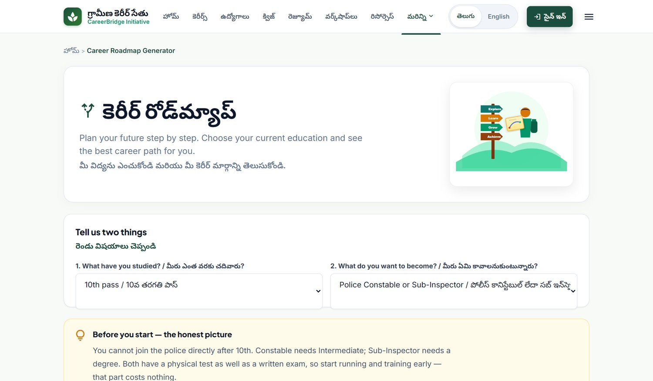
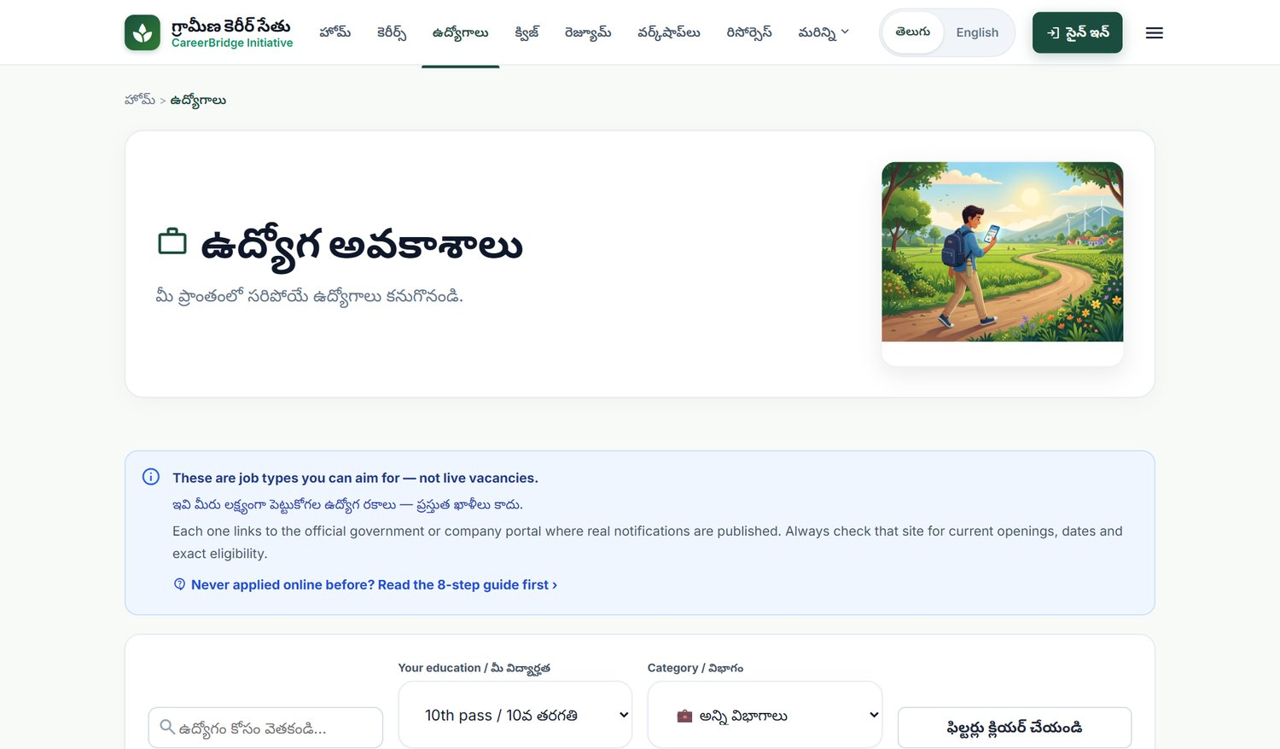
From a question to a plan
1 Take the quiz
2 Get the roadmap
3 See real options
Five quick questions about interests and comfort with subjects.
A flow of steps that starts where this student is today.
Job roles the student can apply for, with official links.
Then build a resume: the student fills one simple form and downloads a ready PDF to use when applying.
Notes:
Screenshots are from the running application. The student shown in the roadmap is a sample 10th-pass user.

Slide 9
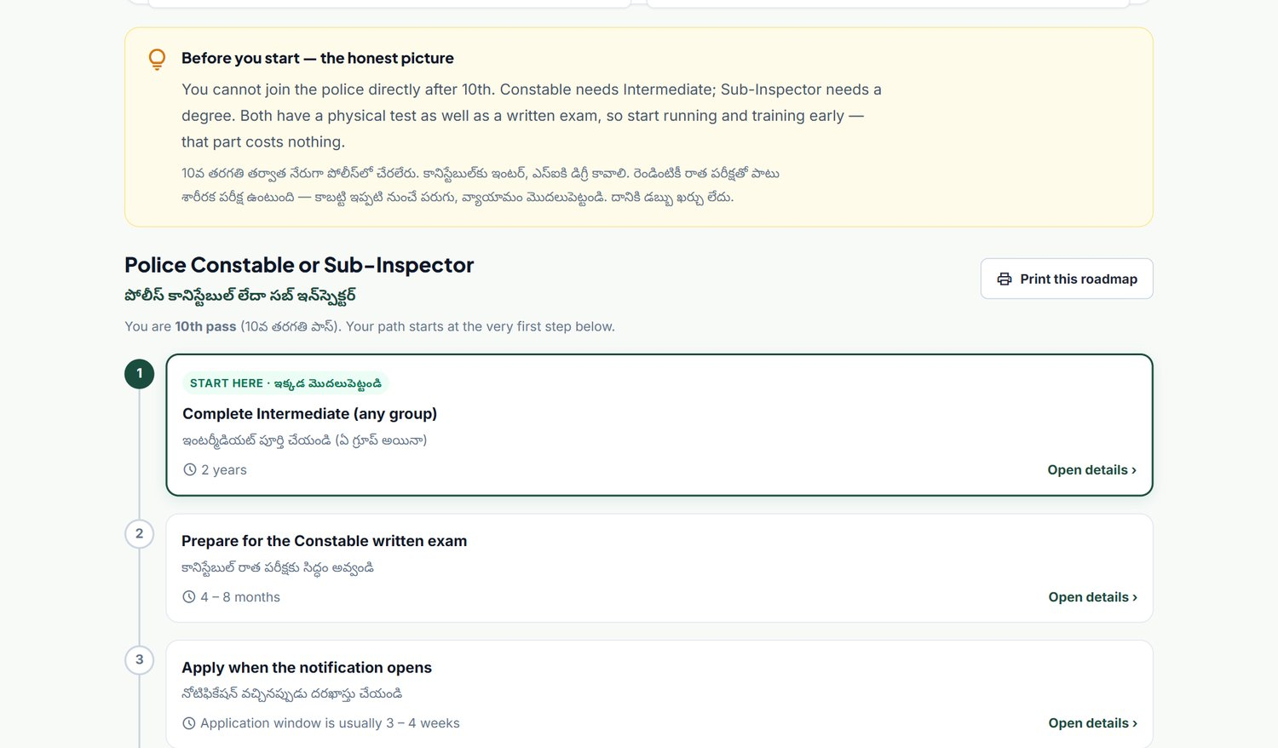
A roadmap that fits the student
1
Pick two things
Education and a goal. The path redraws for that student.
2
Every step explained
What it is, how to do it, how long, what it costs, and the official website.
3
Honest labels
Steps the student can start now are marked. Others say what comes first.
4
Seven goals
Example: a 10th-pass student who wants to join the police is told the truth first: Constable needs Intermediate, so Step 1 is finishing it.
Police, doctor, teacher, government exams, ITI trades, BPO and services, own business.
Notes:
This was the main design decision: a student should not be sent to a path they cannot yet take.

Slide 10




Honest by design
No invented vacancies
No guessed numbers
The job list shows role types and links to the official site. We never show a vacancy we can't verify.
Age limits, fees and cut-offs change with every notification, so we send students to the official one.
No fake impact
Private by default
The impact dashboard stays empty until real survey counts are entered. Nothing is pre-filled.
A student's details stay on their own phone. Applying or registering needs a sign-in.
Notes:
For a community project, trust matters more than looking impressive. These rules are also checked by automated tests.

Slide 11




How it is built
Student's phone
Static web server
Backend API
Database
Web app (HTML, CSS, JavaScript). Service worker keeps it working offline.
Node.js serves the site and passes API calls on.
Spring Boot with sign-in tokens, role checks and rate limiting.
Versioned migrations. H2 for development, MySQL or Postgres for live use.
Content lives in plain data files
Job roles come from one spreadsheet (jobs.csv); roadmaps, workshops and survey results are separate, readable files. A village volunteer can update them without touching the code.
Notes:
We kept the architecture light on purpose: no heavy frontend framework, so pages load fast on low-end phones and weak networks.

Slide 12
Tested and light enough for village networks
44
35
7
3×
automated tests passing
job roles from one source file
career roadmaps, step by step
lighter images: 1.94 MB to 0.62 MB
Security checks run against the live backend
Anonymous write
Signed-in write
Student on admin area
Forged token
Request flood
refused (401)
accepted (201)
refused (403)
refused (401)
limited (429)
Notes:
Early versions allowed anonymous writes and had a demo password bypass. Both were found in our own audit and removed before this presentation.

Slide 13
Impact and the road ahead
What students get
Next steps
A clear path from where they are today
Career information in Telugu, free, offline
A resume they can make themselves
Official links instead of agents and rumours
Measured change, not assumed change
Run more village sessions and keep the same before-and-after survey
Hand the site to the school and panchayat, with a local volunteer to update it
Add more roadmaps and local job roles from student requests
Review every official link each term
Notes:
Sustainability depends on a local owner for the data files; the design makes that a spreadsheet job, not a coding job.

Slide 14


What we learned
Values
Technical skills
Life skills
Listening before building, empathy for first-generation job seekers, and responsibility for what we publish.
Offline-first web apps, secure APIs, automated testing, and designing for low-end devices.
Field surveys, speaking with elders and officials, working as a team of six, and honest reporting.
Sustainable Development Goals this supports
SDG 4 Quality Education
SDG 8 Decent Work and Economic Growth
SDG 10 Reduced Inequalities
Notes:
Mention the values and skills, then the SDG link.

Slide 15
What we built
Thank you
35
job roles
To the residents and ASHA workers of Bahubalendrunigudem who gave us their time, and to our guide, department and college.
7
career roadmaps
44
automated tests
Questions and feedback welcome
2
languages: Telugu and English
Gramin Career Setu · CSE Community Service Project · LBRCE, November 2026
Notes:
Close with thanks and invite questions.

