Slide 1

Marathwada Mitra Mandal's College of Engineering, Pune
Proposed Topic : Fruit Identification using Machine Learning
Name of Student : Yogesh Kanwade
Class : TE2
Roll No: TC229
Guided by : Prof. Swarupa Deshpande

Slide 2
INTRODUCTION
Fruits form a large part of farm produce and are also a major part of market share.
Traditionally classification of fruits is done with the help of human input but has its own drawbacks.
Use of computer programs as a step towards smart agriculture.
Notes:
hjdmgku

Slide 3
MOTIVATION
Smart Agriculture
Optimizing human input
Reducing labor cost
Improving efficiency
Time saving approach
Helping producers and businesses to grow

Slide 4
Process that requires human input can be automated using machine learning to achieve fruit classification which can be directly implemented in stores and warehouses.
Problem Statement

Slide 5
Liuchen Wu, Ruibo Chen, Hui Zhang, Junfei Yi, “Fruit Classification using Convolutional Neural Network via Adjust Parameter and Data Enhancement”, 12th International Conference on Advanced Computational Intelligence (ICACI) Dali, China, August 14-16, 2020
Technique used : Two data sets - public self-made. For self-made data set, we do not perform any image preprocessing and directly send data to training. It is easier to identify area of interest in public data set.
Software used : Halcon
Advantages : Uses data enhancement techniques (random cropping, brightening and flipping) to improve the classification
.
Disadvantages : Halcon encapsulates the pre-training network and does not open the underlying source code, so the specific framework structure of the convolutional neural network is not given.

Slide 6
Huai-Kuei Wu, Jui-Sheng Wang and Yuan-Hsin Chen, “Development of Fruit Grading System Based on Image Recognition”, 2nd IEEE International Conference on Architecture, Construction, Environment and Hydraulics 2020
Technique used : The architecture includes the identification host, transmission mechanism, and Database. The identification host includes microcontroller, LCD panel, camera, and Wi-Fi module. The LCD provides a user interface and fruit display. The camera takes images of fruits. After grading is completed, the rod pushes the fruit to different fruit baskets according to the grade.
Advantages : Using the system settings adjustable parameters like fruit size, fruit color threshold, and percentage of allowable black points on fruit can be changed.
Disadvantages : Accuracy is questionable.

Slide 7
Dewi Agushinta R. and Henny Medyawati, Ihsan Jatnika and Hustinawaty, “A Method of Cloud and Image-Based Tracking for Indonesia Fruit Recognition”
Technique used : The image captured by phone camera will be sent to vuforia server for checking and after the server identities and confirms the image, the details like name and information will be displayed on the mobile application.
Software used : This paper proposes using blender and unity 3d to develop the 3d models.
Advantages : A mobile application is convenient to use as mobiles have become an integral part of our lives.
Disadvantages : Input image will vary according to user which can make the process of difficult due to issues of lighting, orientation and angles.

Slide 8
Yanfeng Tang, Yawan Zhang, and Ying Zhu, “A Research on the Fruit Recognition Algorithm Based on the Multi-Feature Fusion”, 2020 5th International Conference on Mechanical, Control and Computer Engineering(ICMCCE)
Technique used : Features used : 1) Color : HSV color model and 2) Shape : the perimeter, area and roundness of the shape.
Algorithm used : Back Propagation Neural Network : The basic idea is implementing Backpropagation using recursive algorithm to minimize the error rates.
Advantages : Recognition rate achieved by multi-feature fusion can reach upto 95% which is more than single feature algorithm.
Disadvantages : With increase in feature dimensions and nodes, time spent in feature recognition is more. Low recognition rate in fruits with similar size & color.

Slide 9
Wei Ni and Rihui Li, “Research on Recognition Technology of Fruit based on Simulated Annealing Algorithm and Neural Network”, 2021 IEEE Asia-Pacific Conference on Image Processing, Electronics and Computers (IPEC)
Technique used : Apple is the research object. Model for Apple classification is established that analyzes size, color and damage, and then the corresponding BP neural network model is established.
Algorithm used : BPNN and Simulated Annealing Algorithm
Advantages : Accuracy is higher than BPNN. Simulated Annealing Algorithm prevents finding only the local optimal solution.
Disadvantages : This algorithm loses training speed due to introduction of annealing algorithm.

Slide 10
Software Used
Kaggle
NumPy
Pandas
Matplotlib
Keras
Tensorflow

Slide 11
Proposed Technology
Unique labels for train are: ['apple' 'banana' 'mixed' 'orange']
Number of jpg images in train are: 240
Unique labels are for test are: ['apple' 'banana' 'mixed' 'orange']
Number of jpg images for train are: 60
X_train shape: (240, 50, 50, 3)
X_test shape: (60, 50, 50, 3)
y_train shape: (240, 4)
y_test shape: (60, 4)

Slide 12
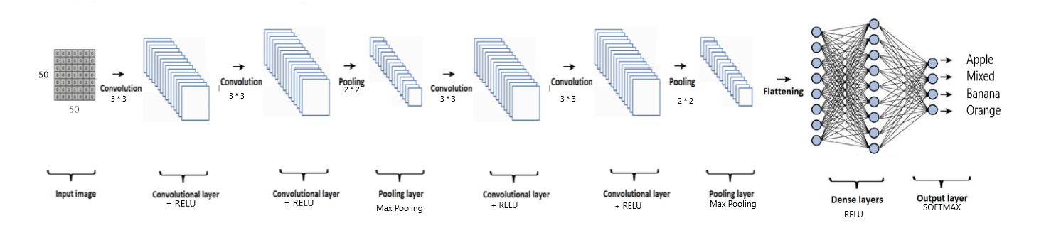
System Architecture
Fig. Convolutional Neural Network

Slide 13
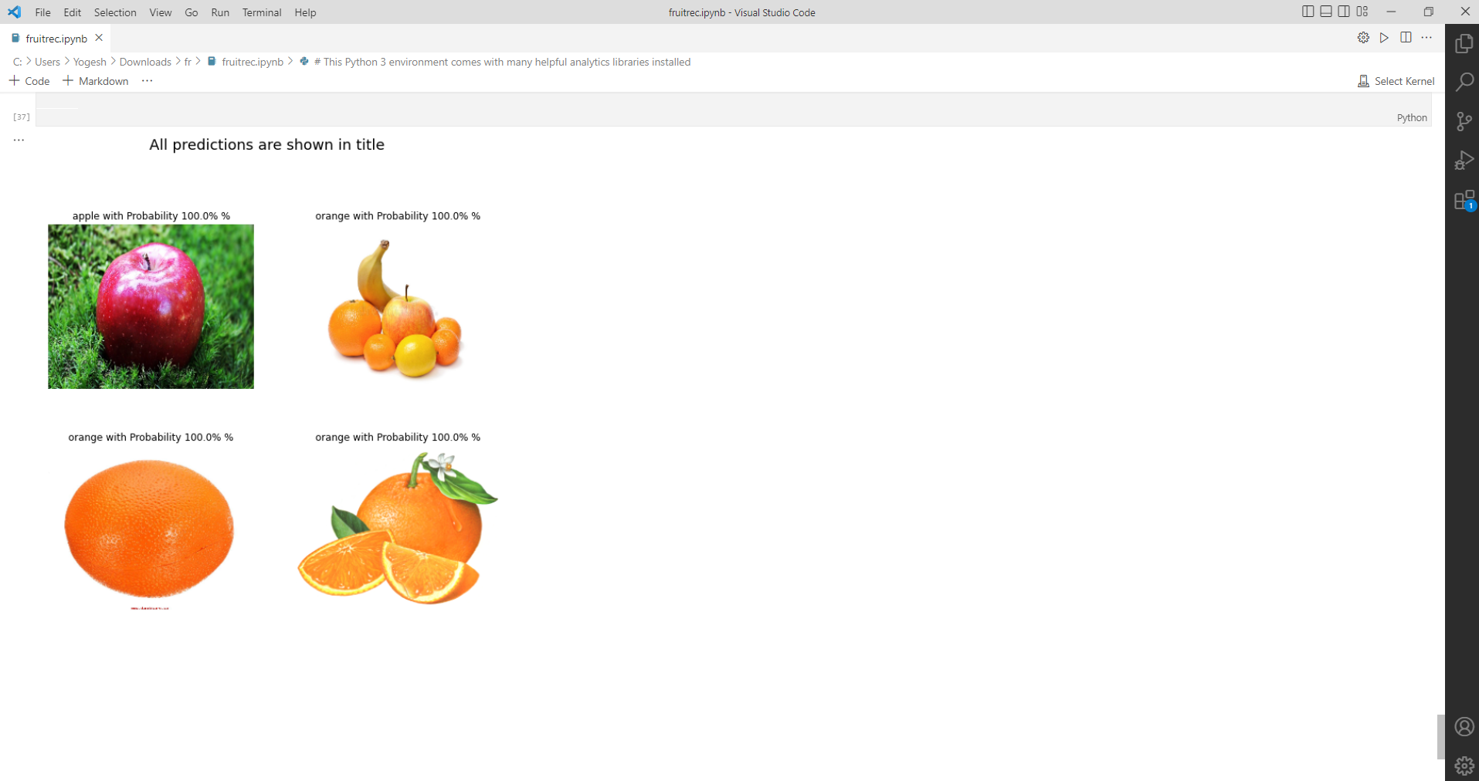
Results

Slide 14
Applications
Use in supermarkets and retail stores
Integrating into Augmented Reality
Developing a mobile application
Educational usage
Agricultural applications

Slide 15
Conclusion
Use of computer aided programs has been increased across all fields and one such field is agriculture. Through implementation of machine learning algorithms task of fruit classification can be automated such that it requires minimum human effort. This would truly be a step towards smart agriculture. Using a convolutional neural network for classification gives satisfactory results which need to be improved upon. However there are certain points that may limit its implementation on a large scale.

Slide 16
Future Work
There is significant research available on Fruit Classification. However, we still are a step short of implementing it on a large scale at profitable rates. The classification algorithms can be further improved upon for better accuracy. This can be a starting point for fruit grading and fruit disease analysis. If in combination with Fruit Classification, Fruit Grading can be implemented, then it shall thus help to segregate fruits on the basis of their quality. Overall improvement in this area will surely give way to more profitable agriculture and better market produce.

Slide 17
References
[1] Huai-Kuei Wu, Jui-Sheng Wang and Yuan-Hsin Chen, “Development of Fruit Grading System Based on Image Recognition”, 2nd IEEE International Conference on Architecture, Construction, Environment and Hydraulics 2020
[2] Dewi Agushinta R. and Henny Medyawati, Ihsan Jatnika and Hustinawaty, “A Method of Cloud and Image-Based Tracking for Indonesia Fruit Recognition”
[3] Liuchen Wu, Ruibo Chen, Hui Zhang, Junfei Yi, “Fruit Classification using Convolutional Neural Network via Adjust Parameter and Data Enhancement”, 12th International Conference on Advanced Computational Intelligence (ICACI) Dali, China, August 14-16, 2020
[4] Yanfeng Tang, Yawan Zhang, and Ying Zhu, “A Research on the Fruit Recognition Algorithm Based on the Multi-Feature Fusion”, 2020 5th International Conference on Mechanical, Control and Computer Engineering(ICMCCE)
[5] Wei Ni and Rihui Li, “Research on Recognition Technology of Fruit based on Simulated Annealing Algorithm and Neural Network”, 2021 IEEE Asia-Pacific Conference on Image Processing, Electronics and Computers (IPEC)
[6] https://keras.io/

