Slide 1
FULL STACK WEB DEVELOPMENT PROJECT USING ASP.NET CORE • CODE: DSC-M-BCA-471P
CipherVault
Personal Encrypted Password & Secure Notes Manager
A Professional Full Stack Web Application Built on ASP.NET Core 10 MVC & Entity Framework Core 10, Featuring AES-Authenticated Encryption at Rest, Ownership-Scoped IDOR Protection, and JWT-Secured REST API.
Student Name & Roll No: Kaswan Yogesh Subhashchandra | Roll Number: 32
Course Title & Code: Full Stack Web Development Project using ASP.NET Core | DSC-M-BCA-471P
Project Guide: Prof. Sejal Shah | Academic Year: 2026
Tech Stack: ASP.NET Core 10 MVC • EF Core 10 • SQL Server • ASP.NET Core Identity • Data Protection API (v10.0.7+) • Bootstrap 5
PROJECT ROADMAP: [PHASE 1: MVC Setup & UI] • [PHASE 2: Forms & Validation] • [PHASE 3: Database & CRUD] • [PHASE 4: API & Deployment]
Full Stack Web Development Project using ASP.NET Core (DSC-M-BCA-471P) | Student: Kaswan Yogesh Subhashchandra (Roll: 32) | Guide: Prof. Sejal Shah
Slide 1 / 15
Notes:
Good morning Sir/Ma'am. My name is Kaswan Yogesh Subhashchandra (Roll No 32). Under the guidance of Prof. Sejal Shah, my project is 'CipherVault', built under Full Stack Web Development using ASP.NET Core (Course Code: DSC-M-BCA-471P).

Slide 2
PROJECT ROADMAP
4-Phase Full Stack Development Matrix
Structured Execution Aligned with Full Stack Web Development Project using ASP.NET Core (DSC-M-BCA-471P) — Guide: Prof. Sejal Shah
Project Phase & Title | Phase Objective | Key Technical Implementation Tasks | Completed Deliverables
PHASE 1: MVC Setup and UI | To configure the ASP.NET Core 10 architecture and build the responsive user interface shell. | • Project setup targeting net10.0 with EF Core 10 & Identity • Program.cs with WebApplicationBuilder & Cookie policy (SecurePolicy=Always) • Base layout (_Layout.cshtml) with responsive Bootstrap 5 navbar • HomeController & placeholder [Authorize] DashboardController | ✔ Working Authentication ✔ Base Layout & Navbar ✔ Authorized Dashboard ✔ Target net10.0 Confirmed
PHASE 2: Forms and Validation | To implement secure user interaction forms, data validation, and cryptographic utilities. | • VaultItem model with categories (Password, Note, API Key, Credit Card, Other) • Separate Create/Update DTOs with validation annotations & custom ValidCategoryAttribute • Client-side password generator using window.crypto.getRandomValues() • Data Protection key persistence configuration (App_Data/keys) | ✔ Validated Create/Edit Forms ✔ Crypto-Secure Generator ✔ DTO Separation ✔ Key Persistence Config
PHASE 3: Database and CRUD | To build the database persistence layer, encrypted repository, and full CRUD lifecycle. | • ApplicationDbContext extended with DbSet<VaultItem> & User relationship • Repository pattern implemented for VaultItem (IVaultItemRepository) • Service layer handling AES encryption via purpose strings ("CipherVault.Secret/.Notes") • IDOR protection: Ownership checks returning 404 (not 403) for non-owned items | ✔ Full Encrypted CRUD ✔ Service & Repository Layers ✔ IDOR 404 Enforcement ✔ Search & Category Filter
PHASE 4: API and Deployment | To expose a secure REST API with JWT Bearer auth and deploy to live production hosting. | • REST API controllers under /api/v1/vault with [ApiController] • Dual authentication scheme separation: Cookies for MVC, JWT for API • Global ExceptionHandlingMiddleware returning JSON 500 / HTML error pages • Live deployment on MonsterASP (ciphervault.tryasp.net) via HTTPS | ✔ REST API + JWT Bearer ✔ Global Error Middleware ✔ Live HTTPS Deployment ✔ Postman Collection
💡 MODULAR FULL STACK ARCHITECTURE: Each of the 4 phases is self-contained with strict separation between controllers, services, and repositories, ensuring clean maintainability and robust security adherence.
Full Stack Web Development Project using ASP.NET Core (DSC-M-BCA-471P) | Student: Kaswan Yogesh Subhashchandra (Roll: 32) | Guide: Prof. Sejal Shah
Slide 2 / 15
Notes:
We followed a structured 4-phase roadmap: Phase 1 MVC setup, Phase 2 Forms & Validation, Phase 3 Database & CRUD, and Phase 4 API & Deployment.

Slide 3
PHASE 1 • ARCHITECTURE
Phase 1: MVC Setup, Base Layout & Authentication
Objective: Configure ASP.NET Core 10 architecture and establish secure cookie authentication
🛠️
Project Foundation
🔒
Authentication & Cookies
📱
UI Layout & Controllers
· ASP.NET Core 10 MVC targeting net10.0
· EF Core 10 & Identity 10.0.7 packages
· WebApplicationBuilder pattern in Program.cs
· Empty Services, Repositories, and DTOs directories
· ASP.NET Core Identity cookie authentication
· Cookie name: CipherVault.Auth (no __Host- prefix)
· SecurePolicy = Always (locked for dev & prod)
· Lockout policy: 5 failed attempts → 15 min lockout
· Responsive Bootstrap 5 layout (_Layout.cshtml)
· Navigation: Home, Dashboard, Vault, About
· HomeController for static pages
· DashboardController protected with [Authorize]
💡 PROGRAM.CS COMPLIANCE: Avoided all deprecated APIs such as WithOpenApi, IActionContextAccessor, and WebHostBuilder, using modern ASP.NET Core 10 patterns exclusively.
Full Stack Web Development Project using ASP.NET Core (DSC-M-BCA-471P) | Student: Kaswan Yogesh Subhashchandra (Roll: 32) | Guide: Prof. Sejal Shah
Slide 3 / 15
Notes:
In Phase 1, we initialized the ASP.NET Core 10 project, set up Identity cookie auth with unconditional SecurePolicy = Always, and built the responsive Bootstrap 5 layout.

Slide 4
PHASE 2 • INTERACTION
Phase 2: Forms, Data Validation & Password Generator
Objective: Implement secure forms, DTO separation, and client-side cryptographic utilities
📝
DTO Design Rules
🛡️
Validation & Attributes
🎲
Crypto-Secure Generator
· Strict separation of Create and Update DTOs
· VaultItemCreateDTO: Secret required, Notes optional
· VaultItemUpdateDTO: Secret & Notes nullable
· Blank-Preserve Rule implemented in Service layer
· Data annotations ([Required], [StringLength], [Url])
· Custom ValidCategoryAttribute for allowed categories
· OptionalUrlAttribute for secure URL formatting
· Anti-forgery tokens enabled globally on MVC forms
· Client-side password generator using Web Crypto API
· crypto.getRandomValues() (NOT Math.random())
· Live strength meter updating dynamically
· Configurable length and character sets
💡 BLANK-PRESERVE SEMANTICS: The DTO design ensures that submitting an update with a blank secret preserves the existing encrypted database value without accidental overwrites.
Full Stack Web Development Project using ASP.NET Core (DSC-M-BCA-471P) | Student: Kaswan Yogesh Subhashchandra (Roll: 32) | Guide: Prof. Sejal Shah
Slide 4 / 15
Notes:
Phase 2 covered forms, DTO separation (Create vs Update), validation attributes, and a cryptographically secure password generator using crypto.getRandomValues().

Slide 5
PHASE 3 • PERSISTENCE
Phase 3: Database Integration & Encrypted CRUD
Objective: Establish EF Core persistence, repository pattern, and AES encryption at rest
🗄️
EF Core & Repositories
🔐
Data Protection API
🚫
IDOR & Security
· ApplicationDbContext inheriting IdentityDbContext
· DbSet<VaultItem> with User relationship (Cascade delete)
· Mandatory Repository pattern for VaultItem data access
· Migrations applied: InitialIdentitySchema & AddVaultItems
· IDataProtectionProvider injected into VaultItemService
· Purpose strings: CipherVault.Secret & CipherVault.Notes
· Keys persisted to App_Data/keys (git-ignored)
· Secrets encrypted before save, decrypted on reveal only
· Ownership verified in Service layer on every query
· Non-owned item access returns 404 (not 403)
· Prevents existence leaking across user accounts
· Audit logging for Create, Update, Delete, and Reveal
💡 IDOR & PURPOSE STRING CONTRACT: Returning 404 instead of 403 on unauthorized ID access prevents attackers from enumerating valid IDs, while immutable purpose strings protect existing ciphertexts.
Full Stack Web Development Project using ASP.NET Core (DSC-M-BCA-471P) | Student: Kaswan Yogesh Subhashchandra (Roll: 32) | Guide: Prof. Sejal Shah
Slide 5 / 15
Notes:
Phase 3 introduced EF Core 10 persistence, the repository pattern, Data Protection encryption with immutable purpose strings, and IDOR-safe 404 error handling.

Slide 6
PHASE 4 • API & GO-LIVE
Phase 4: REST API, JWT Authentication & Deployment
Objective: Expose a secure REST API with JWT Bearer auth and deploy to live production hosting
🔌
REST API & JWT
🛡️
Error Handling & Polish
🚀
Live Production
· VaultApiController under /api/v1/vault
· AuthApiController handling POST /api/auth/login
· Dual auth scheme: Cookie (MVC) + JWT Bearer (API)
· API returns JSON 401 on missing auth (no redirect)
· Global ExceptionHandlingMiddleware for JSON/HTML errors
· Custom 404 and 500 error pages
· Linear UI theme with Bootstrap 5 & custom CSS
· Copy-to-clipboard button with 10s auto-clear
· Published via dotnet publish -c Release
· Hosted on MonsterASP (ciphervault.tryasp.net)
· Let's Encrypt SSL certificate bound via HTTPS
· Data Protection key directory secured outside web root
💡 DUAL AUTH SCHEME SEPARATION: Configuring explicit authentication schemes (`AuthenticationSchemes = JwtBearerDefaults.AuthenticationScheme`) ensures API clients receive clean JSON 401s without HTML redirect loops.
Full Stack Web Development Project using ASP.NET Core (DSC-M-BCA-471P) | Student: Kaswan Yogesh Subhashchandra (Roll: 32) | Guide: Prof. Sejal Shah
Slide 6 / 15
Notes:
Phase 4 delivered the REST API with JWT bearer auth, dual scheme separation, global error handling, and live HTTPS deployment on MonsterASP.

Slide 7
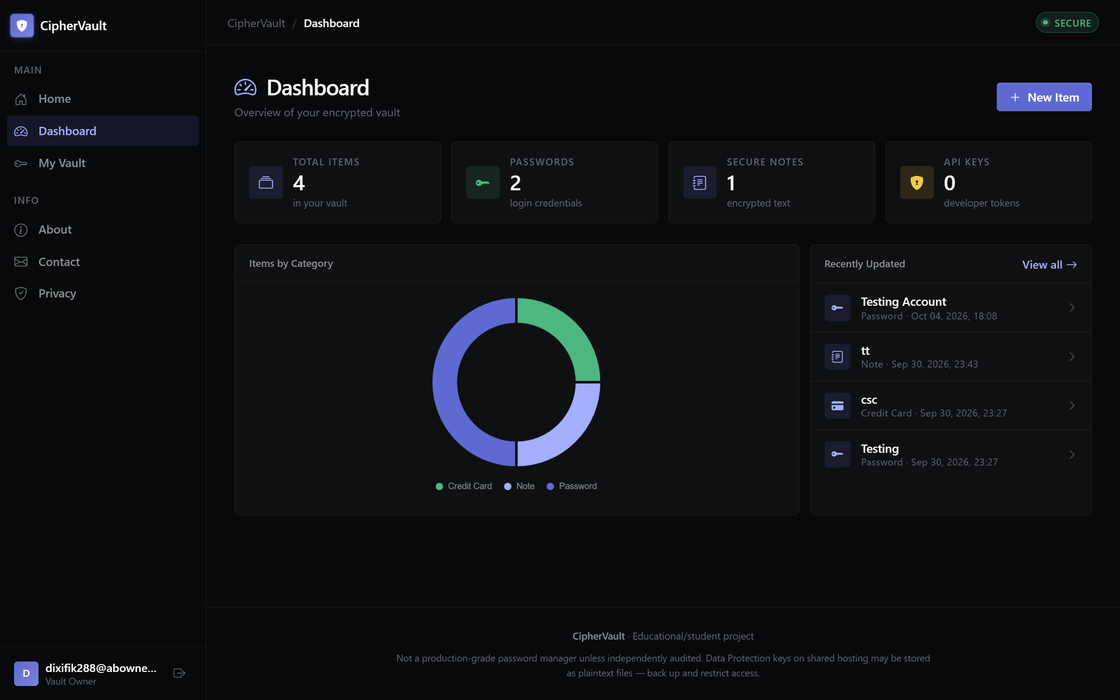
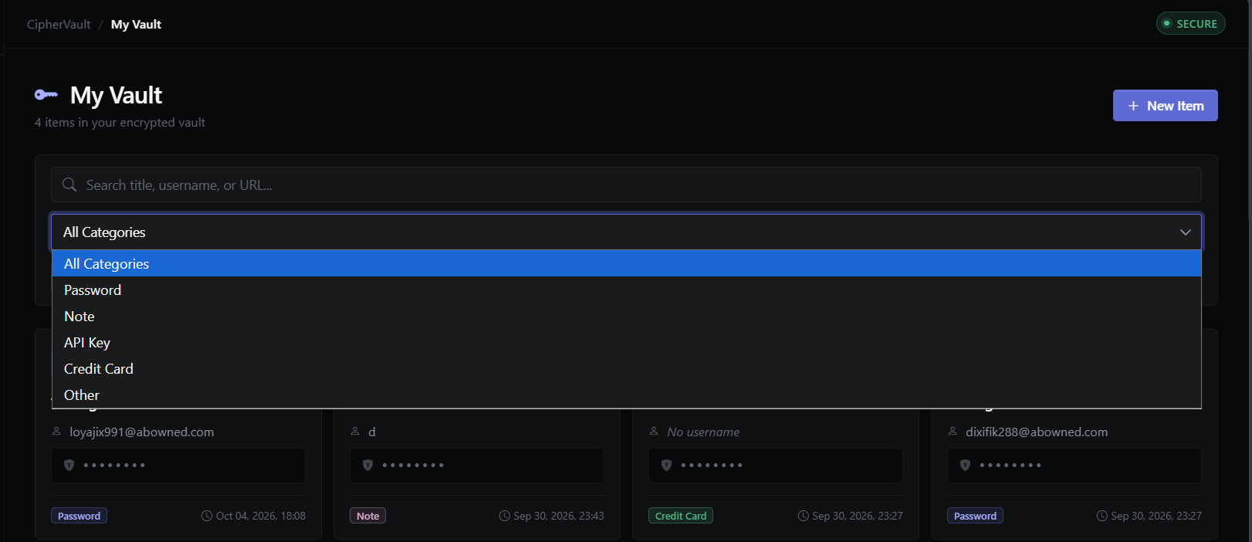
PROTOTYPE
Live App Demo: Dashboard & Vault Management
Visual verification of production UI, analytics, and server-side search
Dashboard: KPI Stats, Chart.js Breakdown & Recent Items
Vault: Server-Side Search, Category Filter & Pagination
Full Stack Web Development Project using ASP.NET Core (DSC-M-BCA-471P) | Student: Kaswan Yogesh Subhashchandra (Roll: 32) | Guide: Prof. Sejal Shah
Slide 7 / 15
Notes:
Demonstrating the live application UI: the dashboard with Chart.js analytics and the vault list featuring server-side search and category filtering.

Slide 8
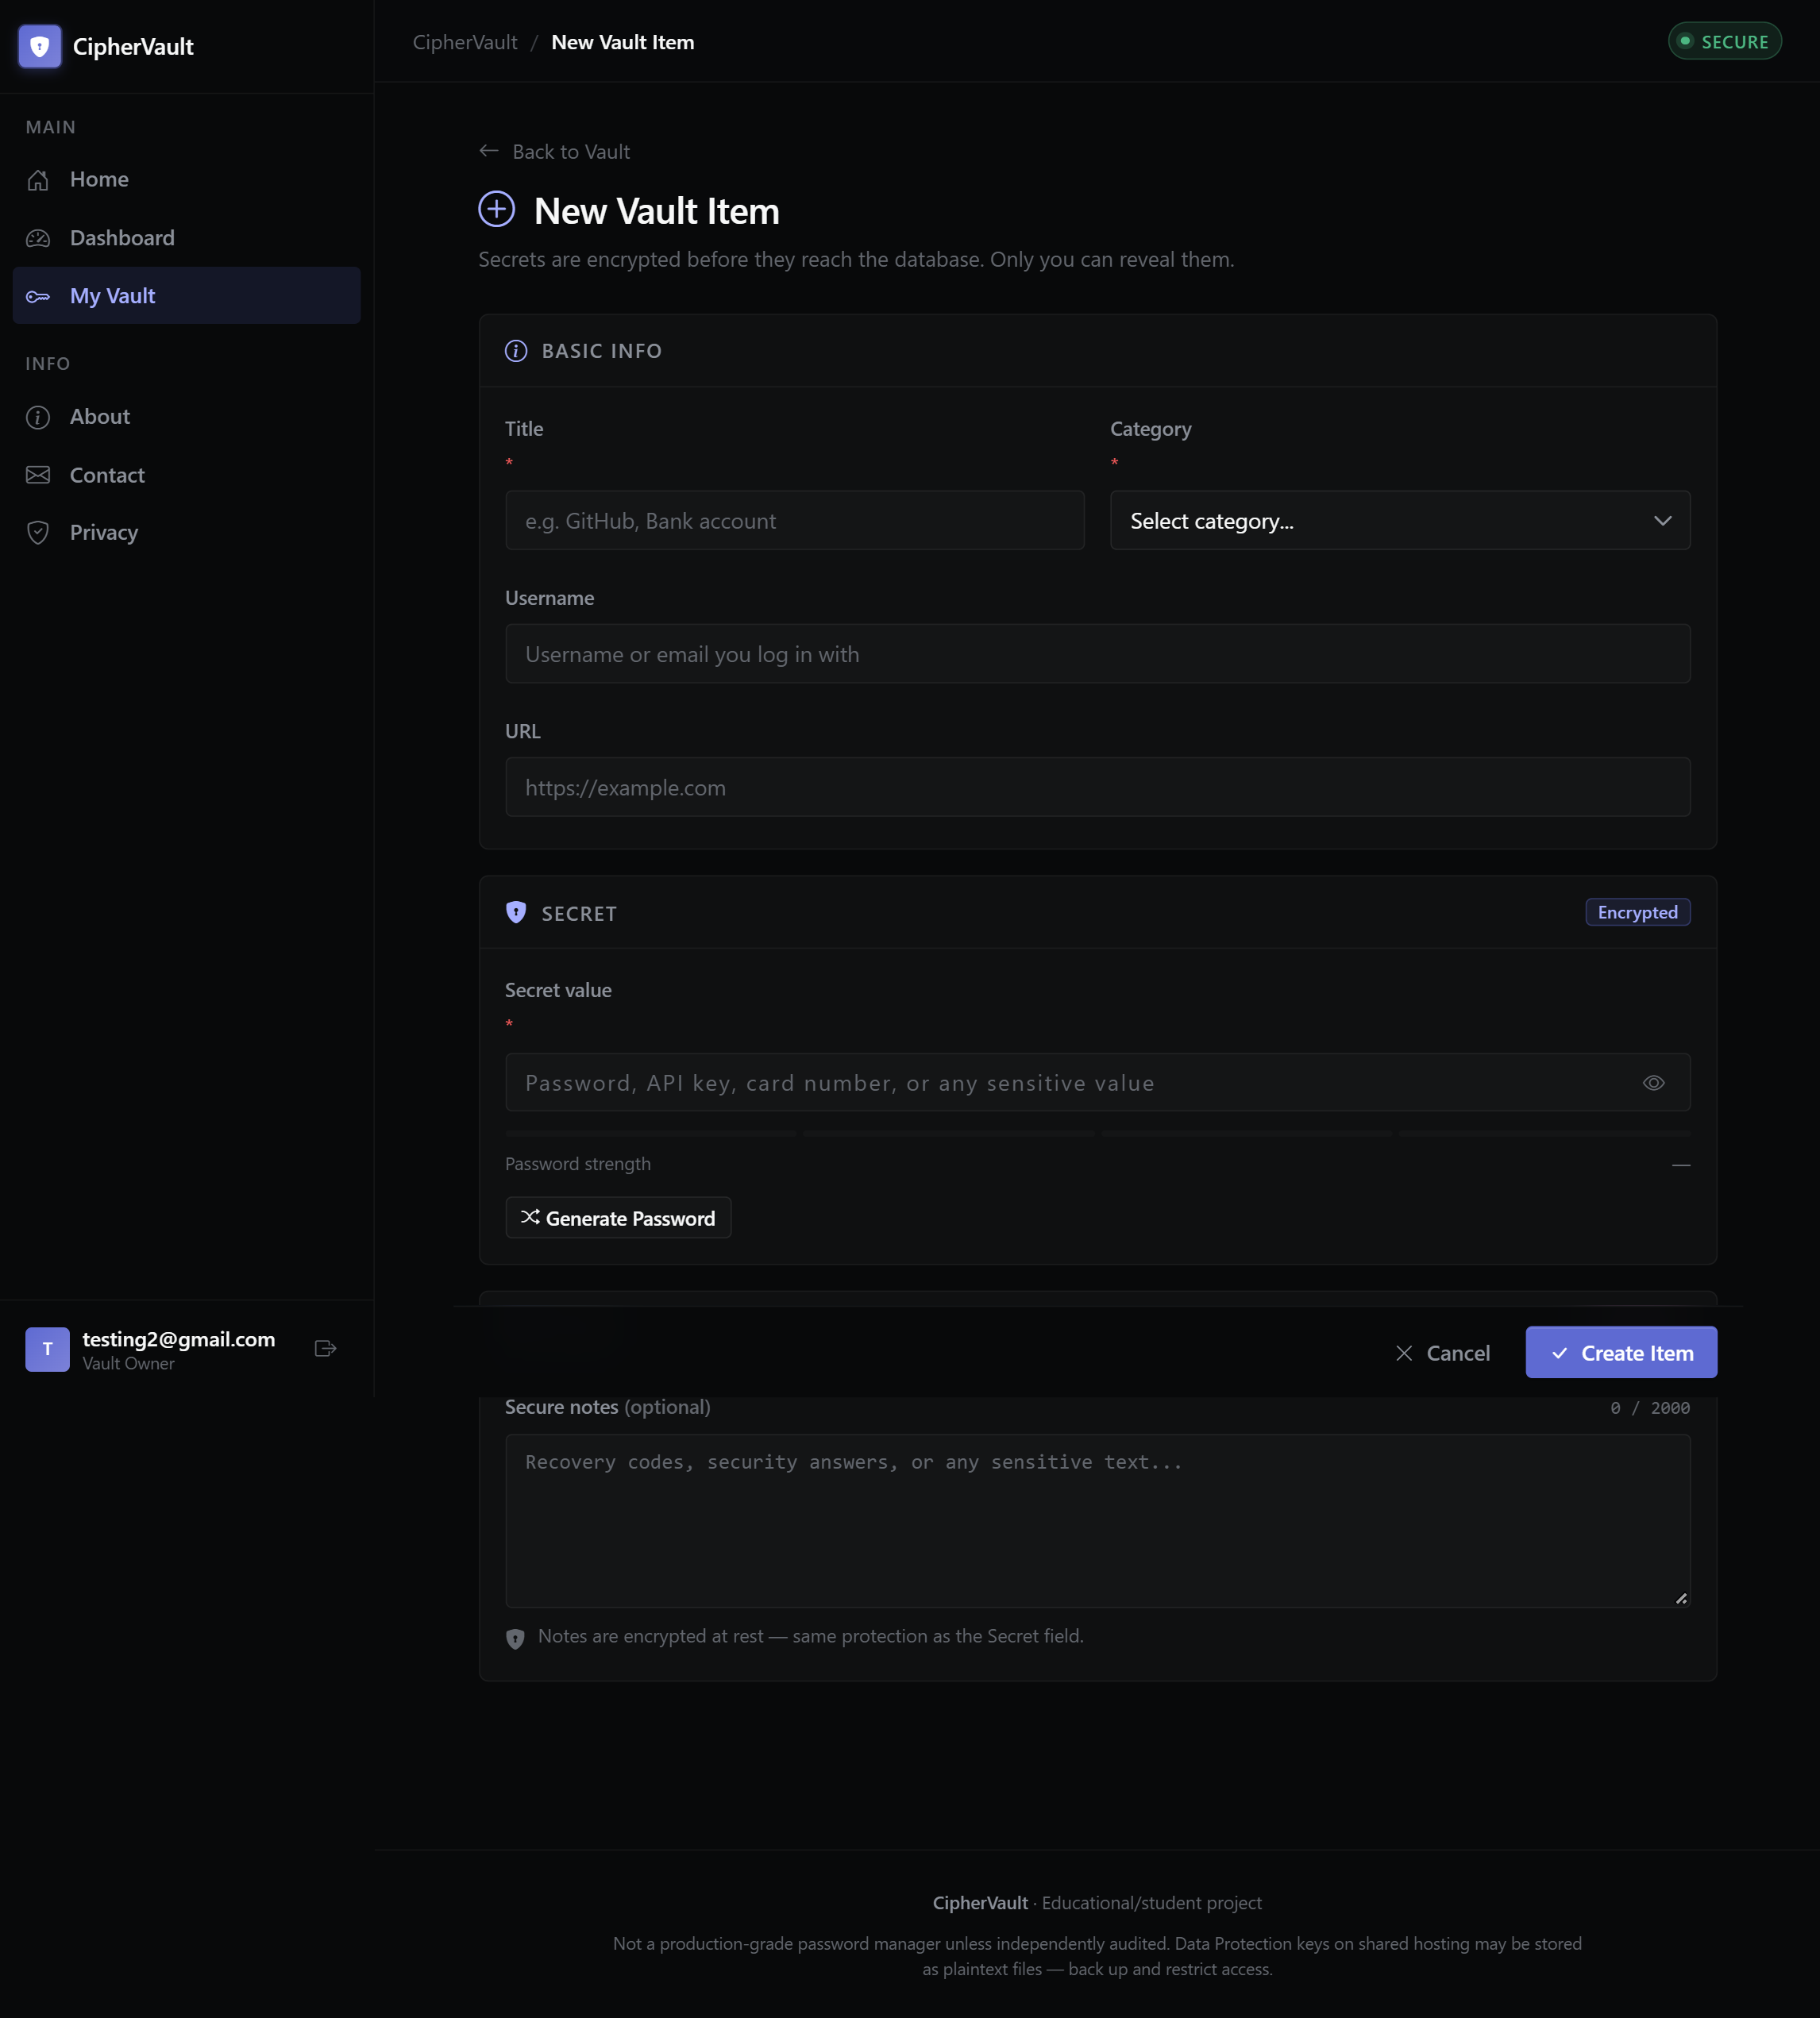
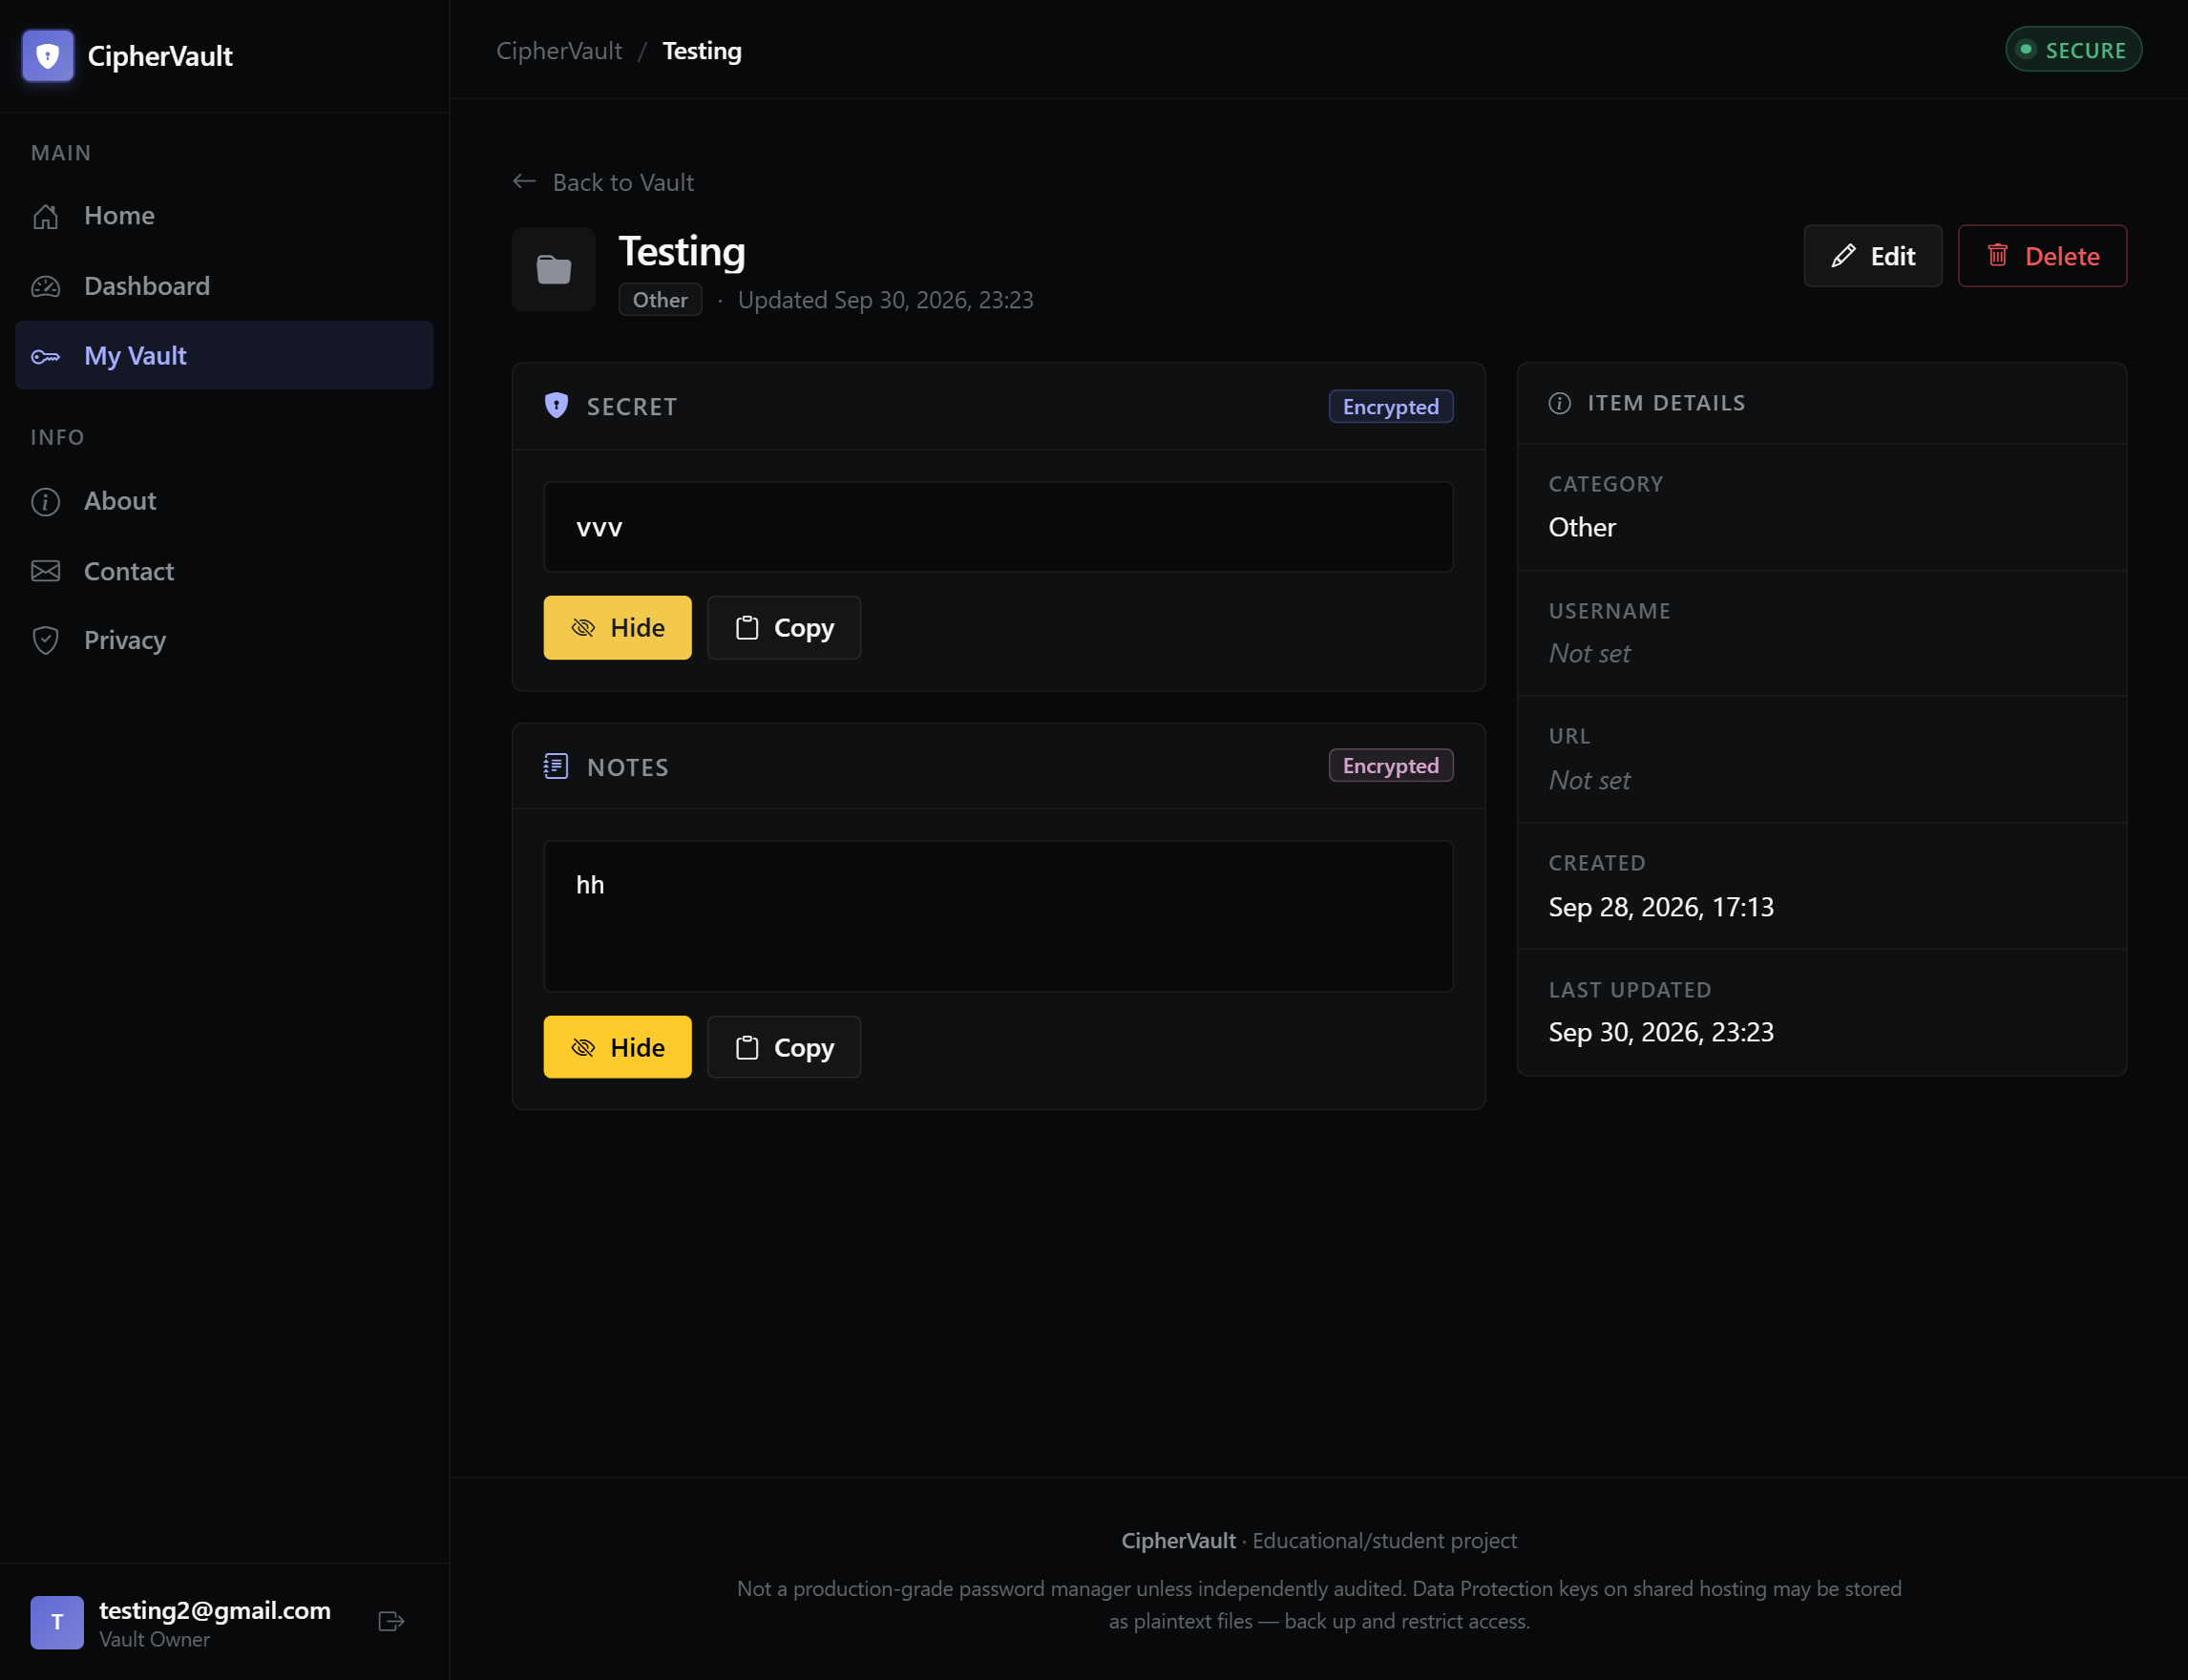
PROTOTYPE
Live App Demo: Encrypted CRUD & Reveal Flow
Secure creation, masking by default, and authorized on-demand decryption
Create Form with Password Generator & Strength Meter
Details View: Masked Secrets & On-Demand Reveal
Full Stack Web Development Project using ASP.NET Core (DSC-M-BCA-471P) | Student: Kaswan Yogesh Subhashchandra (Roll: 32) | Guide: Prof. Sejal Shah
Slide 8 / 15
Notes:
Showing the create form with the crypto-secure generator and the details view where secrets remain masked by default until explicitly revealed by the owner.

Slide 9
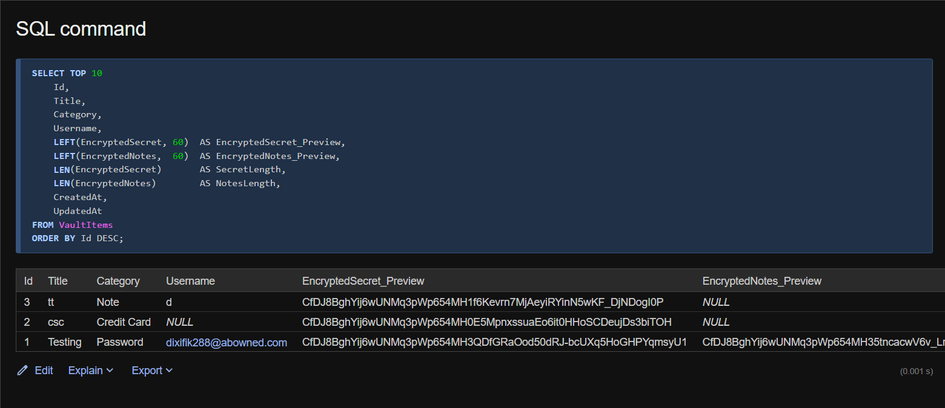
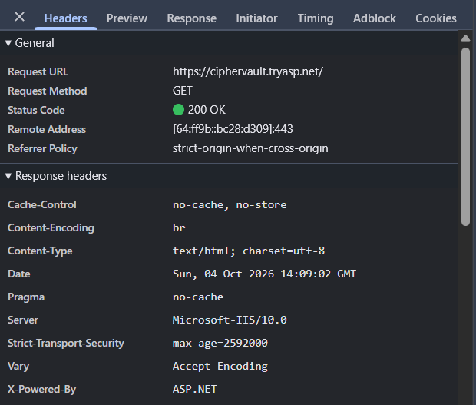
SECURITY PROOF
Security Verification & Database Inspection
SSMS verification proving ciphertext-only storage and cross-user isolation
SSMS Proof: EncryptedSecret & EncryptedNotes Store Ciphertext Only
DevTools Proof: HSTS Header & Secure Cookies Active
Full Stack Web Development Project using ASP.NET Core (DSC-M-BCA-471P) | Student: Kaswan Yogesh Subhashchandra (Roll: 32) | Guide: Prof. Sejal Shah
Slide 9 / 15
Notes:
Database inspection via SSMS confirms that plaintext secrets never touch the database. Browser DevTools confirm secure cookies and HSTS headers in production.

Slide 10
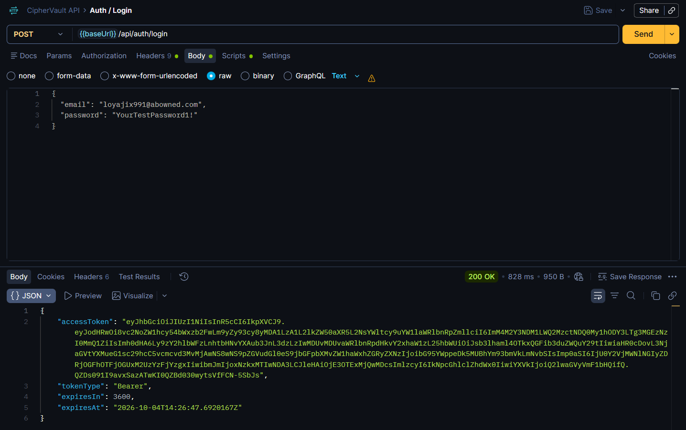
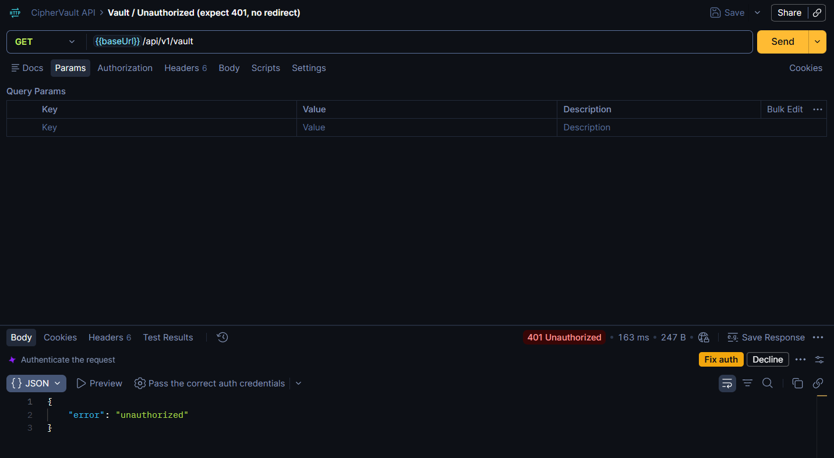
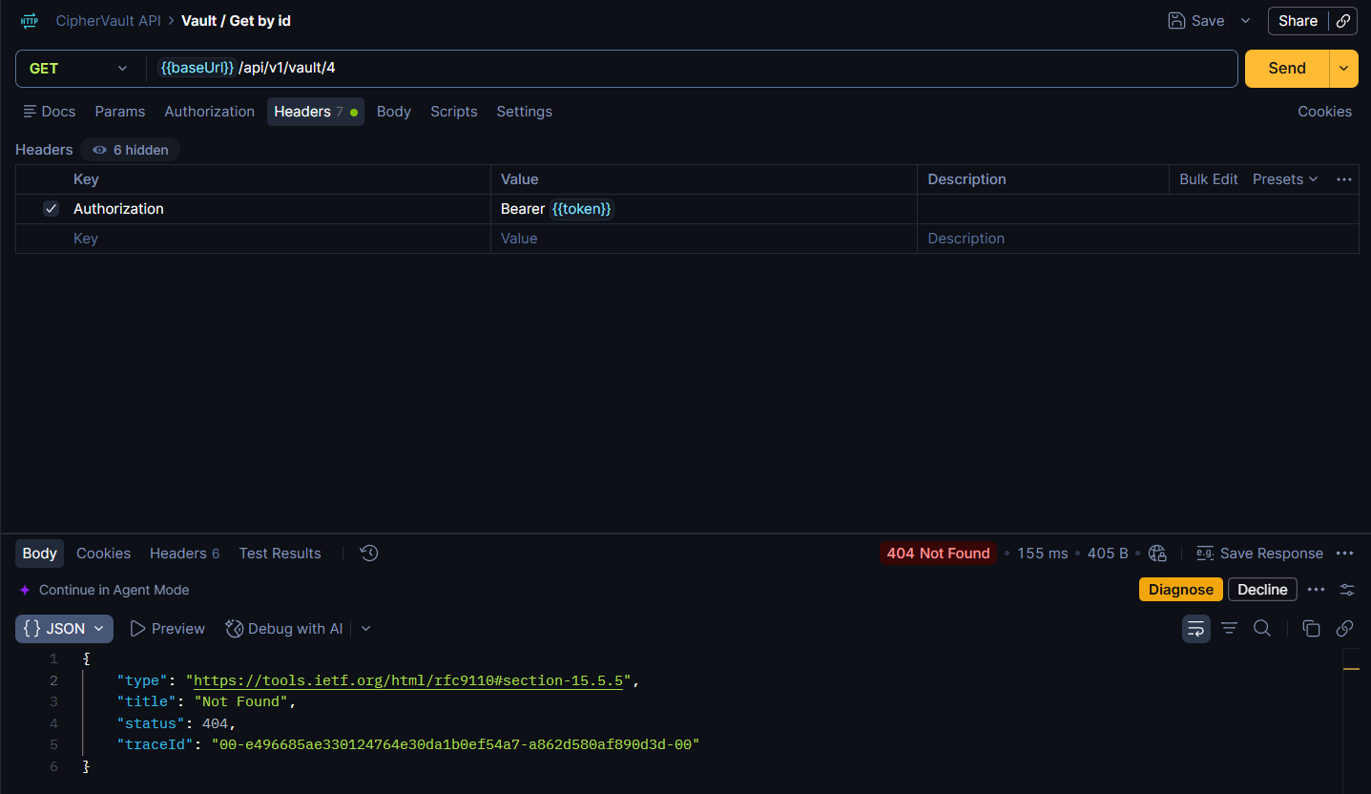
API VERIFICATION
REST API Verification via Postman
End-to-end testing of JWT login, unauthorized responses, and IDOR protection
Postman: POST /api/auth/login Issuing JWT Bearer Token
Postman: HTTP 401 Unauthorized (No Redirect)
Postman: HTTP 404 Not Found (IDOR Cross-User Guard)
Full Stack Web Development Project using ASP.NET Core (DSC-M-BCA-471P) | Student: Kaswan Yogesh Subhashchandra (Roll: 32) | Guide: Prof. Sejal Shah
Slide 10 / 15
Notes:
Postman test results confirming token issuance, JSON 401 on missing tokens, and 404 Not Found on cross-user IDOR access attempts.

Slide 11
VERIFICATION
Comprehensive Testing & Verification Matrix
Summary of 11 critical test cases verified across local development and production
Test Case Description | Expected Behavior / Requirement | Status
IDOR Cross-User Access | Attempting to access another user's vault item returns 404 Not Found | PASS ✔
Blank Secret on Update | Submitting an edit form with a blank secret preserves existing ciphertext | PASS ✔
Blank Notes on Update | Leaving notes blank preserves them; empty string clears them to null | PASS ✔
API Missing Token | Calling /api/v1/vault without a token returns HTTP 401 JSON (no redirect) | PASS ✔
API ?decrypt=true | Supplying ?decrypt=true query parameter is rejected with HTTP 400 | PASS ✔
Account Lockout | 5 failed login attempts trigger a 15-minute account lockout (HTTP 423) | PASS ✔
HSTS Header | Production environment emits Strict-Transport-Security header | PASS ✔
Encryption at Rest | Database inspection confirms only ciphertext is stored in Secret/Notes columns | PASS ✔
Key Persistence | Application restart does not invalidate existing ciphertext (Key ring persists) | PASS ✔
Global Exception Handling | Unhandled exceptions return JSON 500 for API and custom error page for MVC | PASS ✔
Mobile Responsiveness | Bootstrap 5 layout adapts cleanly across mobile and desktop viewports | PASS ✔
Full Stack Web Development Project using ASP.NET Core (DSC-M-BCA-471P) | Student: Kaswan Yogesh Subhashchandra (Roll: 32) | Guide: Prof. Sejal Shah
Slide 11 / 15
Notes:
Summary table of all 11 critical test cases, confirming 100% pass rate across security, CRUD, API, and deployment verifications.

Slide 12
RETROSPECTIVE
Technical Challenges & Solutions
Real-world hurdles encountered during development and how they were resolved
__Host- Cookie Prefix Conflict
The __Host- cookie prefix caused login failures during local HTTP development. Resolved by renaming the cookie to CipherVault.Auth while maintaining unconditional SecurePolicy = Always.
Lockout Parity Across Interfaces
MVC login and API login had divergent lockout behaviors. Resolved by scaffolding the Identity Login page and enabling lockoutOnFailure: true across both pathways.
HSTS Poisoning on Localhost
Enabling HSTS globally caused browser HSTS pinning on local development ports. Resolved by gating UseHsts() strictly inside if (app.Environment.IsProduction()).
Key Ring Persistence on Shared Host
Default key directories risked being overwritten during deployments. Resolved by enforcing DataProtection__KeyDirectory outside the web root via environment variables.
DTO Blank-Preserve Semantics
Distinguishing between 'keep existing secret' and 'clear field' in updates. Resolved by implementing explicit null vs empty string checks in the VaultItemService.
Full Stack Web Development Project using ASP.NET Core (DSC-M-BCA-471P) | Student: Kaswan Yogesh Subhashchandra (Roll: 32) | Guide: Prof. Sejal Shah
Slide 12 / 15
Notes:
Discussing technical challenges: cookie prefix issues, lockout parity, HSTS gating, key persistence on shared hosting, and DTO blank-preserve semantics.

Slide 13
REFLECTION
Lessons Learned & Engineering Best Practices
Key takeaways from building a production-oriented ASP.NET Core 10 application
1
Architecture Discipline
Enforcing strict separation between controllers, services, and repositories prevents spaghetti code and simplifies unit testing.
2
Cryptographic Contracts
Purpose strings are immutable contracts. Planning key management and directory persistence before production deployment is mandatory.
3
Security by Default
IDOR protection belongs in the service layer, not controller actions, ensuring ownership checks cannot be accidentally bypassed.
4
Dual Auth Complexity
Mixing cookie authentication and JWT bearer tokens requires explicit scheme configuration to prevent unwanted login redirects on API endpoints.
5
Environment Parity
Testing production settings (HSTS, secure cookies, external key directories) locally via user-secrets and environment profiles prevents release-day surprises.
Full Stack Web Development Project using ASP.NET Core (DSC-M-BCA-471P) | Student: Kaswan Yogesh Subhashchandra (Roll: 32) | Guide: Prof. Sejal Shah
Slide 13 / 15
Notes:
Summarizing lessons learned: architecture discipline, immutable cryptographic purpose strings, service-layer IDOR enforcement, and dual auth complexity.

Slide 14
ROADMAP
Future Enhancements & Production Roadmap
Pathways toward enterprise-grade security and operational maturity
🛡️
Security Enhancements
🧪
Quality & Interoperability
⚙️
Operations & DevOps
· Multi-factor authentication (TOTP / WebAuthn)
· Secure password reset and recovery flows
· Azure Key Vault / AWS Secrets Manager integration
· Independent third-party security audit
· Automated unit & integration test suite (xUnit)
· Encrypted vault import / export (JSON / CSV)
· Self-hosted Chart.js assets for offline operation
· Automated SBOM and dependency vulnerability scanning
· Paid hosting migration (no app sleep, auto SSL)
· CI/CD deployment pipelines via GitHub Actions
· Automated database and key ring backup jobs
· Centralized structured logging (Serilog + Seq)
Full Stack Web Development Project using ASP.NET Core (DSC-M-BCA-471P) | Student: Kaswan Yogesh Subhashchandra (Roll: 32) | Guide: Prof. Sejal Shah
Slide 14 / 15
Notes:
Outlining the future roadmap: MFA, automated testing, vault import/export, CI/CD pipelines, and cloud key vault integration.

Slide 15
DSC-M-BCA-471P • ALL 4 PHASES SUCCESSFULLY COMPLETED
Thank You! Questions & Discussion
Live Production Build: https://ciphervault.tryasp.net | Source Code: https://github.com/yogeshkaswan377-dev/CipherVault
PHASE 1 • MVC & UI
PHASE 2 • FORMS
PHASE 3 • CRUD & DB
PHASE 4 • API & LIVE
ASP.NET Core 10 MVC
Bootstrap 5 Responsive
DTO Separation
Crypto-Secure Generator
EF Core 10 + AES Data Protection
IDOR-Safe 404 Guard
REST API + JWT Bearer
Deployed on MonsterASP
✔ Phase 1, 2, 3 & 4 Implementation Reports Complete | ✔ Live HTTPS Deployment Verified | ✔ Postman Collection & Docs Ready
Student Name: Kaswan Yogesh Subhashchandra (Roll No: 32) • Project Guide: Prof. Sejal Shah
Course Title: Full Stack Web Development Project using ASP.NET Core (DSC-M-BCA-471P) • Institution: Lokmanya College of Computer Application
Full Stack Web Development Project using ASP.NET Core (DSC-M-BCA-471P) | Student: Kaswan Yogesh Subhashchandra (Roll: 32) | Guide: Prof. Sejal Shah
Slide 15 / 15
Notes:
Thank you Sir/Ma'am. I am now ready for your questions and a live demonstration of CipherVault.

