Slide 1
Project 94 — Azure PIM Just-In-Time Access
Objective • Controlled temporary privileged access in Microsoft Azure
OBJECTIVE
Provide privileged Azure permissions only when they are needed, for a limited period, instead of keeping permanent access.
Security goal
Azure services used
Expected outcome
• Reduce unnecessary permanent privileged access
• Use Just-In-Time (JIT) activation
• Automatically end temporary access
• Azure for Students subscription
• Resource group: project94-rg
• Microsoft Entra Privileged Identity Management
• User is Eligible, not permanently Active
• User activates Contributor when required
• Access expires after the configured duration
Project 94 • Azure Privileged Identity Management (PIM)
1

Slide 2
Project Flow — From Eligibility to Expiration
The key difference is the temporary Active state
1
2
3
4
5
6
Azure subscription
Project resource
PIM assignment
Activation
Temporary access
Expiration
Azure for Students
project94-rg
Contributor • Eligible
Reason + limited duration
Contributor • Active
Active access removed
ELIGIBLE → ACTIVE → EXPIRED
This is the core Just-In-Time access behavior demonstrated by Project 94.
Project 94 • Azure Privileged Identity Management (PIM)
2

Slide 3
Implementation Process — Step by Step
A lightweight Azure configuration project; no application coding is required
1
Create environment
4
Assign role
Create/confirm the Azure resource group project94-rg under the Azure for Students subscription.
Add the Contributor role to the test user as Eligible rather than permanently Active.
2
Open PIM
5
Activate when needed
Microsoft Entra ID → Privileged Identity Management → Azure resources.
From My roles, activate Contributor, provide a reason, and choose a limited duration.
3
Select project resource
6
Verify and document
Choose Azure for Students → project94-rg.
Capture Eligible/Active screens and verify that the active assignment ends after expiration.
Current account note: PIM requires the appropriate Microsoft Entra Premium/Governance licensing in the tenant.
Project 94 • Azure Privileged Identity Management (PIM)
3

Slide 4
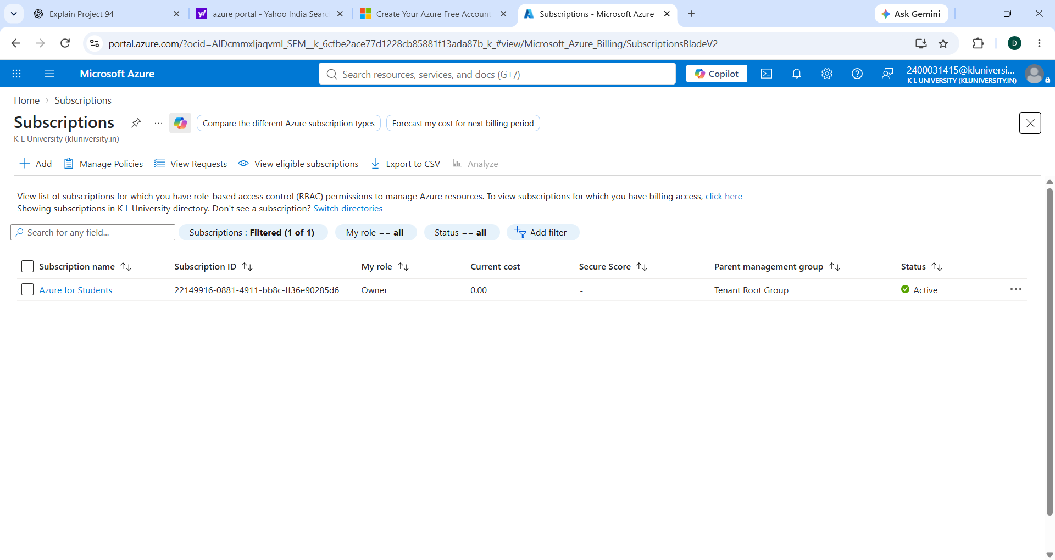
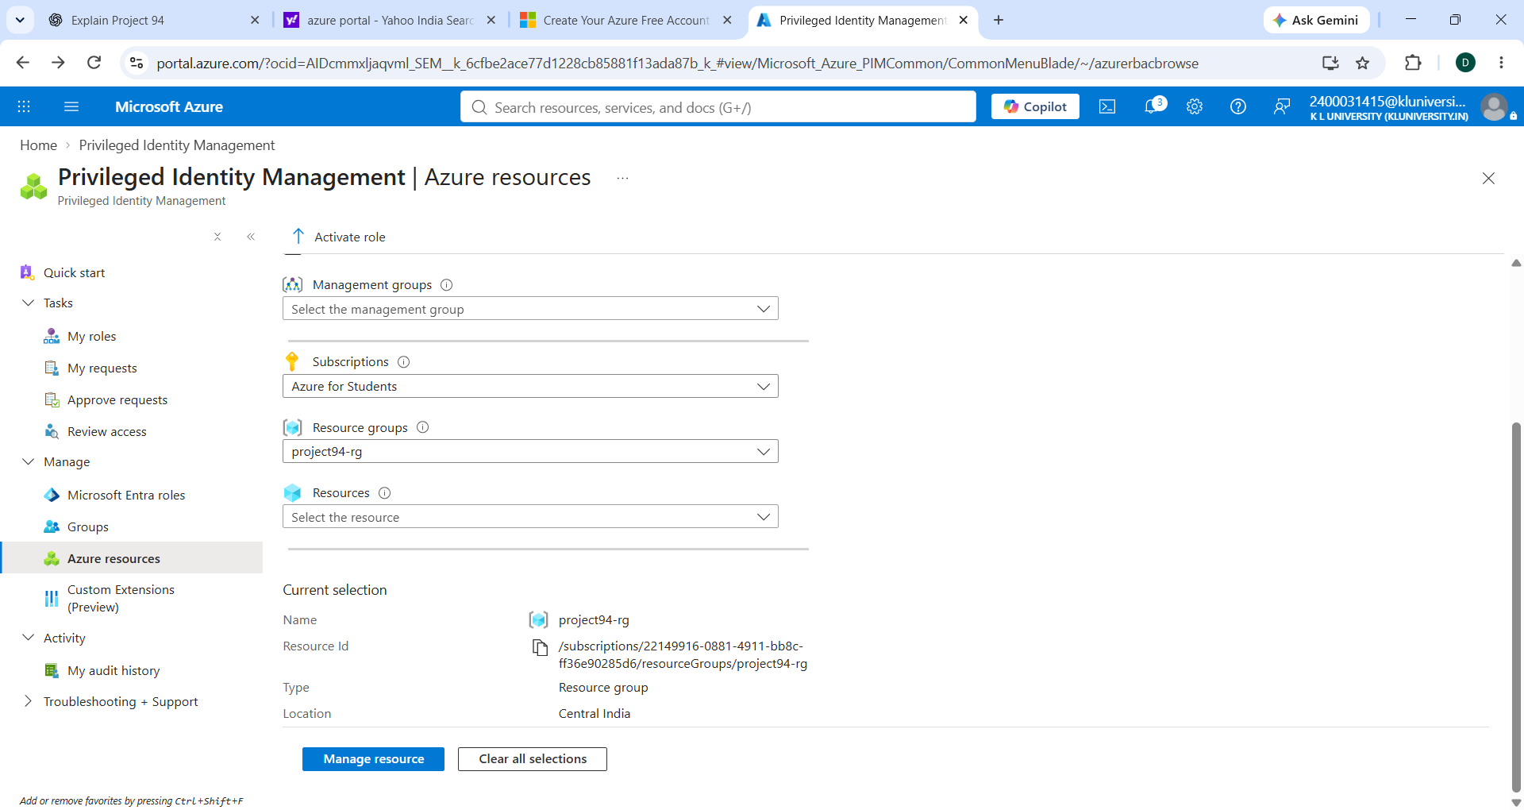
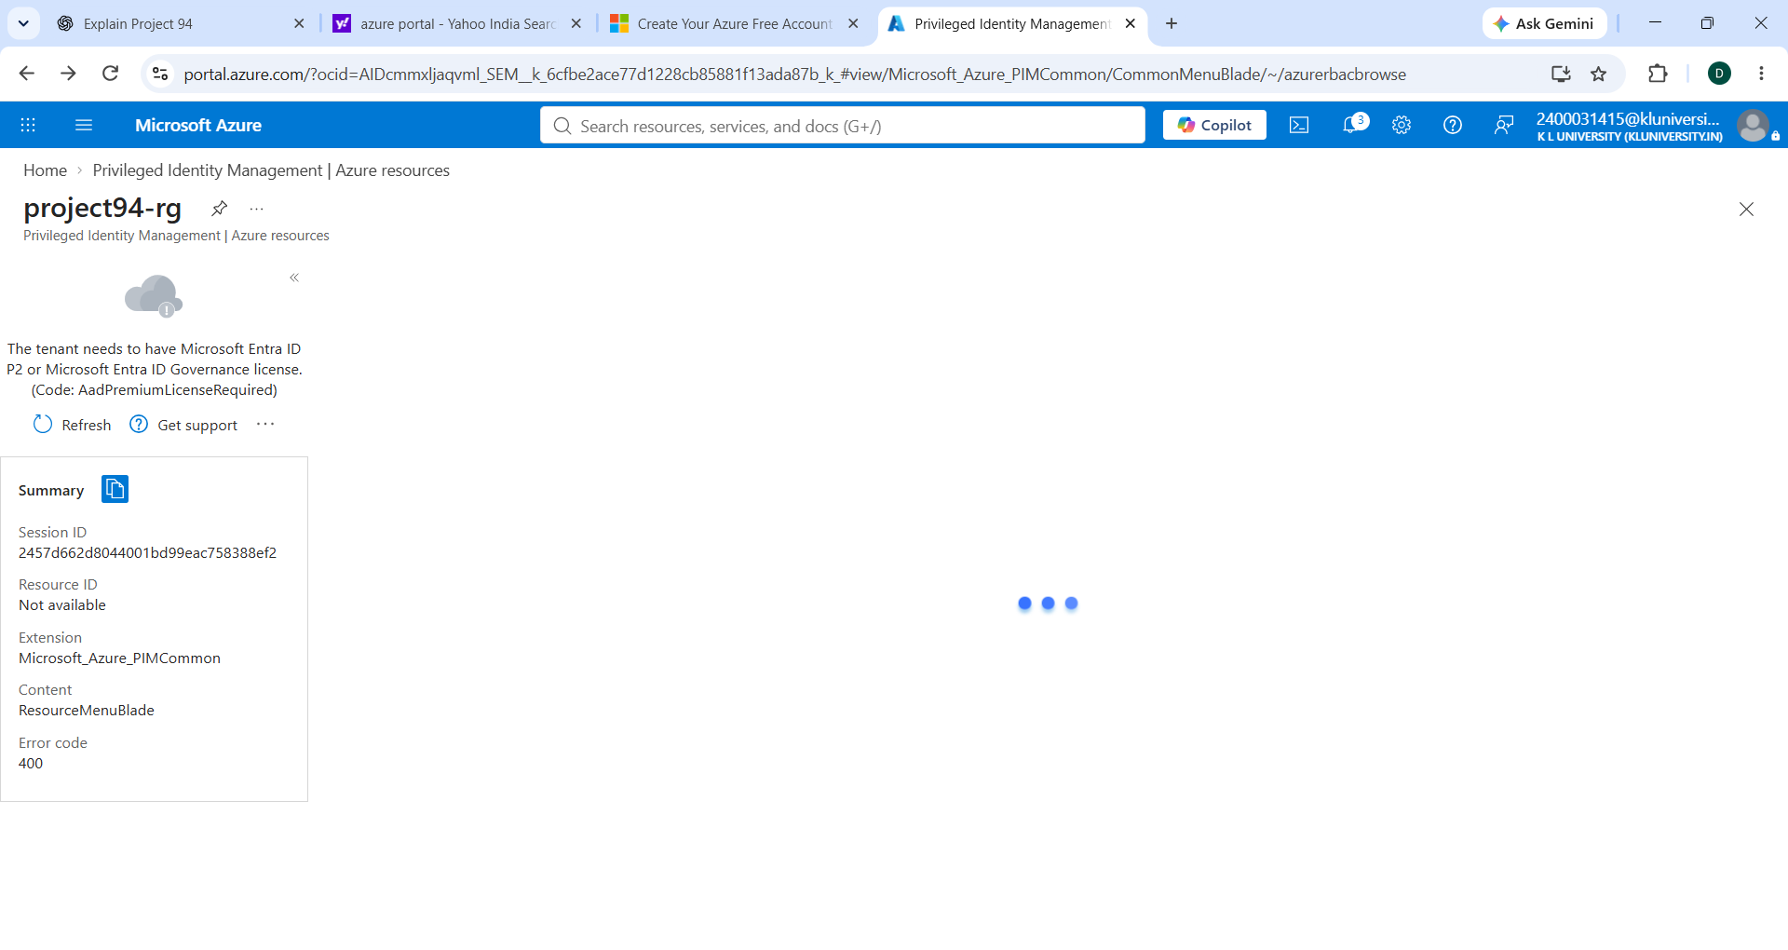
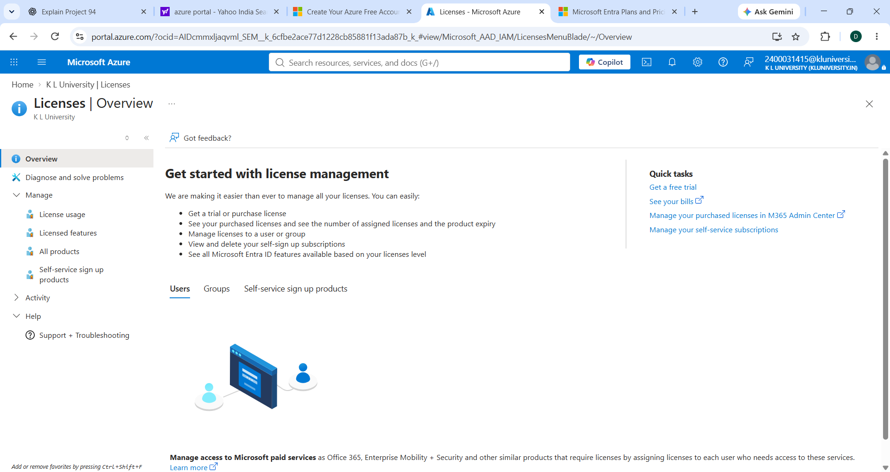
Evidence — Azure Screenshots From the Work Done
Actual screenshots supplied during the project setup and access verification
1. Azure for Students subscription — Active
2. PIM Azure resources — project94-rg selected
3. PIM access check — Premium license required
4. Entra Licenses — access/license page
Project 94 • Azure Privileged Identity Management (PIM)
4

Slide 5
Conclusion
Project outcome, security value, and current implementation status
What Project 94 demonstrates
Current project status
• Privileged access should be granted only when required.
• PIM changes the model from permanent access to eligible, time-bound access.
• The user activates Contributor for a limited duration.
• When the activation expires, the temporary privileged access is removed.
• The process supports controlled and auditable privileged access.
Azure for Students subscription
Configured
project94-rg resource group
Created
PIM resource scope
Located
PIM role activation
Requires Entra Premium/Governance license
Final takeaway: Eligible → Activate → Temporary Access → Expire
Project 94 • Azure Privileged Identity Management (PIM)
5

