Slide 1

Insights Report: Order, Customer, and Sales Analysis
A data-driven approach to analysing sales trends and customer behaviour

Slide 2
Overview
This document provides key insights into customer transactions, product purchases, and shipping performance based on structured data. The insights help in optimizing logistics, inventory, and marketing strategies.

Slide 3
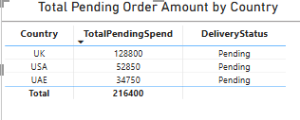
Total Amount Spent per Country for Pending Deliveries
The total amount spent for pending deliveries varies significantly across countries
Recommendation: Optimize logistics and prioritize high-value pending deliveries to improve customer satisfaction and revenue recognition

Slide 4
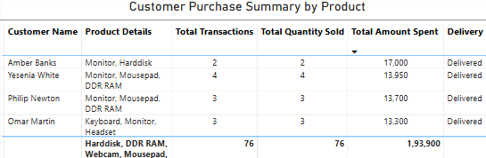
Customer-wise Transactions, Quantity Sold, and Amount Spent
Customers with a higher number of transactions are more likely to be repeat buyers
Recommendation: Create personalized marketing campaigns and loyalty programs for top-spending customers.

Slide 5
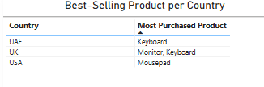
Maximum Purchased Product for Each Country
Certain products are more popular in specific countries, indicating regional preferences.
Recommendation: Optimize stock levels based on region-specific demand, ensuring product availability.
Localize product promotions to align with market demand.

Slide 6
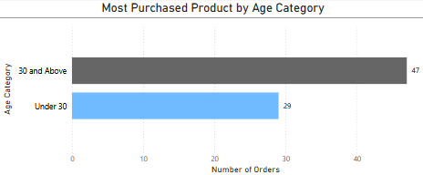
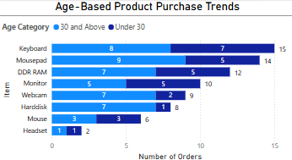
Most Purchased Product by Age Category
Customers under 30 years tend to purchase Keyboards more frequently than those aged 30 and above.
Customers above 30 years have purchased more Mouse-pads
Recommendation: Implement age-specific promotions, such as student discounts on Keyboards and ergonomic accessories for older demographics
Leverage targeted ads on platforms where each demographic is most active

Slide 7
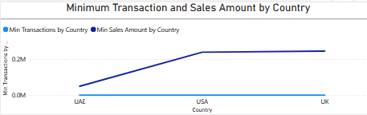

Country with Minimum Transactions and Sales
Insight:
Some countries exhibit significantly lower transaction volumes and sales.
Potential factors include regional demand, marketing reach, or logistics challenges.
Conduct
Recommendation: Conduct a market analysis to identify barriers to sales in low-performing countries.
Enhance
Enhance marketing and distribution channels in under-performing regions
Offer
Offer localized incentives or discounts to boost engagement and transactions.

Slide 8
Conclusion & Next Steps
By leveraging these insights, the organization can optimize supply chain management, refine marketing strategies, and enhance customer experience to drive revenue growth and efficiency.

Slide 9

Thank You

