Slide 1
SENTINEL-BC
Uncertainty-aware breast mass classification
Calibrated predictions, a safety gate and human review
Samsung Innovation Campus / RV College of Engineering
Academic research prototype. Never clinical clearance.
Notes:
Problem Statement 8. Present the project as an engineering integration and empirical study, not a clinically approved system. Source: docs/project_report.md; results/full/metrics.json.

Slide 2
Overconfidence and referral
The decision problem
The research question
A label alone gives limited support for deciding when a model should defer.
Ambiguous measurements and unfamiliar inputs need a visible route to human review.
How much automation can a conservative gate support while referring potential malignancies?
Report accepted accuracy together with coverage and review workload.
No diagnostic approval, patient records or treatment recommendations.
02
Notes:
A confident label can conceal uncertainty. Scope: numerical features already extracted from FNA imagery, not raw image analysis. Source: https://archive.ics.uci.edu/dataset/17/breast-cancer-wisconsin-diagnostic

Slide 3
Established methods, original integration
Method | Reused capability | Project contribution
scikit-learn / Keras | Fresh fitted classifiers | Leak-free experiment roles
Calibration / MAPIE | Probabilities and prediction sets | Independent held-out stages
Deep ensemble / Dropout | Neural dispersion signals | Batch-consistent estimates
SHAP / permutation | Feature attribution | Explicit limits and direction
Gradio / SQLite | Interface and persistence | Frozen gate and review audit
The contribution is a coherent, testable referral workflow and its measured trade-offs.
03
Notes:
References: Guo et al. https://proceedings.mlr.press/v70/guo17a.html ; Lakshminarayanan et al. https://arxiv.org/abs/1612.01474 ; Gal & Ghahramani https://proceedings.mlr.press/v48/gal16.html ; MAPIE https://mapie.readthedocs.io/ ; source revisions and licenses: docs/third_party_reuse.md. No upstream code or weights copied.

Slide 4
569 observations, five disjoint roles
357 benign / 212 malignant / 30 numerical features
Scaling fits only within training folds. No test-driven model or threshold choice.
04
Notes:
Source: UCI WDBC DOI 10.24432/C5DW2B, CC BY 4.0, via sklearn equivalent bundle. Canonical class mapping BENIGN=0, MALIGNANT=1. Splits: results/full/partitions.json. Unknown patient linkage limits independence checks.

Slide 5
System architecture
30 measurements
Validity / OOD
Calibrated model
→
→
Uncertainty + sets
Frozen gate
Research / review
→
→
Versioned local artifacts support offline inference. SQLite preserves the original prediction.
05
Notes:
Source: docs/architecture.md. All boxes are editable native slide objects. Inference and training use different entry points; UI startup never trains. Artifacts enforce version, schema and class order.

Slide 6
Training and development selection
Candidate | CV accuracy | CV malignant recall
logistic | 98.17% | 97.09%
rbf_svm | 97.80% | 98.04%
random_forest | 95.97% | 96.13%
xgboost | 97.07% | 97.11%
mlp | 97.44% | 95.13%
deep_ensemble | 97.80% | 96.11%
The prespecified development rule chose the RBF SVM, C = 3.0.
Three independently trained Keras members remain part of the uncertainty system.
06
Notes:
All figures read results/full/cross_validation.json. CV uses three fixed stratified folds on 273 fitting rows. Neural models keep 18% inner validation data. MLP: 64/32 ReLU, dropout .25/.20, L2 .001, Adam .001, up to 100 epochs. Final seeds 42,142,242. Selection maximizes mean(accuracy, malignant recall), with lower NLL tie-break.

Slide 7
Locked test results
Primary SVM: 109 / 114 correct (95.61%)
95% accuracy interval 90.14–98.11% · Malignant recall 38/42 (90.48%)
Four false negatives and one false positive at the ordinary 0.5 threshold
07
Notes:
Source: results/full/metrics.json; test_predictions.csv. 114 rows, 72 benign and 42 malignant. Model selection froze before evaluation. The MLP performed better on this test but was not selected from development data. Do not switch models based on this test. Accuracy interval: Wilson 95%.

Slide 8
Calibration and uncertainty
Calibration worsened this split
Entropy and confidence
Three-network disagreement
20 MC Dropout passes
90% MAPIE prediction sets
Observed conformal coverage: 108/114 (94.74%). Marginal coverage is not an individual guarantee.
08
Notes:
Sources: results/full/metrics.json and docs/methodology.md. Sigmoid calibration uses 57 held-out development rows. Test Brier, NLL and ECE worsen; report honestly. Neural dispersion is separate from primary calibrated SVM probabilities. Conformal LAC nominal .90 on 57 independent conformalization rows.

Slide 9
The safety gate and its workload
Acceptance requires all of these conditions
Valid, familiar measurements
Benign-only conformal set
p(malignant) < 0.02
Entropy ≤ 0.65 bits
Neural and dropout std ≤ 0.15
38 / 114
cases accepted as low-risk estimates
76 referred for review
42/42 malignant cases referred
0 observed accepted malignancies
100% accepted accuracy at 33.33% coverage. Never clinical clearance.
09
Notes:
Sources: results/full/policy_selection.json, metrics.json and safety_gate.py. Development threshold .02 accepted20/68 with zero observed accepted malignancies. Test38/114 accepted, all benign. Accepted accuracy Wilson interval90.82–100%. All42 malignant referred. These observations do not prove zero future risk.

Slide 10
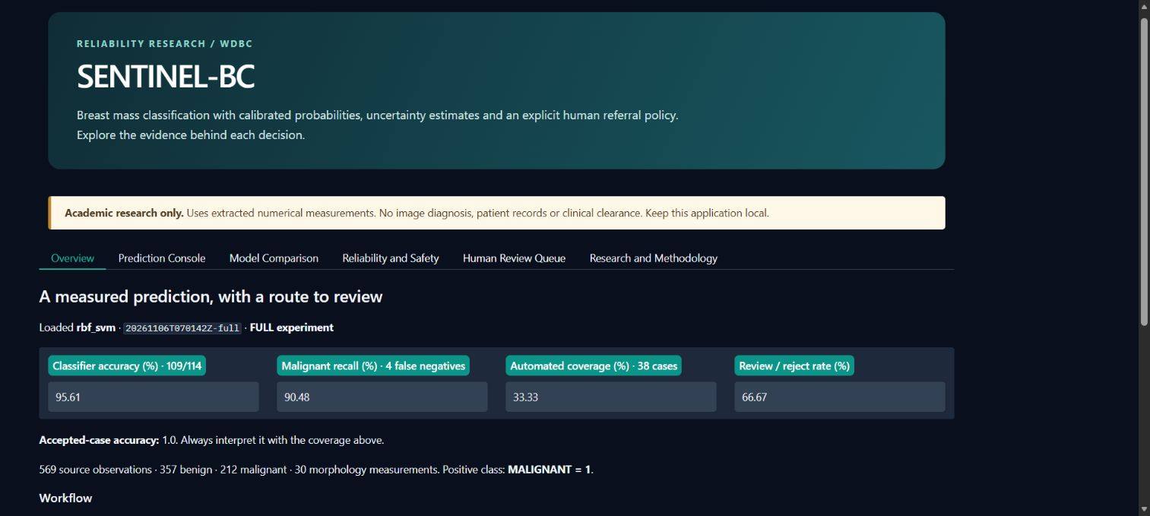
Gradio research console
Six working tabs
Labeled examples
CSV inference
Local explanations
Persistent review
Local by default. No public tunnel, paid APIs or automatic retraining.
10
Notes:
Screenshot: docs/images/overview.png, captured from the running local application. Browser tests include labeled prediction, invalid input, save case and human review. Other views expose uncertainty, comparison, teaching explanations and persistent original predictions.

Slide 11
Ablations, stress tests and limits
Stage | Coverage | Accepted accuracy | Accepted malignant
Base classifier | 65.79% | 94.67% | 4
Calibrated classifier | 65.79% | 94.67% | 4
With uncertainty | 33.33% | 100.00% | 0
Full gate | 33.33% | 100.00% | 0
Noise, missing values, a radius shift and implausible values expose failure modes.
These controlled experiments do not establish real clinical robustness.
11
Notes:
Sources: results/full/ablation.json and robustness.json. Descriptive ablations change stage definitions; not causal isolation. Perturbations use68 policy development cases, not external clinical data. Correlations limit both SHAP and permutation importance.

Slide 12
Conclusions and next evidence
The completed experiment
The remaining evidence
Fresh classical and neural models
Explicit calibrated referral workflow
Genuine results and preserved review history
Independent student retraining commands
Larger calibration and policy samples
Independent external evaluation
Subgroup and prospective workload studies
Domain-led clinical validation
Historical WDBC data supports an academic prototype. Clinical use remains unvalidated.
12
Notes:
Sources and verified links: docs/methodology.md#references and docs/third_party_reuse.md. UCI https://doi.org/10.24432/C5DW2B ; MAPIE https://mapie.readthedocs.io/ ; SHAP https://arxiv.org/abs/1705.07874 . Repository https://github.com/yogeshkrishna/sentinel-bc .

