Slide 1
Impact of managing product categories for profitability
Presented by: Yogesh Krishna

Slide 2
Agenda
Objective
Background
Key findings
Recommendations
Appendix:
Data sources
Data methodology
Data model assumptions

Slide 3
Objective
Improve our shared understanding of top products that contribute to the revenue (using 80/20 rule).
Improve our shared understanding with the use of market basket analysis to analyze the purchase behavior of customers.
Understand what items are more likely to be purchased individually or in combination with some other products.

Slide 4
Background
For the past few months, Olist has faced low revenues and they want to manage their inventory so as to reduce any unnecessary costs that might be incurring.
Now to be able to meet the demands of the customers, the company would need to store tons and tons of products in warehouses.
Since storing these products adds to the costs that the company incurs, it is necessary for Olist to plan its inventory well.

Slide 5
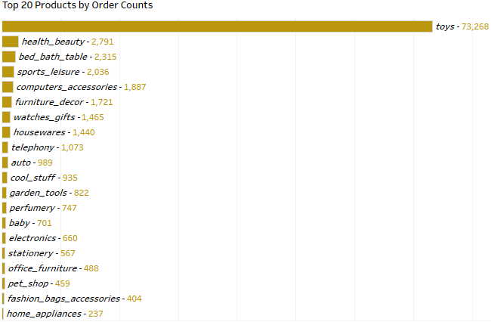
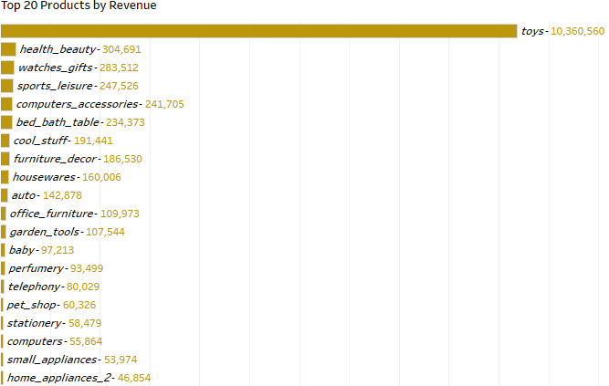
Toys are the best selling product category and the best revenue generator
Toys are the most ordered and the largest revenue generator among all the categories.
Toys alone were ordered more than all the categories combined and also generated more revenue than other categories combined.
Therefore, stocking and managing the Toys category in the inventory should be the first priority.

Slide 6
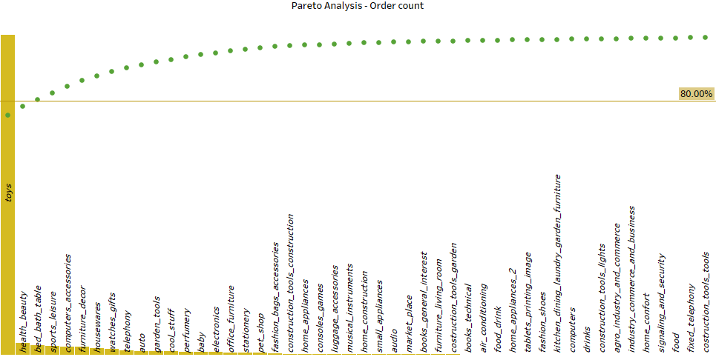
Just 3 categories combined sold over 80% of total orders
As per Pareto Analysis; toys, health_beauty, and bed_bath_table are 80.38% of total orders.
The rest of the product categories are responsible for the remaining 19.62% of orders.
Categorize the inventory into priority groups based on orders counts. So that these top-selling items can be monitored; don’t fall short in managing them.

Slide 7
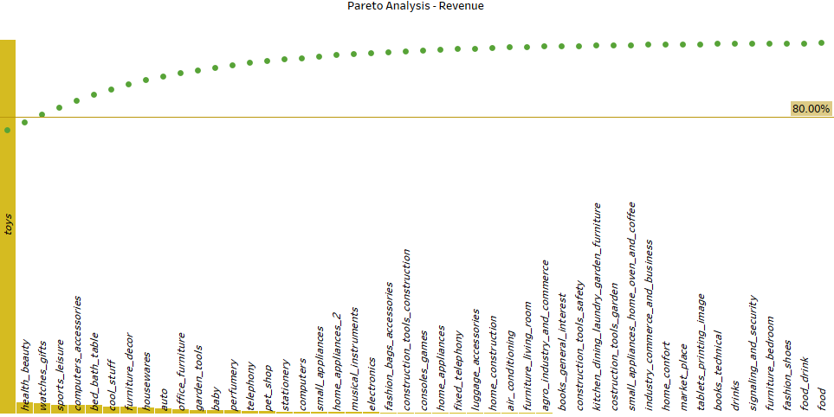
Toys generate approx. 76.23% of Revenue alone
Toys, health_beauty, and watches_gift combined generated 80.56% of the revenues.
The rest of the other 70+ product categories generated 19.44%.
Therefore, plan the restocking of inventory for these top products ensuring that there’s always enough to sell. And these products should be easy to access in the warehouse or facility.

Slide 8
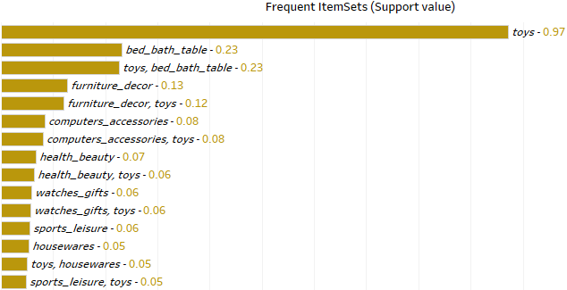
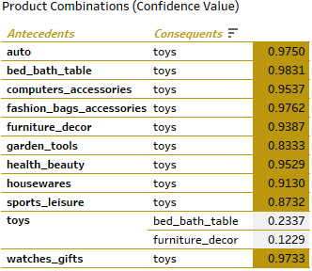
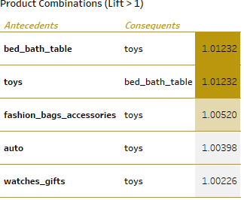
Toys sell well with other product categories
Toys category is the most frequently purchased item individually having the highest support value of 0.97.
Toys is also the most sought-after product as a consequent (the item which the customer follows to buy).
These product combinations can be sold on discounts (discount on one of the items), this will help the inventory move continuously and be free from stale.

Slide 9
Recommendations
Focus on the categories which generated more than 80% of the Revenue. Always keep them in stock and if required restock in advance.
Provide discounts on the products which go well in combination with toys.
Keep the Toys category in the inventory on the same shelf along with other products that go well with it. That way all the top product combinations will be fast-moving saving labor time and expense.
Provide discounts on categories that are old stock, to move them quickly and keep the inventory fresh and according to trend.

Slide 10
Appendix - Data Sources:
Here is a snapshot of our data dictionary:
Orders details such as order id, order status, price, shipping charges, etc.
Customer details such as customer id, customer city, and customer state.
Product attributes such as product id, product category name, and product dimensions.
The team used the following data sources:
OList retail dataset containing order-related information.
The data is for the years 2016 to 2018.

Slide 11
Appendix - Data Methodology
We conducted a thorough analysis of the OList retail data. The process included:
Cleaning and transforming the data set using the Python Libraries (Pandas and Numpy) in Jupyter Notebook.
Exploratory data analysis using the Python Libraries (MatplotLib and Seaborn) in Jupyter Notebook.
The Python Jupyter Notebook PDF file (attached below) with a detailed Data Cleaning, EDA, and Market Basket Analysis process.

Slide 12
Appendix - Data Assumptions
We assumed the data provided was achieving the desired revenue more or less.
We assumed the company does not want to expand to new warehouses/facilities.
The company’s strategies are decided considering there’s a constant growth in sales.
“Knowledge is power in business, and data is the fuel that creates this power“
THANK YOU

