Slide 1

Project Reversi-Game of Brains
Presented by-
Yogesh N
Roshan S

Slide 2
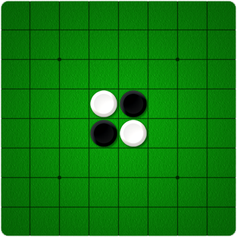
Goal
The goal is to simulate the game Reversi efficiently given the initial configuration.
The human makes the first move always.
Analysis.

Slide 3
Implementation
Java
Algorithm- Min-Max Alpha Beta pruning
Heuristics Functions using Strategies
Threading

Slide 4
Min-Max Alpha Beta
Adversarial search algorithm
Game thought as a tree
Decrease the number of nodes that evaluated
private float minimax(Board board, float alpha, float beta, int depth);
Prunes search at maximum depth 6.

Slide 5
Front end- Java Swings
Outcomes: Win
Draw
Lose

Slide 6
Different Stages
Beginning Stage
Mid-Game
End game

Slide 7
Heuristics
Coin Parity Heuristic Value = 100*(MaxPlayerCoins - MinPlayerCoins )
(Max Player Coins + MinPlayer coins)
Mobility Heuristic Value = 100*(MaxPlayerMoves - Min Player Moves)
(Max Player Moves + Min Player Moves)
Corner Heuristic Value = 100*(Max Player Corners - Min Player Corners)
(Max Player Corners + Min Player Corners)
Stability Heuristic Value = 100* (Max-Stability Value - Min- StabilityValue)
(Max-Stability Value + Min-Stability Value)

Slide 8
Important Functions and Interfaces
private float minimax(Board board, float alpha, float beta, int depth)
class MoveComparator implements Comparator<Move>
public static int mobility (int player, Board board)
public static int cornerSquares (int player, Board board)
public static float eval(int player, Board board)

Slide 9
Analysis
Display the number of times the minimax algorithm called.
Display the points owned at each move.
Display the move made by the computer
Display the move made by the player
Display the end points and the winner

Slide 10
References
1. https://courses.cs.washington.edu/courses/cse573/04au/Project/mini1/O-Thell-Us/Othellus.pdf
2. http://www.samsoft.org.uk/reversi/strategy.htm
3. https://kartikkukreja.wordpress.com/2013/03/30/heuristic-function-for-reversiothello/

