Slide 1
Embedded Security
Project presentation
Yogesh nagor | SANDESH GHARGE
Notes:
<number>

Slide 2
INDEX
Project description
Solution and creating IP
Block Diagram
Improvement ideas
References
Problems faced

Slide 3
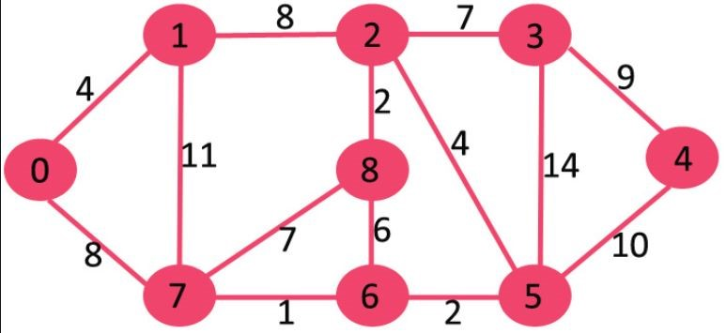
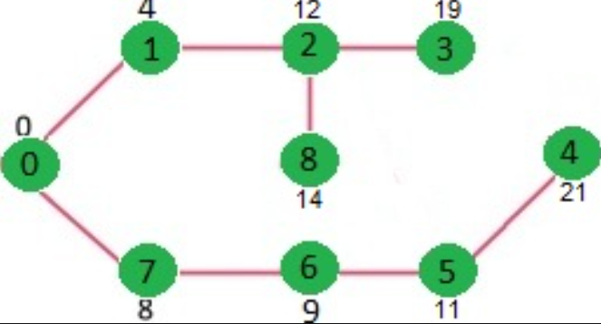
1. PROJECT DESCRIPTION Dijkshtra Algorithm
-Dijkshtra Algorithm is a pre-defined algorithm conceived by computer scientist Edsger W. Dijkstra. This algorithm helps finding the shortest distance between two points in a given graph.
-It calculates shortest distance, but doesn’t calculate the path information.
- The code is for undirected graph, same dijkstra function can be used for directed graphs also.

Slide 4
2. SOLUTION AND CREATING IP
Tasks:
While implementing the algorithm, following major tasks are supposed to be completed -
- Creating IP using Vitis HLS
- Creating Overlay using Vivado
- Designing Jupyter Notebook
- Comparing CPU and FPGA results.
Notes:
<number>

Slide 5
2. Creating IP using Vitis HLS
void dijkshtra(int* a, int* res) { #pragma HLS INTERFACE m_axi port = a offset = slave bundle = gemm1 #pragma HLS INTERFACE m_axi port = res offset = slave bundle = gemm2 #pragma HLS INTERFACE s_axilite port = return // a → Input ( [8 x 8] 2d Array) // res → Output ( [8] 1d Array) . . //Algorithm . . }
*full code is attached in the git link
Notes:
<number>

Slide 6
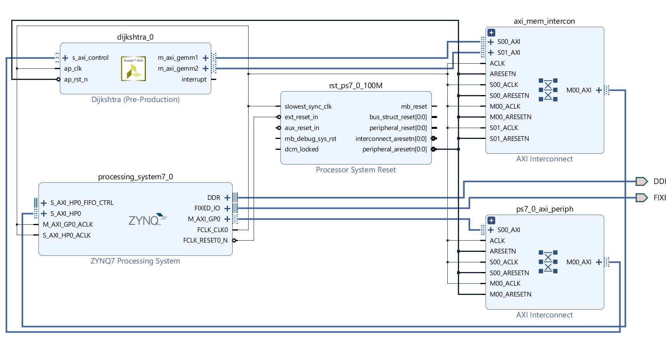
Creating Overlay using Vivado
Block Diagram

Slide 7
3. IMPROVEMENT IDEAS
This project has implemented Dijkshtra algorithm with fixed input, along with fixed reference point. It will of great advantage if this project developed for dynamic inputs and dynamic reference point. It will better to compare the performance of FPGA and CPU with different types of input.

Slide 8
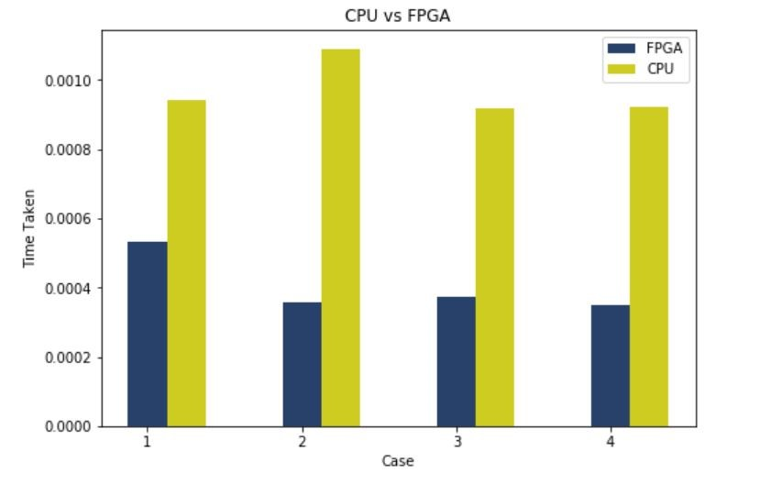
4. CPU AND FPGA COMPARISION
Comparing CPU and FPGA results :
As checked, FPGA perform better than CPU most of the time. Also note that we are running the data with same input, i.e. we are using a for loop for running the algorithm on both FPGA as well as CPU. Below is the graph for few results -

Slide 9
5. REFERENCES
https://www.xilinx.com/support/documentation/sw_manuals/xilinx2016_2/ug902-vivado-high-level-synthesis.pdf
https://www.geeksforgeeks.org/dijkstras-shortest-path-algorithm-greedy-algo-7/
https://www.programmersought.com/article/90206197757/
https://ilearn.th-deg.de/mod/url/view.php?id=348864

Slide 10
6. PROBLEM FACED
DMA Receive channel Issue
Initially DMA were used where we did not get the output. Below command was running forever in jupyter while fetching the results- dma.recvchannel.wait() As an alternative the Overlay was redesigned without DMA, with registers of ZYNQ processssor.

Slide 11
Thank you for your attention.
Yogesh nagor | Sandesh Gharge

