Slide 1
Mini project PRESENTATION topic transportation services website
NAME : YOGESH KUMAR PANDEY (ECC2014001)
SUMIT BIND (ECC2014012)
ADVISOR: Miss. DEEPALI MISHRA

Slide 2
ABOUT project
The project is based on Packers & Movers which is SERVICE based company.
The website will provide a way for customers to reach out service-providers directly

Slide 3
Why this project
Due to lack of own platform, the following problems were being faced.
The objective is to tackle them.
MARKET GAP
CUSTOMERS
Lack of digital presence makes customers doubtful
Takes lots of effort to prove your confidentiality
FINANCIALS
ADVERTISEMENT
Third-Party listings aren’t cost-effective
Offline advertisements do not provide the reach needed to grow

Slide 4
THE PROJECT WILL PROVIDE FOLLOWING SOLUTIONS
CLOSE THE GAP
TARGET AUDIENCE
Enough details on your platform makes customers believe your services
With the help of a website, you can target customers by running advertisement
COST SAVINGS
EASY TO USE
Reduce expenses by making you to not rely on third-party
Simple design that gives customers the targeted information they need

Slide 5
project BENEFITS
Will increase reach drastically
Number of engaged-customers will ultimately help to grow your product
Easy to use platform to share data instantly and avail services as soon as possible

Slide 6
Technologies used

Slide 7
React.js
React is a declarative, efficient, and flexible JavaScript library for building user interfaces. It lets you compose complex UIs from small and isolated pieces of code called “components”.

Slide 8
Styled-components
Styled-component Module allows us to write CSS within JavaScript
styled-components is a React-specific CSS-in-JS styling solution that creates a platform for developers to write actual CSS code to style React components

Slide 9
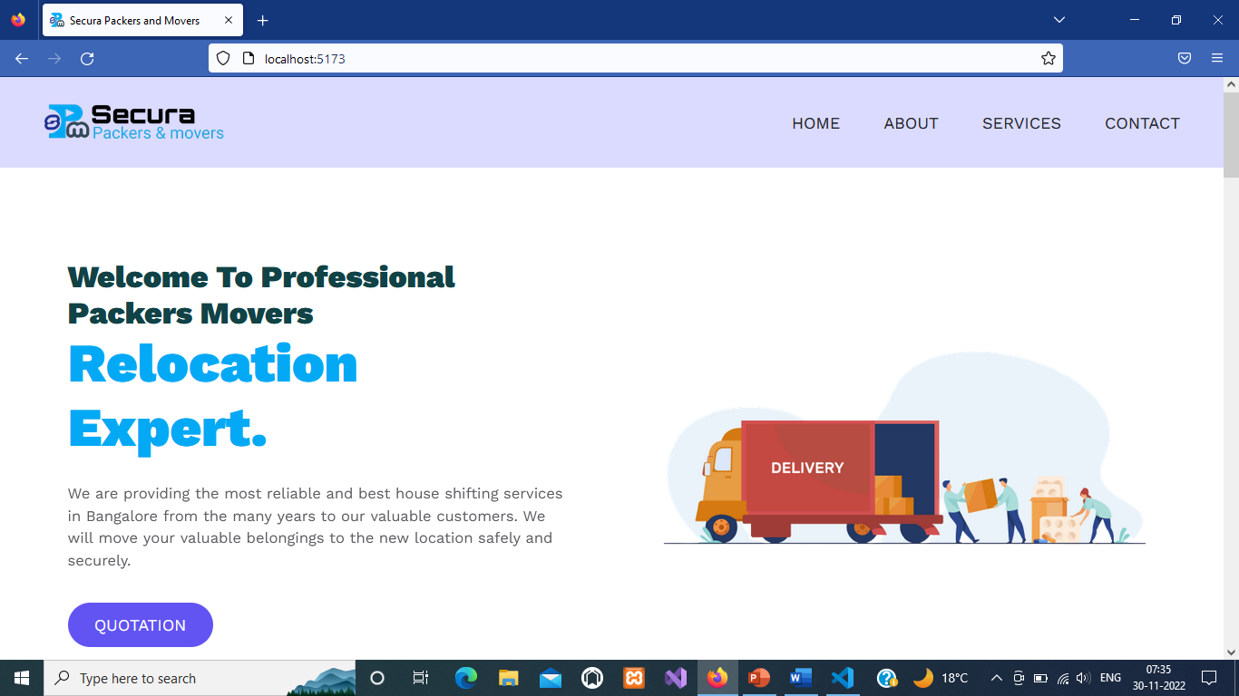
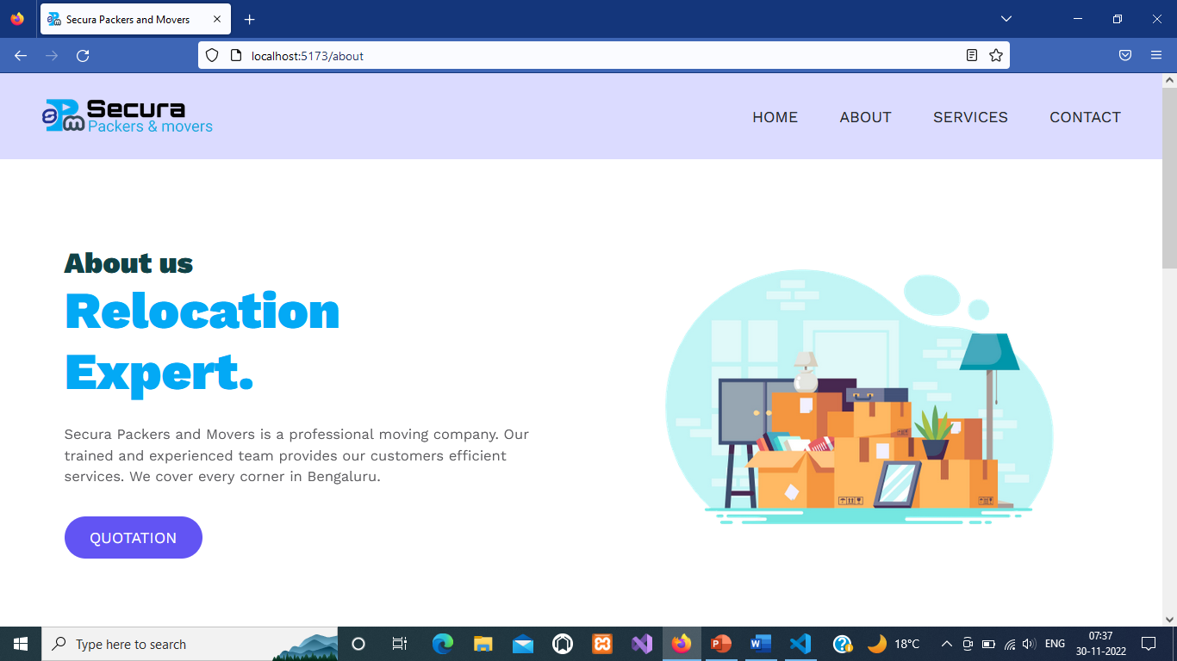
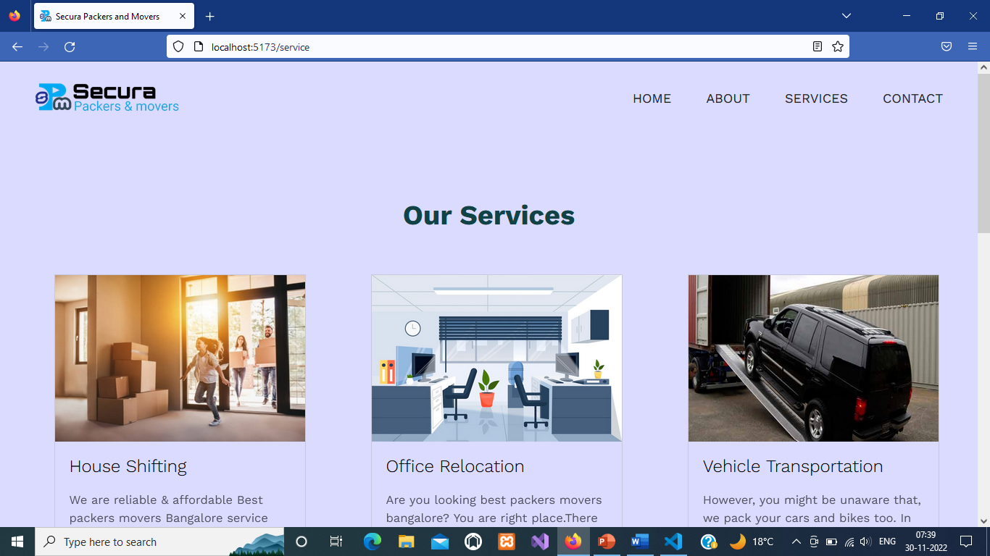
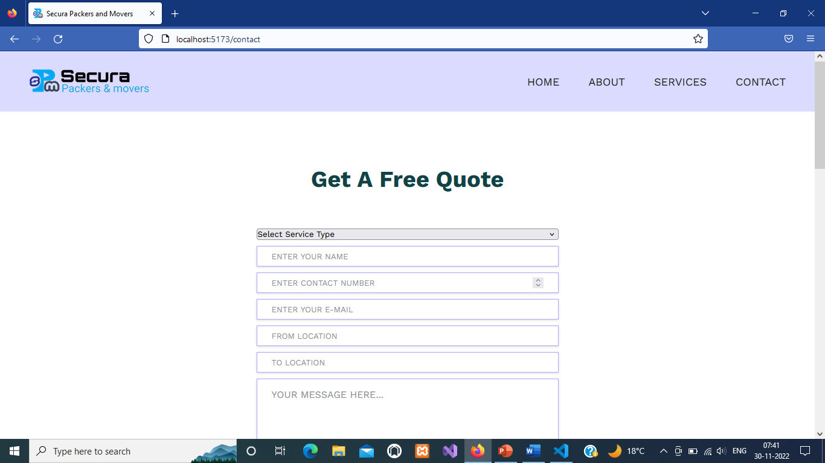
Project structure
Home page
About us page
Our services page
Contact page

Slide 10
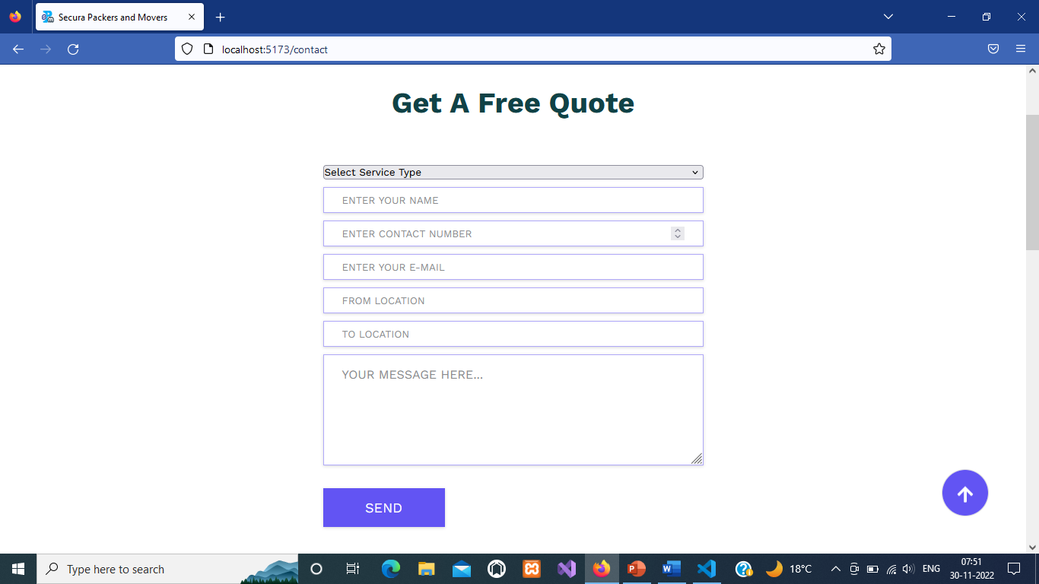
Quotation form

Slide 11
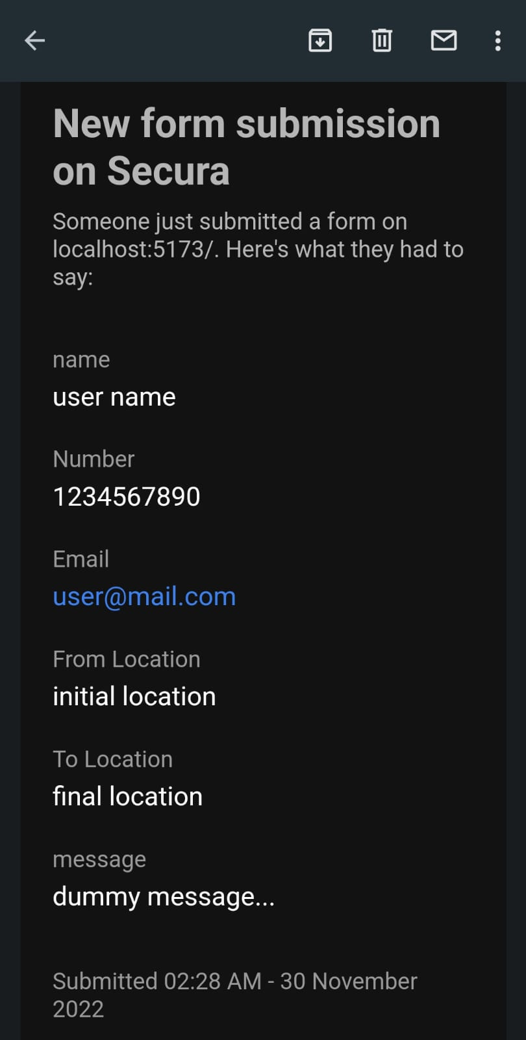
Form submission

Slide 12
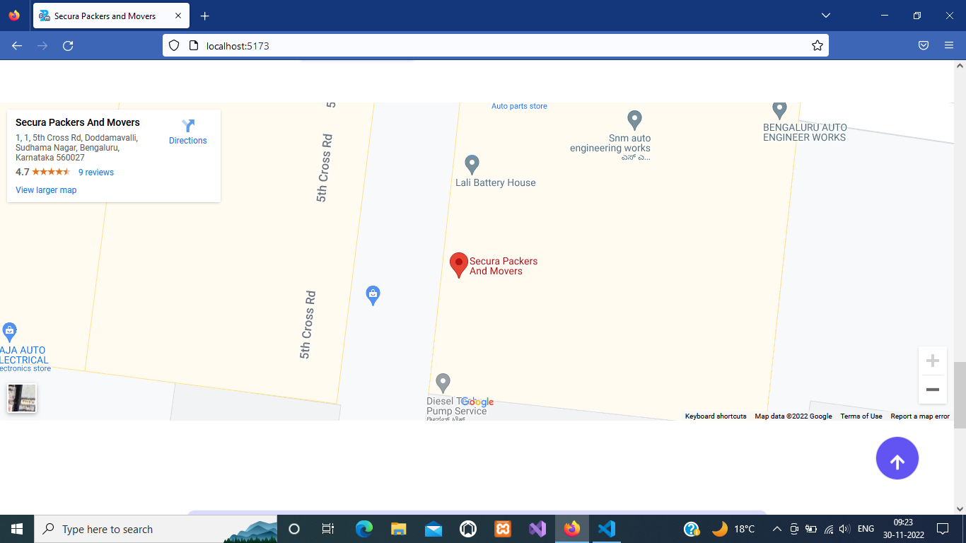
Office location

Slide 13
SUMMARY
The project was chosen to eliminate the limited reach
The website is being built using REACT.JS library with STYLED-COMPONENTS
Currently this has 4-pages that are providing required details to attract customers
It also contains a form that will be used by customers to share contact details
Adding testimonials section is our next priority in this project

Slide 14
THANK YOU

