Slide 1

ONLINE RETAIL STORE DATABASE/WAREHOUSE QUERYING SYSTEM REPORT
YOGESH PAREEK
104933189
SUPERVISOR : DR. CHRISTIE EZEIFE

Slide 2
CONTENT
INTRODUCTION
PROJECT OVERVIEW
TOOLS AND TECHNOLOGIES
ARCHITECTURE
SCHEMAS
TABLES

Slide 3
TOOLS AND TECHNLOGIES
FRONT END
HTML
CSS
JS
BACKEND
SQL
MYSQL
PHP

Slide 4
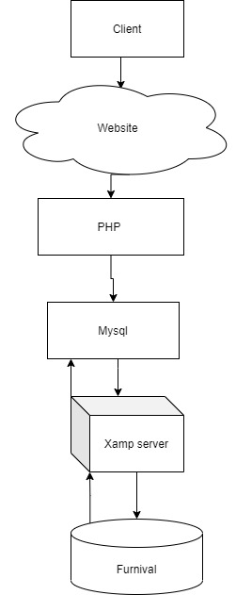
ARCHITECTURE

Slide 5
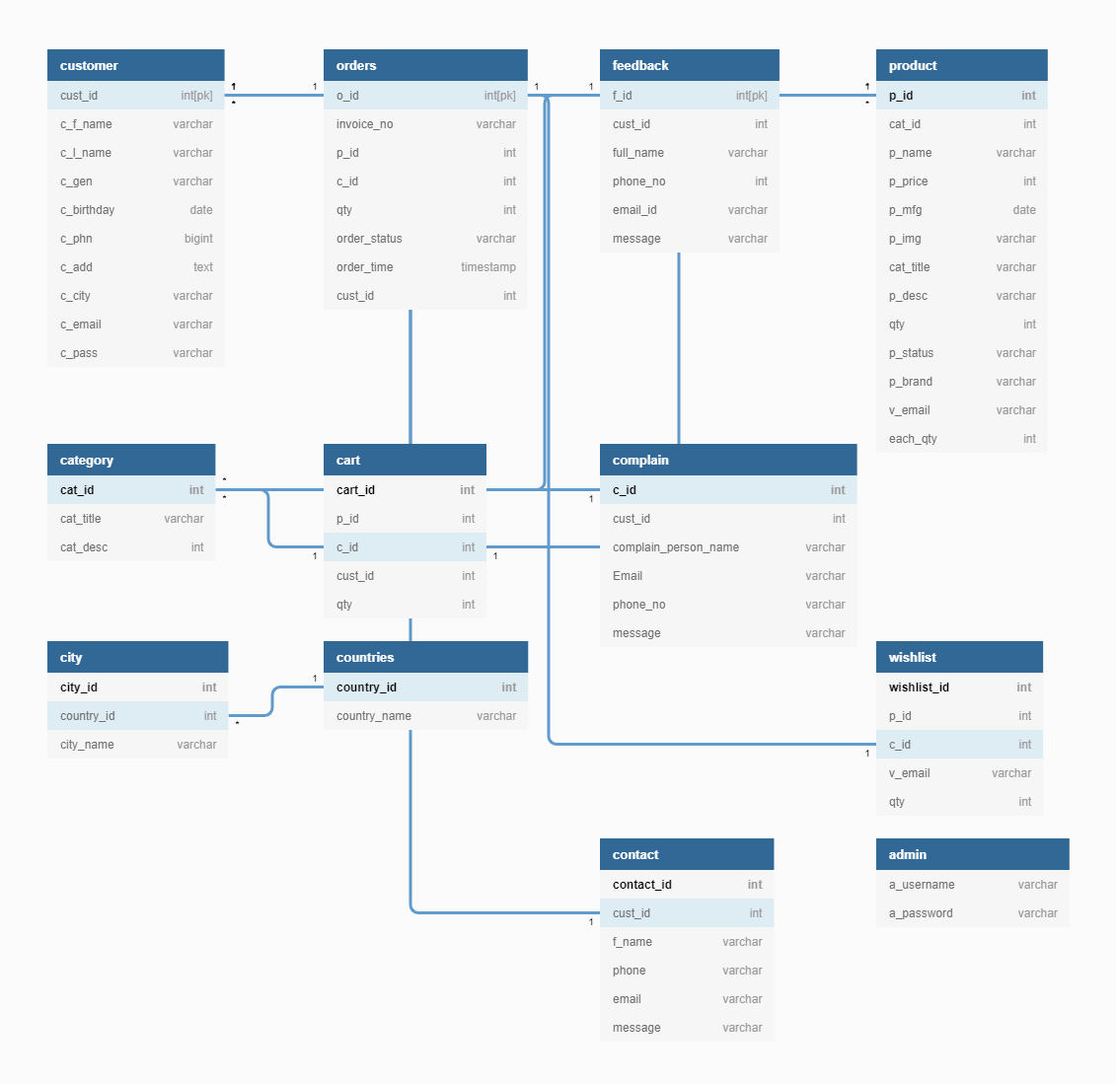
Schema-1

Slide 6
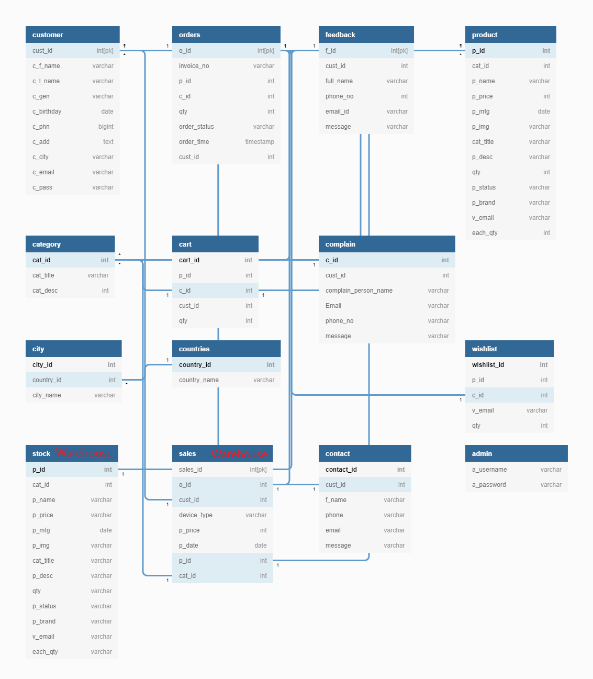
Schema-2

Slide 7
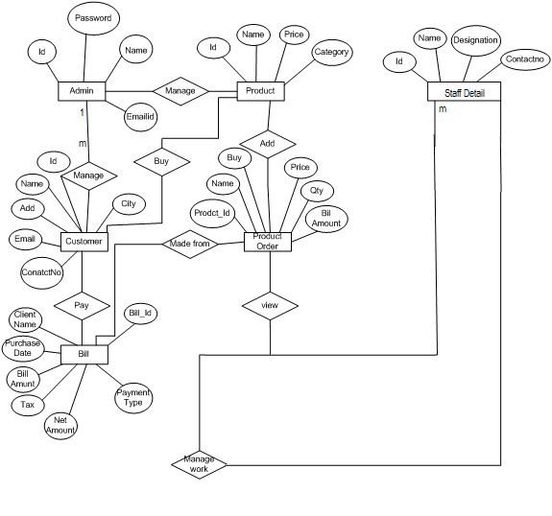
ER diagram

Slide 8
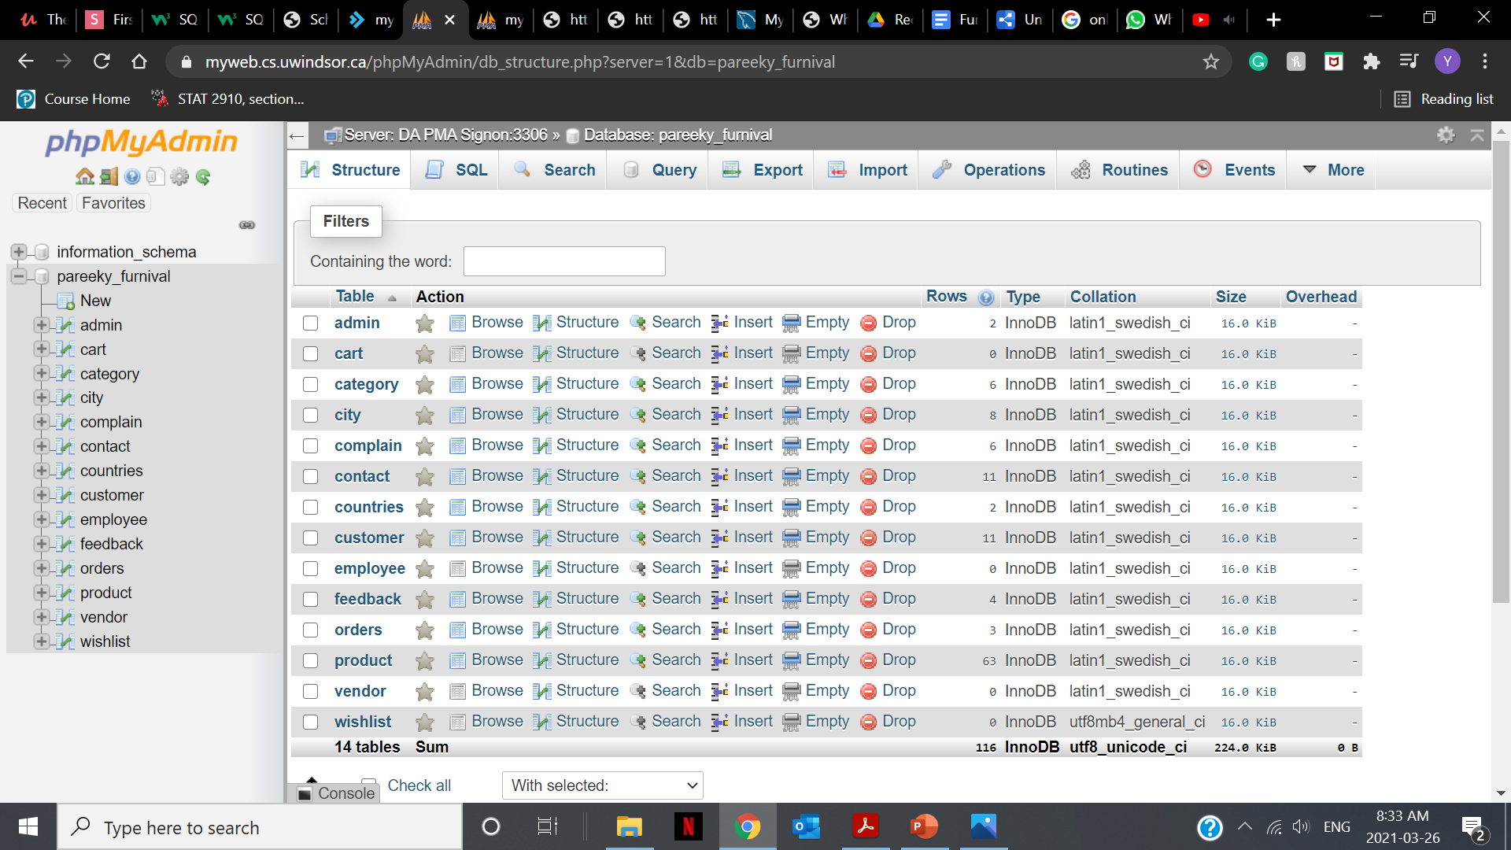
Database: Furnival

Slide 9
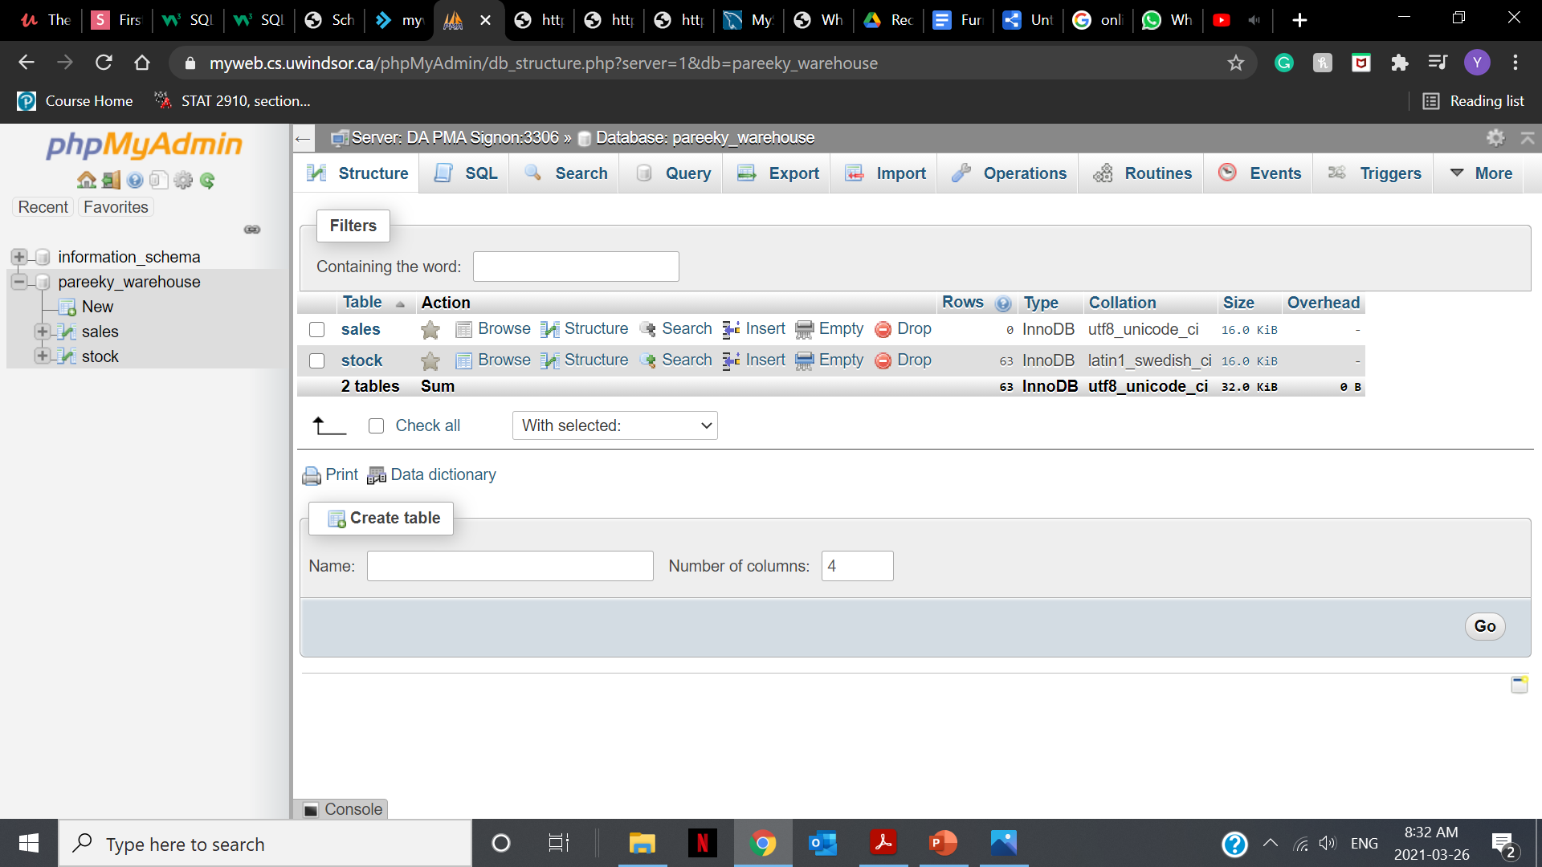
Database: Warehouse

Slide 10

SCREENSHOTS

Slide 11
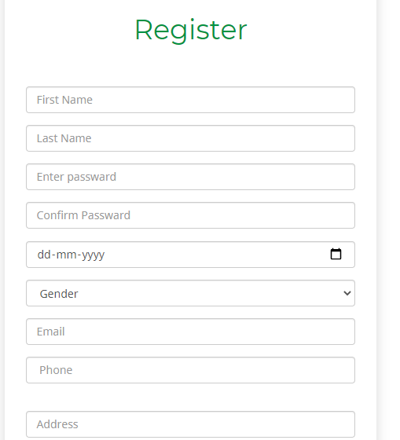

Slide 12
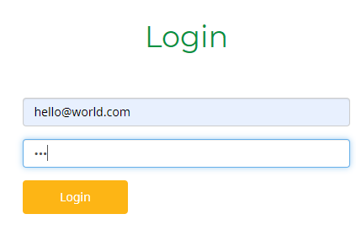

Slide 13
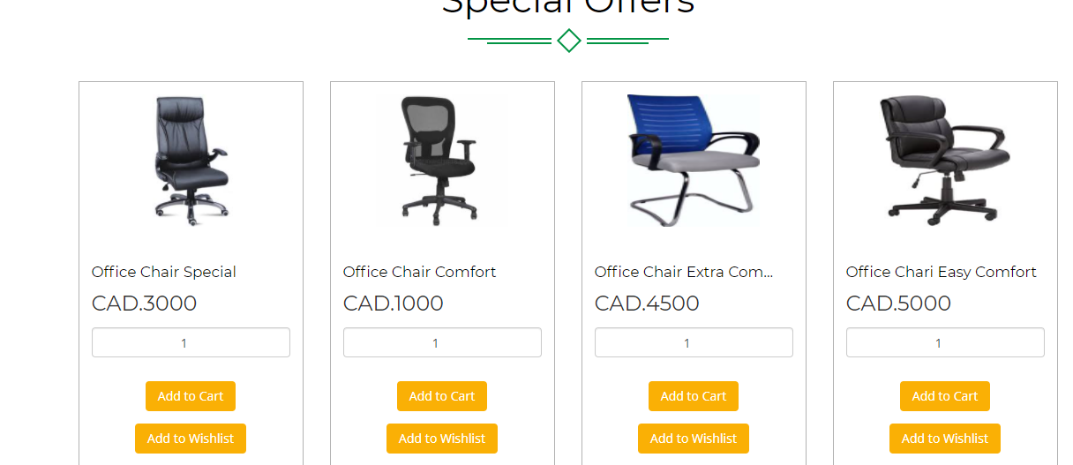

Slide 14
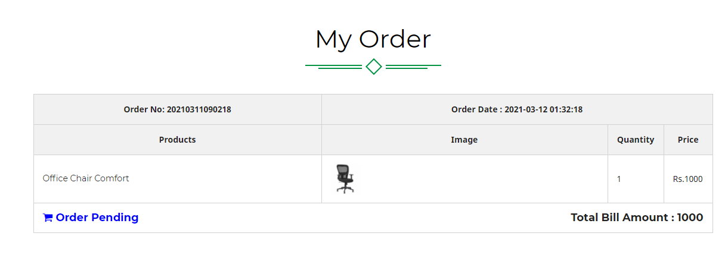

Slide 15
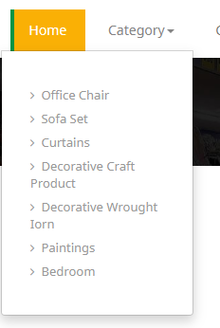

Slide 16
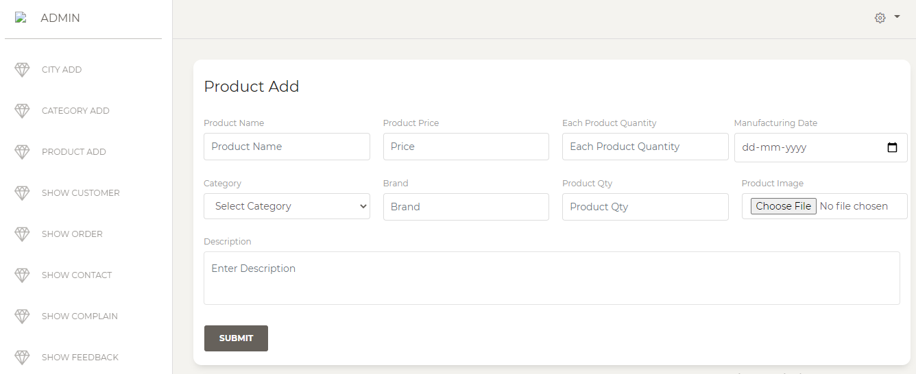

Slide 17
THANK YOU

