Slide 1

TAP · THE APPRENTICE PROGRAMME · YASHADA, PUNE
The Role of Technology
in Education
Shaping the future of Bharat
Yogesh Powar
CTO, InCred Money · 28 July 2026
CC BY-SA 4.0
Slide 1 / 10
Notes:
MAIN MESSAGE: Set the frame — this is a talk about technology, education and Bharat, told through one person's journey.
Open warmly: "Respected guests, dignitaries, fellow partners, teachers and students — good morning."
Say the title out loud. Pause on the word "Bharat" — that is the word the room should carry into the next ten minutes.
PAUSE 2 seconds before moving on.
TRANSITION: "Before I begin, a few words about who is standing in front of you."
TIMING: ~45 seconds.

Slide 2






INTRODUCTION
Where I come from
Kolhapur, then Sainik School, Satara
Where the discipline came from
OFF THE CLOCK
Marathon runner,
turned triathlete
IIT Bombay — MTech, Computer Science
Major in wireless networking
7.5 years in semiconductors
Yoga practitioner
and yoga teacher
Wireless technology, before the leap
2015: Orowealth → 2023: CTO, InCred Money
Built with hostel wingmates; acquired after seven years
CC BY-SA 4.0
Slide 2 / 10
Notes:
MAIN MESSAGE: Credibility, briefly — and a signal to the students that no path is a straight line.
Move fast down the timeline; do not read the sub-lines, they are for the audience's eyes.
EMPHASIS: "A couple of hostel wingmates and I started Orowealth in 2015. Seven years later it was acquired and became InCred Money."
The right-hand card is deliberate — mention the running and the yoga in one sentence. It tells students that a technology career is not the whole of a life.
TRANSITION: "Everything I do rests on three beliefs."
TIMING: ~60 seconds.

Slide 3



WHAT I STAND ON
Three things I believe
Potential
Choice
Advaita
Every single individual
has it.
You can always pick only
the good from what
surrounds you.
All in one,
and one in all.
CC BY-SA 4.0
Slide 3 / 10
Notes:
MAIN MESSAGE: My starting assumptions about people — everything after this follows from them.
Say each belief in your own words, one breath each. Do not elaborate on all three; pick ONE to expand — usually "Potential", because the room is full of apprentices.
EMPHASIS on Advaita: "all in one, and one in all" — say it slowly, then stop. PAUSE 2 seconds.
TRANSITION: "With that, let me come to the subject of today — the role of technology in education."
TIMING: ~60 seconds.

Slide 4

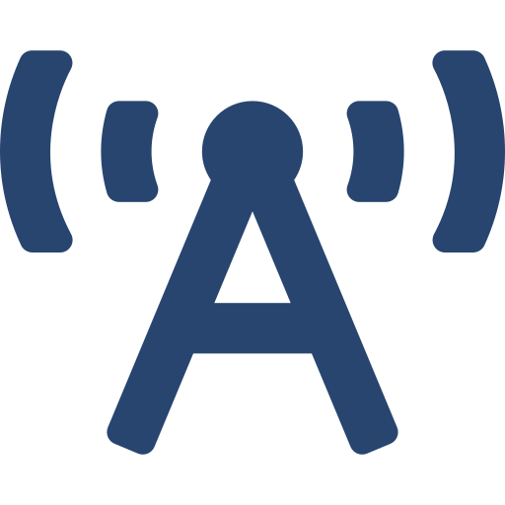




THE OPPORTUNITY
Every time technology reaches the masses,
disruption follows.
Printing
press
Radio
Television
Internet
Blockchain
AI
A breakthrough starts in very few hands. The disruption begins when it reaches everyone.
CC BY-SA 4.0
Slide 4 / 10
Notes:
MAIN MESSAGE: This is a pattern, not a novelty. AI is the newest entry in a very old list.
Walk the timeline with your hand, left to right, naming each one. Keep the pace quick — the audience already knows these.
STOP at AI. Let the size difference on the slide do the work. PAUSE.
EMPHASIS: "Every one of these was, at first, in very few hands. The disruption happened when it reached the masses."
TRANSITION: "Let me tell you what that spread did for one friend of mine."
TIMING: ~75 seconds.

Slide 5
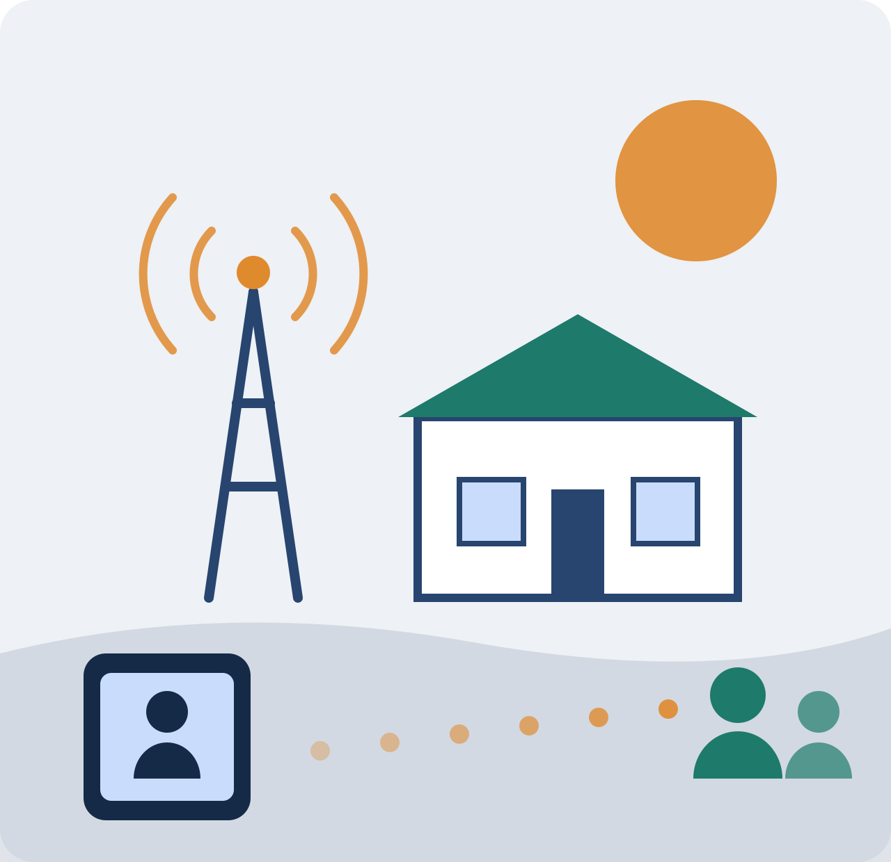
A STORY
The search for the next Ramanujan
1
Village by village
Logic tests for rural students,
one school at a time.
2
Then COVID
A sceptic of online learning
had no choice but to move to screens.
3
Reach multiplied
The same mission —
far more children than any road could reach.
None of it was possible without the internet and a handheld device — even in a remote village.
CC BY-SA 4.0
Slide 5 / 10
Notes:
MAIN MESSAGE: Technology did not replace the teacher. It multiplied his reach.
THE STORY — tell it, do not read it:
Dr Ravi G, my friend and colleague from IIT Bombay, believed the next Ramanujan would come from a rural village. So he went looking — driving to villages in Karnataka, giving logic tests, mentoring whoever shone.
Then COVID. Everything moved to screens. Ravi was VERY sceptical of online education. He went online anyway.
EMPHASIS: "That move expanded his programme to a base far bigger than he could ever have driven to."
PAUSE. Let the sceptic-changed-his-mind detail land.
TRANSITION: "I have my own, much smaller version of that story."
TIMING: ~90 seconds.

Slide 6


THE OPPORTUNITY, PERSONALLY
Learning keeps you in the game
20 YEARS AGO
THIS YEAR
An online course in finance
Sanskrit, online
An engineer with no grounding
in the foundations of money.
It became my bridge into fintech.
Late-evening classes, built around
working professionals.
Proctored online exams — so the
certificate actually means something.
As they say — always learning new things keeps you in the game.
CC BY-SA 4.0
Slide 6 / 10
Notes:
MAIN MESSAGE: Online learning is not only for children in villages — it changed my own career, twice.
Left card: the honest admission. "I am an engineer. I always felt the gap of not knowing the foundations of finance." One course, twenty years ago, is why I am standing here as a fintech CTO.
Right card: Sanskrit — recent, and personal. The detail that matters is WHY it worked: late-evening timing built for working adults, and proctoring credible enough that the certificate means something.
Look at the students when you say the closing line.
TRANSITION: Change of tone here. "Just as there is a bright side, there is a darker side too." Slow down. Drop your voice.
TIMING: ~75 seconds.

Slide 7
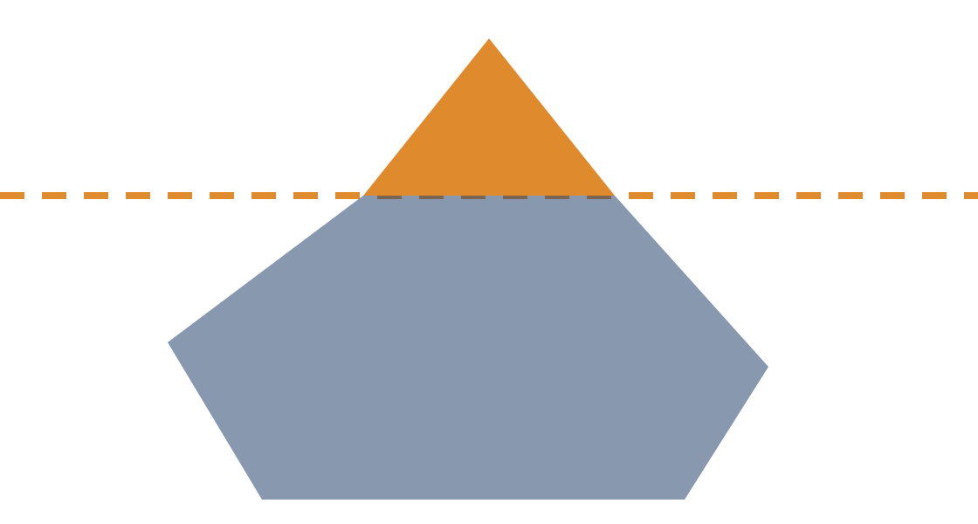


THE RESPONSIBILITY
You can see smoke. You can see blood.
You cannot see this.
Physical harm
SEEN
You see it the moment it happens,
and you react.
UNSEEN
Digital harm
By the time the damage shows,
the addiction is already deep.
And it is not only children. Parents and elders fall to it too.
CC BY-SA 4.0
Slide 7 / 10
Notes:
MAIN MESSAGE: Digital harm is real harm — it is simply invisible, so we catch it late.
These devices and apps are addictive by design, and they sit alongside dozens of other apps competing for the same attention.
EMPHASIS, slowly: "Unlike physical harm, where you see smoke or blood, digital harm is invisible. By the time we notice the damage, the addiction is already deep."
You may, if you are comfortable, mention that people in your own extended family and circle of friends have been treated for this — and that it is tough. Keep it brief and respectful; no names. This is the most serious moment of the talk.
PAUSE 3 seconds.
TRANSITION: "And behind the addiction sits a business model."
TIMING: ~75 seconds.

Slide 8

THE RESPONSIBILITY
Power's true nature is to centralise
Free to use
Your data
Patterns
Targeting
Influence
It begins free — to gather data and learn your patterns. It ends with a handful of companies able to shape what you think.
A monopoly is not only an economic problem. In education, it decides what a child is allowed to see.
CC BY-SA 4.0
Slide 8 / 10
Notes:
MAIN MESSAGE: The model is not an accident — free access is the entry point, not the product.
Walk the chevrons left to right with your hand. Name each one; do not explain each one.
EMPHASIS: "Because power's true nature is to centralise, a very few Big Tech companies control the entire show. It is, effectively, a monopoly."
The last step — Influence — is the one to sit on: algorithms targeting individuals, and at the far end, manipulating thoughts and steering groups.
The grey bar at the bottom is your bridge to education specifically. Say it plainly.
TRANSITION: "So what do we do? There is no single answer."
TIMING: ~70 seconds.

Slide 9


THE WAY FORWARD
No single answer. But there are directions.
Free & open-source in schools
Digital boundaries at home
Teach and use GNU/Linux.
By its licence — not by permission —
open to study, modify and share.
Guide the boundaries.
Watch the usage of devices.
Until the maturity to navigate
safely has actually arrived.
AI is the biggest elephant in the room. Its challenges are harder — and the solutions will be harder still.
CC BY-SA 4.0
Slide 9 / 10
Notes:
MAIN MESSAGE: There is no one-size-fits-all fix — but there are two directions worth taking seriously.
Left: open source. Say the licence line clearly — "open to study, to modify, and to share." For an apprentice audience this is also a career door, not just a philosophy.
Right: digital boundaries. Frame it as guidance, not surveillance — "until they develop the maturity to navigate it safely."
Then point at the dark bar: AI. Name it as the elephant in the room and admit openly that the solutions are not yet known. Honesty lands better than false certainty here.
TRANSITION: "Technology will keep changing. What we owe the next generation is something that does not."
TIMING: ~70 seconds.

Slide 10

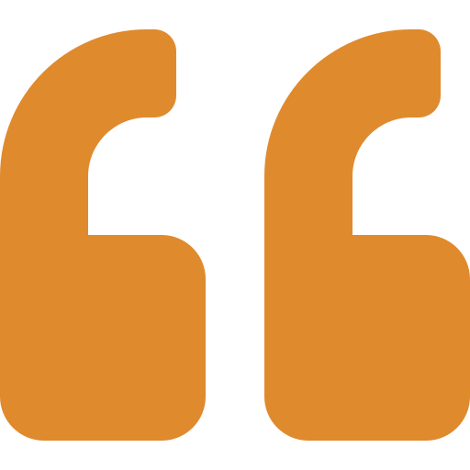
TECHNOLOGY
CHARACTER
gives skills
gives wisdom
Education is not the amount of information that is put into your brain and runs riot there, undigested, all your life.
We must have life-building, man-making,
character-making, assimilation of ideas.
— Swami Vivekananda
Thank you. Yogesh Powar · CTO, InCred Money
CC BY-SA 4.0
Slide 10 / 10
Notes:
MAIN MESSAGE: Technology can hand our youth skills. Only character-building education gives them wisdom.
Deliver the bridge line first, in your own voice: "Technology keeps changing. We must prepare the new generation of Bharat for problems of tomorrow that we have not yet seen."
Then the balance line at the top of the slide — say it as one sentence: "Technology can give our youth skills, but only character-building education will give them wisdom."
PAUSE.
Read the Vivekananda quote slowly. Do not rush the second half — "life-building, man-making, character-making, assimilation of ideas" — four beats, one at a time.
PAUSE 3 seconds. Then: "Thank you."
TIMING: ~80 seconds. Total deck: ~11-12 minutes at an unhurried pace.

