Slide 1
Introduction to
Integral Yoga
of
Sri Aurobindo
Presented by
Shri Yogesh Ashok Powar
YIC Batch Feb 2024
V1.0

Slide 2
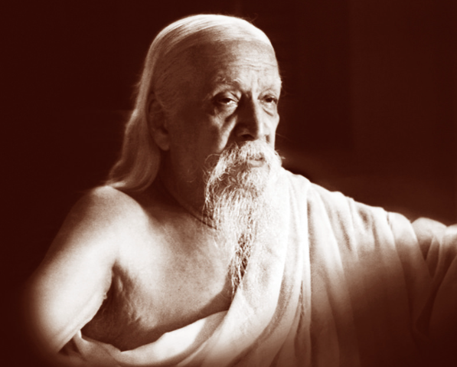
All life is Yoga
Source: 2.1

Slide 3
Sri Aurobindo
15 August 1872 – 5 December 1950
Philosopher, yogi, maharishi, poet, and Indian nationalist
Journalist, editing newspapers such as Bande Mataram
Aurobindo studied for the Indian Civil Service at King's College, in Cambridge, England.
Civil service works under the Maharaja of the princely state of Baroda
Involved in nationalist politics in the Indian National Congress
He was arrested for bombings linked to his organization Alipore Conspiracy.
During his stay in the jail, he had mystical and spiritual experiences
At Pondicherry, Sri Aurobindo developed a spiritual practice he called Integral Yoga.
Nominated twice for the Nobel prize, 1943 for the Nobel award in Literature and in 1950 for the Nobel award in Peace.
His main literary works are The Life Divine, which deals with the philosophical aspect of Integral Yoga
Synthesis of Yoga, which deals with the principles and methods of Integral Yoga
A Yogi can do Anything
Sources: 2.3, 3.1

Slide 4
Three Folds of Life
Spritual
Unchanging
East
Physical
Mental
Active & Progressive
Spiral
Rigid
Works in cycles
West

Slide 5
Existing Systems of Yoga
Yog does something seems impossible at the beginning.
But have problems
  Loads our natural human life under the load of machinary to purchase certain form of freedom.
  Mastery at the price of increased servitude
  Draws away from the common existance
If he gains god, he loose life, if he holds life he looses god.
Sources: 1.1

Slide 6
Synthesis of Yoga
Human crisis are many side, so does solution should also be many sided. Hence Synthesis.
Not by merely picking the best from each school of yoga.
Or not by practicing each successively.
But by merging the central principals common to all the system.

Slide 7
Aim Of Integral Yoga
“The passage from the lower to the higher is the aim of Yoga; and this passage may effect itself by the rejection of the lower and escape into the higher, — the ordinary view-point, — or by the transformation of the lower and its elevation to the higher Nature. It is this, rather, that must be the aim of an integral Yoga.”
The synthesis of Yoga, Page 45

Slide 8
Levels of Being
Supermind
Spiritual
Involution
Evolution
Mental
Mental
Physical
Physical

Slide 9
Types of Being
Mental
Outer Being
Vital
Psychicisation
1. Consecration
2. Concentration
3. Surrender
Physical
Inner Being
Surface Consciousness
Inner Consciousness
Psychic Being
Evolving Soul,
Divine Spirit in Individual

Slide 10
Three Stage of Integral Yoga
Contact with the Divine
Preparation for whole lower nature to become higher nature
Transformation

Slide 11
Not just for Individual
“We have to recognise once more that the individual exists
not in himself alone but in the collectivity and that individual
perfection and liberation are not the whole sense of God’s inten-
tion in the world. The free use of our liberty includes also the
liberation of others and of mankind; the perfect utility of our
perfection is, having realised in ourselves the divine symbol, to
reproduce, multiply and ultimately universalise it in others.”
- [The Sythesis of Yoga, Page 29]

Slide 12
Referrences
Book The Synthesis of Yoga by Sri Aurobindo
Websites
  https://en.wikipedia.org/wiki/Integral_yoga
  https://aurosociety.org/
  https://en.wikipedia.org/wiki/Sri_Aurobindo
Youtube
  Sri Aurobindo & the Earth's Future - Part I : From Darkness to Light https://youtu.be/47yhMAAjRyM
  Integral Yoga - Sri Aurobindo https://youtu.be/uq6CKMU4JXA
  Evolution Fast-forward - Part 2 - Integral Yoga of Sri Aurobindo https://youtu.be/1tFtHPA87ZM
  Integral Yoga: An Introduction to Principles, Theory and Practice (TE 444) https://youtu.be/gRzZ3iDWcvc

Slide 13
License under CC0
This work is dedicated to the public domain under the Creative Commons Zero (CC0) license.
To the extent possible under law, Shri Yogesh Ashok Powar has waived all copyright and related or neighboring rights to this work. This work is published from: India.
You can copy, modify, distribute, and perform the work, even for commercial purposes, all without asking permission.
For more information, see https://creativecommons.org/publicdomain/zero/1.0/

