Slide 1
Machine Learning Final Project
The objective of this project is to analyze New York City property sales data using Exploratory Data Analysis (EDA) and Machine Learning techniques to:
Analyze NYC property sales dataset
Perform EDA to identify trends and outliers
Study relationship between features and sale price
Build a machine learning model to predict property sale price

Slide 2
Dataset Description & Model Selection
The dataset consists of New York City property sales records, containing information about properties sold across five boroughs:
Manhattan (1)
Bronx (2)
Brooklyn (3)
Queens (4)
Staten Island (5)
Each record includes the following key attributes:
Property location and address
Borough and tax class
Building type
Sale price
Sale date
The dataset is used to analyze real estate trends and to predict property sale prices based on historical data.

Slide 3
Load Data and Initial Overview
DataFrame shape: 2018049 rows, 21 columns
Filter Data for Last 5 Years:
Most recent sale date: 2022-12-31 00:00:00
Date 5 years prior to most recent sale: 2017-12-31 00:00:00
Shape of DataFrame after filtering for last 5 years: (428248, 21)

Slide 4
Data Cleaning and Preprocessing
Stripped whitespace from column names.
Dropped 0 rows with NaT in 'SALE DATE'. Remaining rows: 428248
Dropped 162550 rows where 'SALE PRICE' was 0. Remaining rows: 300589
Dropped 'EASE-MENT' column.
Dropped 110597 rows with NaN in critical numerical columns. Remaining rows: 190001

Slide 5
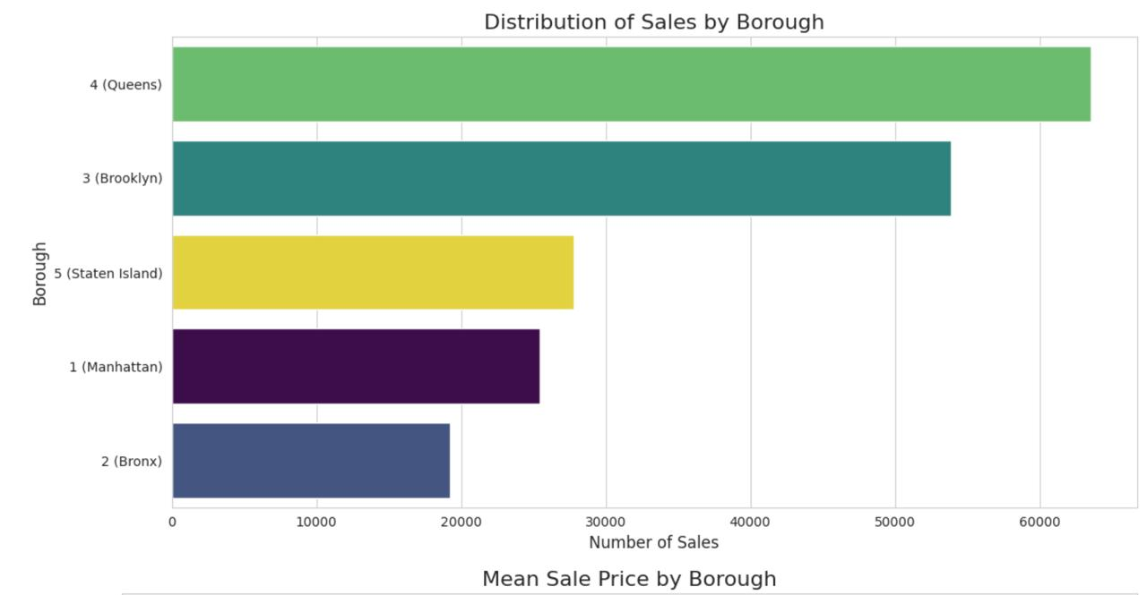
Exploratory Data Analysis

Slide 6
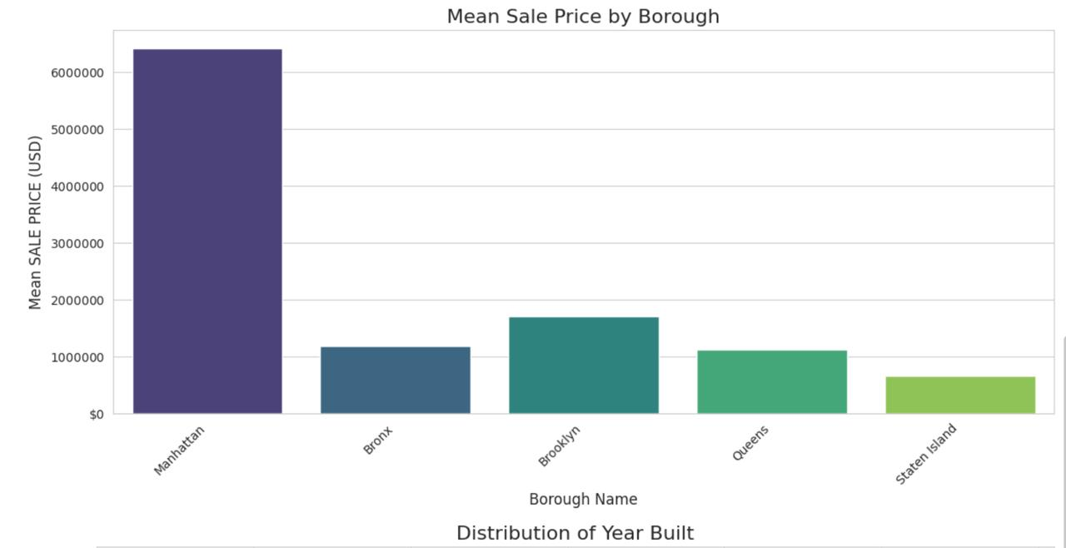
Exploratory Data Analysis

Slide 7
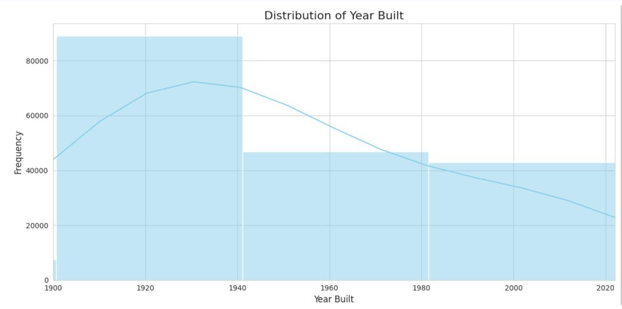
Exploratory Data Analysis

Slide 8
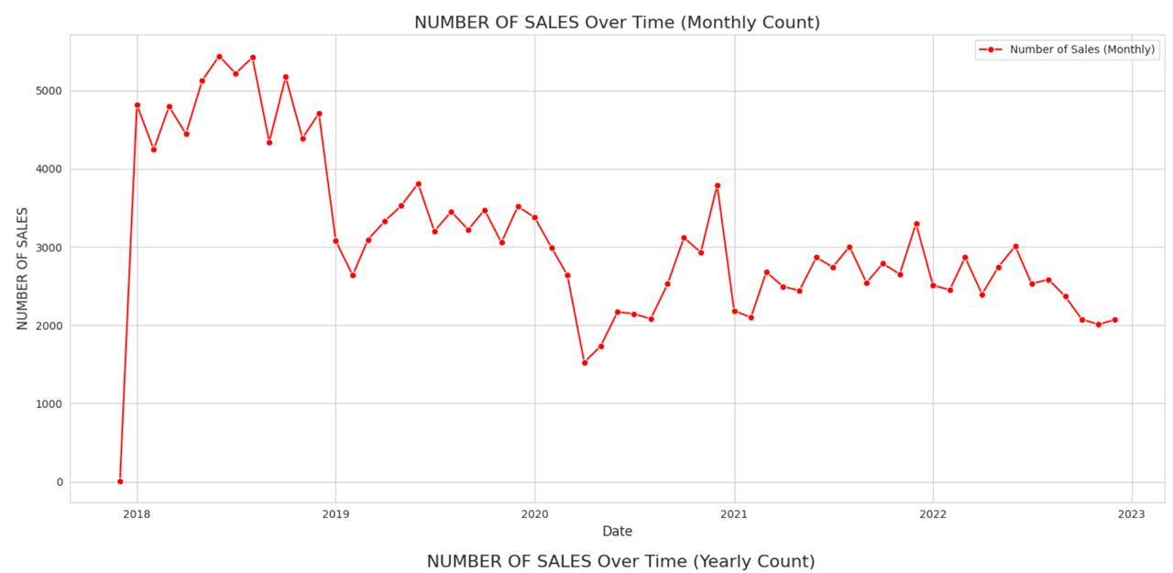
Time Series Analysis of Sales

Slide 9
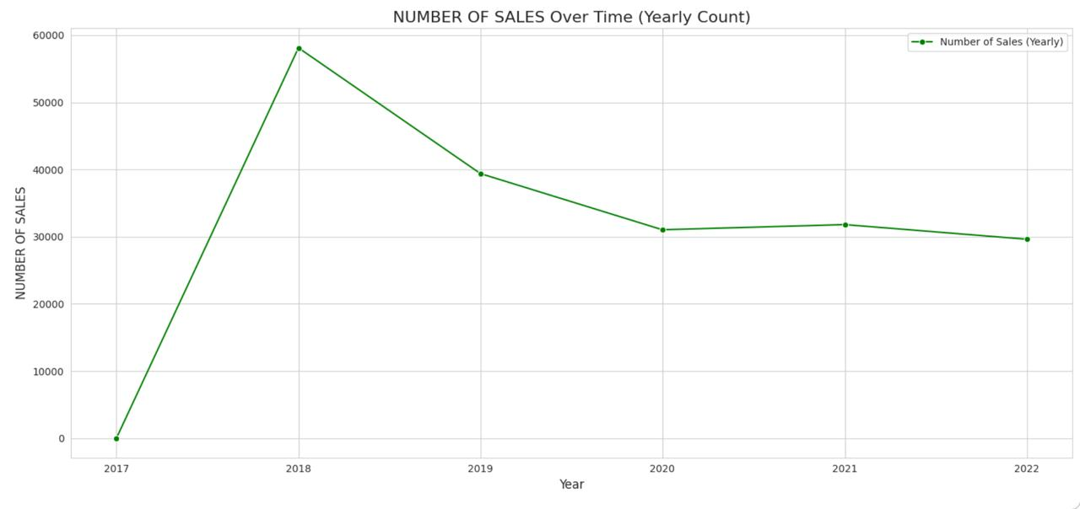
Time Series Analysis of Sales

Slide 10
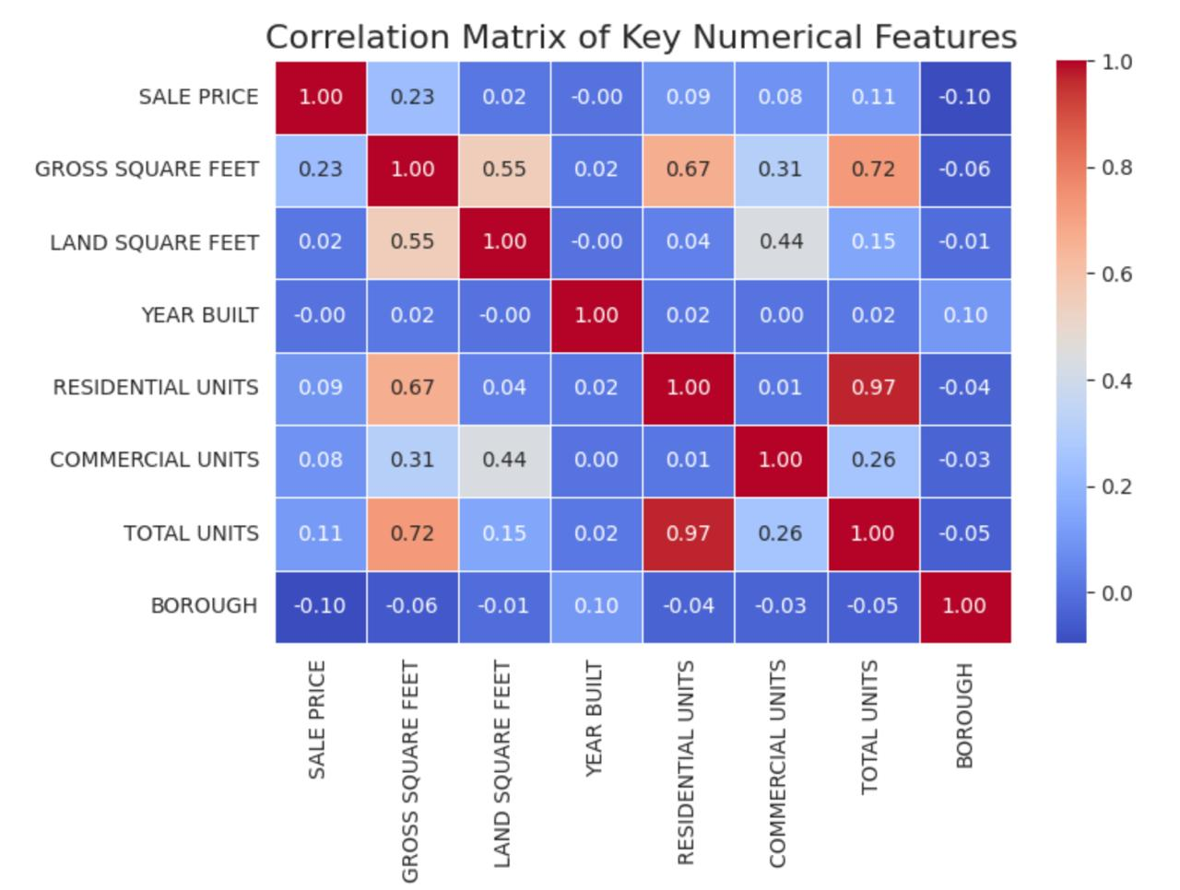
Feature Correlation with Sale Price

Slide 11
Feature Engineering
New features 'PRICE_PER_SQFT' and 'AGE_OF_BUILDING' created and cleaned.
Categorical features one-hot encoded.
'BOROUGH_NAME_’,
‘TAX CLASS AT TIME OF SALE_’,
‘BUILDING CLASS CATEGORY_’,
‘ZIP CODE_
Sale_Date used to create Sale_Year, Sale_Month

Slide 12
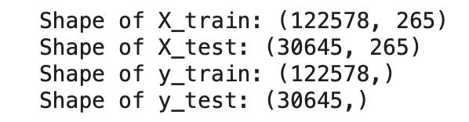
Prepare Data for Modeling
Machine Learning Models used:
Linear Regression
Decision Tree
Random Forest
Gradient Boosting Regressor

Slide 13
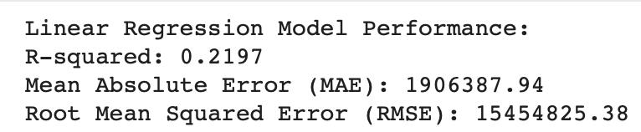
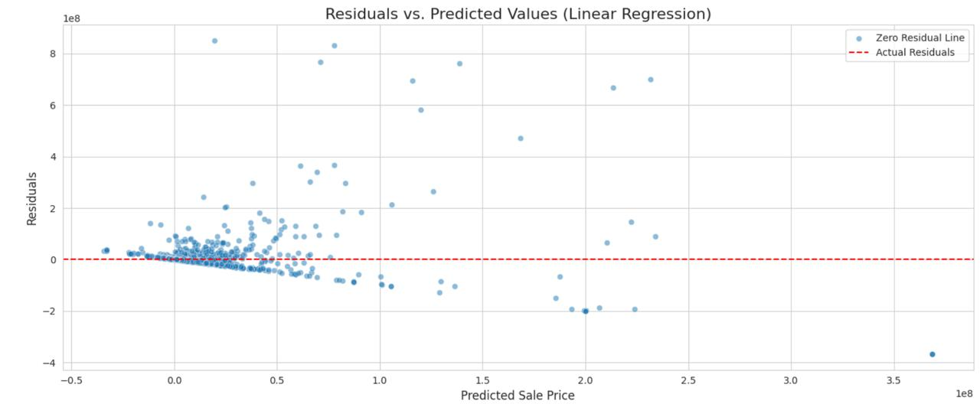
Train and Evaluate Linear Regression Model

Slide 14
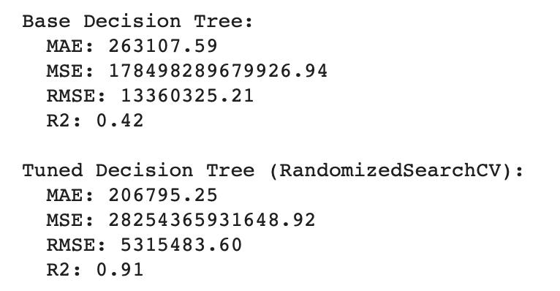
Train and Evaluate Decision Tree Models

Slide 15
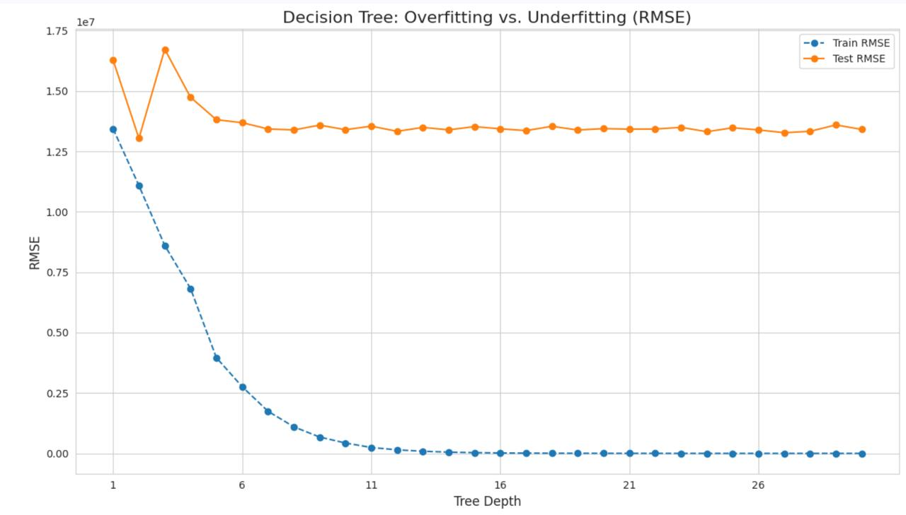
Train and Evaluate Decision Tree Models

Slide 16
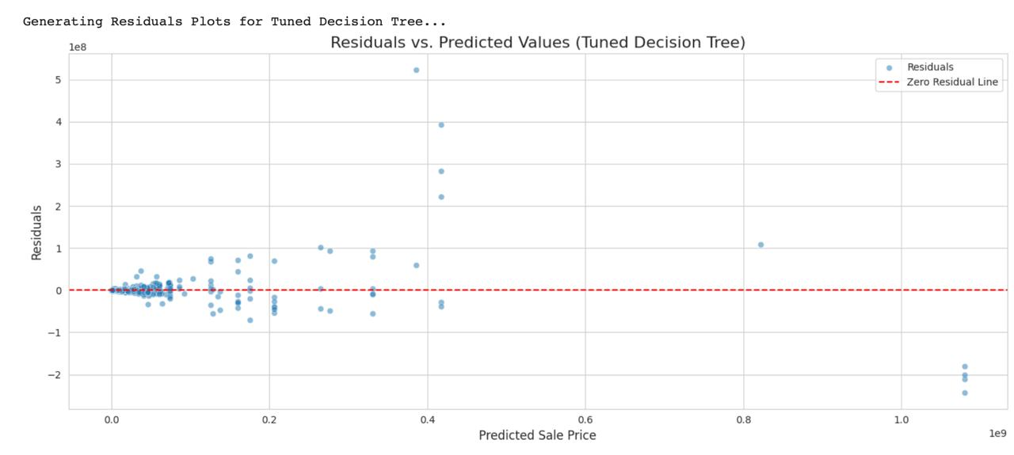
Train and Evaluate Decision Tree Models

Slide 17
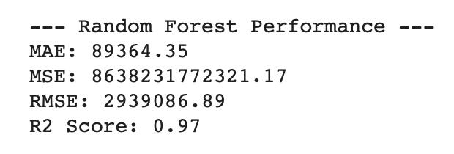
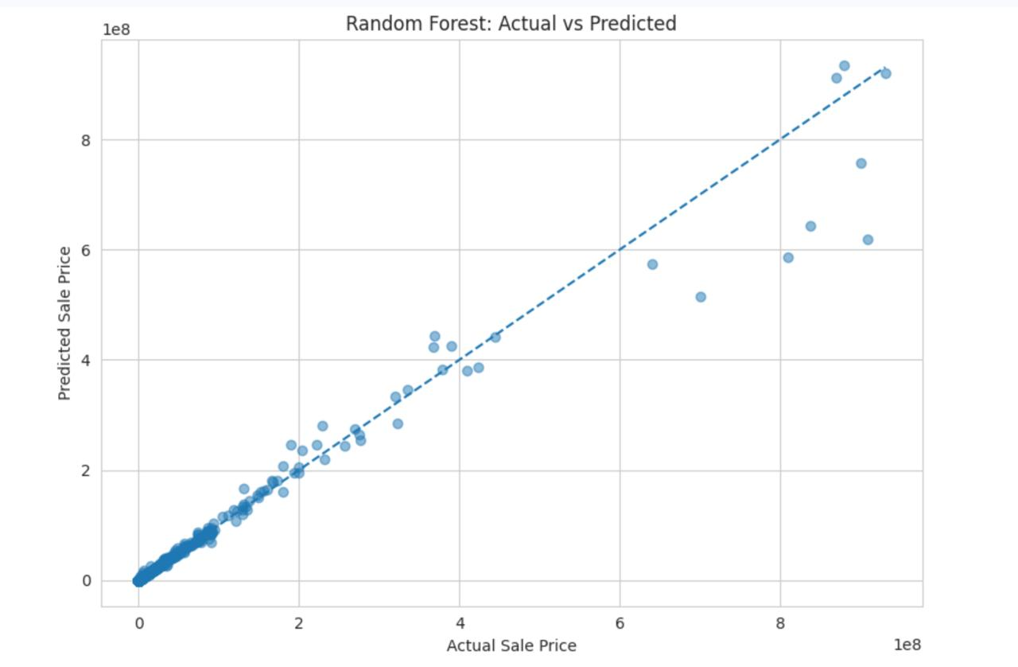
Train and Evaluate Random Forest Regressor Model

Slide 18
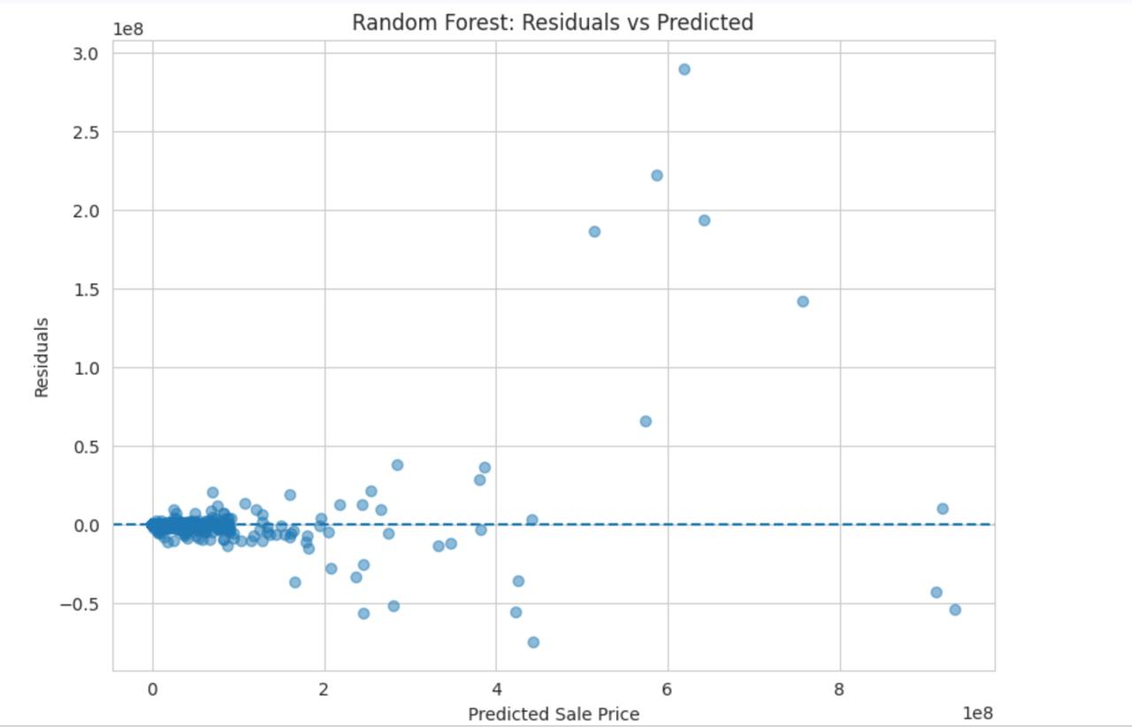
Train and Evaluate Random Forest Regressor Model

Slide 19
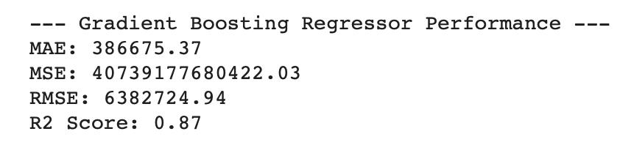
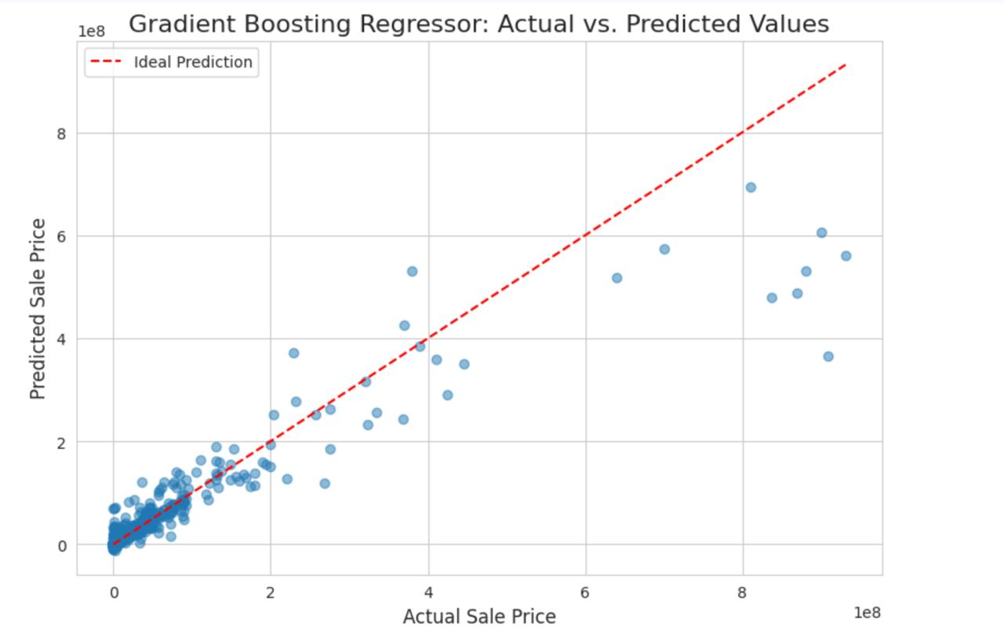
Train and Evaluate Gradient Boosting Regressor Model

Slide 20
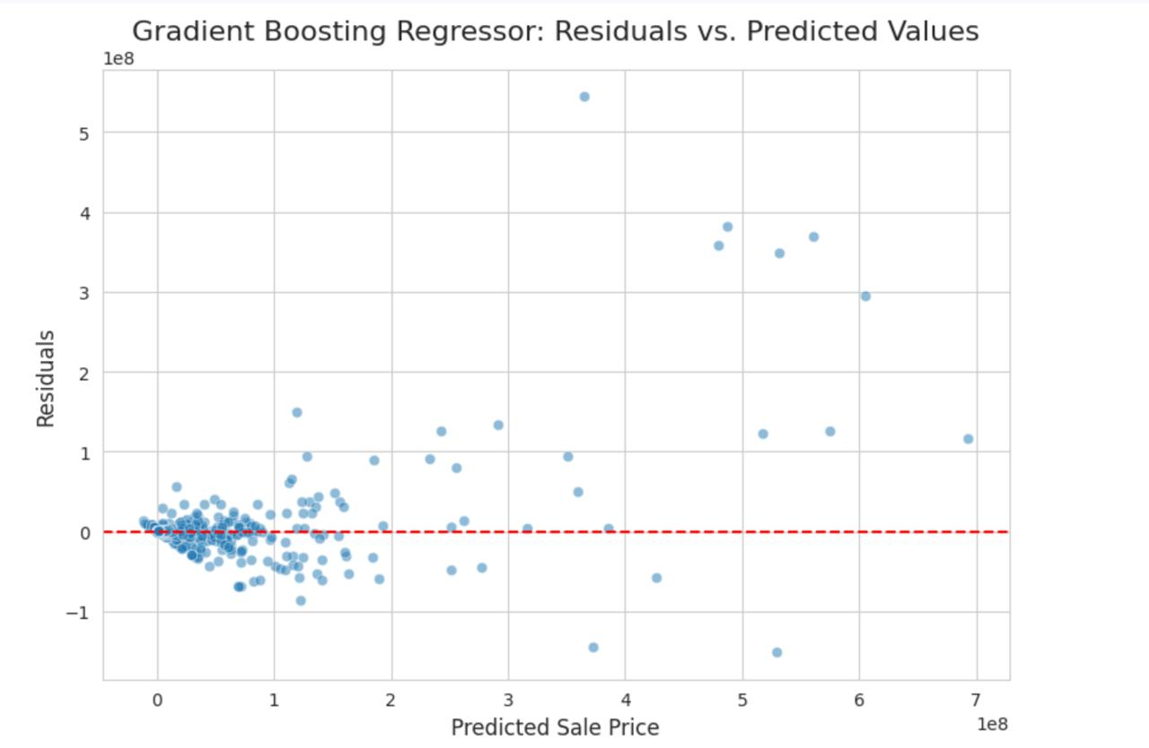
Train and Evaluate Gradient Boosting Regressor Model

Slide 21
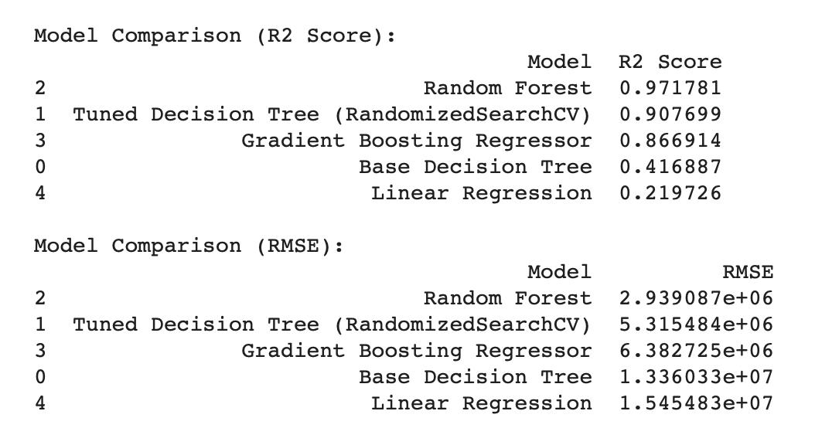
Model Comparison and Summary

Slide 22
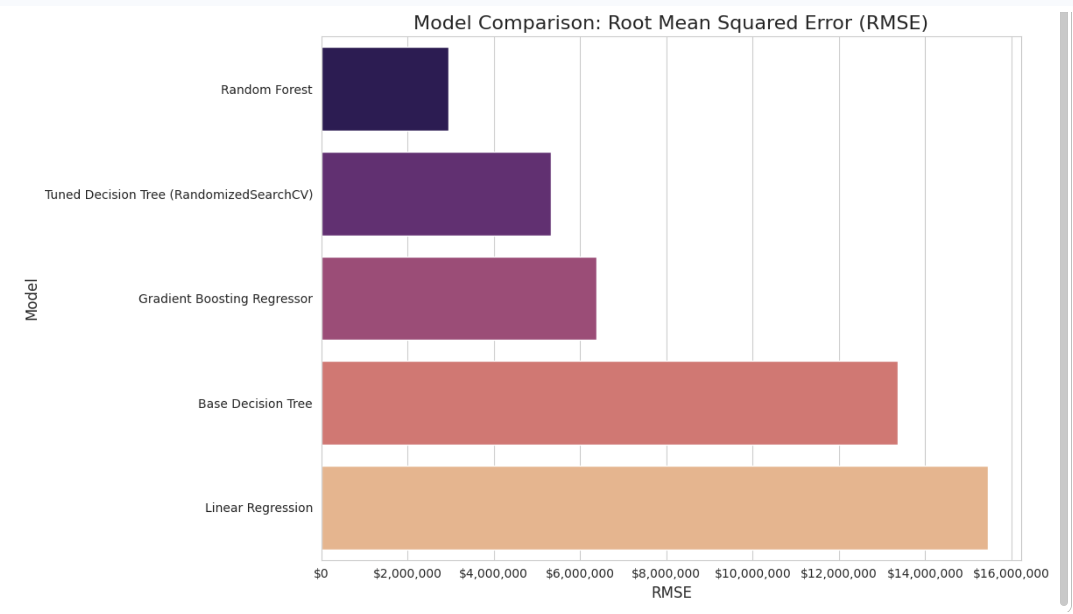
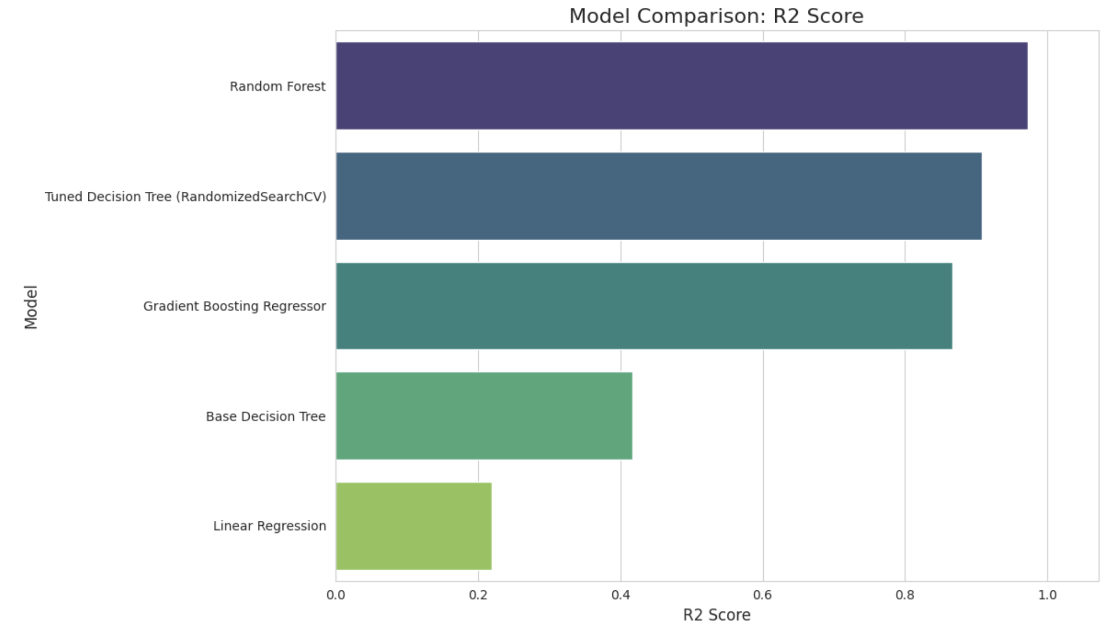
Model Comparison and Summary

Slide 23
Conclusion
This project successfully navigated through the stages of data loading, cleaning, EDA, feature engineering, and machine learning model development to predict NYC property sales prices. The comprehensive analysis provided valuable insights into the factors influencing property values in New York City.

Slide 24
Thank You!

