Slide 1
Splines
A Concept beyond Linearity

Slide 2
AGENDA
About dataset and R packages
Polynomial Regression
Step-wise regression
Natural Splines
Smoothening Splines
Local Regression
Generalized Additive Models

Slide 3
Dataset and Packages
Packages:
  ISLR
  splines
  gam
Dataset
  Auto - ISLR package
  Auto data set has information about Gas Mileage, Horsepower, displacement and other information for 392 vehicles. In short it has 392 records and 9 variables.

Slide 4
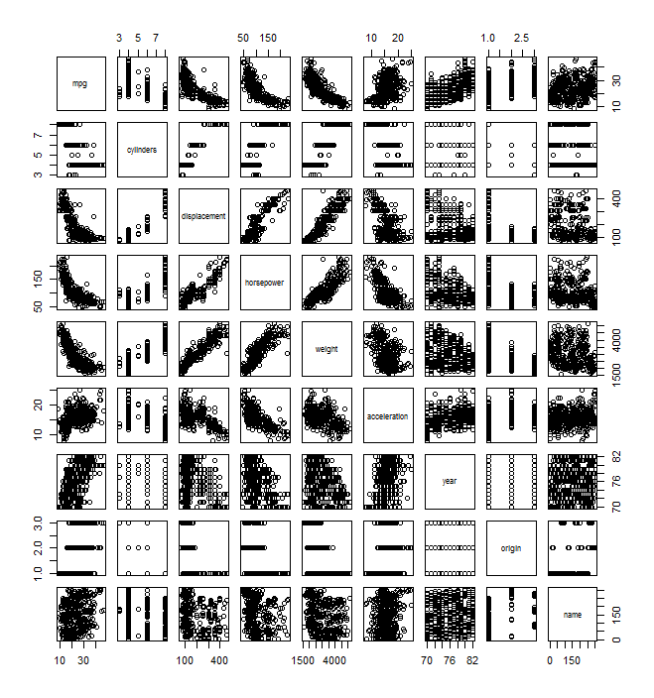
Exploratory Data Analysis
To check how data is spread with respect to dependent variable mpg
Displacement, horsepower and weight show a trend which may be linear. Or Not ?
Examining further with displacement and mpg

Slide 5
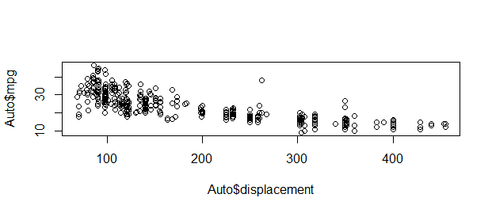
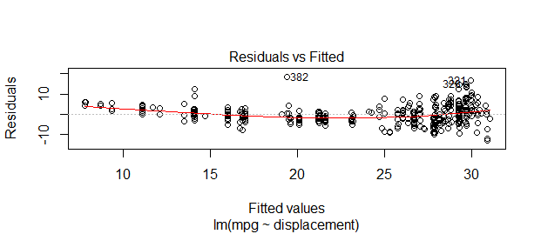
Displacement Vs Miles per gallon
Scatter plot
Residual plot of Linear fit
There is something beyond linearity here

Slide 6
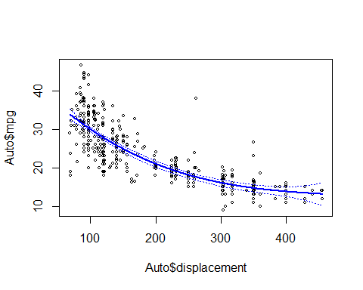
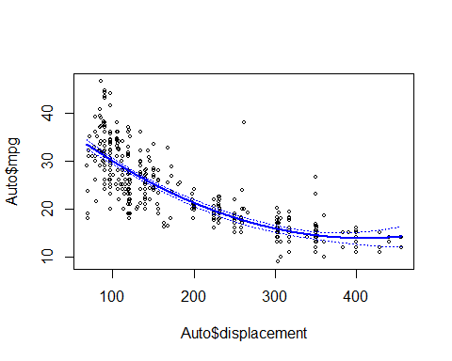
Polynomial Regression
Degree 2
Degree 3
R square : 0.64
R square : 0.68
For large values of d, the polynomial curve can become overly flexible and can take on some very strange shapes.
This is especially true near the boundary of the X variable.

Slide 7
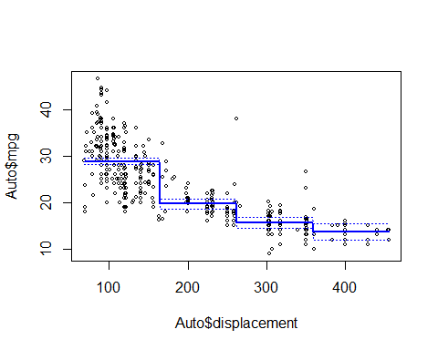
Piece wise Linear Model
Split the region into K parts
Fit a linear model for each part
R-Square = 0.60
Problem: Normality and Homoscedasticity assumptions fail
lm(mpg~cut(displacement,4))
Step Function: Piece wise linear model

Slide 8
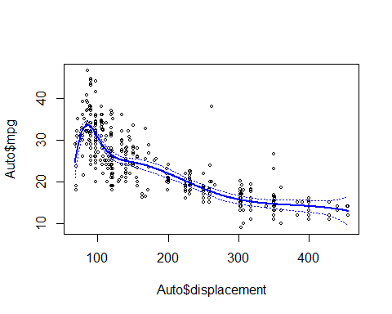
Regression Spline
Y = b₀+b₁*x_{i}+b₂*x_{i}²+b₃*x_{i}³
Split the region into pieces based on knots
Fit a non linear model for each piece
R-Square = 0.71
Degrees of freedom : 7
Problem: Discontinuity
lm(mpg ~ bs(displacement, knots = c(105,151,275)), data = Auto)
Regression spline

Slide 9
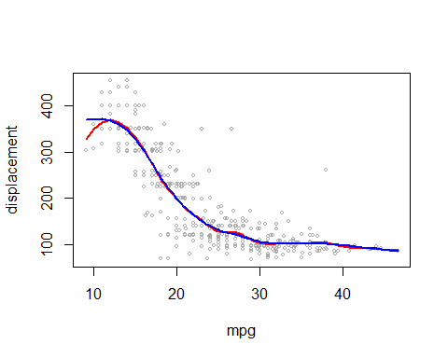

Smooth Splines
Smoothness of the curve is dependent on selecting appropriate Degrees of freedom => No of Knots
Red: 15 degrees of freedom
Blue: Knots estimated using LOOCV(Leave One Out Cross Validation.
Resulting in 8 degrees of freedom.
Result: Much Simpler Model with a better fit is obtained
Red- smooth.spline(mpg,displacement , df = 15)
Blue- smooth.spline (mpg ,displacement ,cv=TRUE)
Loss term + Penalty term

Slide 10
Local Regression
Fits an observation using other observations in the selected neighbourhood
Higher weights are assigned to nearest data points and weights decreases as observations are spread far away in the neighbourhood
loess() function in R is used for implementing Local Regression
Span, s = Number of neighbours (k) / Number of Observations(n) determines the smoothness of the curve
Syntax:
loess(formula, data, weights, span = 0.75, degree = 2, parametric = FALSE, normalize = TRUE, family=c(‘guassian’, ‘symmetric’))
Notes:
We can also pass user defined weights to Loess() function.
Can be applicable to multiple variables (maximum 3 to 4)
Uses Least squares estimation to compute the fit (Assuming homoscedasticity)

Slide 11
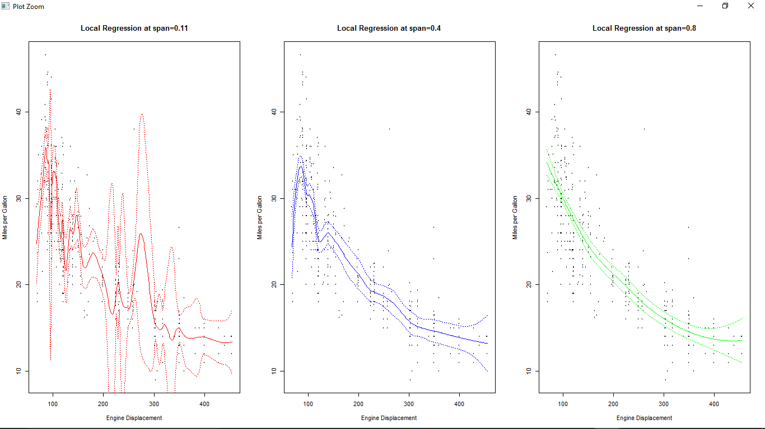
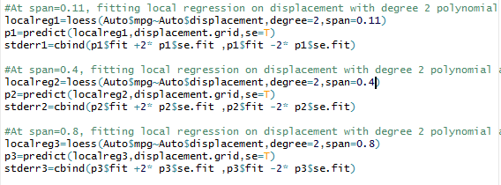
Local Regression on Auto Dataset
Default weights for loess is 0.5
Default family is considered as Gaussian (Normal variance)
As span increases, smoothness improves from being wiggly

Slide 12
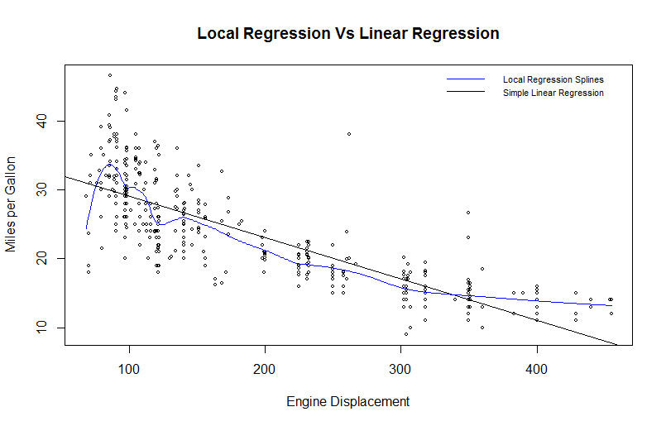
Comparing Local and Linear Regression
Local Regression Splines Captures Non linearity in Data
We can either randomly set span or use cross validation to determine span value

Slide 13
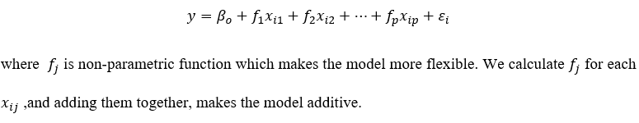
Generalized Additive Models
Extension of multiple linear regression
GAM using Natural splines
lm() function used to build regression model using non-linear functions
ns() in splines library – Fits natural cubic spline for the predictor
plot.gam() - A plot method for GAM objects

Slide 14
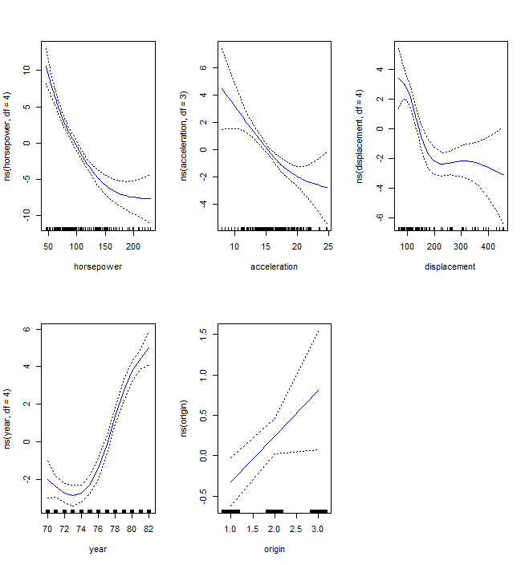
Generalized Additive Models
Plots display the fitted function and pointwise standard error for the model built using Natural Splines

Slide 15
Generalized Additive Models
GAM Using Smooth splines
gam () function in gam library - fit smoothening splines using backfitting approach
s() function used to indicate smoothening function in gam() function
Syntax:
  gam (formula, family, data ….)
  s (x, df=4, spar=1)

Slide 16
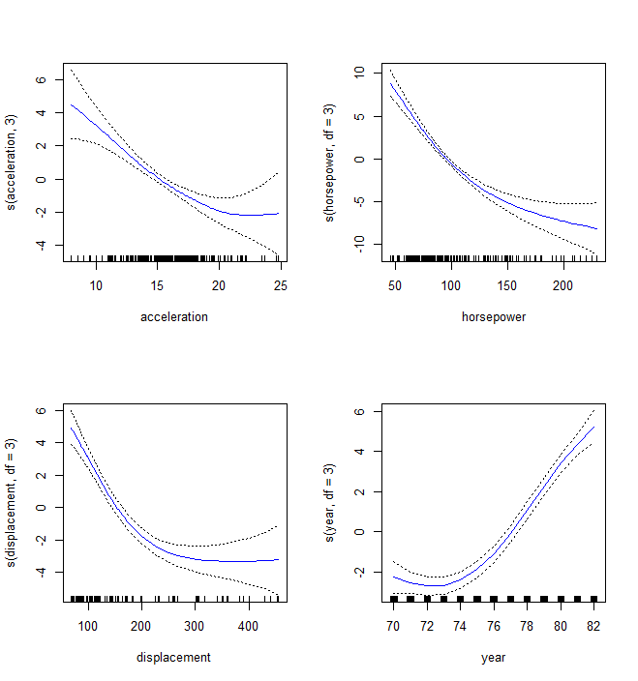
Generalized Additive Models
Plots display the fitted function and pointwise standard error for the model built using Smooth Splines

Slide 17
Generalized Additive Models
GAM Using using any combination of spline functions, local regression and polynomial regression for the predictor variables.
lo() - function to indicate a local regression term in gam()
Syntax: lo(x, span=0.5, degree=1)

Slide 18
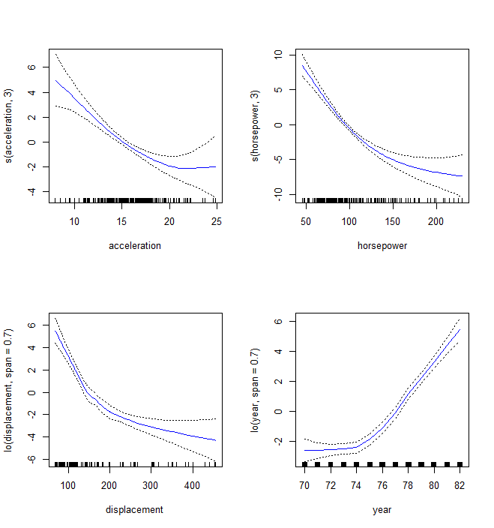
Generalized Additive Models
Plots display the fitted function and pointwise standard error for the model built using Smooth Splines and Local regression

Slide 19
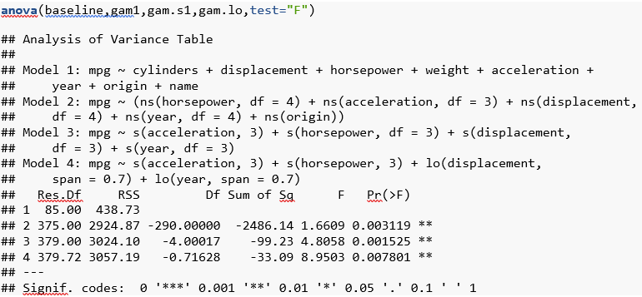
Comparing GAMs
Perform ANOVA to determine which of the four multiple regression models is best in predicting Miles per gallon(mpg)
GAM built using Smooth Splines is best
Trade-off between bias and variance

Slide 20


Notes:
References:
Text: An Introduction to Statistical Learning with Applications in R, Gareth James, Daniela Witten, Trevor Hastie and Robert Tibshirani
https://cran.r-project.org/web/packages/ISLR/index.html
https://cran.r-project.org/web/packages/gam/index.html
http://www.stat.ucla.edu/~cocteau/stat204/readings/cleveland.pdf

