Slide 1
Chef
Amit Kumar

Slide 2
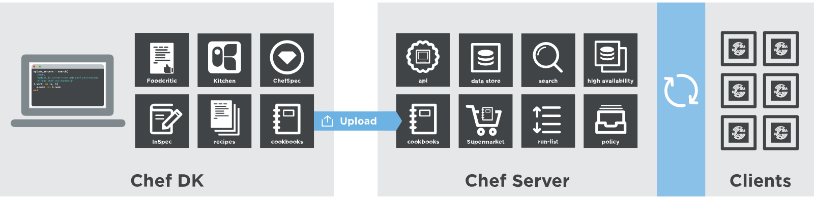
Architecture
Chef DK : Create and test your code on your workstation before you deploy
Your personal Laptop/workstation
Server : Chef server acts as a hub for configuration data and stores cookbooks
A Central server reachable by clients
Client : A machine (VM, Physical machine etc.) which is managed by Chef.
Periodically, the Chef client contacts the Chef server to retrieve the latest cookbooks.

Slide 3
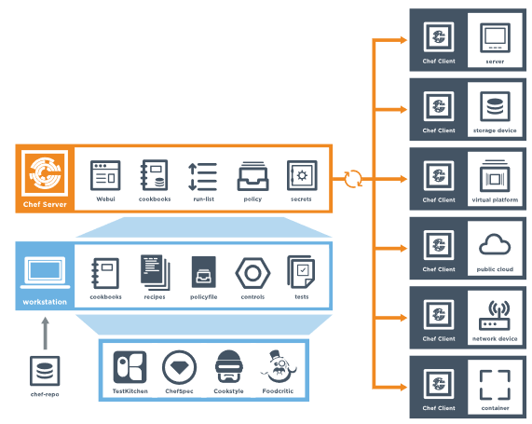
Architecture

Slide 4
Installation - prepare
Enable Apt to fetch packages over HTTPS:
$ sudo apt-get install apt-transport-https
Install the public key for Chef Software Inc:
$ wget -qO - https://packages.chef.io/chef.asc | sudo apt-key add -
Create the Apt repository source file:
$ echo "deb https://packages.chef.io/repos/apt/<CHANNEL> <DISTRIBUTION> main" > chef-<CHANNEL>.list
Replace <CHANNEL> with the release channel: stable or current. Replace <DISTRIBUTION> with the appropriate distribution name:
For Debian 7: wheezy
For Debian 8: jessie
For Ubuntu 12.04: precise
For Ubuntu 14.04: trusty
For Ubuntu 16.04: xenial
Update the package repository list:
$ sudo mv chef-stable.list /etc/apt/sources.list.d/
Update the cache for the package repository:
$ sudo apt-get update

Slide 5
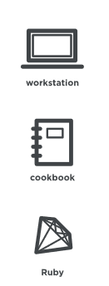
Workstation
Workstations are configured to allow users to author, test, and maintain cookbooks.
Cookbooks are uploaded to the Chef server from the workstation.
Self created OR community cookbooks
Workstation is configured to use the Chef Development Kit as the development toolkit.
The Chef Development Kit provides recommended set of tooling (e.g. Chef, CLI, Test Kitchen, ChefSpec, Berkshelf, etc).
Ruby is the programming language that is the authoring syntax for cookbooks.

Slide 6
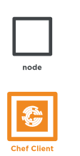
Node
A node is any machine (physical, virtual, cloud, network device, etc.) that is under management by Chef.
A chef-client is installed on every node.
chef-client performs all of the configuration tasks that are specified in cookbooks

Slide 7

Server and Supermarket
The Chef server stores Cookbooks and policy settings from workstations.
The chef-client talks to Chef server from the node and pulls down the necessary configuration data.
Chef Supermarket is the location in which community cookbooks are shared and managed. Cookbooks that are part of the Chef Supermarket may be used by any Chef user.

Slide 8
Installation : Server
https://manage.chef.io/
Create Organization

Slide 9
Installation : workstation
Find the package
https://downloads.chef.io/chefdk#ubuntu
Download the package
wget https://packages.chef.io/files/stable/chefdk/2.4.17/ubuntu/16.04/chefdk_2.4.17-1_amd64.deb
Install the package
dpkg -i chefdk_2.4.17-1_amd64.deb
Add Ruby to Path
echo 'export PATH="/opt/chefdk/embedded/bin:$PATH"' >> ~/.bash_profile && source ~/.bash_profile
Download Chef-repo from server

Slide 10
Installation : Client
On Worskation:
knife bootstrap <hostname> -x username -P password --sudo

Slide 11
Resources
Resource
package − Manages the packages on a node
service − Manages the services on a node
user − Manages the users on the node
group − Manages groups
template − Manages the files with embedded Ruby template
cookbook_file − Transfers the files from the files subdirectory in the cookbook to a location on the node
file − Manages the contents of a file on the node
directory − Manages the directories on the node
execute − Executes a command on the node
cron − Edits an existing cron file on the node
https://docs.chef.io/resource_reference.html

Slide 12
Cookbook
Resource Syntax¶
A resource is a Ruby block with four components: a type, a name, one (or more) properties (with values), and one (or more) actions. The syntax for a resource is like this:
type 'name' do
attribute 'value'
action :type_of_action
end
Example:
package 'tar' do
version '1.16.1'
action :install
end
Example:
service 'apache' do
action [ :enable, :start ]
retries 3
end

Slide 13
Recipe Examples
bash ‘print_something' do
user 'root'
cwd '/tmp'
code <<-EOH
echo “printing”
echo “From”
echo “Chef”
EOH
end
package 'tar' do
version '1.16.1'
action :install
end
service 'apache' do
action [ :enable, :start ]
retries 3
end
file '/tmp/fileFromChef' do
content ‘This File is created by Chef'
mode '0755'
owner 'web_admin'
group 'web_admin'
end

