Slide 1
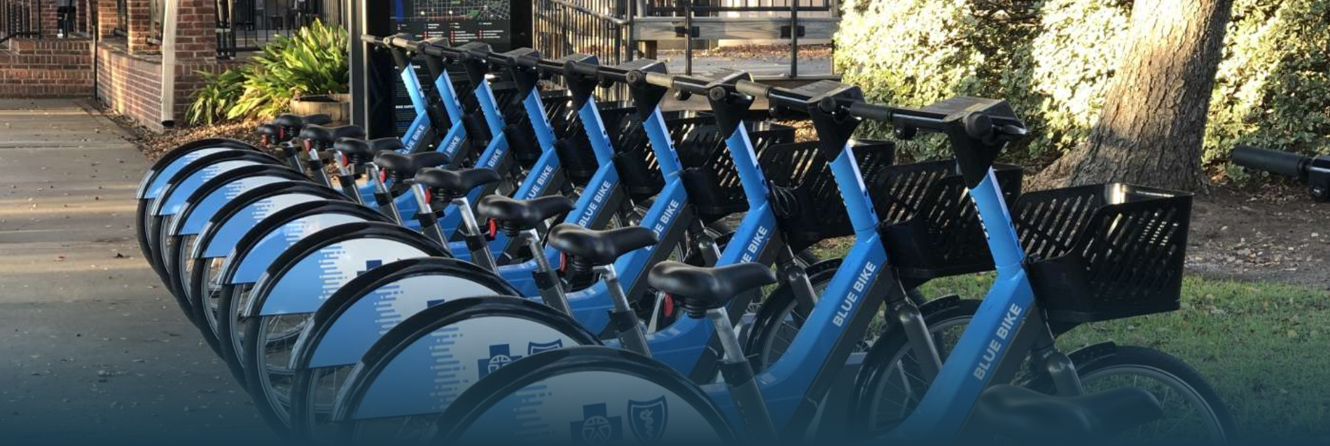
Bikes Rental System

Slide 2
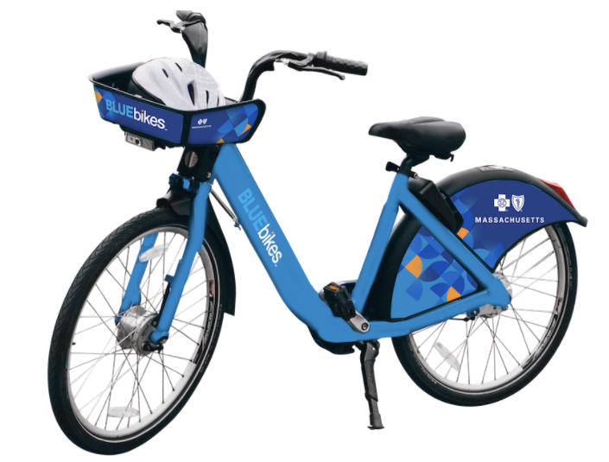
Agenda :
Company Overview
Current Process
Objectives
Problems
Data Base/ ERD
Report
Q&A

Slide 3
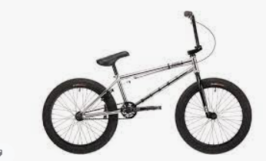
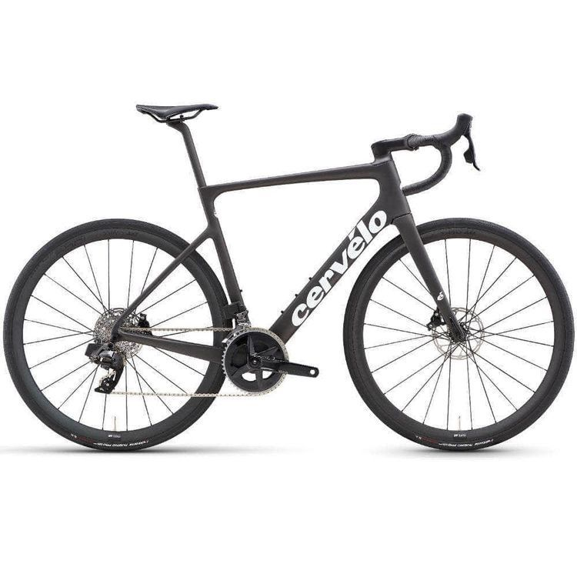
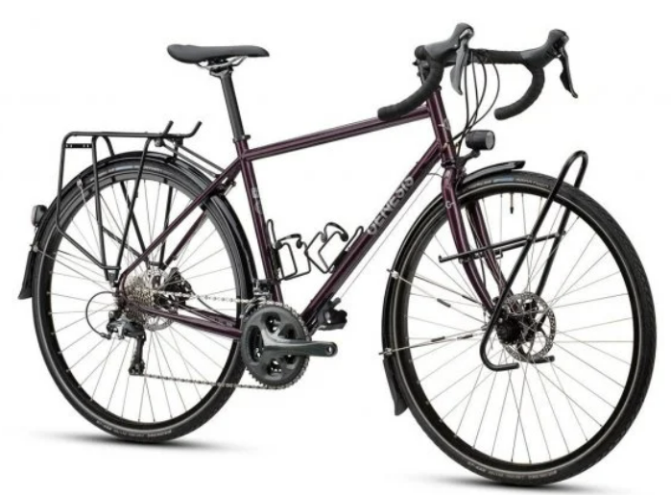
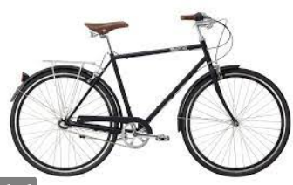
Boston Blue Bikes
Bike renting company based in Boston.
Looking to launch their renting model on large scale.
Product offerings
BMX
ROAD BIKE
TOUR BIKE
CLASSIC BIKE

Slide 4


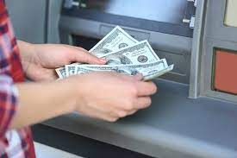
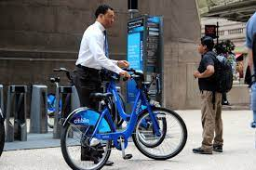
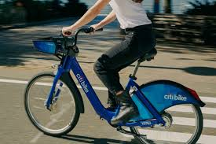
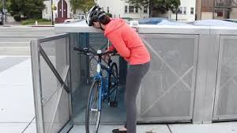
Current Process
Booking through the website and phone call.
Customers are charged on the basis of source and destination stations.
Pay money at the Kiosk.
Can I book a bike?
Sure, why not!
Take the bike from the source station
Return the bike at destination station
LA..LA…LA

Slide 5



Objectives
STEP 02
STEP 01
STEP 02
STEP 03
STEP 01
ANALYSE CURRENT FLOW
IDENTIFY BOTTLENECKS IN THE SYSTEM
PROVIDE SOLUTIONS FOR FUTURE UPGRADES

Slide 6





Current problems
Problems
Tracking the trips.
Tracking the customers
Lack of Promotional strategies
Keeping track of bikes
Limited payment methods
Account and Bill Maintenance
Unable to scale the service

Slide 7
ERD :

Slide 8
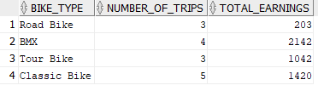
Report 1
Which type of bike gives the most revenue?
Query
Report
select a.bike_type, count(d.trip_id) as Number_of_trips,sum(d.bill_amount) as Total_earnings
from pricing a left outer join bike b on a.bike_type_id=b.bike_type_id left outer join trip_details c on b.bike_id=c.bike_id left outer join payment_details d on c.trip_id=d.trip_id
group by a.bike_type;

Slide 9

Report 2
Which season has the higher usage?
Query
Report
select * from (select 'Total Number of trips' as "Season" from Dual),
(select count(trip_id) as "Spring" from trip_details
where to_char(start_time,'MM') in ('03','04','05') and to_char(end_time,'MM') in ('03','04','05')),
(select count(trip_id) as "Summer" from trip_details
where to_char(start_time,'MM') in ('06','07','08') and to_char(end_time,'MM') in ('06','07','08')),
(select count(trip_id) as "Fall" from trip_details
where to_char(start_time,'MM') in ('09','10','11') and to_char(end_time,'MM') in ('09','10','11')),
(select count(trip_id) as "Winter" from trip_details
where to_char(start_time,'MM') in ('12','01','02') and to_char(end_time,'MM') in ('12','01','02'));

Slide 10
Conclusions :
For the company to work on a larger scale they will need new database management system.
To have a seamless customer experience the company should turn to automated ways rather than relying on human labor.
With the prescribed database system company can overcome all the current bottlenecks and this system is amphibious to any future upgrades.

Slide 11
Thank You!

