Slide 1
IBM DATA SCIENCE CAPSTONE PROJECT
Space X Falcon 9 Landing Analysis
Yogesh Thupda

Slide 2
Agenda
Executive Summary
Introdcution
Methodology
Results
Conclusions

Slide 3
Introduction
Falcon 9 rocket launches by SpaceX cost about $62 million. This is significantly less expensive than other providers (which typically cost more than $165 million), and a large portion of the savings is due to SpaceX's ability to land and reuse the rocket's first stage.
We can estimate the cost of a launch and use this data to decide whether or not a different company should compete against SpaceX for a rocket launch if we can anticipate whether the first stage will land.
In the end, this project will be able to forecast if the Space X Falcon 9 first stage will land safely.

Slide 4
Methodology
Data Collection
Making GET requests to the SpaceX REST API
Web Scraping
Data Wrangling
Using the .fillna() method to remove NaN values
Using the .value_counts() method to determine the following:
Number of launches on each site
Number and occurrence of each orbit
Number and occurrence of mission outcome per orbit type
Creating a landing outcome label that shows the following:
0 when the booster did not land successfully
1 when the booster did land successfully
Exploratory Data Analysis
Using SQL queries to manipulate and evaluate the SpaceX dataset
Using Pandas and Matplotlib to visualize relationships between variables, and determine patterns
Interactive Visual Analytics
Geospatial analytics using Folium
Creating an interactive dashboard using Plotly Dash
Data Modelling and Evaluation
Using Scikit-Learn to:
Pre-process (standardize) the data
Split the data into training and testing data using train_test_split
Train different classification models
Find hyperparameters using GridSearchCV
Plotting confusion matrices for each classification model
Assessing the accuracy of each classification model

Slide 5
Results
Exploratory Data Analysis
Interactive Analysis
Predictive Analysis

Slide 6
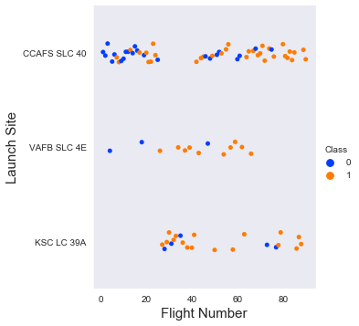
EDA 1 – Flight Site vs Flight Number
The success percentage for a launch site increases as the number of flights increases, according to the scatter plot of Launch Site vs. Flight Number.
Launched from CCAFS SLC 40, the majority of the early flights (flight numbers 30) were typically unsuccessful.
The flights from VAFB SLC 4E also support this trend, which indicates that early flights had lower rates of success.4) Since no early flights were launched from KSC LC 39A, this site's

Slide 7
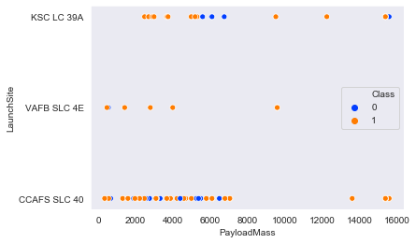
EDA 2 – Launch Site vs Payload Mass
There are very few unsuccessful landings above a payload mass of around 7000 kg, but there is significantly less data for these heavier launches.
A given launch site's success rate and payload mass do not clearly correlate.
There were a variety of payload masses launched from each site, with the majority of launches from CCAFS SLC 40 having relatively lighter payloads (with a few exceptions).

Slide 8
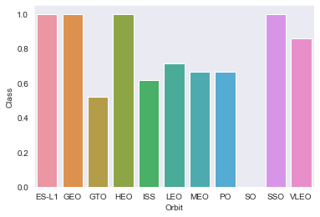
EDA 3 – Success Rate vs Orbit type
The bar chart of Success Rate vs. Orbit Type shows that the following orbits have the highest (100%) success rate:
ES-L1 (Earth-Sun First Lagrangian Point)
GEO (Geostationary Orbit)
HEO (High Earth Orbit)
SSO (Sun-synchronous Orbit)
The orbit with the lowest (0%) success rate is:
SO (Heliocentric Orbit)

Slide 9
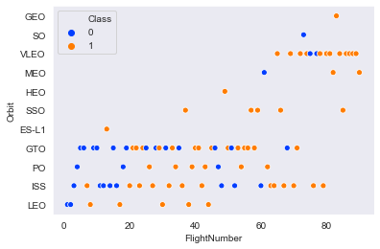
EDA 4 – Orbit type vs Flight Number
In contrast to the other plots, this scatterplot of Orbit Type vs. Flight Number reveals a few useful details, such as:
Only one flight into the respective orbits can account for the 100 percent success rate of the GEO, HEO, and ES-L1 orbits.
With five successful flights, the 100 percent success rate in SSO is more impressive.
There is little correlation between GTO's success rate and flight number.

Slide 10
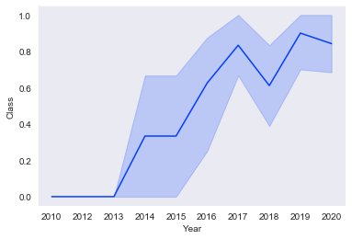
EDA 6 – Lauch Success Yearly Trend
The line chart of yearly average success rate shows that:
Between 2010 and 2013, all landings were unsuccessful (as the success rate is 0).
After 2013, the success rate generally increased, despite small dips in 2018 and 2020.
After 2016, there was always a greater than 50% chance of success.

Slide 11
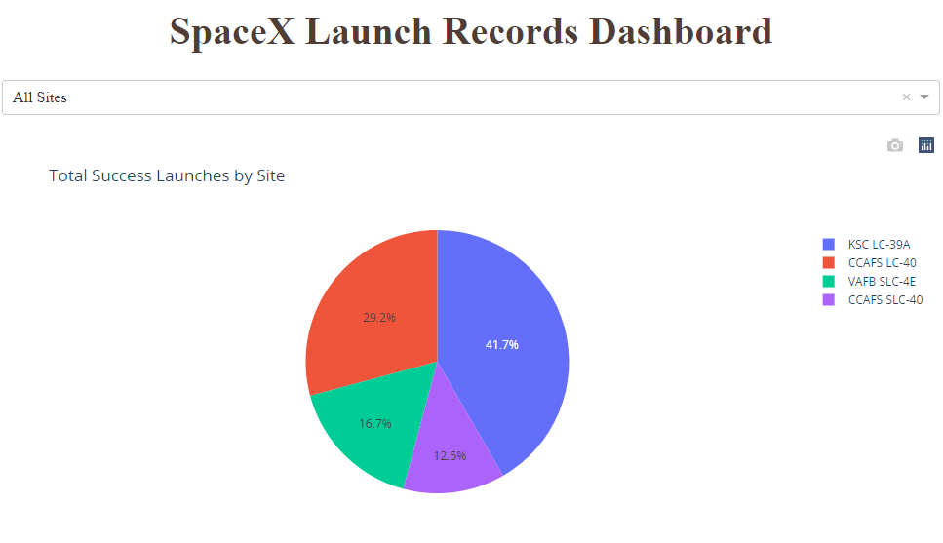
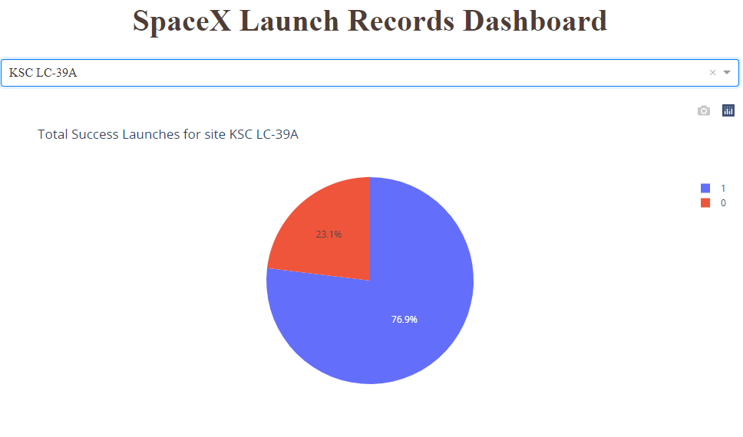
Interactive Analysis:
The launch site KSC LC-39 A had the most successful launches, with 41.7% of the total successful launches
The launch site KSC LC-39 A also had the highest rate of successful launches, with a 76.9% success rate

Slide 12
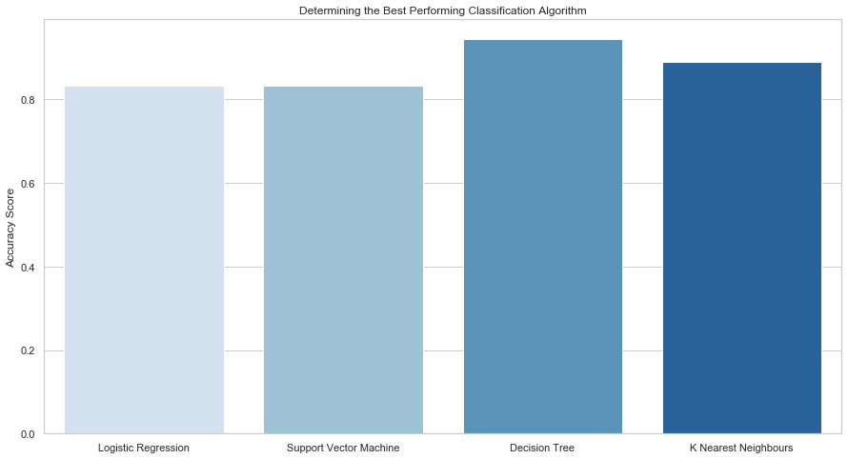
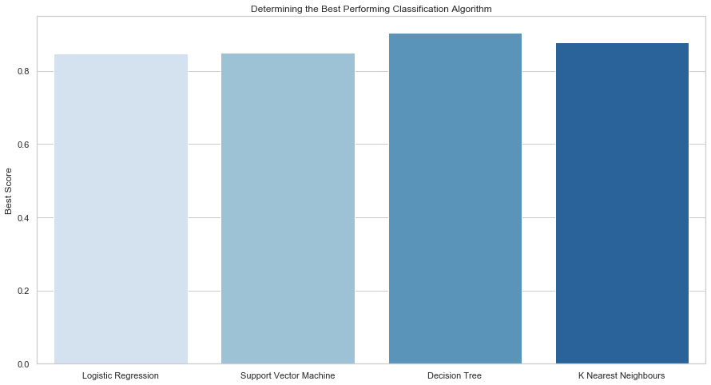
Predictive Analysis:
Plotting the Accuracy Score and Best Score for each classification algorithm produces the following result:
The Decision Tree model has the highest classification accuracy
The Accuracy Score is 94.44%
The Best Score is 90.36%

Slide 13
Conclusion
As the number of flights increases, the rate of success at a launch site increases, with most early flights being unsuccessful. I.e. with more experience, the success rate increases.
Between 2010 and 2013, all landings were unsuccessful (as the success rate is 0).
After 2013, the success rate generally increased, despite small dips in 2018 and 2020.
After 2016, there was always a greater than 50% chance of success.
The launch site KSC LC-39 A had the most successful launches, with 41.7% of the total successful launches, and also the highest rate of successful launches, with a 76.9% success rate.
The success for massive payloads (over 4000kg) is lower than that for low payloads.
The best performing classification model is the Decision Tree model, with an accuracy of 94.44%.
Notes:
It is difficult to validate the results of our model, but it would be interesting to see if users do end up watching movies recommended to them and if so how they are rated.

Slide 14
Thanks!

